Slide 1
Data Design
Dr. Jose Annunziato

Slide 2
Agenda
Designing Tables
Class Diagrams
Converting Class Diagrams to Relational Model
Design Process
Relationships and Constraints
Functional Dependencies and Normalization

Slide 3
Designing Tables
Consider cataloging your CD collection
CD(CDId, Title, ReleaseYear, Band, Genre)
TRACK(TrackId, CDId, Track#, SongTitle, Duration)
But what about
"Best of" CD with tracks from various CDs
Burn own CD with same songs in different order
CDs with songs from various bands, band per track?
CD with various genres, genre per track?
Performers in band

Slide 4
Class Diagrams
Let's not think of tables at first, instead think of entities, relationships, & attributes
Class diagram describes the world in terms of entities and how they relate to one another
A class is a type of entity and is represented by box; they correspond to tables
Relationships are represented by lines; they correspond to foreign keys
Attributes describe entities and have values; they correspond to fields
Eventually convert class diagrams to tables

Slide 5
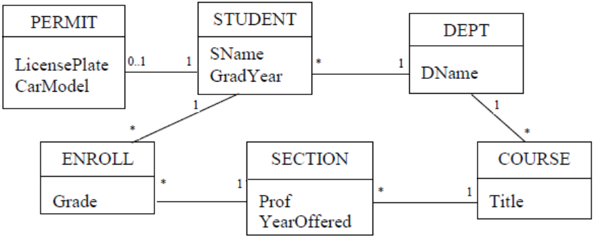
Class Diagram Example
STUDENT participates in 3 relationships
Classes have zero or more attributes

Slide 6
Relationship Cardinality
Cardinality denotes how many entities participate in the relationship
* denotes zero or more participants
The * next to STUDENT indicates record in DEPT can be related to zero or more STUDENT records
The 1 next to DEPT indicates that each STUDENT record must have exactly one major department
This is referred to as a many-one relationship
The 0..1 next to PERMIT denotes zero or 1, i.e, a PERMIT is optional

Slide 7
Cardinality Annotations
If we change the 1 next to DEPT to * it would mean that a student could declare several majors
This is referred to as a many-many relationship
Between PERMIT and STUDENT there is a one-one relationship
In general cardinality is denoted as N..M
* is a shorthand for 0..*
1 is a shorthand for 1..1
1, *, and 0..1 are the most common
These are referred to as annotations

Slide 8
Relationship Strength
The annotation 1 is considered a strong annotation because requires participation of an entity
The * and 0..1 annotations do not require participation of an entity (they are optional), therefore are considered weak annotations
Example relationship all relations are weak-strong
Many-many relationships are weak-weak, as well as one-one relations with 0..1 on both sides
One-one relations with 1 on both sides are strong-strong relations

Slide 9
Example Relationship Strengths
Relationship | Example
weak-strong | *-1, 0..1-1
strong-weak | 1-*, 1-0..1
weak-weak | *-*, *-0..1, 0..1-*, 0..1-0..1
strong-strong | 1-1

Slide 10
Visually Reading a Class Diagram
By inspecting example class diagram we can infer:
students are enrolled in sections of courses
we can determine all courses taken by a student
all students taught by a given professor in a given year
average section size of a given course
We cannot determine
which students changed majors
which professor advises which student
We can add additional annotations to make relationships clearer

Slide 11
Transforming Tables to Class Diagrams
Class diagrams consists of / and correspond to
Class Diagram Relational Model
Classes Tables
Attributes Fields
Relationships Foreign keys & Primary Keys
Foreign keys correspond to weak-strong relations
Consider the CD database we introduced earlier:
CD(CDId, Title, ReleaseYear, Band, Genre)
TRACK(TrackId, CDId, Track#, SongTitle, Duration)
LYRICS(TrackId, Lyrics, Author)

Slide 12
Foreign Key Relationships
LYRICS table holds lyrics and author for each track
LYRICS.TrackId is both primary and foreign key
Each track can have at most one lyrics
Constraints
Many TRACK records have one CD record
One LYRICS record has one TRACK record
No constraints, we infer
One CD record can have many (or 0) TRACK records
One TRACK record can have one (or 0) LYRICS records
Foreign keys express many-one relationship between CD and TRACK (* - 1)
And optional LYRICS record for TRACK (0..1 - 1)

Slide 13
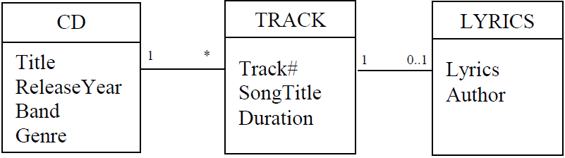
CD Database Class Diagram
No attributes for keys and foreign keys
Keys and foreign keys only for relationships
Class diagrams use lines for relationships, no need to keys and foreign keys
Use: relationships correspond to foreign keys

Slide 14
Transforming a Relational Schema
Create a class for each table in the schema.
If table T1 contains a foreign key of table T2, then create a relationship between classes T1 and T2. The annotation next to T2 will be “1”. The annotation next to T1 will be “0..1” if the foreign key is also a key; otherwise, the annotation will be “*”.
Add attributes to each class. The attributes should include all fields of its table, except for the foreign keys and any artificial key fields.

Slide 15
Applying the Algorithm
STUDENT(SId, SName, GradYear, MajorId)
DEPT(DId, DName)
COURSE(CId, Title, DeptId)
SECTION(SectId, CourseId, Prof, YearOffered)
ENROLL(EId, StudentId, SectionId, Grade)

Slide 16
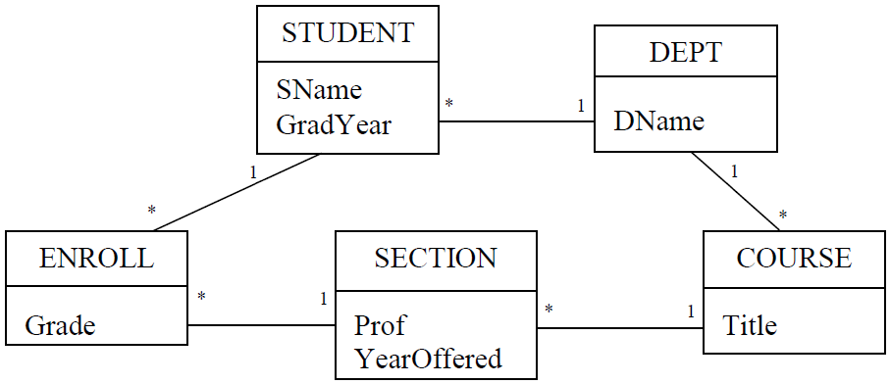
Resulting Class Diagram

Slide 17
Class Diagrams Easier Than Relational
Class diagrams represent schemas visually
Tables represent relationships via foreign keys
A picture is worth 1000 words
It’s easier to work graphically
Easiest way to change a relational schema is to transform it to class diagram, modify it, and then transform it back
It’s easier to understand what tables are involved and how they are related
Easier to create queries

Slide 18
Transforming Class Diagrams
Create a table for each class, whose fields are the attributes of that class.
Choose a primary key for each table. If there is no natural key, then add a field to the table to serve as an artificial key.
For each weak-strong relationship, add a foreign key field to its weak-side table to correspond to the key of the strong-side table.

Slide 19
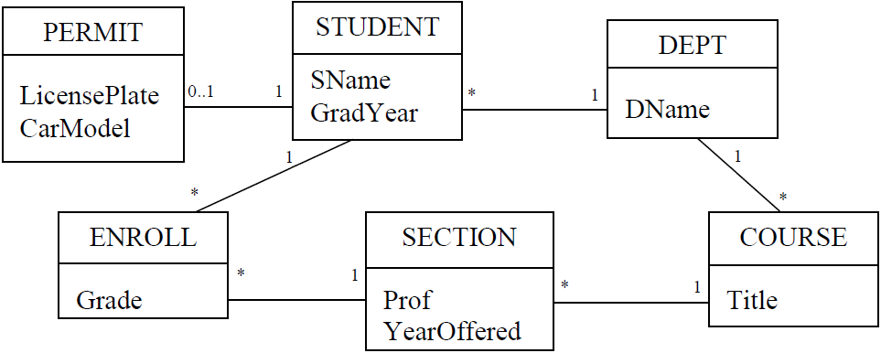
Example Transformation

Slide 20
Resulting Schema
PERMIT(PermitId, LicensePlate, CarModel, StudentId)
STUDENT(SId, SName, GradYear, MajorId)
DEPT(DId, DName)
ENROLL(EId, Grade, StudentId, SectionId)
SECTION(SectId, YearOffered, Prof, CourseId)
COURSE(Cid, Title, DeptId)

Slide 21
Natural Keys and Strong Relations
Alternatively,
if we consider natural keys, and
One-one relationships
Department name is already unique
DEPT(DId, DName)
DEPT(DName)
Therefore foreign key is now the department name
STUDENT(SId, SName, GradYear, MajorId)
STUDENT(SId, SName, GradYear, MajorName)

Slide 22
Using Natural Keys
There’s a 1-1 relationship, we can use the same student ID
PERMIT(PermitId, LicensePlate, CarModel, StudentId)
PERMIT(StudentId, LicensePlate, CarModel)
Since students can enroll in a section only once, the compound key is already unique. Also, no one refers to ENROLL
ENROLL(EId, StudentId, SectionId, Grade)
ENROLL(StudentId, SectionId, Grade)

Slide 23
Using Natural Keys
Title is already unique, and foreign key is the department name
COURSE(Cid, Title, DeptId)
COURSE(Title, DeptName)
Foreign key is now the course title
SECTION(SectId, YearOffered, Prof, CourseId)
SECTION(SectId, YearOffered, Prof, Title)

Slide 24
Algorithm Limitations
The algorithm only deals with weak-strong relationships
No strong-strong or weak-weak relationships yet
We’ll work on those later

Slide 25
Design Good Class Diagrams
Create a requirements specification
Create a preliminary class diagram from the nouns and verbs of the specification
Check for inadequate relationships in the diagram
Remove redundant relationships from the diagram
Revise weak-weak and strong-strong relationships
Identify the attributes for each class
Don’t need to apply steps 3-6 in order. Some steps may affect revisiting other steps

Slide 26
Requirements Analysis
Determine the data to store
Ask users how they’ll use the database
Examine data-entry forms
Determine intended database queries
Examine reports generated from database
Result is a requirements specification

Slide 27
Example Requirements Spec
The university is composed of departments. Academic departments (such as the Mathematics and Drama departments) are responsible for offering courses. Non-academic departments (such as the Admissions and Dining Hall departments) are responsible for the other tasks that keep the university running.
Each student in the university has a graduation year, and majors in a particular department. Each year, the students who have not yet graduated enroll in zero or more courses. A course may not be offered in a given year; but if it is offered, it can have one or more sections, each of which is taught by a professor. A student enrolls in a particular section of each desired course.

Slide 28
Example Requirements Spec
Each student is allowed to have one car on campus. In order to park on campus, the student must request a parking permit from the Campus Security department. To avoid misuse, a parking permit lists the license plate and model of the car.
The database should:
allow students to declare and change major department;
keep track of parking permits;
allow departments, at the beginning of each year, to specify how many sections of each course it will offer for that year, and who will teach each section;
allow current students to enroll in sections each year;
allow professors to assign grades to students in their sections.

Slide 29
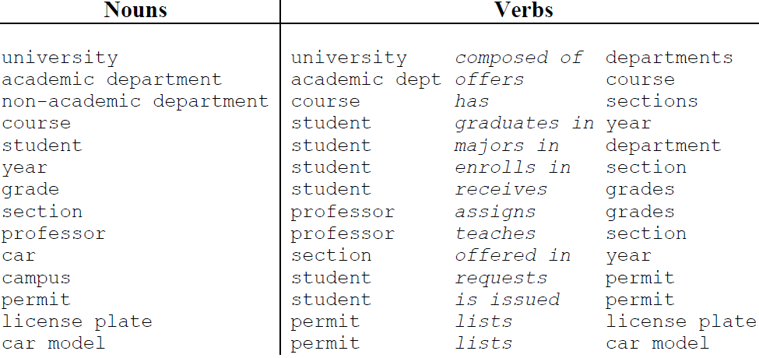
Preliminary Class Diagram
Extract relevant concepts from requirements spec
Nouns describe entities
Verbs describe relationships between entities

Slide 30
Database Scope
Requirements spec defines the scope
Only student enrollment
No employee, financial, or resources issues
Some nouns are irrelevant or redundant
University and campus
Composed of
Non-academic department
Car
Requests
Interview and discuss with stake holders

Slide 31
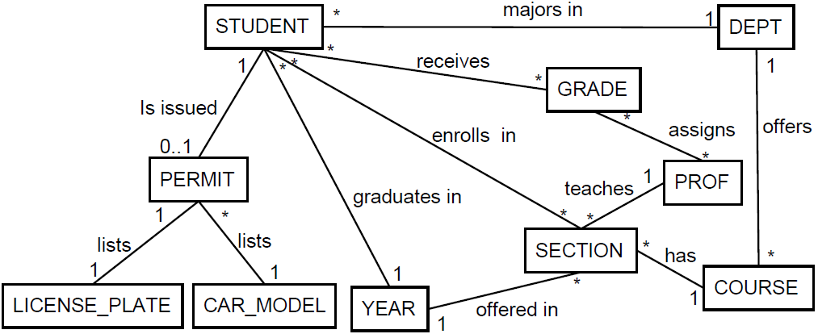
Preliminary Class Diagram
Revised list of nouns and verbs yields initial diagram
Relationships derived from verbs

Slide 32
Inadequate Relationships
Relationships describe how entities connect
From STUDENT record we can follow relationships
majors in to get to corresponding DEPT entity
enrolls in to get all SECTION entities
enrolls in and has to get all COURSE entities
What if we had chosen STUDENT enrolls in COURSE
This relationship is inadequate because we can’t tell which section the student is in
Make sure relationships convey intended meaning

Slide 33
Inadequate Relationships
Exhaustively consider every path
Make sure diagram captures desired information
A couple more inadequate relationships
receives captures grade for each student but not section
assigns captures grades prof gave but no student or section
This happened because we oversimplified requirement spec interpretation
student receives grades
student receives grade for an enrolled section
professor assigns grade
professors to assign grades to students in their sections

Slide 34
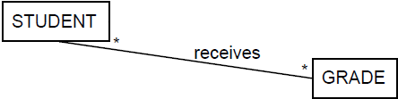
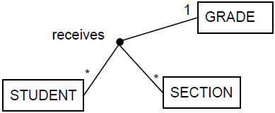
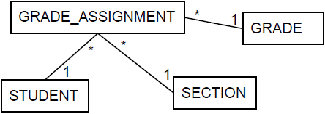
Multi-Way Relationships
Involve three or more classes, (>2 nouns) e.g.:
“student receives a grade for an enrolled section”
“professor assigns grade to student in section”
Consider
Two ways to represent multi-way relationships
Line connects all New class relates all

Slide 35
Lines Connecting Various Classes
“1” next to GRADE → one grade/student/section
“*” next to STUDENT means many students in a section with same grade
“*” next to SECTION means many sections/student with same grade

Slide 36
Class as Relationship
Replace receives with class GRADE_ASSIGNMENT
GRADE_ASSIGNMENT record per grade assigned
This will eventually become the ENROLL table

Slide 37
Reification: To Make Concrete
reification converts relations → classes
Relation → class, similar to verb → noun
“Receives” → “reception” or “receiving”
Reification is easier than 3-way relations
It’s easier to deal with binary relations
It’s more flexible
Each new class can have it’s own attributes
Apply reification to relationship assigns
New class has one record per grade
But we have class already: GRADE_ASSIGNMENT

Slide 38
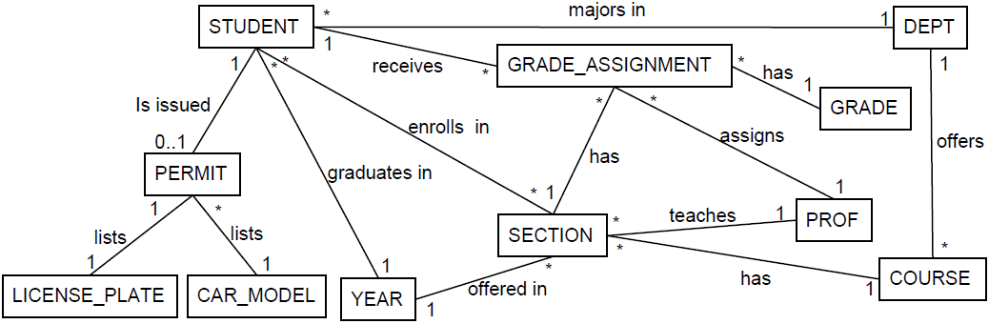
After Reifying Inadequate Relations

Slide 39
Redundant Relationships
Consider the query “all sections a student is enrolled in”
Obvious solution is to use enrolls in relationship
But another solution is path from STUDENT to GRADE_ASSIGNMENT to SECTION
Enrolls in relationship is redundant.
A relationship is redundant if removing it does not change the information content of the class diagram

Slide 40
Redundant Relationships
The assigns relationship is also redundant
Describes who assigned each grade
But PROF assigns all the grades of a SECTION
We know PROF of each SECTION
Don’t need each assignment, just PROF of section
GRADE_ASSIGNMENT
* *
has
assigns
1
1
SECTION
*
1
PROF
teaches

Slide 41
Check All Relationships for Redundancy
Consider relationship majors in
Check redundancy with STUDENT, GRADE_ASSIGNMENTS, SECTION, COURSE, DEPT
But this path describes the DEPT, offering the COURSE, as opposed to the STUDENT’s major
So, majors in is not redundant
STUDENT
*
majors in
1
DEPT
1
receives
1
*
GRADE_ASSIGNMENT
offers
has
*
1
*
SECTION
COURSE
*
has
1

Slide 42
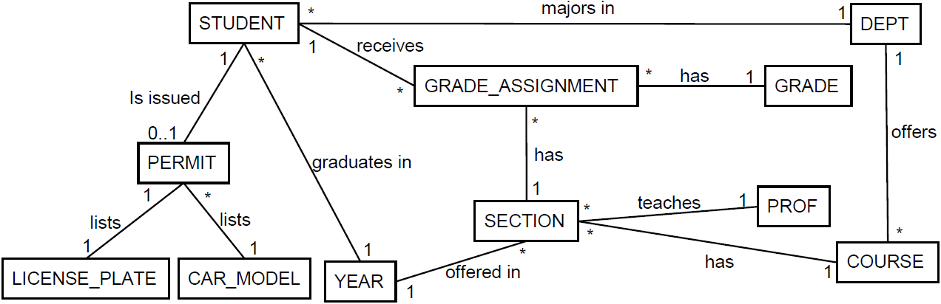
Having Removed all Redundancies

Slide 43
Handling Weak-Weak Relationships
So far algorithm works with weak-strong relations
Convert weak-weak relationships to 2 weak-strong
Consider the many-one relationship majors in between STUDENT and DEPT
States each student only has one major
But if students could declare various majors we would have many-many, weak-weak relationship
STUDENT
*
majors in
1
DEPT
STUDENT
*
majors in
*
DEPT

Slide 44
Use Reification To Remove Many-Many
Students can declare several majors
Reifying the many-many relationship we get
There’s a STUDENT_MAJOR record for each major a STUDENT declares
Reifying a many-many relationships creates an equivalent diagram without many-many
STUDENT
*
majors in
*
DEPT
STUDENT
1
*
STUDENT_MAJOR
*
1
DEPT

Slide 45
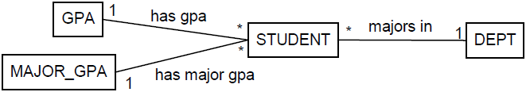
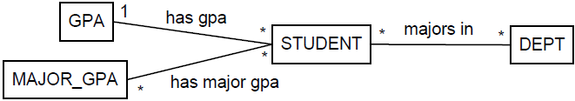
Another Example
Consider storing both GPA and major GPA
If STUDENT has several majors then has major gpa is many-many
But MAJOR_GPA doesn’t know which DEPT

Slide 46
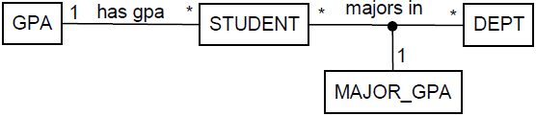
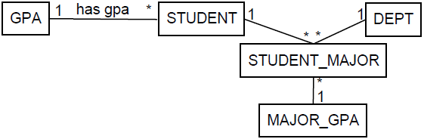
Reify Multi-Way Relationships
We can combine majors in and has major gpa into multi-way relationship
Reifying the multi-way relationship we get

Slide 47
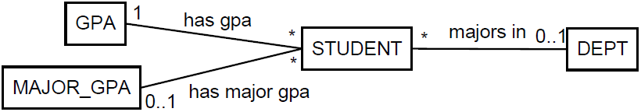
Reifying Weak-Weak Relationships
If students can have at most one major we have
Where we have 0..1 next to MAJOR_GPA & DEPT
The major is now optional
Now we DO know which MAJOR_GPA for DEPT
But there shouldn’t be a MAJOR_GPA with no DEPT
There should be a MAJOR_GPA only if there is a DEPT

Slide 48
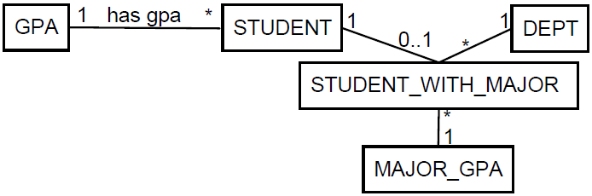
Since one should not exist without the other, they really should be part of the same thing
It should be part of a multi-way relationship
Then we can apply reification on the multi-way relationship and end up with
The 0..1 indicates that the relation is optional, but if there is, then there’s 1 DEPT and one MAJOR_GPA

Slide 49
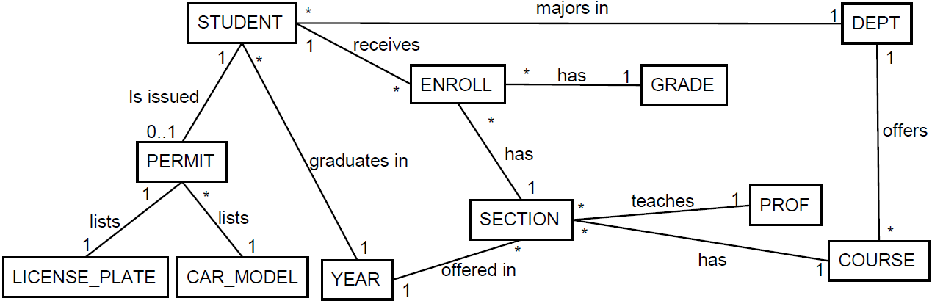
Weak-Weak With 0..1 Annotations
Consider the PERMIT --- STUDENT relationship
Suppose PERMITs are given to STUDENTS and STAFF and student’s can expire

Slide 50
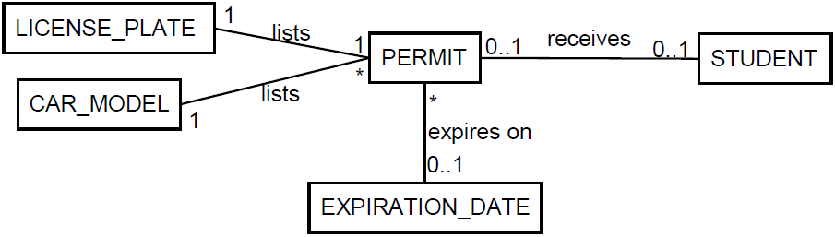
A symmetrical relationship
Students can have at most one permit, but some students will have permits
Each permit can be issued to at most one student, but only some permits will be issued to students
Both sides have 0..1 annotations:

Slide 51
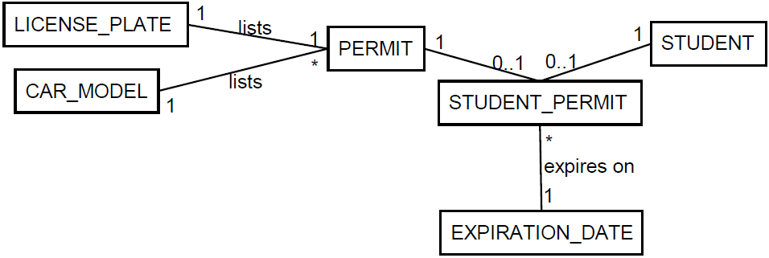
But
But expires on depends on receives, i.e., we only want EXPIRATION_DATE if the student gets a permit
One cant exist without the other. They are part of the same multi-way relationship
We can combine the relations and then reify:

Slide 52
Reify weak-weak relations to remove them so our algorithm works
Weak-weak relations are often part of a multi-way relationship

Slide 53
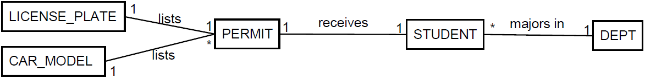
Strong-Strong Relationships
Strong-strong relations have 1 on both sides, that is, entities are in one-to-one correspondence
If University required all students to get a permit, then STUDENT, PERMIT would be in a 1-to-1

Slide 54
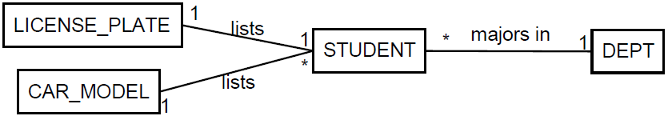
Strong-Strong Relationships
We can either
merge the classes together or
leave the relationship alone and then treat it as weak and maybe treat it as attribute of the other class
Below we merged PERMIT into STUDENT and left LICENSE_PLATE alone

Slide 55
Adding Attributes to Classes
All nouns cant be classes.
Nouns for real life entities are classes, e.g., student
Nouns for values are attributes, e.g., year
But it really depends on the level of abstraction we choose
Consider a license plate
Do we just care about the value of plate (attribute)
Or do we care about several aspects, i.e., state, design, physical condition (class)
Depends on the requirements and domain to decide whether we care about this minutia

Slide 56
Classes Vs. Attributes
Depending on the domain, a noun can be a class or an attribute
Consider a professor
If it’s just the name we care as part of a course, then attribute
If we need to maintain an official list of professors, then it’s a class
Same thing for departments
If we want to keep track of all departments, it’s a class
Represent a noun as a class if we want to keep an explicit list of its entities

Slide 57
Transforming Classes into Attributes
Let C be the class that we want to turn into an attribute
Add an attribute to each class that is directly related to C
Remove C (and its relationships) from the class diagram

Slide 58
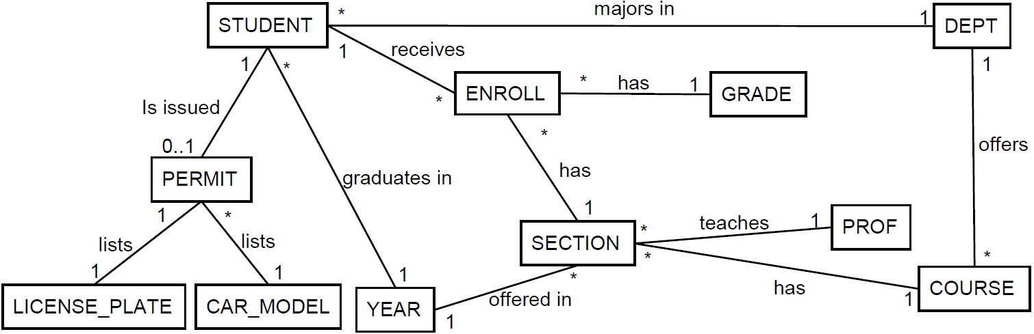
Example
Consider the following class diagram
Let’s convert the following classes to attributes
GRADE PROF
YEAR LICENSE_PLATE
CAR_MODEL

Slide 59
Classes to Attributes
GRADE is only related to ENROLL
We add grade to ENROLL and remove the GRADE class
PROF is only related to SECTION
We add prof to SECTION and remove the SECTION class
LICENSE_PLATE & CAR_MODEL are only related to PERMIT
We add licensePlate and carModel to PERMIT and remove those classes
YEAR related to both STUDENT and SECTION
We add year to both classes and remove the YEAR class

Slide 60
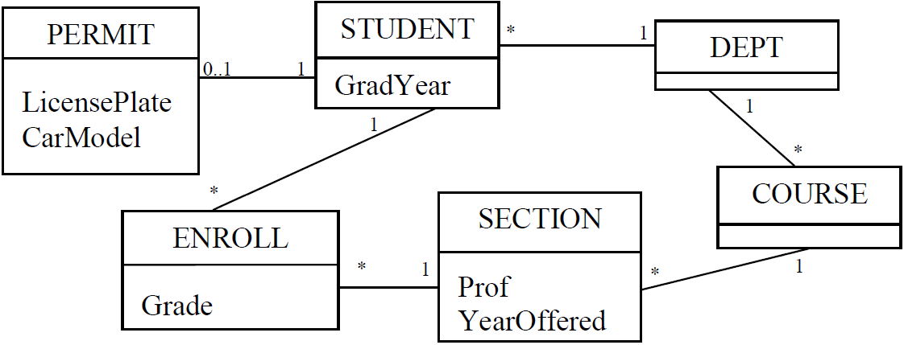
Classes to Attributes
Having converted the following classes to attributes
GRADE PROF
YEAR LICENSE_PLATE
CAR_MODEL

Slide 61
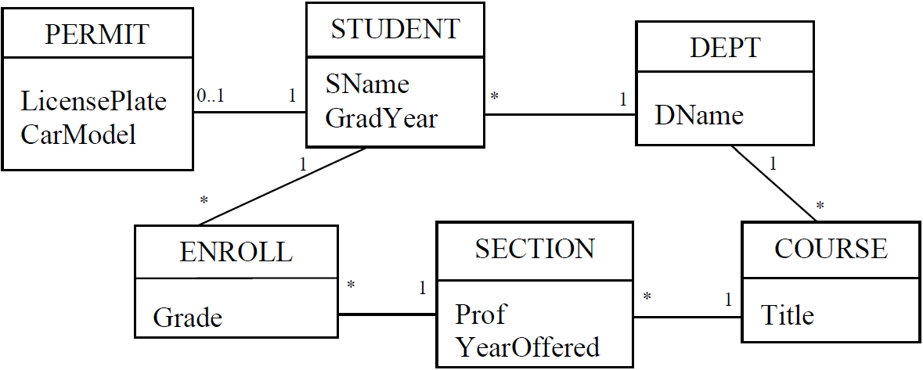
Adding Additional Attributes
Often requirements are incomplete and do not contain necessary classes or attributes
Obvious attributes
Assumed attributes
E.g., student name, department name, course title

Slide 62


Attribute Cardinality
Just like classes, attributes have cardinality: single-valued or multi-valued
Consider the many-one relationship teaches between SECTION and PROF
Each section has a single professor, so the prof attribute in SECTION is single valued
If many-many, then multi-valued

Slide 63
Implementing Single / Multi Valued
Single-valued just correspond to fields in a table
Many relational databases support collection types such as lists and arrays
These can be used to implement multi-valued
Otherwise, use reification to remove the many-many relationships

Slide 64

Aggregation
Aggregation describes a part-whole or part-of relationship
No lifecycle dependency

Slide 65

Composition
Composition describes an owns a relationship
Strong lifecycle dependency

Slide 66
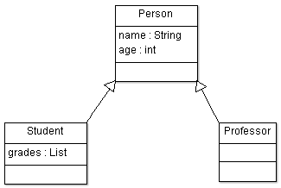
Generalizations / Inheritance
Generalization describes an is a relationship
The can be converted to relational model by creating separate tables for base and subclasses
Subclass entities have a strong 1-1 relation with base

Slide 67

Transforming Generalizations
Consider the following diagram
PERSON(PId, Name, Age)
PROFESSOR(PId, Office)
STUDENT(PId, Grades)

Slide 68
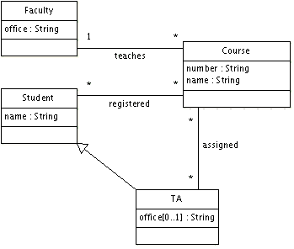
Example

Slide 69
Faculty – Course Strong-Weak Relation
create table Faculty(
id int primary key,
office varchar(255) not null
);
create table Course(
number varchar(255) primary key,
name varchar(255),
taughtBy int not null references Faculty(id)
);

Slide 70
Generalization
create table Student(
id int primary key,
name varchar(255)
);
create table TA(
id int primary key references Student(id)
);

Slide 71
Weak-Weak Relationship
create table assigned(
ta int references TA(id),
course varchar(255) references Course(number),
primary key(ta, course)
);
create table registered(
student int references Student(id),
course varchar(255) references Course(number), primary key(student, course)
);

Slide 72
Another Example
Requirements:
Vehicles may be parked in a garage. Every garage has an address. Some vehicles are cars, and some are boats. Every vehicle has a unique vin (vehicle identification number) and a power rating (in horsepower). A vehicle has at least one owner (known only by name) but may have several. A car has a number of tires. A boat has a number of propellers and may have a name.

Slide 73
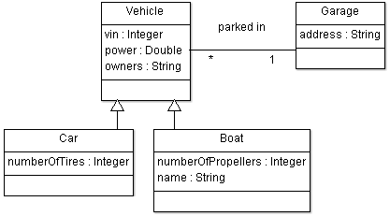
Design

Slide 74
create table Garage(
id int primary key,
address varchar(255) not null
);
create table Vehicle(
vin int primary key,
power double not null,
parkedIn int references Garage(id)
);

Slide 75
create table Car( /* Subclass of Vehicle */
vin int primary key references Vehicle(vin),
numberOfTires int not null
);
create table Boat( /* Subclass of Vehicle */
vin int primary key references Vehicle(vin),
numberOfPropellers int not null,
name varchar(255)
);

