Slide 1
Development of a
Hotel Reservation
Management System
What this project changes
1
Fragmented Tools
spreadsheets • email • notes
Sprint 1 — Requirements Analysis and System Design
A centralized employee-facing system for a medium-sized hotel
2
Hotel Employees
front desk • manager • finance
1 HOTEL
≈ 80 ROOMS
5 STAFF ROLES
8 SPRINTS
3
Centralized HRMS
rooms • guests • reservations • payments
Student Name
4
Better Operations
Student ID
fewer conflicts • faster service • clearer reports
Supervisor

Slide 2
Problem Statement
Why the hotel needs a centralized reservation management system
CURRENT WORKFLOW
1
Booking Conflicts
2
Slow Front Desk
Spreadsheet
availability
Availability is not updated consistently, so reservations can overlap.
Staff spend time searching and re-entering the same information.
Email
booking requests
Handwritten Notes
room changes
3
Inconsistent Records
4
Limited Insight
Guest, room and payment information can differ between tools.
Occupancy, demand and financial performance require manual reporting.
Separate Apps
payments / guests
Reception Staff
Core problem: the hotel has no single, reliable source of reservation-related information.
Employees must switch between several information sources

Slide 3
Existing Solutions
Five commercial PMS products were reviewed to identify common capabilities and limitations
Oracle OPERA
Cloudbeds
Mews
Hotelogix
Little Hotelier
STRENGTH
STRENGTH
STRENGTH
STRENGTH
STRENGTH
Complete enterprise PMS
Integrated cloud operations
Automation + open APIs
Strong front-desk workflow
Simple small-property workflow
PROJECT LESSON
PROJECT LESSON
PROJECT LESSON
PROJECT LESSON
PROJECT LESSON
Enterprise reference
Workflow reference
Architecture reference
Medium-hotel reference
Usability reference
Common capabilities identified across the market
Availability
Reservations
Guest Records
Payments
Reporting
Design takeaway: keep the core hotel workflow, avoid unnecessary enterprise complexity.

Slide 4
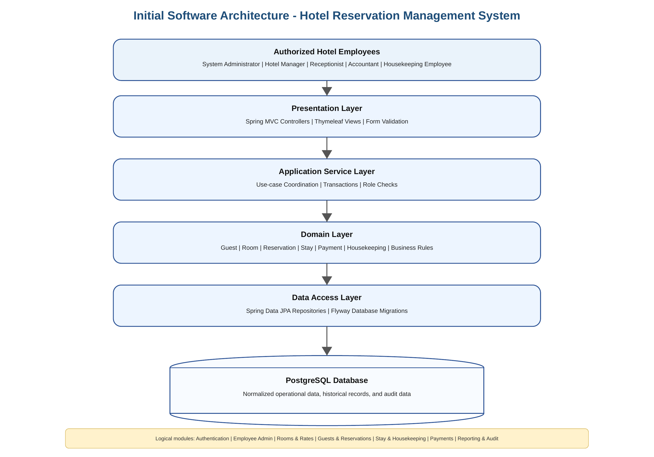
Initial Software Architecture
Proposed Solution
A focused employee-facing system for one medium-sized hotel
INITIAL SCOPE
One hotel
single-property operation
≈ 80 rooms
medium-sized capacity
Employees only
no public guest portal
Centralized data
one source of truth
CORE BUSINESS MODULES
Authentication & Roles
Rooms & Rates
Guests & Reservations
Stay & Housekeeping
Future extensions: online booking • external payments • loyalty • OTA integration
Payments
Reporting & Audit

Slide 5
System Requirements
Main requirement groups identified during Sprint 1
FR
NFR
BR
Functional Requirements
Non-functional Requirements
Business Rules
NON-FUNCTIONAL REQUIREMENTS
Security
RBAC, password protection, auditability
Performance
responsive search and reports
FUNCTIONAL REQUIREMENTS
Reliability
transactional consistency
Authentication & role-based access
Rooms, room types and rates
Guest profiles and availability search
Reservations and room assignment
Check-in / check-out
Payments, refunds and balances
Housekeeping status
Reporting and audit
Usability
clear employee workflows
Maintainability
modular layered design
Data Integrity
validated relationships and history
Backup & Recovery
planned operational safeguards
All requirements use unique IDs (FR / NFR / BR) so they can be traced and reviewed.

Slide 6
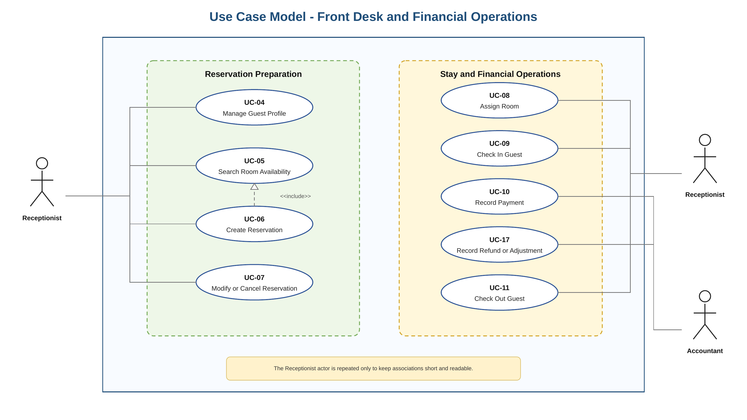
Users and Use Cases
The first version is operated by hotel employees; guests are stored as business entities
Main Actors
1
System Administrator
accounts & roles
2
Hotel Manager
rooms, rates & reports
3
Receptionist
reservations & stay
4
Accountant
payments & refunds
5
Housekeeping
room status
Why is Guest not an actor? Guests do not directly operate the first release.

Slide 7
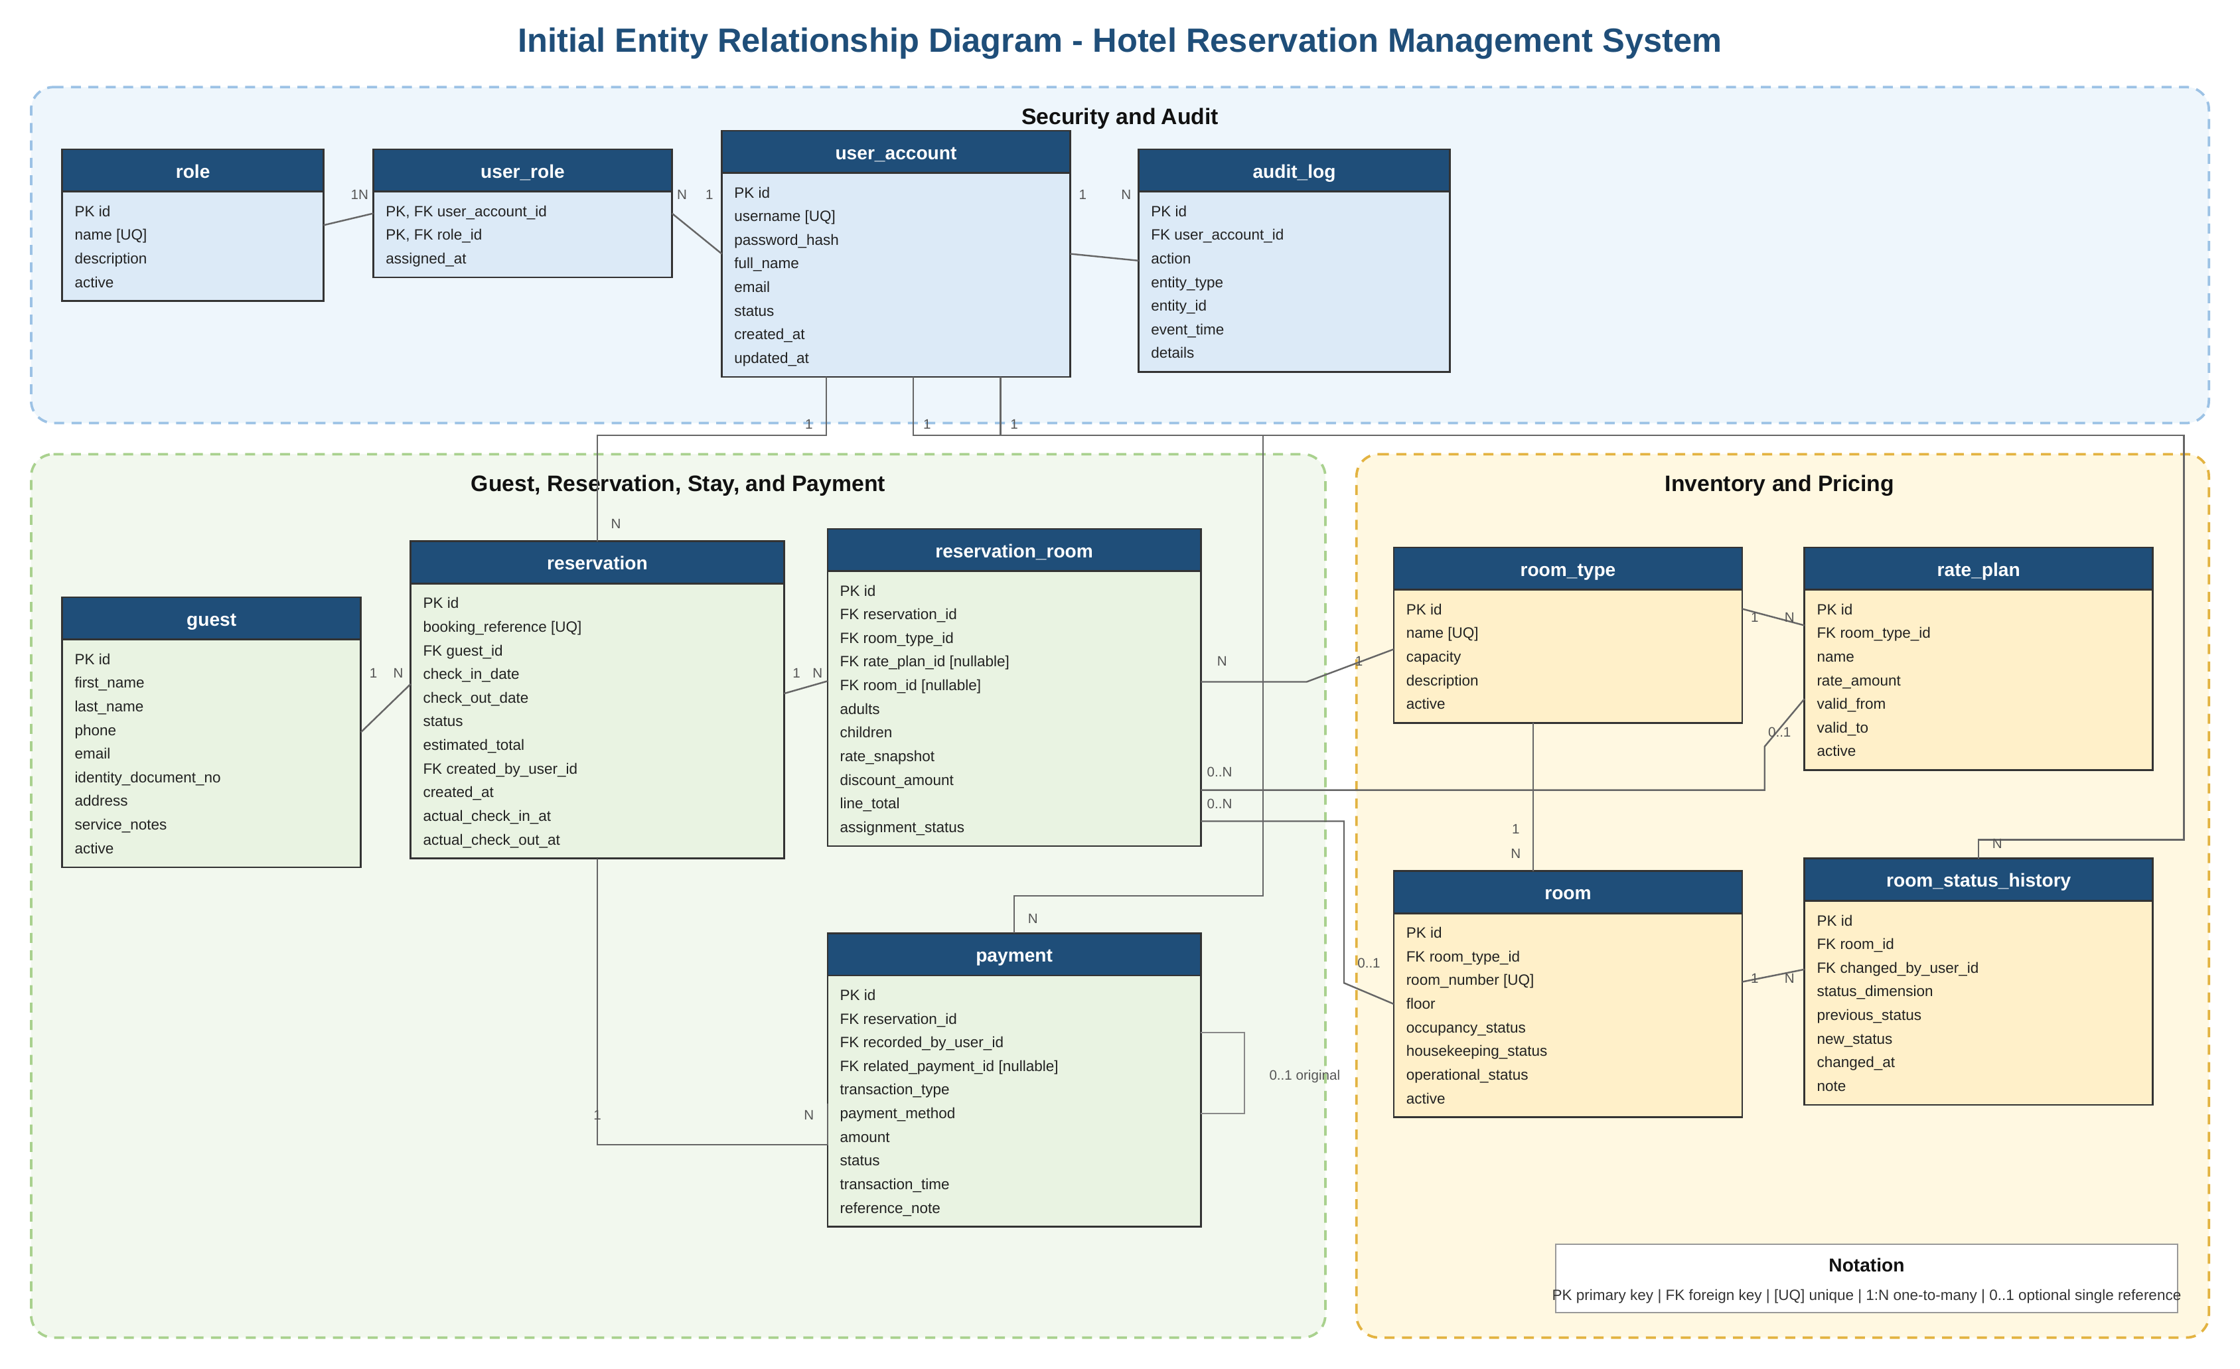
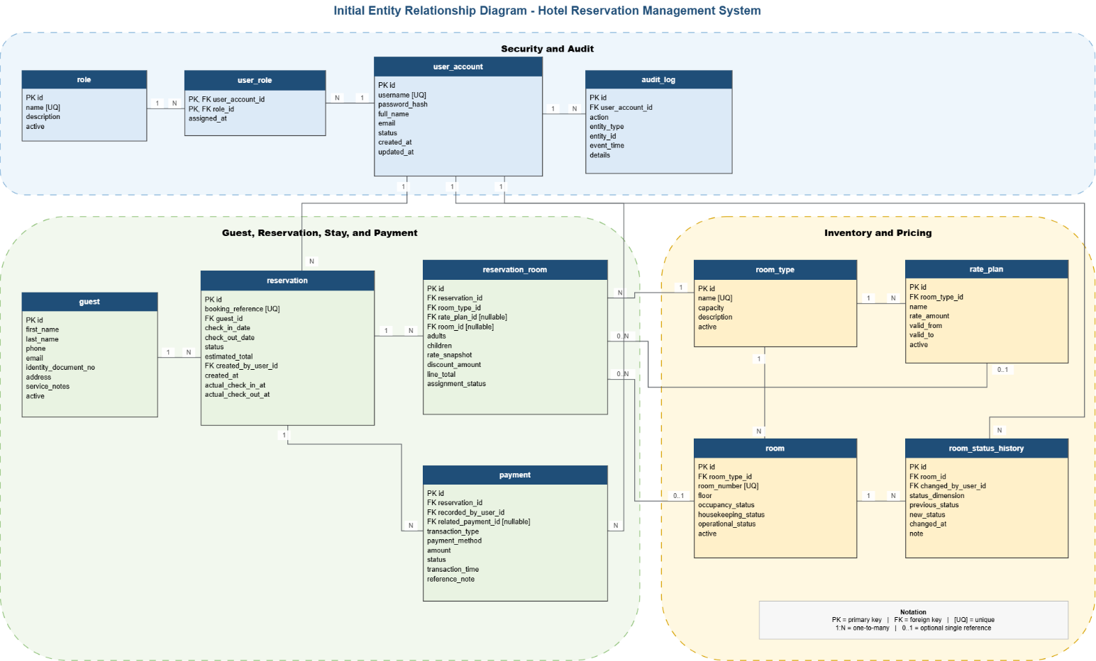
Data Model
Initial ER Diagram and the reasoning behind the core relationships
1 reservation_room
2 rate_snapshot
3 related_payment_id
Supports multi-room reservations and late physical-room assignment.
Preserves the agreed historical price even when rate plans change later.
Links refunds or adjustments to the original financial transaction.

Slide 8
Product Backlog
Priorities, implementation sequence and current Sprint 1 status
MUST — Core Hotel Operations
SHOULD — Enhancements
CURRENT STATUS
Authentication
Rooms & rates
Guests & reservations
Check-in / check-out
Payments
Housekeeping
Operational reports
Advanced filtering
CSV report export
Sprint 1
READY FOR REVIEW
Changes to Done only after supervisor acceptance.
Implementation Roadmap
S1
S2
S3
S4
S5
S6
S7
S8
Requirements
Foundation
Core Logic
User Interface
Integration
Quality
Documentation
Final Review
The backlog is maintained in Excel with ID, priority, planned sprint, dependencies, Definition of Done and status.

Slide 9
Next Sprint Plan
Sprint 2 — Project Initialization and Software Architecture
WHY THERE IS NO CODE YET
Planned Sprint 2 Work
1
Git Repository
2
Spring Boot
Sprint 1 is an analysis and design sprint.
Implementation begins only after requirements and the initial design are reviewed and approved.
version control & project structure
Java 21 + Maven project
3
PostgreSQL
4
Base Architecture
database + Flyway migrations
layers, entities & repositories
5
UML Design
6
Installation Guide
SPRINT 1 → DESIGN
Class + Package Diagrams
build and setup instructions
SPRINT 2 → BUILD
The review result becomes the input to Sprint 2.
Expected Sprint 2 result: the application builds, starts and connects to PostgreSQL.

