Slide 1


Cooperative Control of Second Order Multi-agent Systems Under Switching topologies
Jiayi Cai (caijiayi2018@email.szu.edu.cn)
Student number: 2050201001
College of Mathematics and Statistics, Shenzhen University, China
Supervisor: Prof. Jianwen Feng
31-May-2021

Slide 2
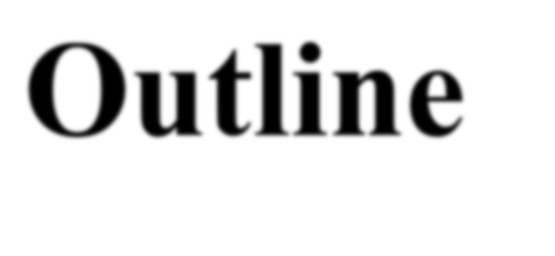
Outline
Background
Cooperative Control of Second Order Multi-agent Systems (MAS) Under Switching Topologies: main results
Future Consideration

Slide 3

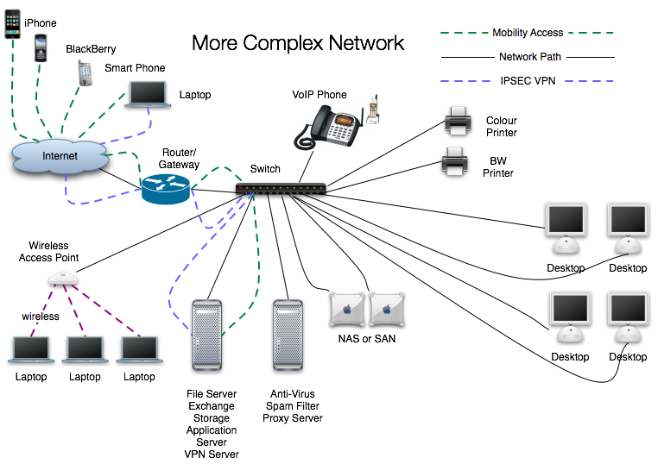

Network exists everywhere in life
Highway system network
Communication network
Human relationship network
A network is a set of nodes
interconnected via links
Internet: Nodes – routers Links – wires
Neural Network: Nodes – cells Links – nerves
Social Networks: Nodes – individuals Links – relations
… …

Slide 4




Network synchronization phenomenon
Pendulum
Fish Swarm
Bird flocking
Fireflies

Slide 5
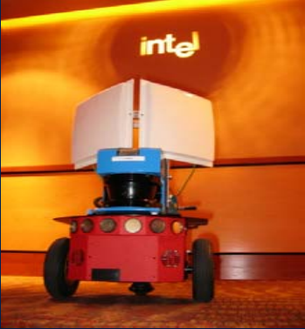
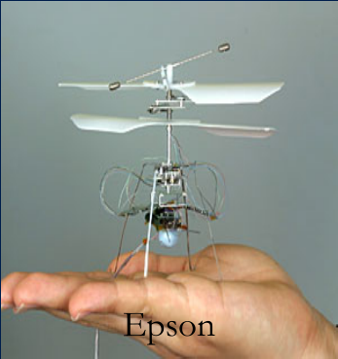



The consensus of multi-agent systems
Cooperative control of Multi-agent systems
The individual of the whole network achieves the purpose of cooperative control
Some individuals need privacy of their sensitive state

Slide 6
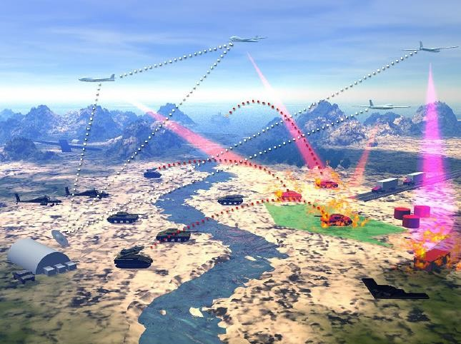
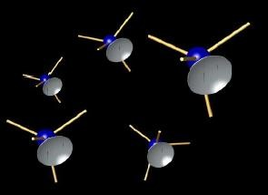

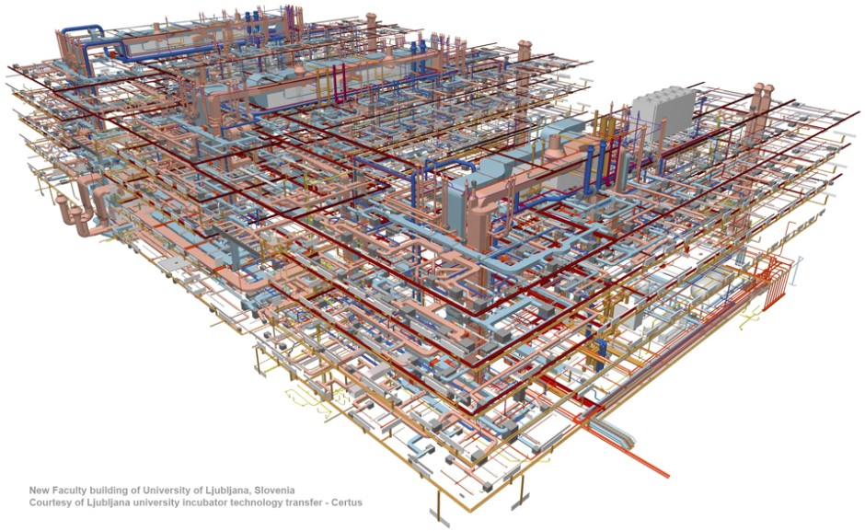
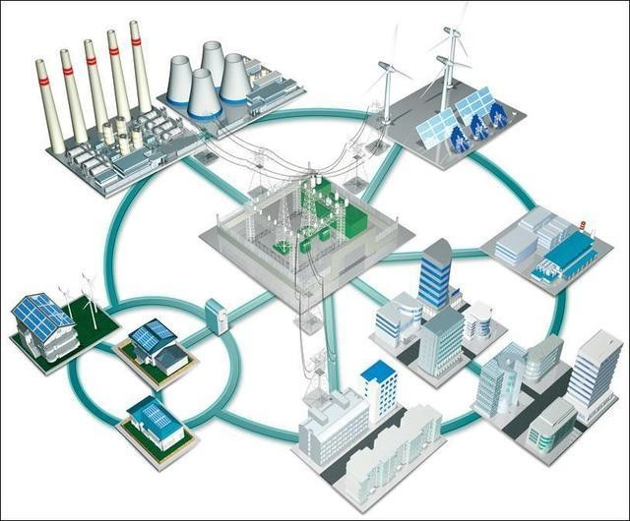
Application of multi-agent consensus
Battle field management
Attitude synchronization
Formation
Mechanical structure network
Smart grid

Slide 7




Complex dynamical network mathematical model:
1
a
31
a


21


3
15
a
2


a
14
a
24
u3
53
a
42
u2
a
5
4
The matrix describes the topological structure of the network
is called the state vector of the node. is called the internal coupling matrix. A is called the coupling matrix, and is called the controller applied to node . is the state vector of leader.
Multi-agent systems consensus：

Slide 8
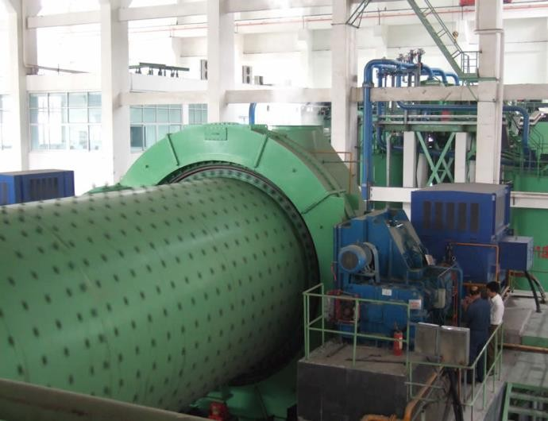
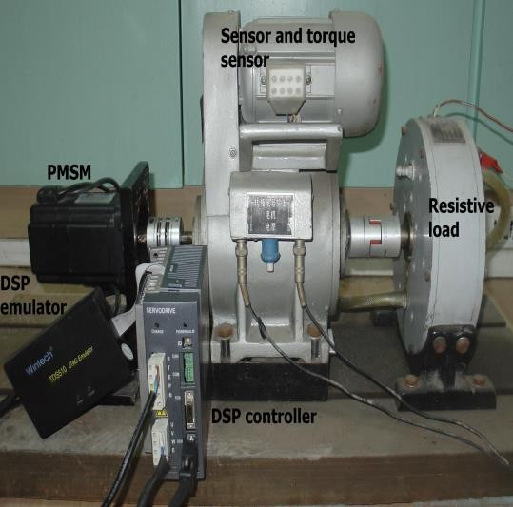
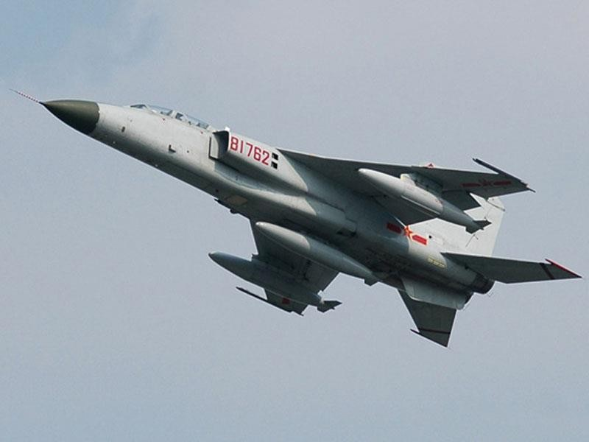
Swiching topologies everywhere
Process Control (grinding classification process)
grain-size and hardness
variation of mineral
Motion control (permanent magnet synchronous motor)
load torque
pivoting friction
Aerospace (missile guidance and control system)
wind geomagnetic interference

Slide 9
Motivation: switching in networks!
Theoretically, there are at least three directions about this topic:
D1: switching topologies + local information: cooperative control + disturbance rejection
D2: the diversity of dynamics: nonlinear dynamics
D3: The communication between leader and followers is time-varying：switching
topologies

Slide 10
Outline
Background
Cooperative Anti-Disturbance Control: main results
Tracking Consensus of Multi-agent Systems Under Switching Topologies via Novel SMC: An Event-Triggered Approach
Future Consideration

Slide 11
Tracking Consensus of Multi-agent Systems Under Switching Topologies via Novel SMC: An Event-Triggered Approach
For cooperative control, what has not been addressed sufficiently?
An important performance index for evaluating a proposed consensus protocol is saving resources
First-order :
undirected√ directed√
Second-order :
time-invariant√ switching topologies?
How to use event-triggered SMC strategy to design Tracking consensus control protocol and prove the correctness?
H. Wang, W. Yu, G. Wen, and G. Chen, IEEE Trans. Circuits Syst. I. Regul. Pap., vol. 65, no. 12, pp. 4336-4348, 2018.
Event triggered sliding mode control (SMC) strategy

Slide 12
Problem Formulation
Second order multi agent system dynamics：
Topologies switching:

Slide 13
Problem Formulation
Second order multi agent system dynamics：
Our purpose：
Topologies switching:

Slide 14
Problem Formulation
Assumptions：

Slide 15
Event-triggered Configuration
Time-triggered Sampling VS Event-Triggered Sampling
Time-Triggered Sampling
Event-Triggered Sampling
Measurement
threshold
a
b
c
...
sampling
time
...
t
t
0
h
2h
3h
4h
5h
6h
7h
8h
9h
10h
11h
...
0
t₄
t₅
t₆
t₇
t₈
...
Periodical sampling instants
Irrespective of real-time network resource
utilization and dynamic system evolution
Resource-wasteful (e.g., little fluctuation at points: a,b,c)
Sample only when an event occurs
e.g., a threshold is violated
Dynamic and intelligent sampling Resource-efficient

Slide 16
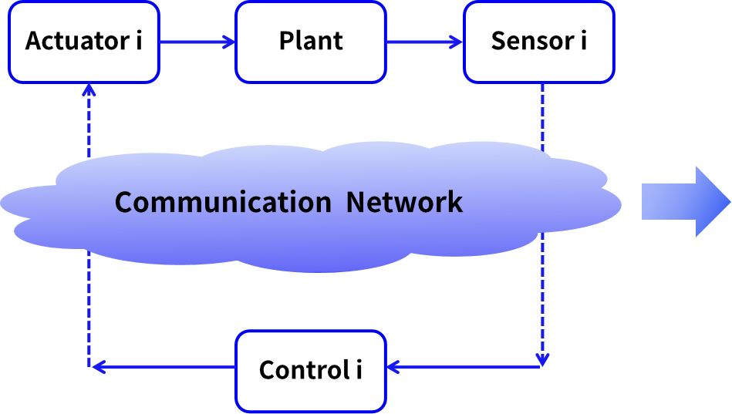
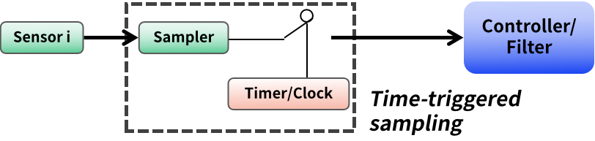
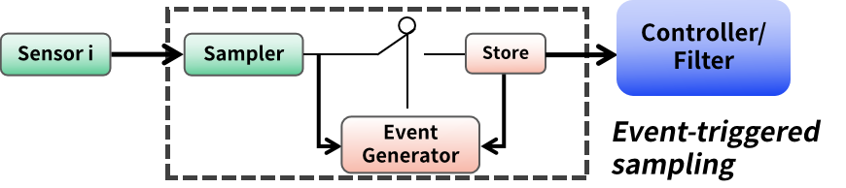
Event-triggered Configuration
Time-triggered Sampling VS Event-Based Sampling
H. Wang, W. Yu, W. Ren, and J. Lv, IEEE Trans. cybern., doi: 10.1109/TCYB.2019.2903218.

Slide 17
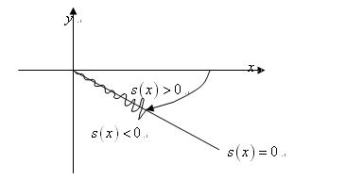
Novel sliding mode control
Novel level sets-based SMC VS General SMC
✹ General sliding mode control method：
A variable structure control is used to drive and maintain the system state from the initial state to a hyperplane determined by the switching function (Sliding mode valued function) in a finite time.
→
Arrival process: reaching the hyperplane;
Symbolic functions usually appear in the controller.
Sliding mode motion: the hyperplane is called sliding mode surface, and the motion of the system on the sliding mode surface is called sliding mode motion.
{
➱ The discontinuous behavior of the cont-
roller leads to more energy consumption
Drawback：
Lyapunov type arrival conditions:
➱ When the system dynamics reaches the
sliding surface, it will produce shaking beh-
avior, which will shorten the machine life

Slide 18

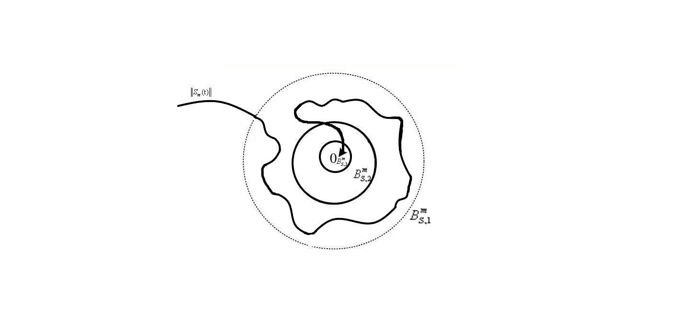
Novel sliding mode control
Novel level sets-based SMC VS General SMC
✹ Novel level sets-based sliding mode control：
The novel dynamic sliding mode control (SMC) mechanism is proposed based on two quantization level sets
. By using the boundary layer technique, the control protocol is designed to
be continuous
→
Arrival process: boundary layer technique;
Sliding mode motion: it does not need the system dynamics to reach the sliding surface, and the error is reduced continuously by reducing the level set.
{
Advantage：
➱ The control protocol is designed to be continuous, which can reduce the chattering of the system and increase the life of machine.
➱ The system dynamics does not need to reach the sliding surface, which reduces the conservatism

Slide 19

The advantages of the event triggered SMC control strategy
Two level sets：The relationship between sliding mode value and error is established
Counteracting the effects of external disturbances
Saving network communication resources
Event triggered control
Sliding mode control
Determine the update of control protocol and the time of level set reduction
Based on two level sets: reduce the size of the level sets
The advantages of the event triggered SMC strategy

Slide 20
Theorem and main conclusion
Stage 1: System dynamics can enter level sets

Slide 21
Theorem and main conclusion
Stage 2: achieve the leader-following consensus of the system

Slide 22
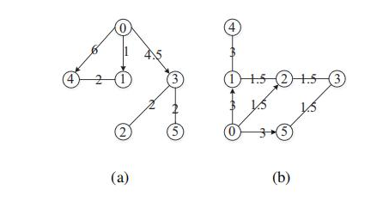
Simulation
contain a spanning tree

Slide 23
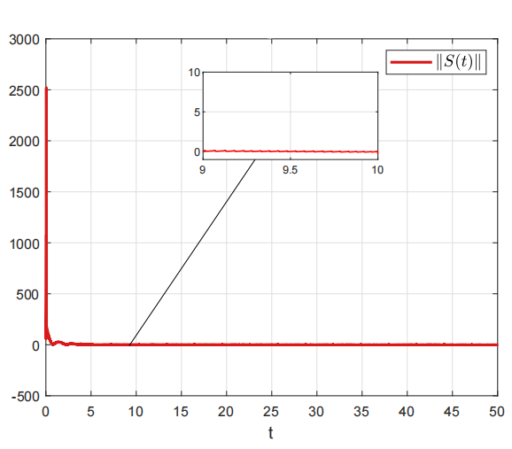
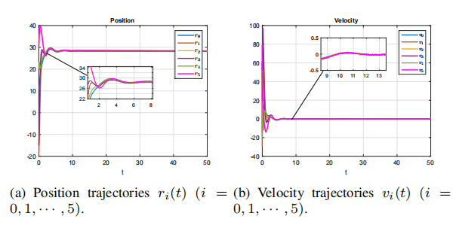
Simulation of case 1
sliding value
tracking error of each follower

Slide 24
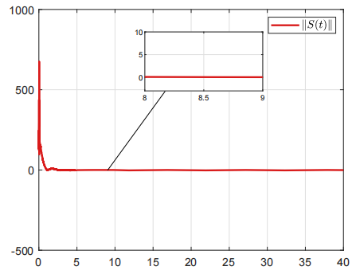
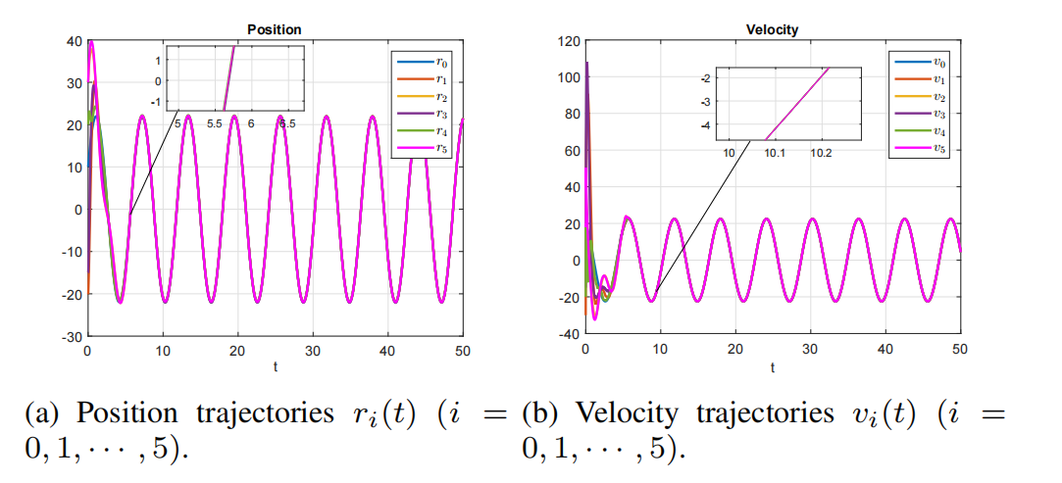
Simulation of case 2
sliding value
tracking error of each follower

Slide 25
Outline
Background
Cooperative Anti-Disturbance Control: main results
Future Consideration

Slide 26
Further consideration
Multiple types of switching
Real applications: robot arms, UAVs…
Cooperative control with only relative information in complex communication situations (switching topologies, connectivity preserving topologies, Markov switching topologies…)
New types of observers (Adaptive finite-time observers…)
……

Slide 27
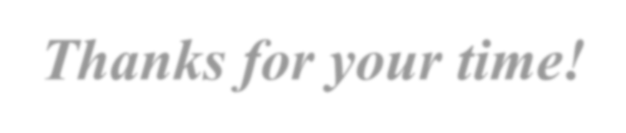

Thanks for your time!

