Slide 1














SCOUTIST
THE COMPANY NOBODY’S BUILDING

Slide 2



PROBLEMS
Parents don’t encourage students to pursue career in sports because of no future.
PATHWAY
Lack of education about sports nutrition and training.
EDUCATION
People’s wrong perception about Grassroot development of Olympic sports.
MINDSET

Slide 3

SOLUTIONS
Everyone is talented but built differently so we are here to identify that talent early and accordingly to inherent capabilities.
IDENTIFY EARLY & ACCORDINGLY

Slide 4
ABOUT
SCOUTIST
THE COMPANY NOBODY’S BUILDING
Scoutist is a sports-tech startup which will help each
individual athletes to find out their inherent talent with the
help of 18 test and statistical methods, using Data analysis techniques by considering their motor and physiological factors.

Slide 5

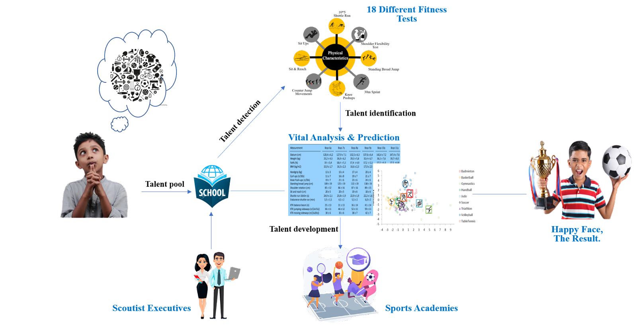


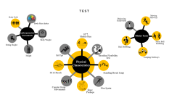


BUSINESS MODEL

Slide 6
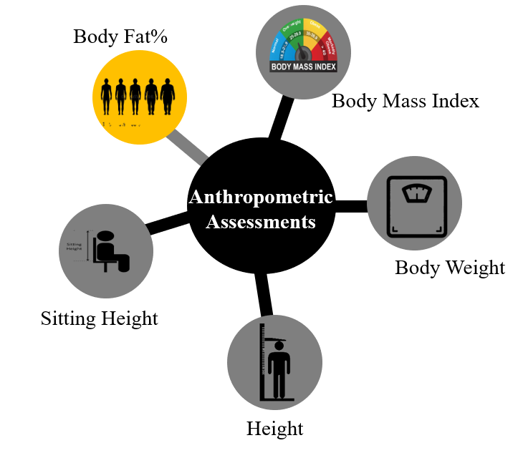
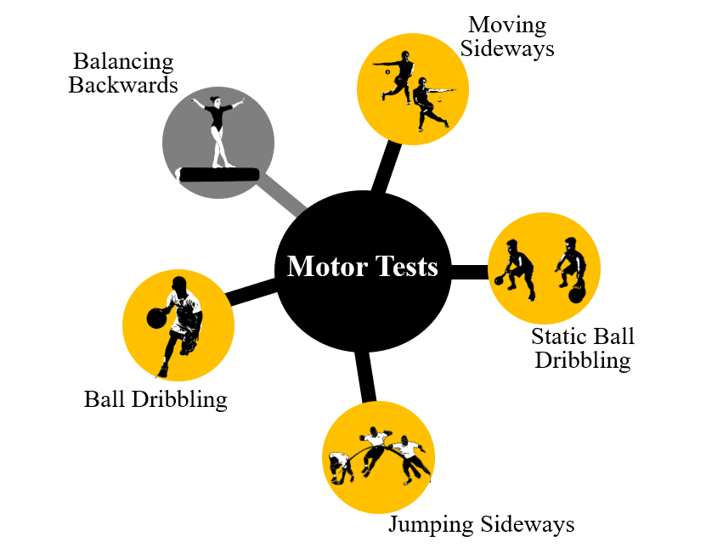
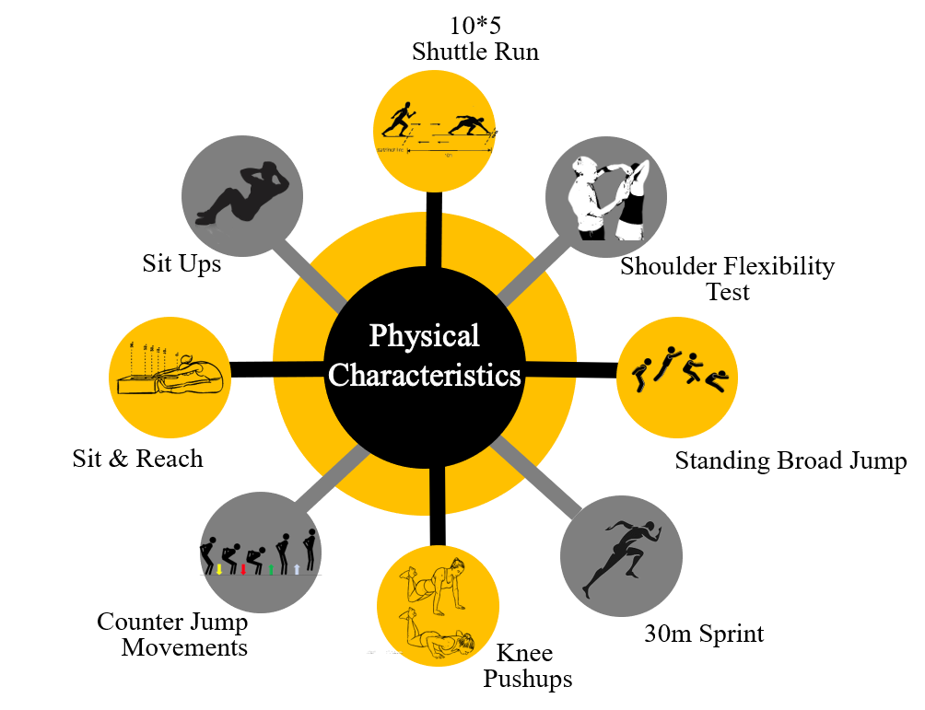
TEST

Slide 7





MARKETING PLAN
TARGET AUDIENCE
SCHOOLS
Children from age group
between 7-16.
Our target is to approach
12 school in 12 months
DIGITAL ADS
FEATURING IN MAJOR
PUBLICATIONS
We will run ads digitally as most of target audience will be using phone
We are in talks with major startup story news
and media blogs like yourstory.com

Slide 8
BUSINESS PLAN
PACKAGES | ANTHROPOMETRIC ASSESMENTS | PHYSICAL CHARACTERISTICS | MOTOR CHARACHTERISTICS | ACADEMY SUSBSCRIPTION
900
1100
✅
✅
✅
❌
✅
✅
✅
✅

Slide 9



USP
PREDICTIVE
ANALYSIS
TALENT
DEVELOPEMENT
Classifying sports according to their inherent capabilities.
Aims to build athletes who will be an asset to India and serve it in sports for a long time
EFFECTIVE & EFFICIENCY
FIRST TO MARKET
This process shows an efficiency of 80% in talent identification compared to coaches 52%
First to identify talent focusing Olympic sports in India.

