Slide 1
Introduction to .NET Core and Basic Concepts
Anh Vu Hoang
20/02/2024

Slide 2
.NET Core Overview
Setup development environment
Introduction C# programing
Basic concepts of web development

Slide 3
.NET Core Overview

Slide 4
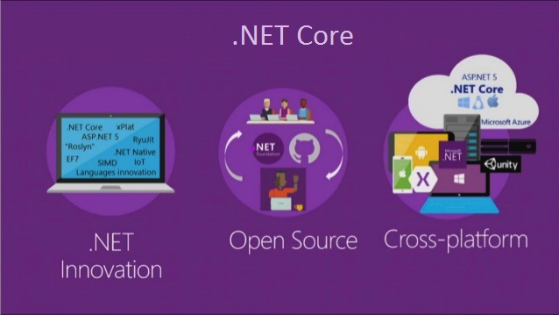
Introduction
.NET Core is a free, cross-platform, open-source developer platform
Notes:
Introduction to .NET - .NET | Microsoft Learn

Slide 5
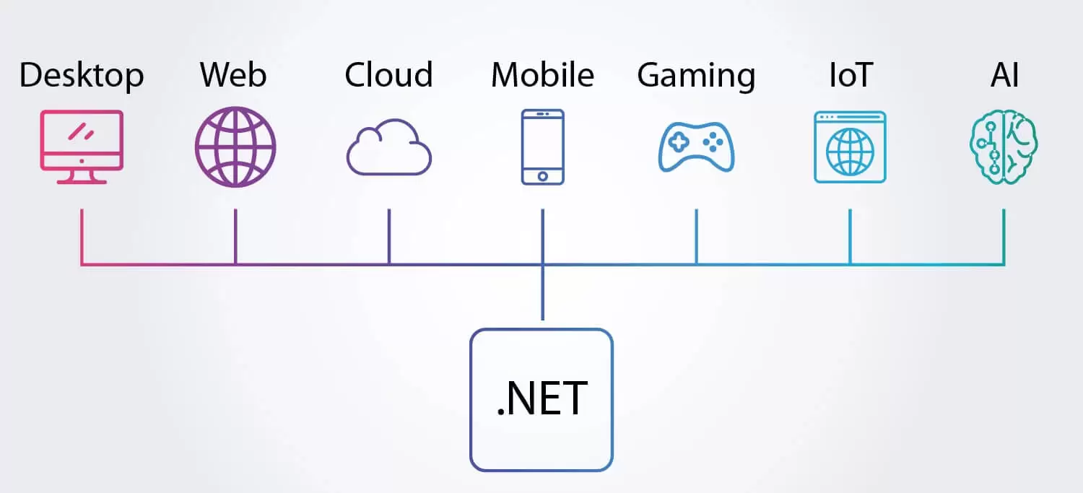
Application Types
Build different types of applications: web, desktop, game, mobile, machine learning, IoT, etc.
Notes:
Build apps with .NET - .NET | Microsoft Learn: Unity, .NET MAUI
Additional information
- Modular Architecture: NuGet packages
CLI tool: https://www.tutorialsteacher.com/core/net-core-command-line-interface

Slide 6
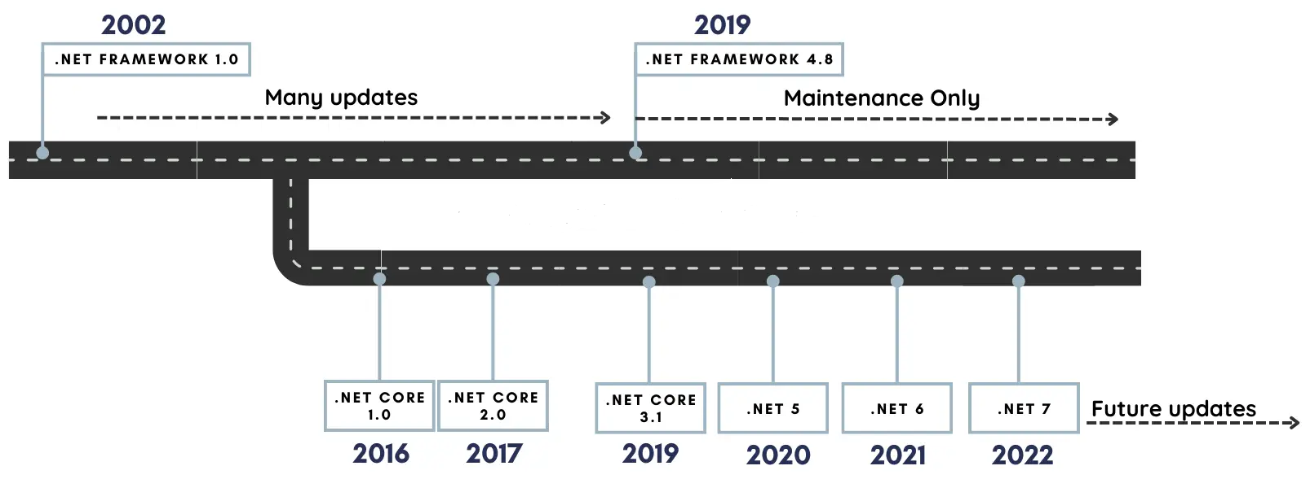
.NET Core Versions

Slide 7
.Net Core vs .Net Framework
BASED ON | .NET Core | .NET Framework
Open Source | .Net Core is an open source. | Microsoft's Windows-only implementation
Cross-Platform | Runs on Windows, Linux and macOS. | Only runs on Windows
Performance and Scalability | .NET Core offers high performance and scalability | .Net Framework is less effective in comparison to .Net Core
Installation | .NET Core is packaged and installed independently of the underlying operating system | .NET Framework is installed as a single package for Window
Notes:
What's the Difference Between .NET Framework and .NET Core? (howtogeek.com)

Slide 8
Q & A

Slide 9
02
Setting up the development environment

Slide 10
Setting up the development environment
Install Visual Studio Community
Install .Net SDK (Optional)
Install Visual Code, C# Dev Kit (Optional)
Notes:
dotnet --list-sdks

Slide 11
03
C# Programming
Notes:
Learn C# | Free tutorials, courses, videos, and more | .NET (microsoft.com)
C# Fundamentals for Absolute Beginners | Microsoft Learn

Slide 12
Project Structure
Solution file (.sln)
Project file (.csproj)
Namespace
Class
Function
Notes:
https://learn.microsoft.com/en-us/dotnet/csharp/tour-of-csharp/

Slide 13
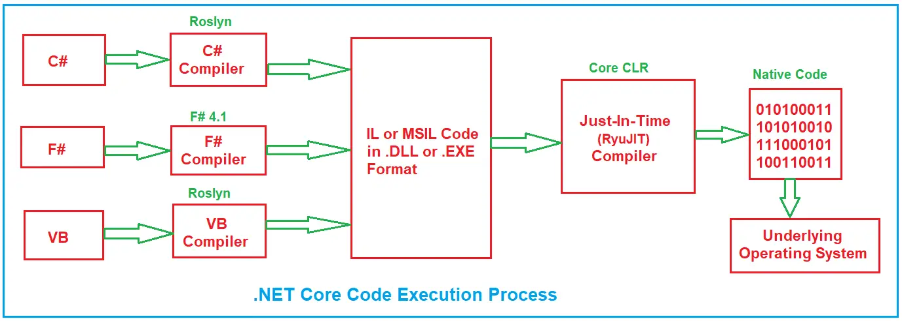
.NET Core Code Execution
Notes:
https://learn.microsoft.com/en-us/dotnet/standard/managed-execution-process
https://dotnettutorials.net/lesson/net-core-vs-net-framework-code-execution-process

Slide 14
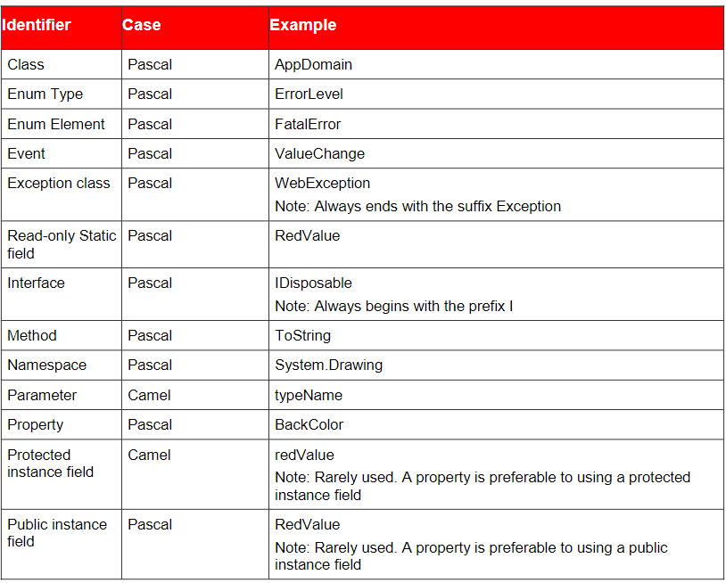
Coding convention

Slide 15
Roadmap
GitHub - MoienTajik/AspNetCore-Developer-Roadmap: Roadmap to becoming an ASP.NET Core developer in 2024

Slide 16
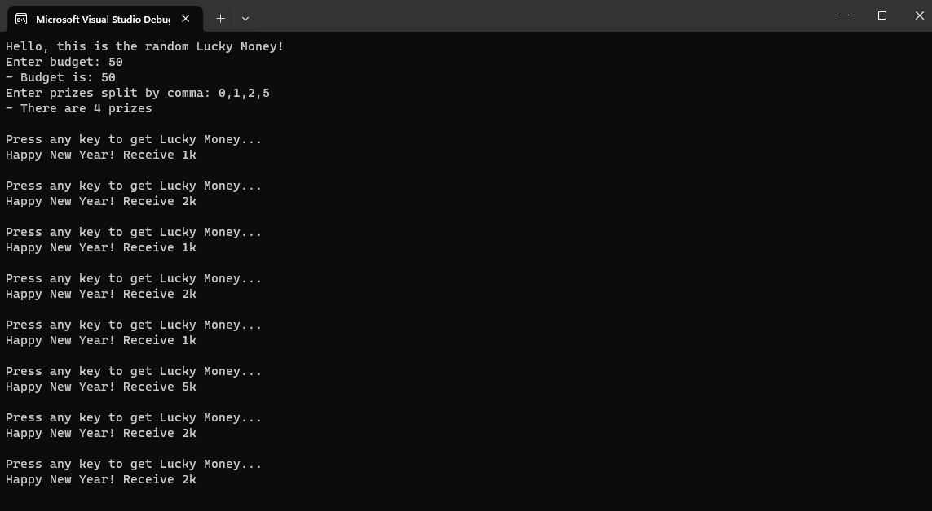
Demo

