Slide 1
DATA SCIENCE ALLIANCE • TASK 2.3 CHECK-IN
Downtown San Diego Unsheltered
Homeless Population: EDA Findings
Kyaw Soe Lwin | Data Science Alliance | 2017–2025
SOURCE DATA
Downtown San Diego Partnership (DSDP) Clean & Safe monthly counts
LONGITUDINAL SCOPE
2017–2025 (8 full & partial calendar years, 7 downtown neighborhoods)
ANALYSIS FOCUS
Overall trajectory, seasonality, COVID dip, methodology & spatial dynamics
Data Science Alliance • Downtown San Diego Homeless Population Analysis • Source: DSDP Monthly Counts (2017–2025)
Slide 1 of 8

Slide 2
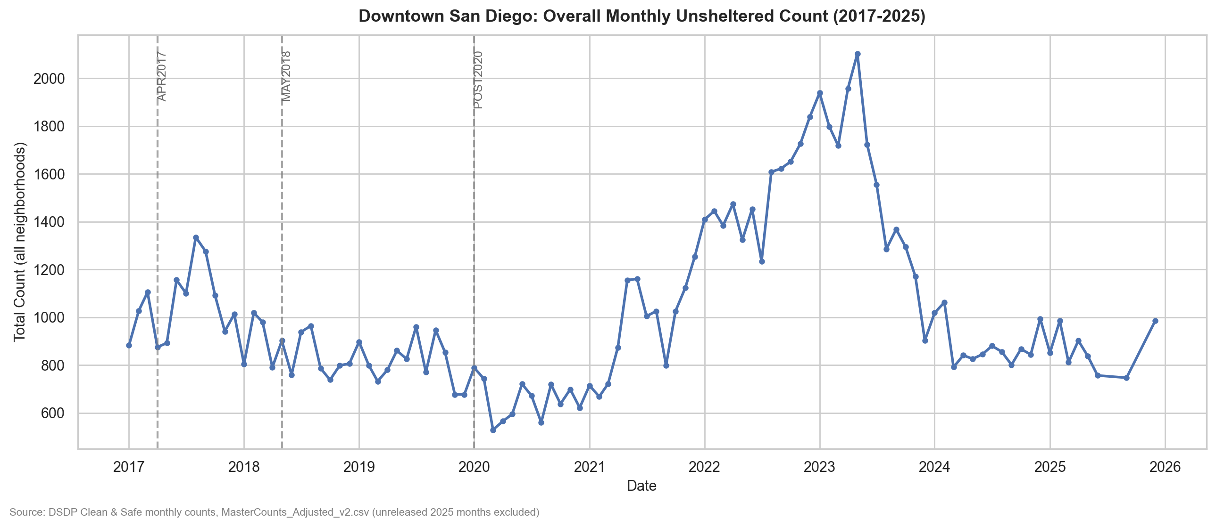
02
LONGITUDINAL ANALYSIS
Overall Longitudinal Trend: Three Distinct Phases (2017–2025)
529
SERIES LOW
March 2020 (COVID trough)
2,103
SERIES PEAK
May 2023 (Rebound peak)
156.8
GRAND MEAN
Per neighborhood-month
Trajectory Overview: Three Clear Phases
• 2017–2020 Decline:
Annual average fell from 176.31 to 109.02 (~-38% cumulative drop). Year-over-year changes: -18.98% (2018), -4.94% (2019), and -19.71% (2020).
• 2021–2023 Rebound & Peak:
Counts rebounded sharply: +25.85% (2021) and +57.63% (2022), reaching an annual average of 223.98 in 2023 — more than double the 2020 trough.
• 2024–2025 Pullback & Stabilization:
A steep -43.52% drop in 2024 brought the annual average down to 126.50; 2025 remained roughly flat (-2.94%) at 122.78.
Data Science Alliance • Downtown San Diego Homeless Population Analysis • Source: DSDP Monthly Counts (2017–2025)
Slide 2 of 8

Slide 3
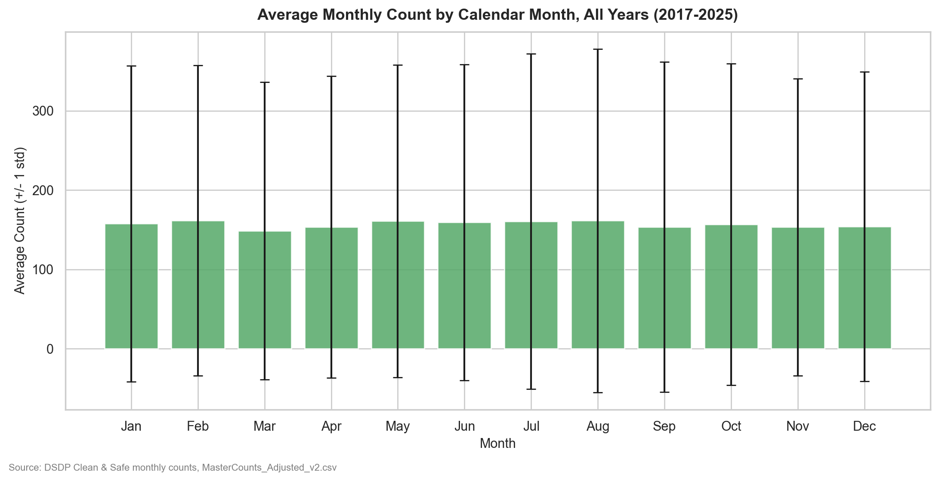
03
SEASONAL ANALYSIS
Calendar-Month Seasonality: Modest Variance vs. Annual Swings
Quantifying Calendar Seasonality
Key Takeaway: Which YEAR a month falls in matters far more than which calendar month it is.
• Modest Range of Deviation:
No single calendar month deviates by more than ~5% from the grand mean (156.78). The peak-to-trough spread is only ~8.4 percentage points.
• Top 3 Highest Months:
Feb (+3.2%, 161.76), Aug (+3.1%, 161.61), and May (+2.6%, 160.93).
• Top 3 Lowest Months:
Mar (-5.2%, 148.67), Sep (-2.0%, 153.63), Nov (-2.1%, 153.43) [Apr: -2.1%, 153.53].
• Large Residual Variance:
Month-to-month standard deviations (187–216) dwarf monthly mean differences, confirming macro annual shocks overpower calendar cycles.
• East Village Sub-Pattern:
East Village diverges from citywide rhythm: peaks in Jul–Aug (~601–604) and dips in spring (Mar–Apr, ~509).
Data Science Alliance • Downtown San Diego Homeless Population Analysis • Source: DSDP Monthly Counts (2017–2025)
Slide 3 of 8

Slide 4
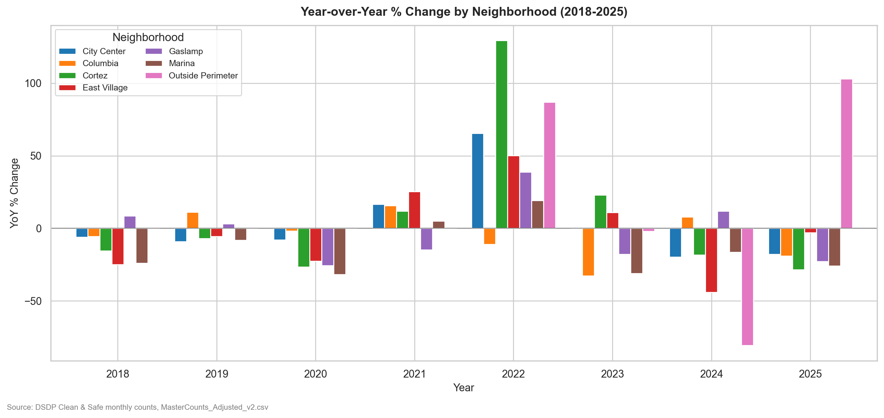
04
SPATIAL DYNAMICS
Neighborhood Rankings: Volume Concentration vs. Growth Rates
Volume Scale vs. Growth Dynamic
Core Insight: Growth is NOT concentrated in the largest neighborhood.
• By Average Monthly Count (Magnitude):
1. East Village: 552.77 (std 157.09 — highest volume & volatility)
2. Outside Perimeter: 217.57 (partial coverage, 56 obs)
3. City Center: 171.81 (std 54.80)
4. Cortez: 59.52 | 5. Gaslamp: 48.43
6. Columbia: 44.49 | 7. Marina: 30.94 (smallest, std 15.82)
• By Growth Rate (Mean YoY %, 2019+):
- Fastest Growing: Outside Perimeter (+26.90%/yr), Cortez (+11.96%/yr), City Center (+3.94%/yr).
- Modest Core Growth: East Village grew slowly (+1.64%/yr) despite ~55% volume share.
- Shrinking Areas: Marina (-12.76%/yr) and Columbia (-4.28%/yr) had sustained drops.
• Spatial Sub-Area Asymmetry:
North East & South East EV consistently outcount West sub-areas.
Data Science Alliance • Downtown San Diego Homeless Population Analysis • Source: DSDP Monthly Counts (2017–2025)
Slide 4 of 8

Slide 5
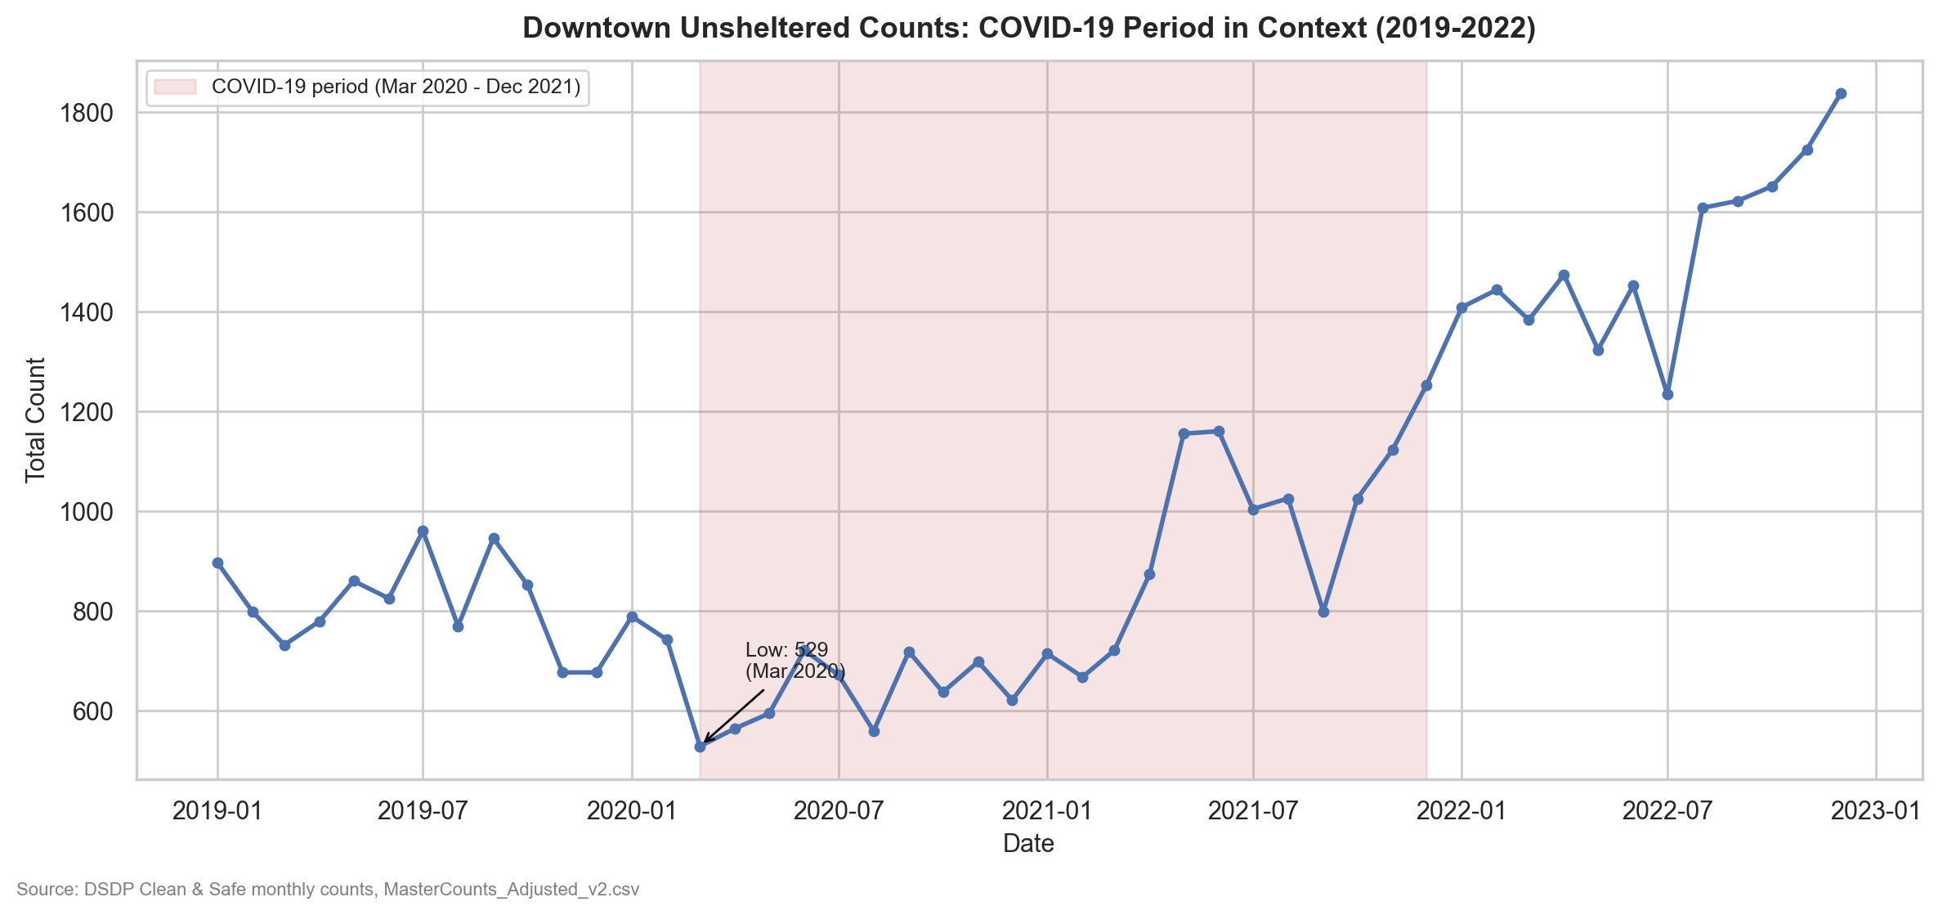
05
PANDEMIC IMPACT
COVID-19 Period Impact: Temporary Suppression & Sharp Rebound
Pandemic Shock & Rebound Profile
Finding: Pandemic programs suppressed visible street counts without a lasting reduction in demand.
• Series All-Time Low (March 2020):
Citywide unsheltered total hit its series low of 529 in March 2020 at the onset of initial COVID shelter-in-place orders.
• 2020 Annual Trough (~20% Reduction):
2020 annual average (654.1) dropped ~20% below the 2019 pre-COVID baseline (814.72), reflecting -19.71% YoY contraction.
• Full Recovery by 2021:
Counts recovered to an annual average of 960.37 in 2021 (+25.85% YoY), climbing above pre-COVID baseline levels prior to the 2022–2023 surge.
• Operational & Policy Mechanisms:
Emergency indoor shelter placements (Convention Center Operation Shelter to Home), eviction moratoria, and curtailed street sweeps temporarily reduced visible unsheltered numbers; demobilization preceded the 2022–2023 peak.
Data Science Alliance • Downtown San Diego Homeless Population Analysis • Source: DSDP Monthly Counts (2017–2025)
Slide 5 of 8

Slide 6
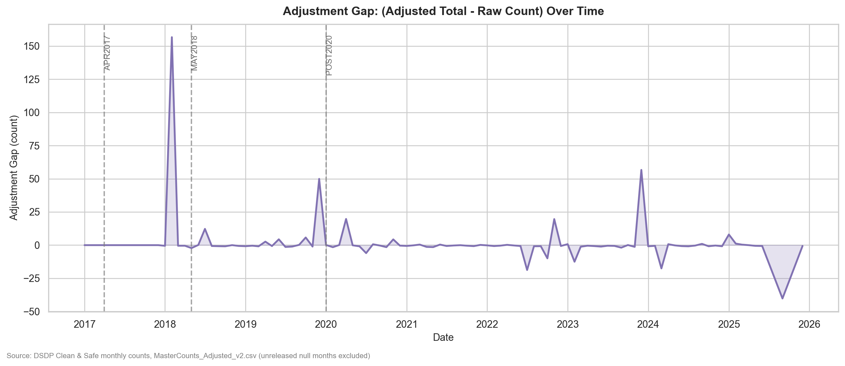
06
DATA GOVERNANCE
Methodology Regimes: Quantifying the Raw vs. Adjusted Count Gap
Evaluation of Multiplier Regimes
Conclusion: Multipliers produce a proportional gap without distorting longitudinal trendlines.
• Four Historical Regimes:
- PRE2017 (Jan–Mar 2017): Direct visual count, no component breakout.
- APR2017 (Apr 2017–Apr 2018): Vehicle multiplier set to 1.66×.
- MAY2018 (May 2018–Dec 2019): Vehicle multiplier increased to 2.03×.
- POST2020 (Jan 2020–present): 2.03× retained by DSDP for continuity.
• 2018 Volatility & Source Discrepancy:
Gap (total_count - raw_count) peaked in 2018 (avg +13.5/mo, spiking to +156.61 in Feb 2018). Audit logged Feb 2018 spike as partly a source-PDF addition error (+30 discrepancy), not purely multiplier mechanics.
• 2019+ Gap Stabilization:
From 2019 onward, monthly gap stabilized to near-zero (roughly ±1 to ±5/month), well within expected rounding tolerance (±2).
• Pre-2018 Constraint:
Because component breakouts began in Jan 2018, raw and adjusted totals are identical across all of 2017 (gap = 0).
Data Science Alliance • Downtown San Diego Homeless Population Analysis • Source: DSDP Monthly Counts (2017–2025)
Slide 6 of 8

Slide 7
07
RESEARCH DIRECTIONS
Hypotheses for Further Analysis: Focus Areas for Later Tasks
H1: Policy & Enforcement Driver of 2022–2023 Peak
SYNCHRONIZED CITYWIDE SURGE
The +57.63% (2022) surge hit nearly every neighborhood simultaneously (Cortez +129%, Outside Perimeter +87%, East Village +50%). This synchronized timing points to systemic citywide drivers (eviction moratorium expirations, shelter demobilizations, or sweep shifts) rather than local dynamics.
• Test: Correlate monthly counts against RTFH policy timelines, shelter census, and 311 encampment dispatch logs.
H2: East Village Asymmetry Reflects Built Environment
EAST VS. WEST INFRASTRUCTURE DIVIDE
East Village sub-areas show persistent asymmetry: North East and South East EV consistently outcount North West and South West EV across 2018–2025. This concentration indicates infrastructure and zoning drivers.
• Test: Spatial autocorrelation (Moran's I / Getis-Ord Gi* in Assignment 5) against transit hubs, shelter proximity, and zoning.
H3: 2024 Pullback (-43.52%) May Be a Reporting Artifact
RAPID SINGLE-YEAR DROP SCRUTINY
A steep -43.52% drop in a single year immediately after the historical peak warrants verification against external benchmarks before reading it as a true population drop. Count area or staffing changes may be confounders.
• Test: Benchmark against independent RTFH Point-in-Time (PIT) counts and audit 2024 DSDP canvassing operations.
H4: Neighborhood Growth Inversely Related to Area Size
PERIPHERAL DISPLACEMENT DYNAMICS
Mid-sized areas grow fastest (Outside Perimeter +26.90%, Cortez +11.96%, City Center +3.94%), while East Village grows slowly (+1.64%) and Marina shrinks (-12.76%). Enforcement in core areas may displace individuals to borders.
• Test: Perform spatial adjacency and boundary-flow analysis in Assignment 5 to evaluate displacement effects.
Data Science Alliance • Downtown San Diego Homeless Population Analysis • Source: DSDP Monthly Counts (2017–2025)
Slide 7 of 8

Slide 8
08
PROJECT ROADMAP
Data Limitations, Governance Caveats & Roadmap Ahead
Identified Data Limitations & Biases
• Incomplete 2025 Series (Reporting Lag):
28 nulls in total_count (Jul, Aug, Oct, Nov 2025 across all 7 neighborhoods) represent unreleased counts, not data errors. All 2025 annual figures must be treated as partial-year.
• Outside Perimeter Partial History:
Outside Perimeter contains only 56 observations (canvassing began ~2022). Its reported +26.90%/yr growth rate is the least statistically reliable neighborhood figure.
• Pre-2018 Lack of Component Breakouts:
Component-level counts (tents, vehicles) are unavailable before Jan 2018. Raw and adjusted totals are identical for all of 2017, precluding early multiplier analysis.
• Documented Source-PDF Addition Errors:
Task 1.1's 45-cell audit found a 97.56% fidelity rate against source PDFs, noting known errors (Feb 2018 +30 PDF addition bug, 2019 EV sub-area duplication, Apr 2025 discrepancy).
Roadmap Ahead: Assignment 3 Integration
• Immediate Deliverable: Assignment 3:
Block-Level Validation & Spatial Integration — moving from macro neighborhood aggregates to granular micro-data across 500+ individual block parcels.
• Granular Block-Level Mapping:
Audit street-level counts, reconcile boundary discrepancies, and align block records with GIS city parcel boundaries.
• Spatial Autocorrelation Modeling:
Execute Global Moran's I and Local Getis-Ord Gi* hot-spot detection in Assignment 5 to quantify spatial clustering around transit nodes and service hubs.
• Cross-Dataset Validation & Benchmarking:
Cross-reference DSDP monthly counts with regional RTFH annual Point-in-Time (PIT) benchmarks and City of San Diego 311 service call logs.
Data Science Alliance • Downtown San Diego Homeless Population Analysis • Source: DSDP Monthly Counts (2017–2025)
Slide 8 of 8

