Slide 1
DATA SCIENCE ALLIANCE • EXECUTIVE SYNTHESIS BRIEFING
Downtown Homelessness:
Executive Strategic Roadmap (2017–2026)
Econometrics, Spatial Dynamics, ML Forecasting & Regional Policy
PARTNERSHIP & AUTHOR
DSA, DSDP, RTFH
Lead: K.S. Lwin | Proj Lead: A. Mancebo Jr.
DATA FOUNDATION
108 months of counts (2017-2025)
Regional PIT censuses
ANALYTICAL FRAMEWORK
Spatial Gi* • Walk-Forward CV • OLS Regime • 4 Comm Rules

Slide 2
02
EXECUTIVE FRAMING
Executive KPIs: Peak & Migration
2,103
CRISIS PEAK (MAY 2023)
Highest count on record. Capped a 3-year surge.
851
RECENT COUNT (JAN 2025)
Down 59% from peak. Dec 2025 hit 985.
54.0%
EAST VILLAGE CONCENTRATION
Core driver of downtown population.
120 m
HOTSPOT MIGRATION VECTOR
Centroid shifted 120m south toward South East Village.
THE REALITY: DOWNTOWN DROPS VS REGIONAL SHIFTS
• Three Phases: Pre-COVID drop, massive 2021-2023 surge (peak 2,103), then post-enforcement contraction (851 in Jan 2025).
• No Seasonality: Weather doesn't drive numbers (p=0.995). Seasonal budgets are a mismatch for year-round needs.
• Map Changes: 121 blocks added in 2022. Correcting for this shows a real, but smaller, +71% surge in the core.
• Regional Shift: Downtown share fell to 15%, while countywide hit a record 6,110. The crisis moved, it didn't end.
Data Science Alliance • Downtown San Diego Homeless Population Analysis • Sources: DSDP Field Counts & RTFH PIT
Slide 2 of 14

Slide 3
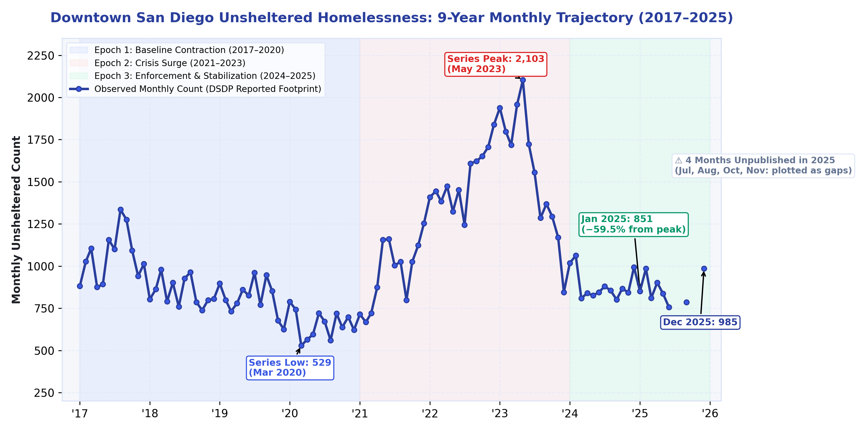
03
LONGITUDINAL DYNAMICS
9-Year Trajectory: Three Policy Epochs
Epoch 1: Contraction (2017–2020)
Low of 529 in Mar 2020 (−38%)
Pre-COVID drop. Baseline interventions worked.
Epoch 2: Crisis Surge (2021–2023)
May 2023 Peak of 2,103 (+297%)
Driven by shelter de-densification and housing vulnerability.
Epoch 3: Enforcement (2024–2025)
Jan 2025 Count of 851 (−59%)
Sharp drop post-Camping Ordinance. Counts stabilized ~860-880.
Data Science Alliance • Downtown San Diego Homeless Population Analysis • Sources: DSDP Field Counts & RTFH PIT
Slide 3 of 14

Slide 4
04
ECONOMETRIC SEASONALITY PROOF
Seasonality Myth: Weather Doesn't Drive Homelessness
Kruskal-Wallis Tests (df=11)
WHY THIS MATTERS FOR MUNICIPAL BUDGETING
• Weather Fallacy: Calendar months explain zero variation (p=0.995). Seasonal planning is flawed.
• Macro Drivers: Shifts are driven by capacity, policy, and housing dynamics—not weather.
• Fund Year-Round: Stop seasonal allocations. Commit to permanent capacity.
• Solid Evidence: 8 of 9 series show strictly non-significant seasonality.
Geographic Series | Kruskal-Wallis H | KW p | ANOVA p | Verdict
Overall — Reported Footprint | 2.66 | 0.995 | 0.998 | No Seasonality
Overall — Fixed Core Six | 9.00 | 0.622 | 0.670 | No Seasonality
East Village (Epicenter) | 14.16 | 0.224 | 0.219 | No Seasonality
City Center (Core) | 4.86 | 0.938 | 0.913 | No Seasonality
Gaslamp Quarter | 14.57 | 0.203 | 0.087 | No Seasonality
Columbia | 8.76 | 0.644 | 0.473 | No Seasonality
Cortez | 12.73 | 0.312 | 0.047 | Mixed
Marina | 19.88 | 0.047 | 0.162 | Mixed
Outside Perimeter | 11.45 | 0.406 | 0.440 | No Seasonality
Data Science Alliance • Downtown San Diego Homeless Population Analysis • Sources: DSDP Field Counts & RTFH PIT
Slide 4 of 14

Slide 5
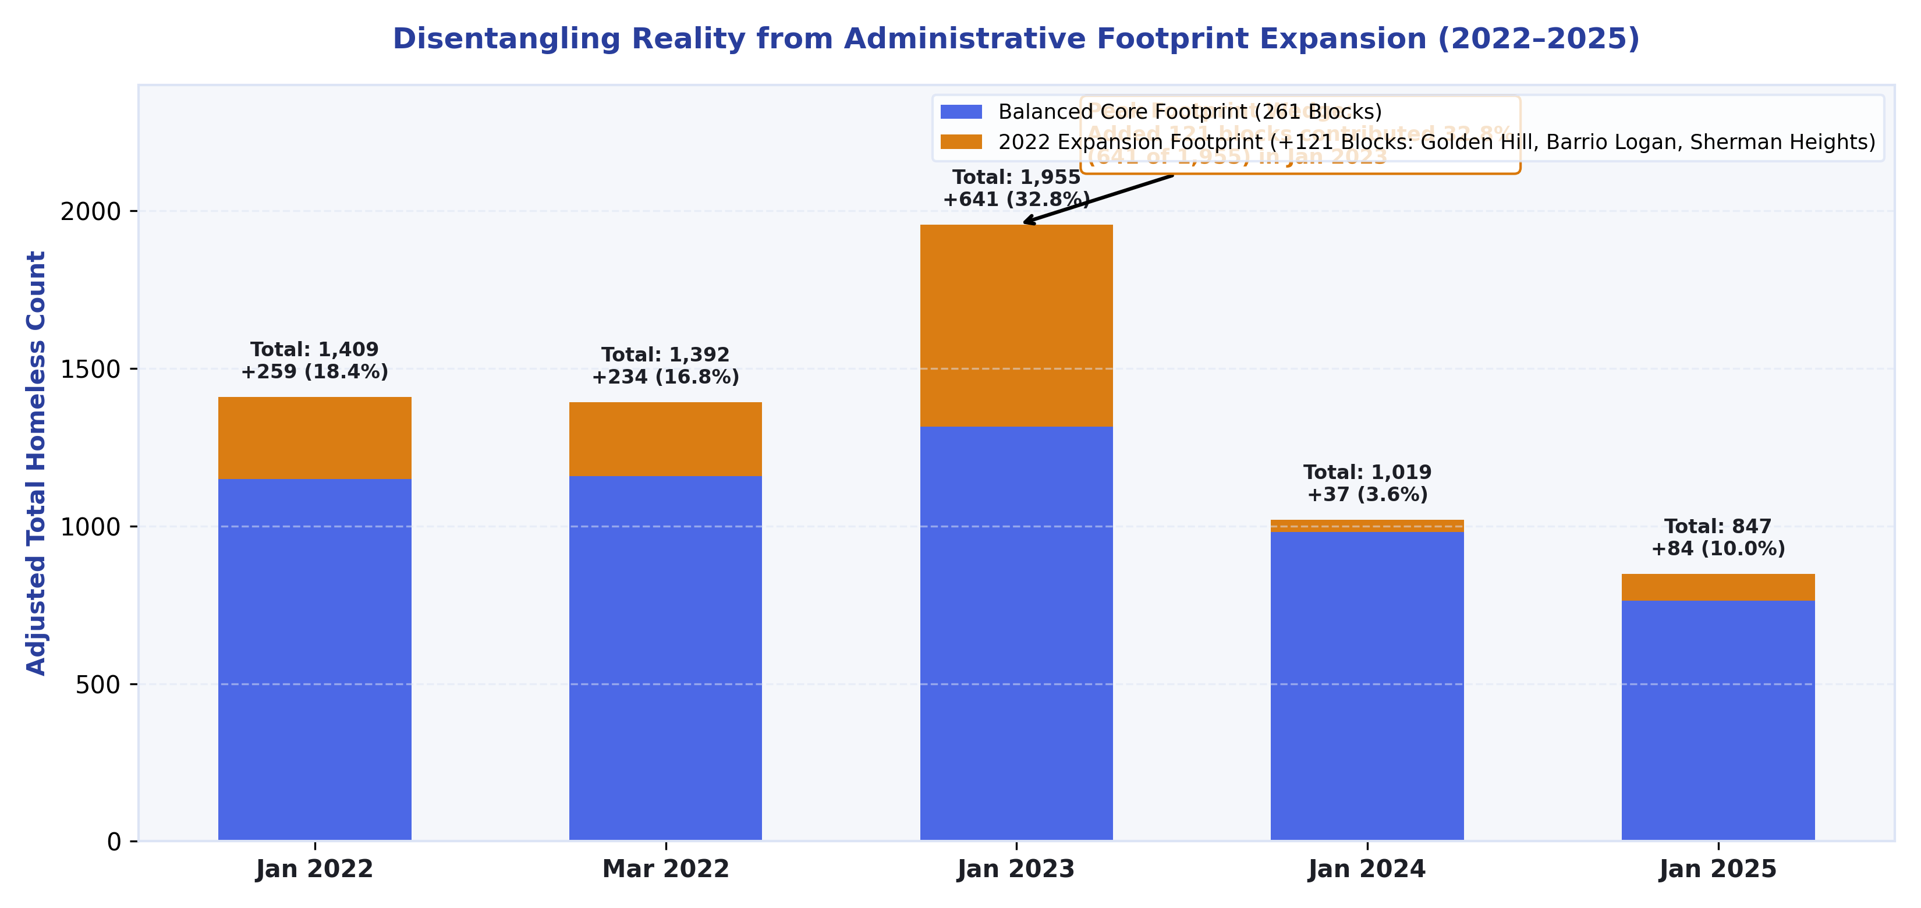
05
SPATIAL PANEL ACCOUNTING
Map Changes: Disentangling Reality from Map Changes
ACCOUNTING FOR THE 121-BLOCK EXPANSION
• Administrative Shift: 121 blocks added in 2022 (Golden Hill, Barrio Logan).
• The Wedge Effect: Added blocks inflated counts by up to 33% (640 individuals at peak).
• True Core Growth: Balanced 261-block panel still grew 71% in 2022. Boundaries matter.
• Analytical Fix: Enforced strict 261-block balance across all years.
Data Science Alliance • Downtown San Diego Homeless Population Analysis • Sources: DSDP Field Counts & RTFH PIT
Slide 5 of 14

Slide 6
06
GEOGRAPHIC CONCENTRATION
Concentration: The East Village Epicenter
Top Hotspots (Getis-Ord Gi*)
THE BUILT-ENVIRONMENT MAGNET
• Volume Dominance: Drives 54% of downtown homelessness (avg 552 individuals).
• Top Hotspots: 100% of the top 10 persistent hotspots are in South East Village.
• Built Magnets: Clusters anchor around transit, services, and freeway underpasses.
Rank | Block Identifier | Area | Hotspot Dates | Rate | Mean Count
#1 | 16th St & Imperial Ave | South East Village | 9 / 12 dates | 75% | 5.9
#2 | I-5 SB & Imperial Ave | South East Village | 8 / 12 dates | 67% | 4.4
#3 | I-5 SB Off-Ramp (Map Border) | South East Village | 6 / 12 dates | 50% | 6.8
#4 | I-5 SB On-Ramp (Map Border) | South East Village | 4 / 12 dates | 33% | 1.3
#5 | 17th St & Imperial Ave | South East Village | 4 / 12 dates | 33% | 5.5
#6 | 16th St & J St | South East Village | 2 / 12 dates | 17% | 13.3
#7 | 17th St & J St | South East Village | 2 / 12 dates | 17% | 12.2
Data Science Alliance • Downtown San Diego Homeless Population Analysis • Sources: DSDP Field Counts & RTFH PIT
Slide 6 of 14

Slide 7
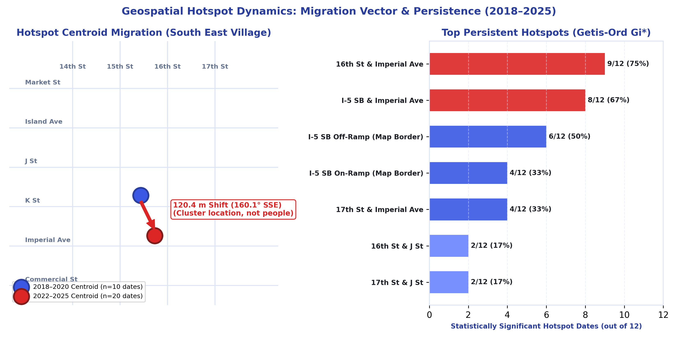
07
CLUSTER MIGRATION VECTOR
Hotspot Dynamics: 120m Southward Vector
DRIVERS OF CLUSTER DISPLACEMENT
• 120m Migration: Centroid shifted 120m SSE toward South East Village.
• Density Driven: Unweighted moved 62m; density and location both pull south.
• Enforcement Push: Sidewalk clearance in Gaslamp displaced clusters south.
• Spatial Shift: Reflects macro cluster movements, not individual tracking.
Data Science Alliance • Downtown San Diego Homeless Population Analysis • Sources: DSDP Field Counts & RTFH PIT
Slide 7 of 14

Slide 8
08
PREDICTIVE INTELLIGENCE
Machine Learning: 5-Fold CV Benchmark
5-Fold CV Performance
CORE FORECASTING TAKEAWAYS
• Horizons: SARIMA wins short-term (5.4% MAPE). XGBoost ties at 12-months (38.3%).
• Champion Model: XGBoost chosen for lowest error and strong 2025 hold-out (8.5%).
• Baseline Check: Naive seasonal performed well in 2025, proving baselines are critical.
• Prophet Failure: Prophet failed (64.2% error) as it missed the post-peak drop.
Model Architecture | 1-Month MAPE | 3-Month MAPE | 6-Month MAPE | 12-Month CV MAPE
SARIMA (ACF/PACF Grid) | 5.4% ± 4.1% | 14.3% ± 10.3% | 24.7% ± 20.9% | 39.6% ± 35.5%
Holt-Winters Exp Smooth | 13.0% ± 9.2% | 17.6% ± 10.4% | 25.2% ± 18.2% | 38.4% ± 28.5%
XGBoost (Champion) | 14.0% ± 8.9% | 19.9% ± 14.8% | 26.7% ± 18.5% | 38.3% ± 26.0%
Naive Seasonal (t−12) | 39.5% ± 31.9% | 40.1% ± 31.3% | 48.5% ± 35.4% | 51.7% ± 24.5%
Prophet (Changepoints) | 42.9% ± 26.0% | 42.7% ± 26.0% | 51.3% ± 31.9% | 64.2% ± 35.4%
Data Science Alliance • Downtown San Diego Homeless Population Analysis • Sources: DSDP Field Counts & RTFH PIT
Slide 8 of 14

Slide 9
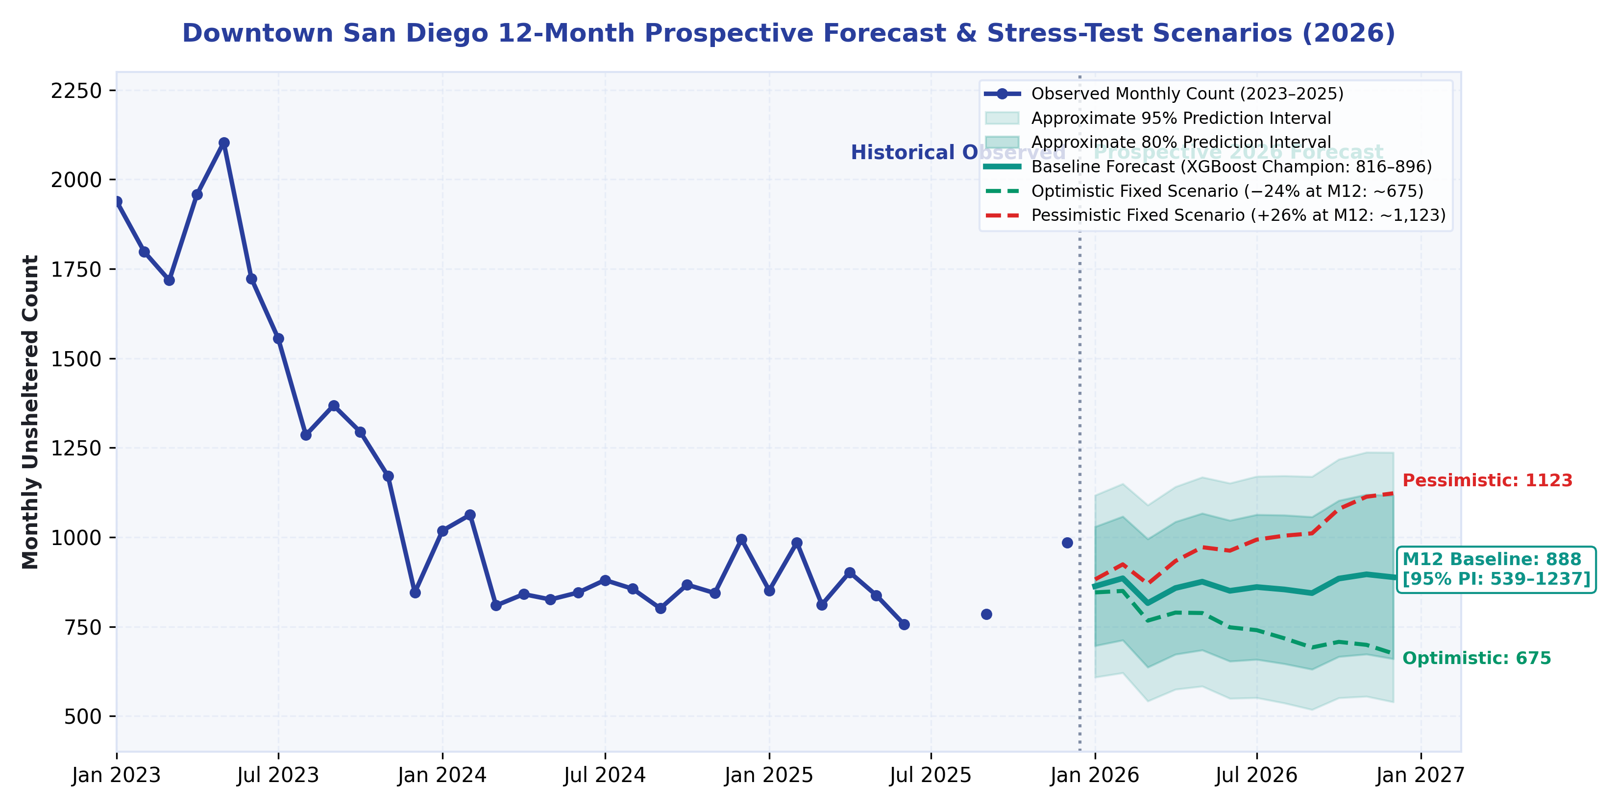
09
PROSPECTIVE FORECASTING
2026 Outlook: Stress-Testing Scenarios
PROSPECTIVE 2026 SCENARIOS
• Baseline: Expected to remain range-bound at 816–896 individuals.
• Stress-Tests: Fixed scenario paths, not causal policy models.
• Optimistic: ~675 individuals by Dec 2026 (favorable dynamics).
• Pessimistic: ~1,123 individuals by Dec 2026 (economic constraints).
• Range Planning: Plan using uncertainty bands, not single points.
Data Science Alliance • Downtown San Diego Homeless Population Analysis • Sources: DSDP Field Counts & RTFH PIT
Slide 9 of 14

Slide 10
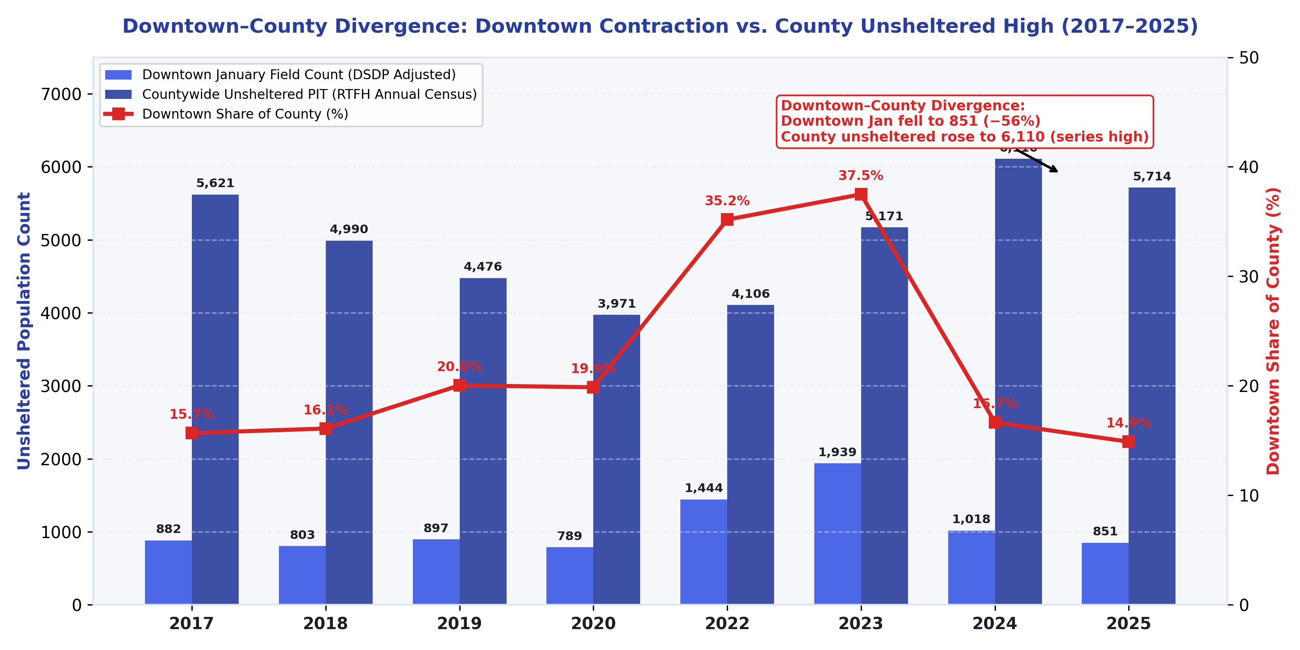
10
REGIONAL POLICY DYNAMICS
Regional Displacement: Downtown Drops vs County Highs
THE DISPLACEMENT REALITY
• Share Plunged: Downtown's share of county unsheltered fell to 14.9%.
• County Record: Countywide numbers reached 6,110 (2024) and 5,714 (2025).
• Displacement: Downtown drops align with regional spikes. The crisis moved.
• Data Limits: Reflects macro divergence, individual tracking is unavailable.
Data Science Alliance • Downtown San Diego Homeless Population Analysis • Sources: DSDP Field Counts & RTFH PIT
Slide 10 of 14

Slide 11
11
MACRO ECONOMETRICS & GOVERNANCE
Macro Model & 4 Communication Rules
POLICY REGIME OLS CHAMPION MODEL
• Ratio Rejected: Fixed ratios fail across policy regimes (ANOVA p=0.0002).
• Model Equation: Y = 4,513 + 0.186X + 1,225*D_post (Accounts for 2024/25).
• Diagnostics: R²=0.50. Slope and D_post are not strictly significant at 5%.
• Current Estimate: 5,900 [95% PI: 3,900 to 8,000]. Margin of error is ±35%.
THE 4 MANDATORY PUBLIC COMMUNICATION RULES
Rule 1: No False Precision
Stop using raw single points (e.g., '5,921'). It damages credibility.
Rule 2: Round to 100
Always round estimates to the nearest hundred.
Rule 3: Show 95% Interval
Mandate prediction ranges: '5,900 [3,900 to 8,000]'.
Rule 4: Disclose Regimes
Explicitly state assumptions (e.g., assumes post-2023 enforcement holds).
Data Science Alliance • Downtown San Diego Homeless Population Analysis • Sources: DSDP Field Counts & RTFH PIT
Slide 11 of 14

Slide 12
12
STRATEGIC RECOMMENDATIONS
Policy Roadmap: Recommendations (R1–R8)
IMMEDIATE (0–3 MONTHS)
Outreach & Governance
• R1. Hotspots: Target 16th-17th & Imperial for rapid outreach.
• R2. Range Planning: Enforce Rules 1-4 for all public numbers.
• R3. Boundary Clarity: Disclose 261 vs 382-block footprint metrics.
• Leaders: City Strategies, DSDP.
MEDIUM (6–12 MONTHS)
Data & Validation
• R4. Component Data: Mandate full tent/vehicle component reporting.
• R5. Displacement: Verify cross-border regional movement.
• R6. Retraining: Update OLS models with 2026 PIT data.
• R7. Shelter Data: Integrate real Housing Inventory Count (HIC).
LONG-TERM (1–3 YEARS)
Digitization & Infrastructure
• R8. Digitize Maps: Digitize remaining 78 monthly block maps.
• Regional HMIS: Unify real-time city and county bed tracking.
• True Evaluation: Measure regional outcomes, not just local clearing.
• Leaders: County HHS, RTFH, DSA.
Data Science Alliance • Downtown San Diego Homeless Population Analysis • Sources: DSDP Field Counts & RTFH PIT
Slide 12 of 14

Slide 13
13
OPERATIONAL DECISION TOOL
Interactive Decision-Support System: The Streamlit Executive Dashboard
7 DASHBOARD MODULES (TASK 9.1)
• Tab 1: History: Multi-year trends with policy epoch overlays.
• Tab 2: Forecast: 2026 projections, 95% fans, and stress-testing.
• Tab 3: Hotspots: Interactive Gi* maps and centroid migration.
• Tab 4: Regions: STL decomposition and seasonality stats.
• Tab 5: Calculator: OLS estimator enforcing the 4 Comm Rules.
• Tab 6: Methods: Multiplier transparency and boundary docs.
• Tab 7: Alerts: Control charts (CUSUM) for early-warnings.
DEPLOYMENT & ACCESS INFO
• Local URL: http://localhost:8501 (Fast response)
• Cloud URL: https://downtown-sd-homelessness.streamlit.app
• Quality Check: 46/46 unit tests passing.
• Performance: Sub-second caching via @st.cache_data.
• Audience: City Council, RTFH, DSDP operations.
Data Science Alliance • Downtown San Diego Homeless Population Analysis • Sources: DSDP Field Counts & RTFH PIT
Slide 13 of 14

Slide 14
14
SYNTHESIS & NEXT STEPS
Synthesis & Next Steps
FUND YEAR-ROUND
End Seasonal Budgeting
Data proves zero seasonality (p=0.995). Lock investments into permanent capacity and target South East Village hotspots.
ACKNOWLEDGE REALITY
Fix Divergence
Downtown drops pair with countywide highs (6,110). Stop localized displacement; demand countywide shelter collaboration.
DATA TRANSPARENCY
Digitize & Retrain
Digitize remaining 78 block maps. Annually retrain the OLS model for accuracy.
Data Science Alliance • Downtown San Diego Homeless Population Analysis • Sources: DSDP Field Counts & RTFH PIT
Slide 14 of 14

