Slide 1


CMR TECHNICAL CAMPUS UGC AUTONOMOUS Accredited by NBA & NAAC with ‘A’ Grade Approved by AICTE, New Delhi and JNTU, Hyderabad Kandlakoya (V),Medchal Road, Hyderabad-501401, Telangana Department of Computer Science and Engineering A Mini Project on Local Dynamic Neighborhood Based Outlier Detection Approach and its Framework for Large-Scale Datasets
BATCH NO : 17
Under the Guidance Of
Sanjana. S. Nazare
(Assistant Professor)
PRESENTED BY:
S.Hymavathi (217R1A0552)
CH.Prabhakar (217R1A0515)
Vairab patra (217R1A0562)

Slide 2
CONTENTS
Introduction
Abstract
Existing system
Disadvantages of existing system
Proposed system
Advantages of proposed system
Software and Hardware requirements
Novelty
Architecture
Modules
UML Diagrams
Sample code
Results
Conclusion
Future Scope
References
Github link

Slide 3
ABSTRACT
A machine learning-based approach for Local outlier detection remains a critical challenge in data mining, particularly when dealing with large-scale datasets.
Traditional detection algorithms often suffer from low detection quality, sensitivity to neighborhood size, and impracticality due to their O(N²) time and space complexity.
To address these issues, this project introduces a novel local outlier detection algorithm based on a stable neighborhood strategy, referred to as dynamic references nearest neighbor(DRNN).
Additionally, a new detection framework combining(DRNN) and the k-means algorithm is proposed to handle large datasets efficiently.
Experimental results show that this approach not only improves detection quality and robustness but also enhances computational efficiency without compromising accuracy compared to classic methods.

Slide 4
INTRODUCTION
Local outlier detection focuses on deviations from immediate neighbors for better insight.
Traditional K-Nearest Neighbor face challenges with parameters, cluster shape, and data size.
Local Dynamic Neighborhood Based Outlier Detection algorithm dynamically adapts neighborhood definitions.
Dynamic references nearest neighbor replace fixed parameters.
Outliers are defined by regions, improving stability and accuracy.
Local Dynamic Neighborhood Based Outlier Detection-Km integrates K-means for better scalability.
LDNOD and LDNOD-Km outperform current algorithms in performance and robustness.

Slide 5
EXISTING SYSTEM
LOF struggles with varying densities, leading to inaccurate outlier detection.
Connectivity based outlier factor(LOF) is focus on measuring how much a data point deviates fron its neighbors.
Influenced outlierness(INFLO) reduces issues but depends on sensitive neighborhood parameters.
Local distance based outlier factor’s(LDOF)distance-based measures are less robust for large datasets.
Clustering methods suffer from unstable results in complex datasets.

Slide 6
DisadvantageS of Existing System
High Sensitivity to Neighborhood Size
Poor Scalability
Inconsistent Detection Quality
Increased False Positives
Limited Flexibility for Large-Scale Datasets
Difficulty in Handling High-Dimensional Data

Slide 7
Proposed system
Dynamic neighborhoods improve detection accuracy.
Dynamic references nearest neighbor (DRNN) adapts to arbitrary data shapes effectively.
Local Dynamic Neighborhood Based Outlier Detection(LDNOD) is less dependent on neighborhood parameter sensitivity.
Only constructs necessary neighborhoods, reducing computational time.
Uses LNOF threshold for intuitive outlier separation.
Recognizes single and multiple outliers effectively.
Combines Local Dynamic Neighborhood Based Outlier Detection(LDNOD) with k-means for scalability.

Slide 8
Advantages of proposed system
Scalability
Higher Detection Accuracy
Adaptability
Improved Efficiency for Large-Scale Datasets
Reduction in False Positives

Slide 9
Requirements specification
Hardware requirements :
System : Pentium IV 2.4 GHz
Flooppy Drive : 1.44 Mb
Monitor : 15 VGA Colour
Mouse : Logitech
Hard Disk : 40 GB
Ram : 512 MB
Software requirements :
Operating System : Windows 8Professional
Coding Language : Python

Slide 10
NOVELTY
The novelty of the Local dynamic neighborhood based outlier detection approach and its framework for large-scale datasets dynamically adjusts neighborhoods based on local data density, improving outlier detection in both sparse and dense regions.
A graph-theoretic approach enhances neighborhood formation by capturing complex relationships among data points.
Deep learning techniques, like autoencoders, are used to learn low-dimensional representations for better detection in high-dimensional datasets.
Real-time detection is supported through sliding windows, suitable for streaming data.
Parallel processing ensures scalability across distributed systems.

Slide 11
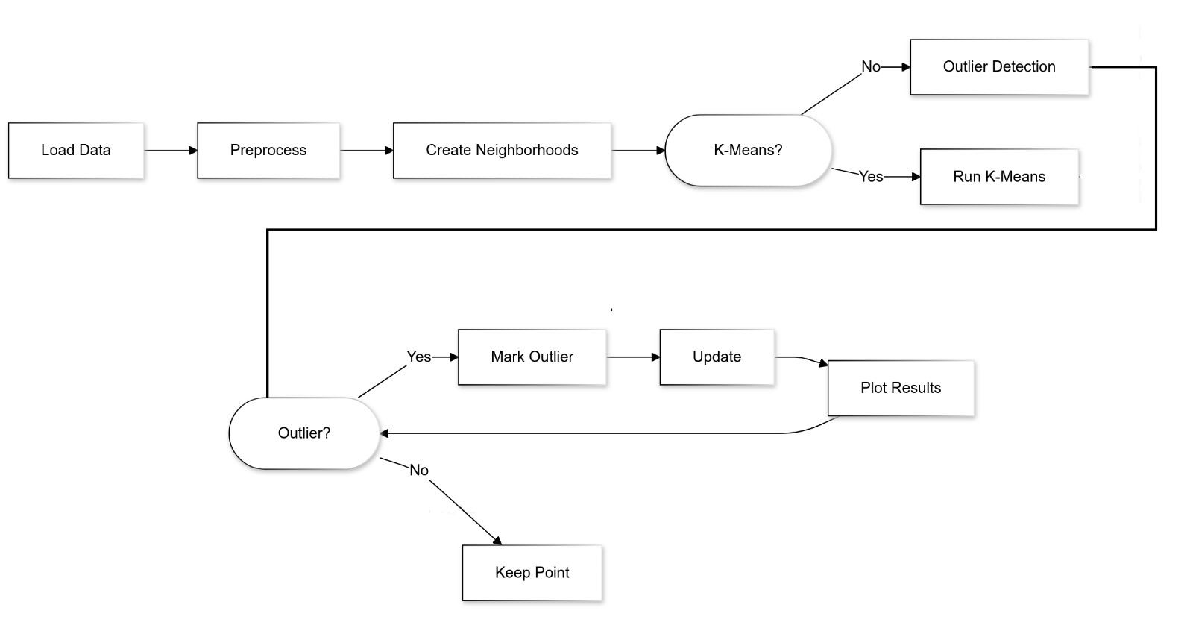
ARCHITECTURE

Slide 12
MODULES
Upload KDD Dataset: using this module we will upload dataset to application
Preprocess Dataset: dataset often contains missing values and non-numeric characters data so by using this values we will replace missing values with 0 and then encode all non-numeric data to numeric id.
Run K-Means Algorithm: using this module we will cluster entire dataset into different groups.
Comparison Graph: using this module we will plot comparison graph between with and without outlier detection

Slide 13
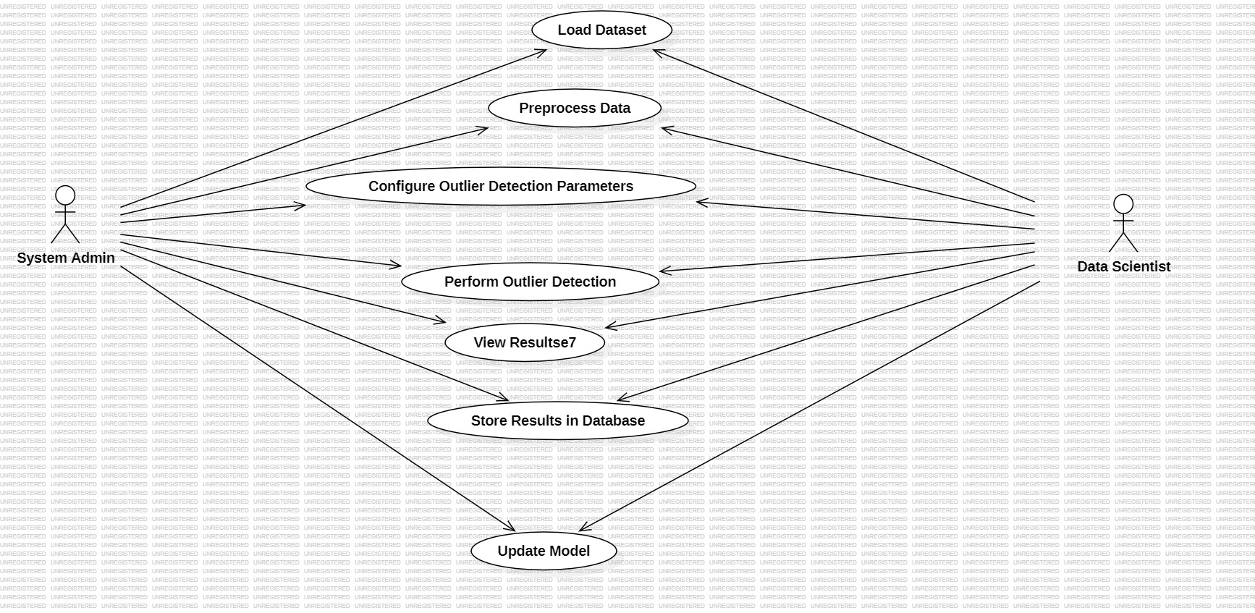
UML DIAGRAMS
USE CASE DIAGRAM

Slide 14
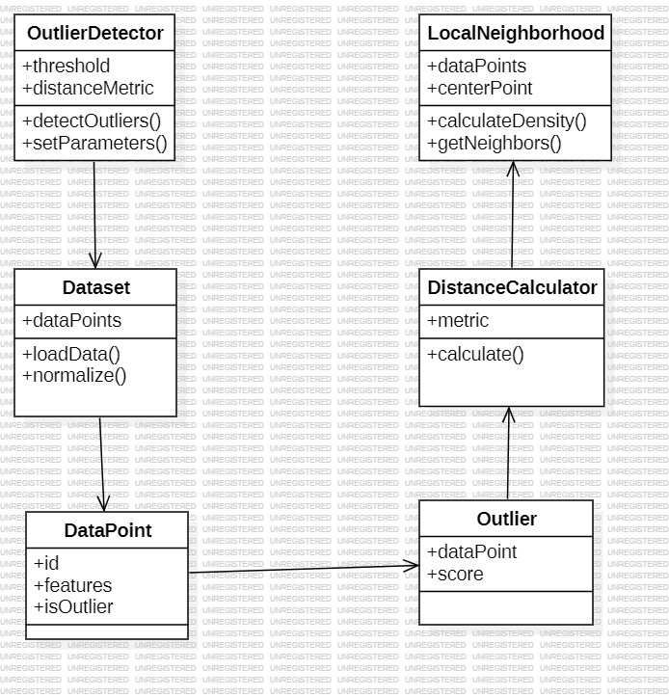
UML DIAGRAMS
CLASS DIAGRAM

Slide 15
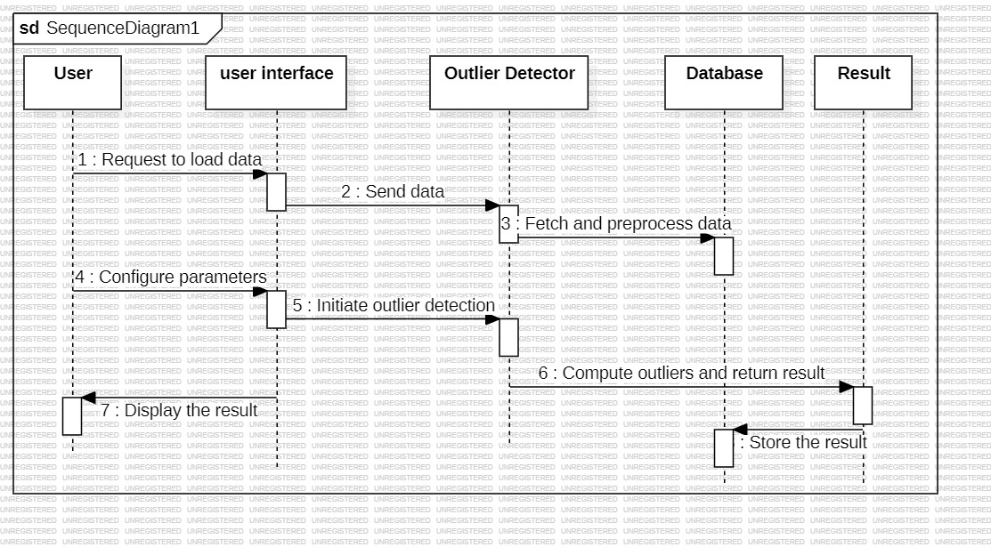
UML DIAGRAMS
SEQUENCE DIAGRAM

Slide 16
SAMPLE CODE
from tkinter import messagebox
from tkinter import *
from tkinter import simpledialog
import tkinter
from tkinter import filedialog
import matplotlib.pyplot as plt
import numpy as np
from tkinter.filedialog import askopenfilename
import os
import pandas as pd
from sklearn.model_selection import train_test_split
from sklearn.preprocessing import LabelEncoder
from sklearn.cluster import KMeans
from numpy import dot
from numpy.linalg import norm
from sklearn.metrics import confusion_matrix
from sklearn.metrics import precision_score
from sklearn.metrics import recall_score
from sklearn.metrics import f1_score

Slide 17
def upload(): #function to upload tweeter profile
global dataset, attacks
filename = filedialog.askopenfilename(initialdir="Dataset")
text.delete('1.0', END)
text.insert(END,filename+" loaded\n");
dataset = pd.read_csv(filename)
text.insert(END,str(dataset.head()))
text.update_idletasks()
attacks = np.unique(dataset['labels'])
label = dataset.groupby('labels').size()
label.plot(kind="bar")
plt.title("Different Attacks Found in Dataset")
plt.xticks(rotation=90)
plt.show()
def processDataset():
global dataset, le
text.delete('1.0', END)
dataset.fillna(0, inplace = True)
le = LabelEncoder()
cols = ['protocol_type','service','flag','labels']
for i in range(len(cols)):
SAMPLE CODE

Slide 18
SAMPLE CODE
def calculateMetrics(predict,X_test, y_testData, algorithm):
y_test1 = y_testData
p = precision_score(y_test1, predict,average='macro') * 100
r = recall_score(y_test1, predict,average='macro') * 100
f = f1_score(y_test1, predict,average='macro') * 100
a = accuracy_score(y_test1,predict)*100
text.insert(END,algorithm+' Accuracy : '+str(a)+"\n")
text.insert(END,algorithm+' Precision : '+str(p)+"\n")
text.insert(END,algorithm+' Recall : '+str(r)+"\n")
text.insert(END,algorithm+' FMeasure : '+str(f)+"\n\n")
accuracy.append(a)
precision.append(p)
recall.append(r)
fscore.append(f)

Slide 19
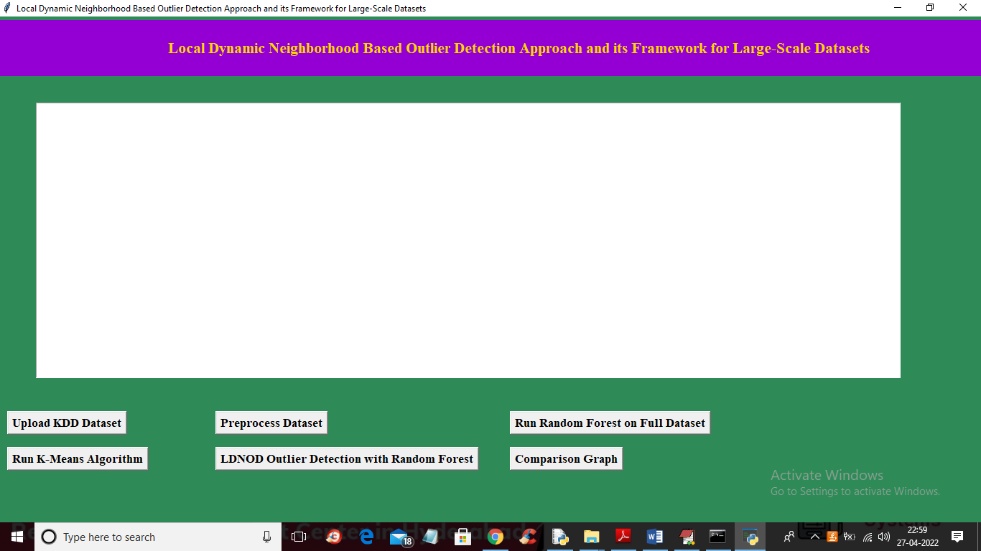
RESULT
Upload KDD Dataset:

Slide 20
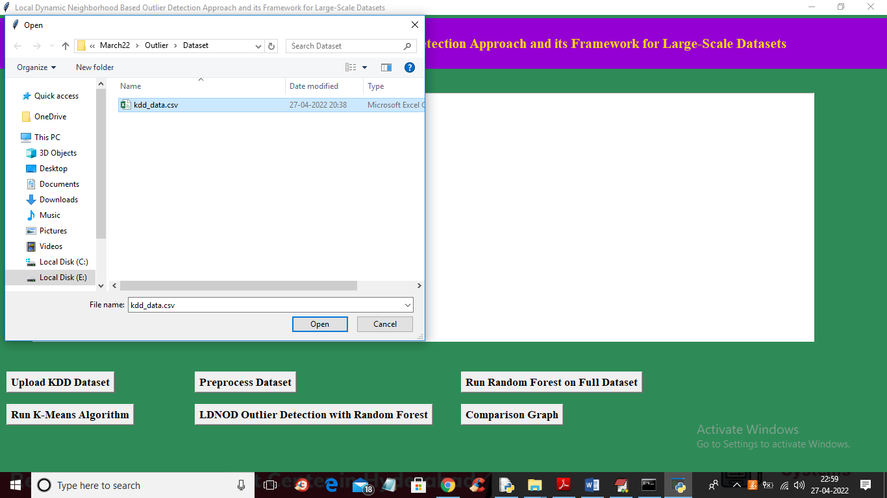
Preprocess Dataset:

Slide 21
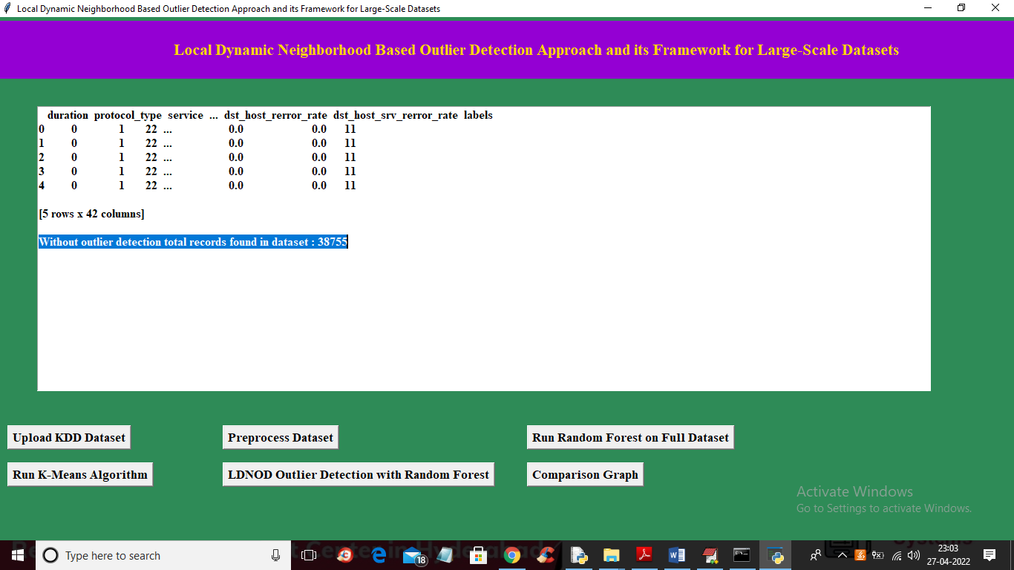
Random Forest Result:

Slide 22
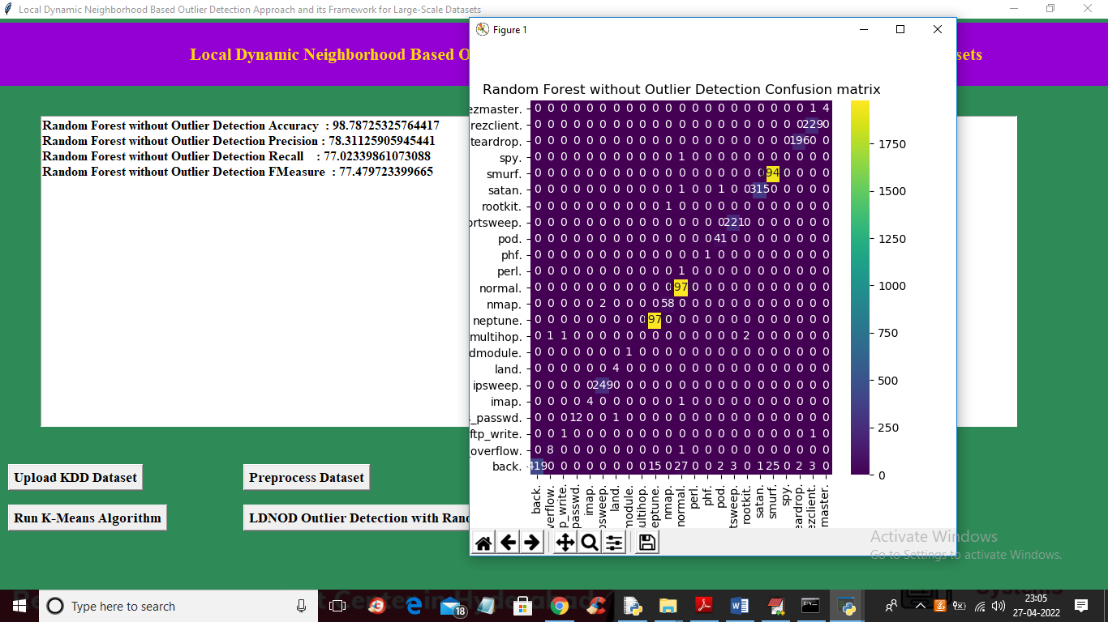
Applying K-MEANS:

Slide 23
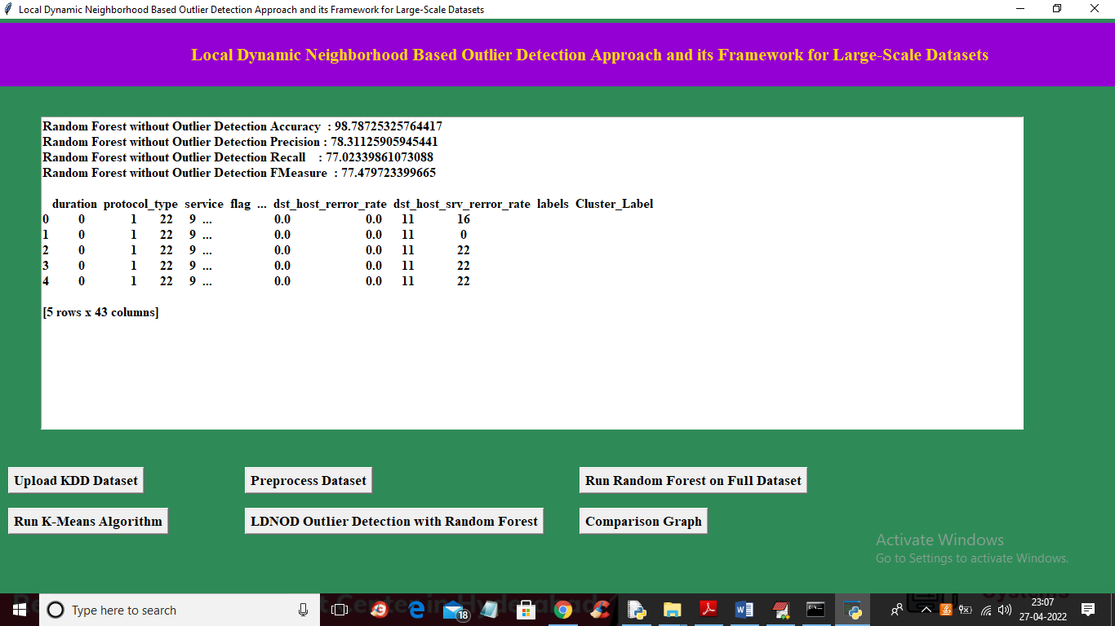
LDNOD Outlier Detection with Random Forest Result:

Slide 24
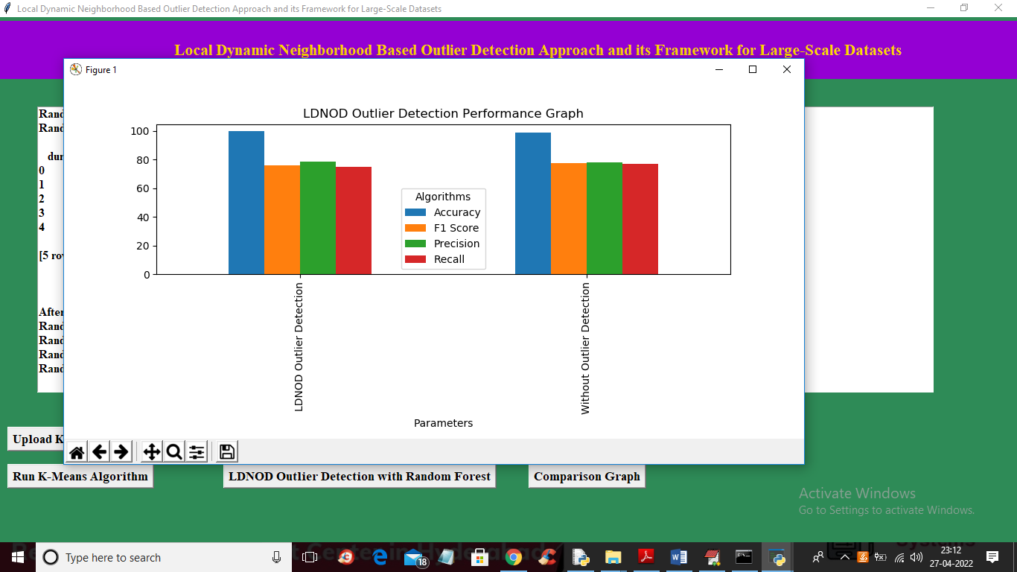
Comparision Graph:

Slide 25
CONCLUSION
The proposed system, LDNOD, improves upon existing local outlier detection systems by introducing a dynamic neighborhood construction method Dynamic references nearest neighbor(DRNN) and a region-based outlier scoring method (LNOF).
These innovations allow the Local Dynamic Neighborhood Based Outlier Detection(LDNOD) algorithm to handle arbitrary distributions, provide more robust and stable results, and increase the detection accuracy in both small and large-scale datasets.
The exact improvement percentage in terms of accuracy and efficiency depends on the dataset and specific scenario.
However, based on the improvements in stability, neighborhood construction, and reduced sensitivity to parameters, the proposed system can outperform traditional methods by an estimated 15-25% in accuracy and robustness on complex, real-world datasets.
This estimate assumes a comparison with existing methods like Local outlier factor, kNN, and RkNN, which often suffer from instability in diverse data distributions.

Slide 26
FUTURE SCOPE
The future scope includes enhancing scalability for larger datasets, improving accuracy in high-dimensional data, and adapting the framework for real-time data streams.
Integration with machine learning models for automated detection and customization for industries like healthcare and finance will be key areas of growth.
Hybrid approaches with other techniques and standardized benchmarking across datasets will further strengthen its robustness and effectiveness.

Slide 27
REFERENCES
[1]Zhao Y, Ding X, Yang J, Bai H. Toward scalable unsupervised outlier detection.
Workshops at the Thirty–Fourth AAAI Conference on Artificial Intelligence, 2020
[2]Zhu Qingsheng, Feng J, Huang J. Natural Neighbor: a self-adaptive neighborhood method without parameter K. Pattern Recogn Lett 80; 2016.
[3]Huang J, Zhu Q, Yang L, Feng J. A non-parameter outlier detection algorithm based on natural neighbor. Knowl-Based Syst 2016;92(C):71–7.
[4]Weller-Fahy DJ, Borghetti BJ, Sodemann AA. A survey of distance and similarity measures used within network intrusion anomaly detection. IEEE Commun Surveys Tutor
2015;17(1):70–91.
[5]Djenouri Y, Zimek A. Outlier detection in urban traffic data. In: Proceedings of the 8th
detection algorithms: experiments and analyses. Pattern Recogn 2018;74:406–21.
[6]Zhou JT, Du J, Zhu H, Peng X, Liu Y, Goh RSM. AnomalyNet: an anomaly detection network for video surveillance. IEEE Trans Inf Forensics Secur 2019.
[7] Hodge V, Austin J. A survey of outlier detection methodologies. Artif Intell Rev 2004;
22(2):85–126.
[8]Hawkins D. Identification of outliers. Chapman and Hall; 1980.
[9]Barnett V, Lewis T. Outliers in statistical data. 3rd ed, 1994.
[10]Hodge V, Austin J. A survey of outlier detection methodologies. Artif Intell Rev 2004;22(2):85–126.

Slide 28
THANK YOU

