Slide 1
The Evolution of Superconducting Qubits
From the Cooper Pair Box to the Xmon

Slide 2

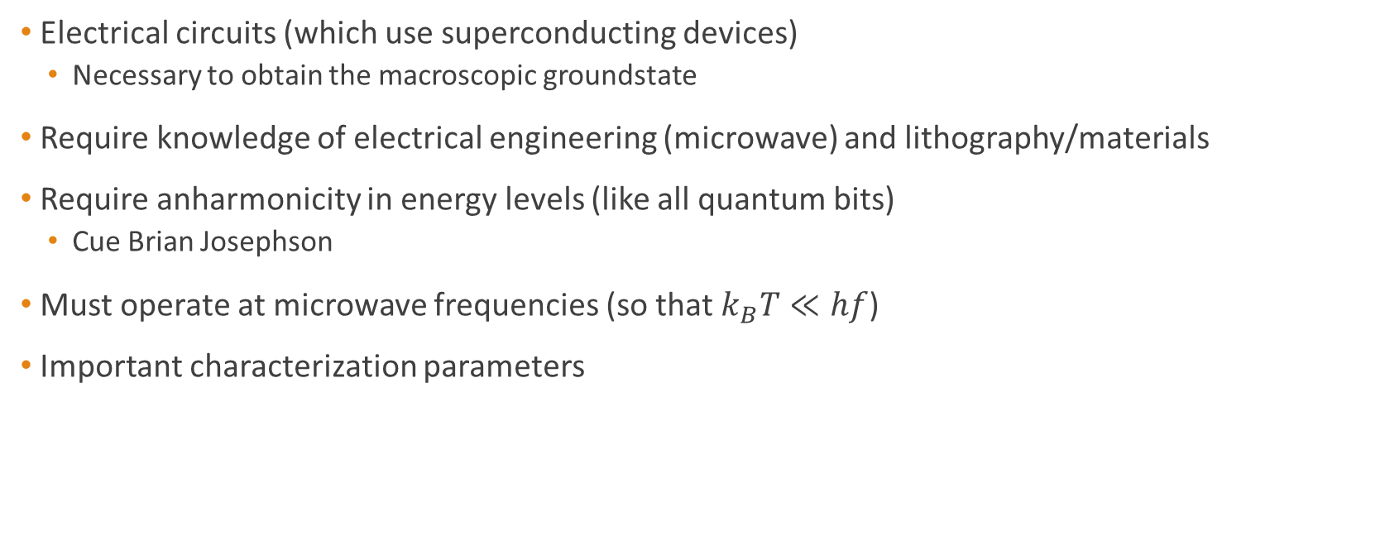

Superconducting Qubits Overview
Electrical circuits (which use superconducting devices)
Necessary to obtain the macroscopic groundstate
Require knowledge of electrical engineering (microwave) and lithography/materials
Require anharmonicity in energy levels (like all quantum bits)
Cue Brian Josephson
Must operate at microwave frequencies (so that $k_{B}T≪hf$)
Important characterization parameters
$$\frac{E_{J}}{E_{c}} , T_{1} , T_{2} , T_{2}^{∗}$$
$E_{J}≡\frac{I_{0}Φ_{0}}{2π}$ , $E_{c}≡\frac{{\left(2e\right)}^{2}}{2C}$

Slide 3
Evolution of Superconducting Qubits
1999
Nakamura designs and measures the quantum state of a Cooper Pair Box. [1]
2003
Chiorescu designs and measures the quantum state of a flux qubit.[3]
2013
Barends et. al. design, measure and characterize the first crossmon. [6]
1962
B.J. predicts the
Josephson Effect [7]
1962
Anderson and Rowell
measure and patent the Josephson Effect [8]
2002
Martinis designs and measures the performance of a large Josephson-junction qubit (phase qubit). [2]
2007
Koch, et. al. design and measure the first transmon reporting “drastically improved” decoherence times [5]

Slide 4
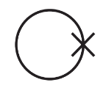
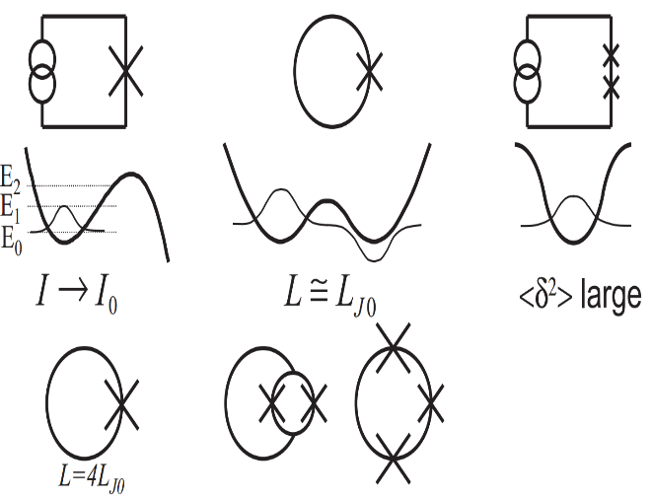
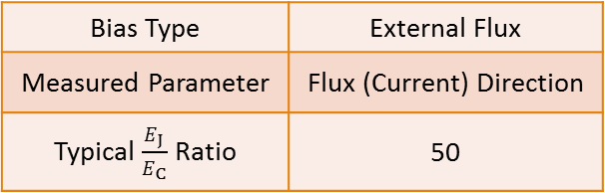
Flux Qubits
Circuit Schematic
Potential Diagram
Bias Type | External Flux
Measured Parameter | Flux (Current) Direction
Typical $\frac{E_{J}}{E_{C}}$Ratio | 50

Slide 5

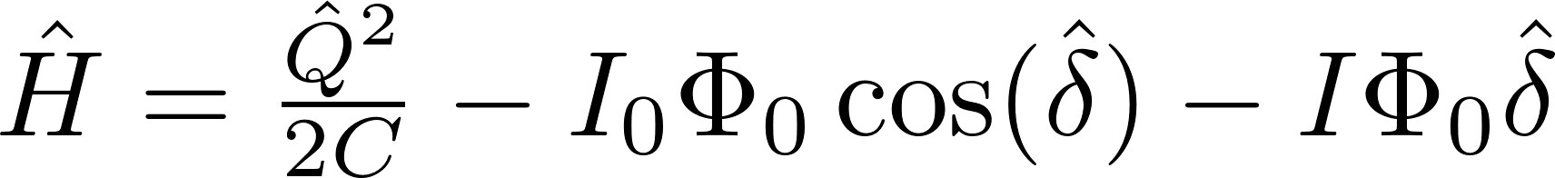
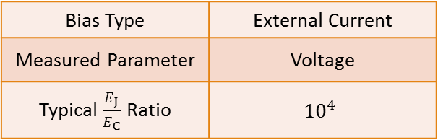
Phase Qubits
Circuit Schematic
Potential Diagram
Bias Type | External Current
Measured Parameter | Voltage
Typical $\frac{E_{J}}{E_{C}}$Ratio | $${10}^{4}$$

Slide 6
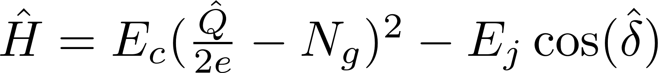
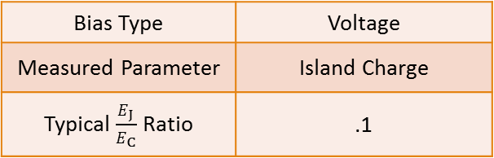
Charge Qubit (Cooper Pair Box)
Circuit Schematic
Potential Diagram
Bias Type | Voltage
Measured Parameter | Island Charge
Typical $\frac{E_{J}}{E_{C}}$Ratio | .1

Slide 7
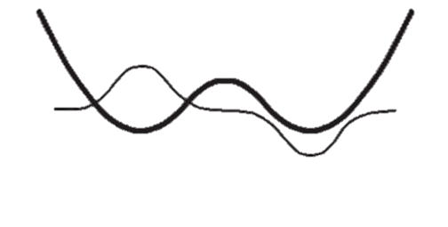
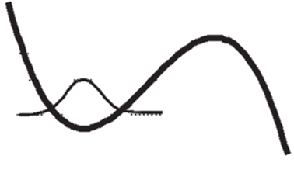

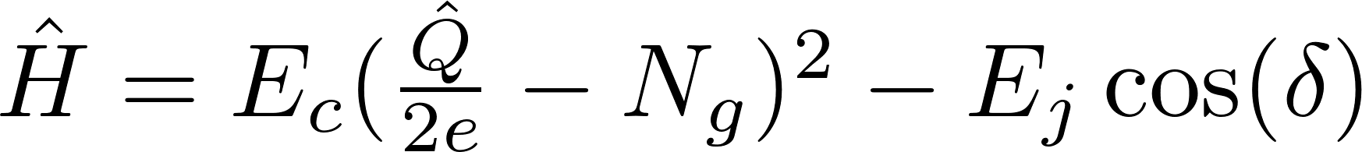
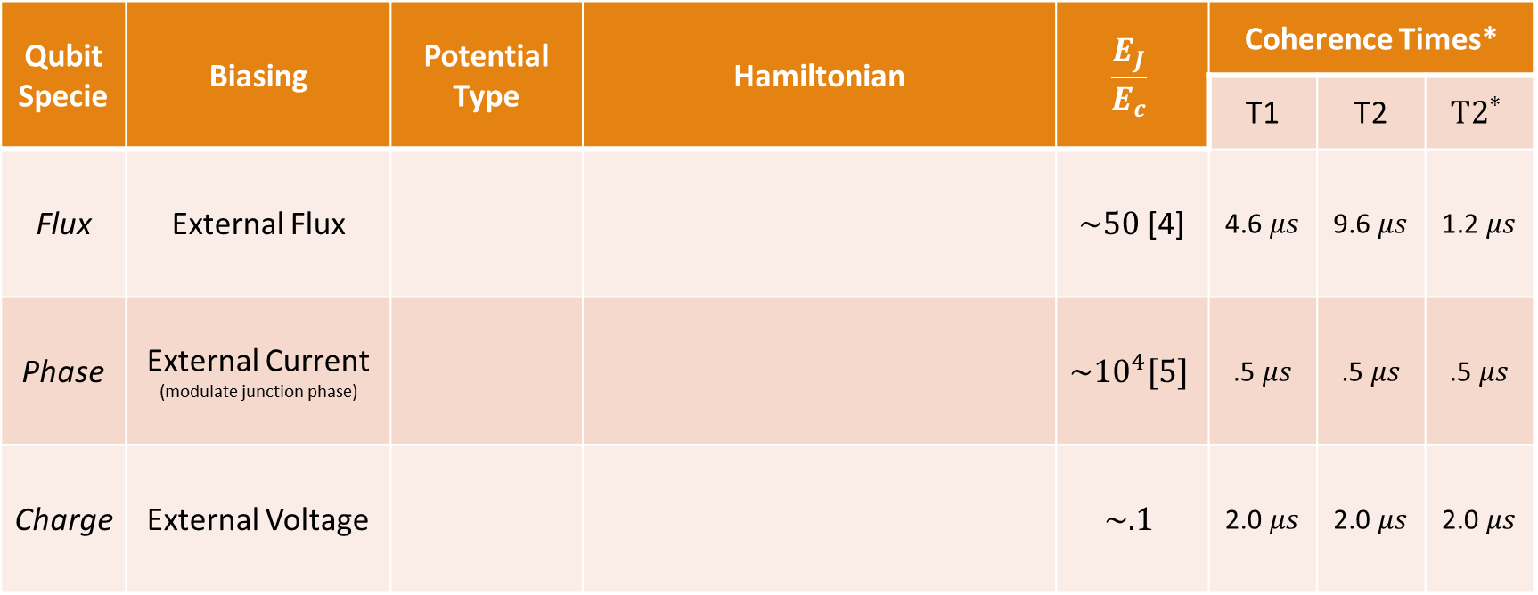
Overview of the Main Three
Qubit Specie | Biasing | Potential Type | Hamiltonian | $$\frac{E_{J}}{E_{c}}$$ | Coherence Times*
 |  |  |  |  | T1 | T2 | $${T2}^{∗}$$
Flux | External Flux |  |  | $\sim 50$[4] | 4.6 $μs$ | 9.6 $μs$ | 1.2 $μs$
Phase | External Current (modulate junction phase) |  |  | $${\sim 10}^{4}[5]$$ | .5 $μs$ | .5 $μs$ | .5 $μs$
Charge | External Voltage |  |  | $$\sim .1$$ | 2.0 $μs$ | 2.0 $μs$ | 2.0 $μs$
Double-Well
Tilted Washboard
Anticrossing
* Values obtained from Reference [4]

Slide 8
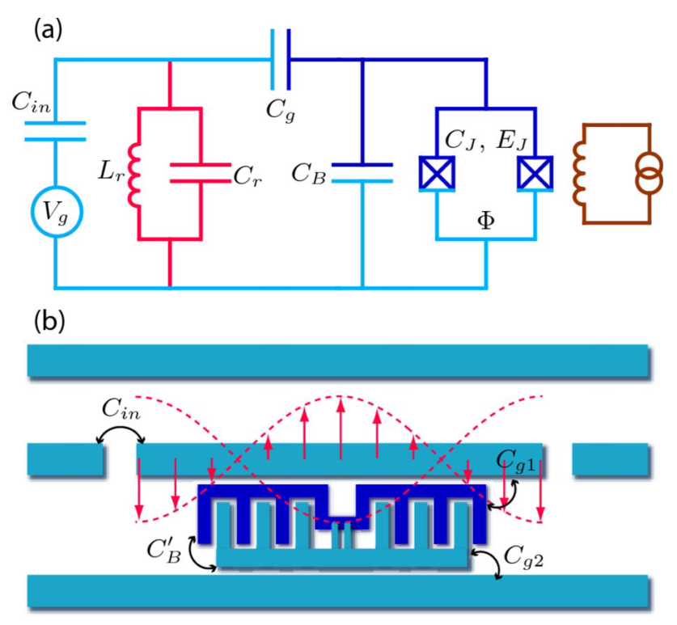
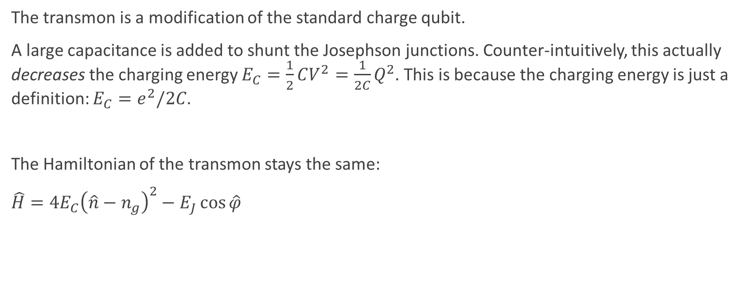
The Transmon
The transmon is a modification of the standard charge qubit.
A large capacitance is added to shunt the Josephson junctions. Counter-intuitively, this actually decreases the charging energy $E_{C}=\frac{1}{2}CV^{2}=\frac{1}{2C}Q^{2}$. This is because the charging energy is just a definition: $E_{C}=e^{2}/2C$.
The Hamiltonian of the transmon stays the same:
$\hat{H}=4E_{C}{\left(\hat{n}−n_{g}\right)}^{2}−E_{J}\cos{\hat{φ}}$
Koch, J. et al. Charge-insensitive qubit design derived from the Cooper pair box. Phys. Rev. A 76, 042319 (2007).

Slide 9
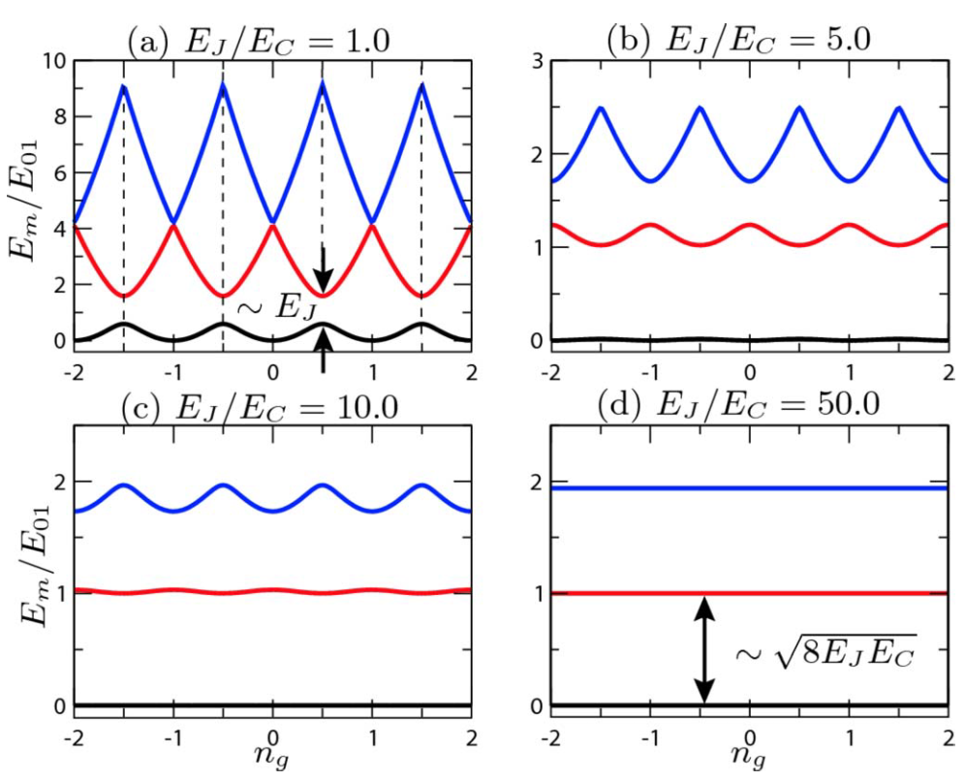
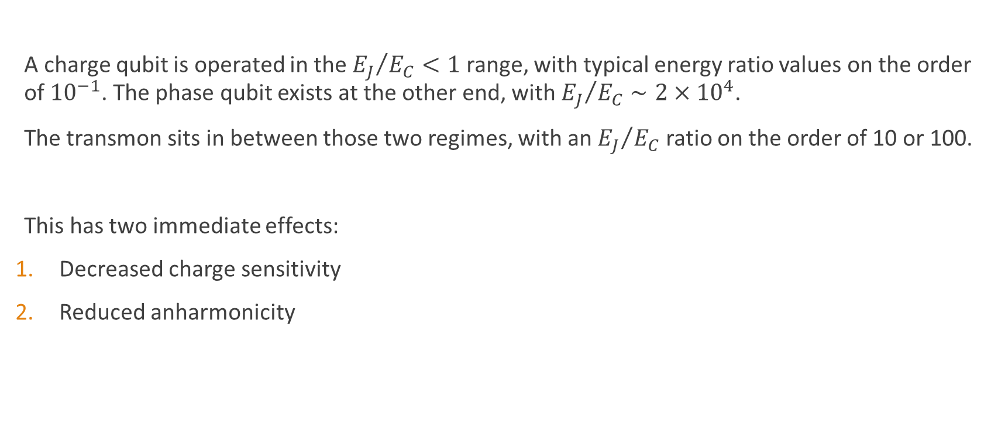
A New Regime
A charge qubit is operated in the ${E_{J}}/{E_{C}}<1$ range, with typical energy ratio values on the order of ${10}^{−1}$. The phase qubit exists at the other end, with ${E_{J}}/{E_{C}}∼2×{10}^{4}$.
The transmon sits in between those two regimes, with an ${E_{J}}/{E_{C}}$ ratio on the order of 10 or 100.
This has two immediate effects:
Decreased charge sensitivity
Reduced anharmonicity
Koch, J. et al. Charge-insensitive qubit design derived from the Cooper pair box. Phys. Rev. A 76, 042319 (2007).

Slide 10

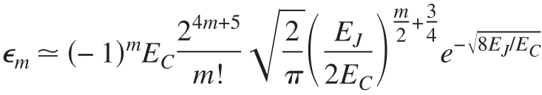
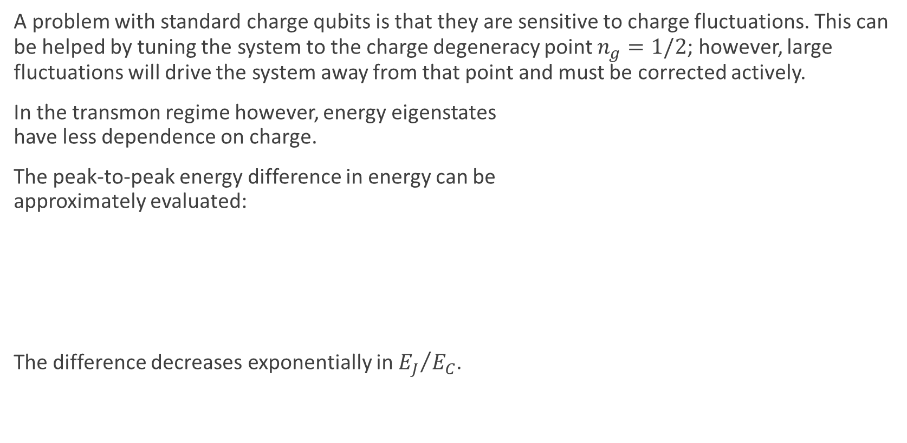
Decreased Charge Sensitivity
A problem with standard charge qubits is that they are sensitive to charge fluctuations. This can be helped by tuning the system to the charge degeneracy point $n_{g}=1/2$; however, large fluctuations will drive the system away from that point and must be corrected actively.
In the transmon regime however, energy eigenstates have less dependence on charge.
The peak-to-peak energy difference in energy can be approximately evaluated:
The difference decreases exponentially in ${E_{J}}/{E_{C}}$.
Koch, J. et al. Charge-insensitive qubit design derived from the Cooper pair box. Phys. Rev. A 76, 042319 (2007).

Slide 11
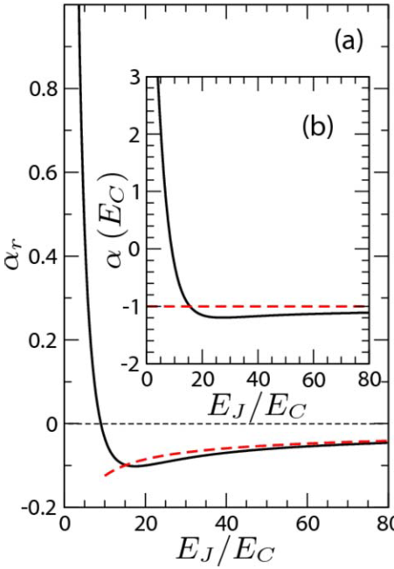


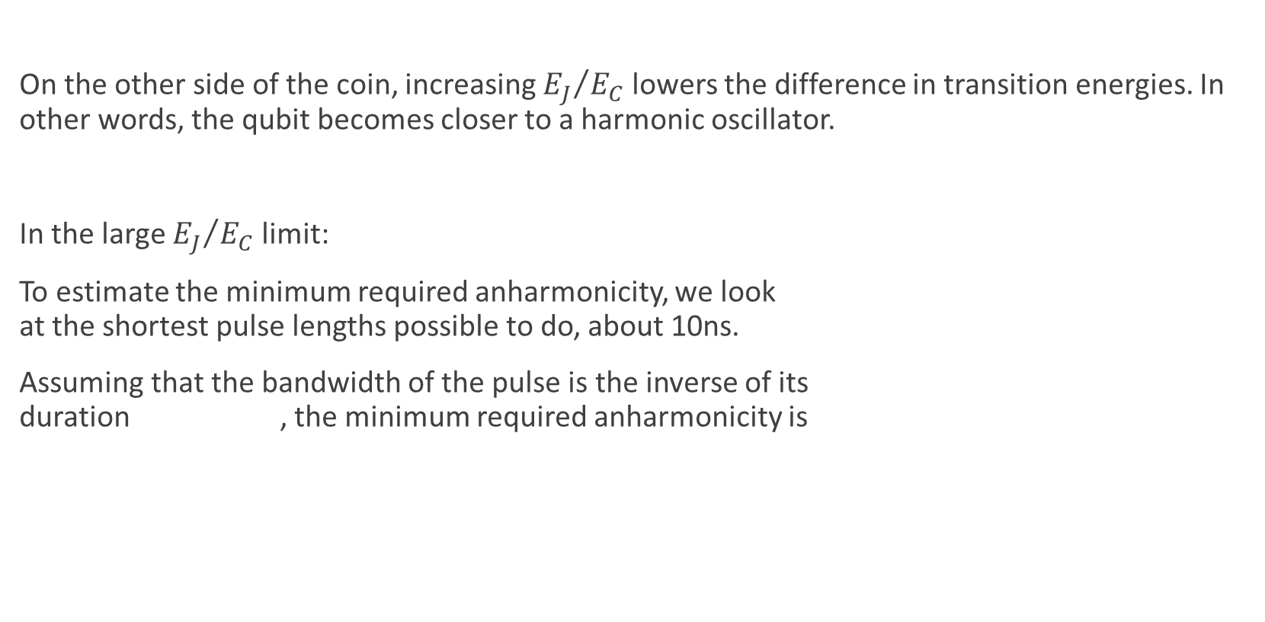
Reduced Anharmonicity
On the other side of the coin, increasing ${E_{J}}/{E_{C}}$ lowers the difference in transition energies. In other words, the qubit becomes closer to a harmonic oscillator.
In the large ${E_{J}}/{E_{C}}$ limit:
To estimate the minimum required anharmonicity, we look at the shortest pulse lengths possible to do, about 10ns.
Assuming that the bandwidth of the pulse is the inverse of its duration , the minimum required anharmonicity is
Koch, J. et al. Charge-insensitive qubit design derived from the Cooper pair box. Phys. Rev. A 76, 042319 (2007).

Slide 12
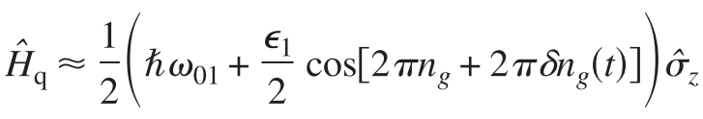

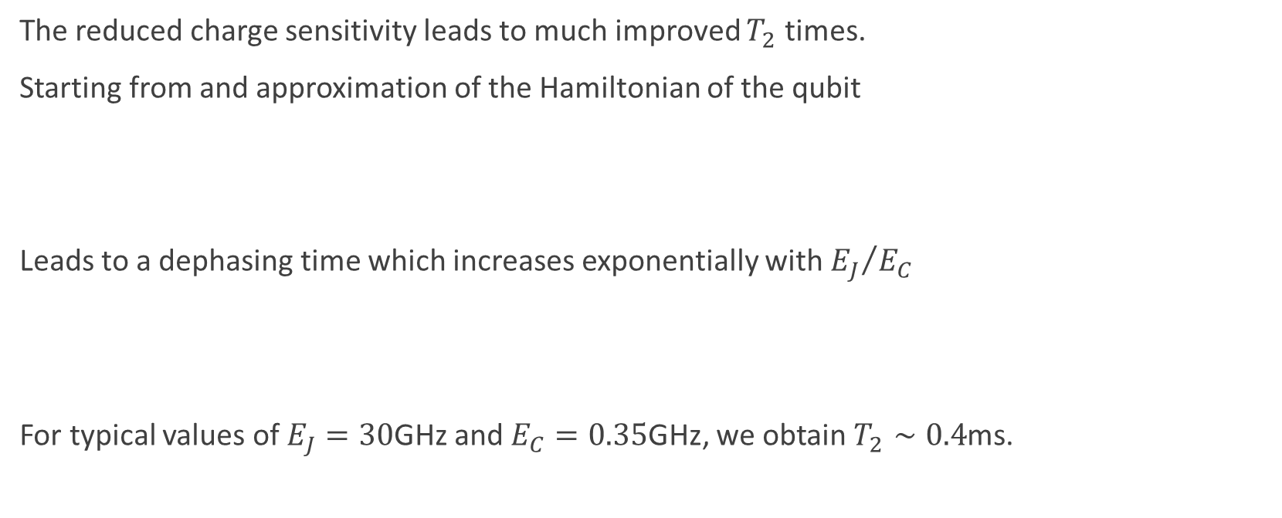
Longer Dephasing Times
The reduced charge sensitivity leads to much improved $T_{2}$ times.
Starting from and approximation of the Hamiltonian of the qubit
Leads to a dephasing time which increases exponentially with ${E_{J}}/{E_{C}}$
For typical values of $E_{J}=30$GHz and $E_{C}=0.35$GHz, we obtain $T_{2}∼0.4$ms.
Koch, J. et al. Charge-insensitive qubit design derived from the Cooper pair box. Phys. Rev. A 76, 042319 (2007).

Slide 13
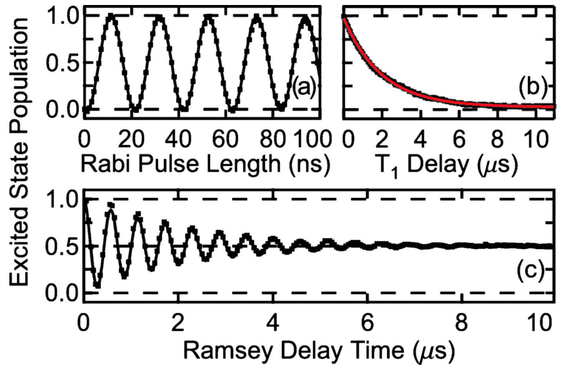
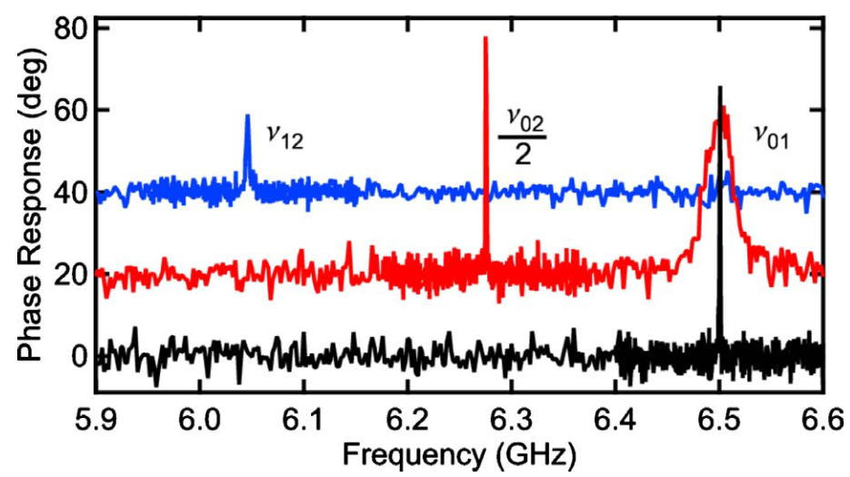

Measurements
The first decoherence measurements of transmon qubits were made by Schreier et al. in 2008. They reported a $T_{1}=1.87±0.02μs$ and $T_{2}^{∗}=2.22±0.03μs$.
More recently, in 2012, Chow et al. measured $T_{1}$ and $T_{2}$ on the order of 10 $μs$.
Schreier, J. et al. Suppressing charge noise decoherence in superconducting charge qubits. Phys. Rev. B 77, 180502 (2008).
Chow, J. M. et al. Universal Quantum Gate Set Approaching Fault-Tolerant Thresholds with Superconducting Qubits. Phys. Rev. Lett. 109, 060501 (2012).

Slide 14
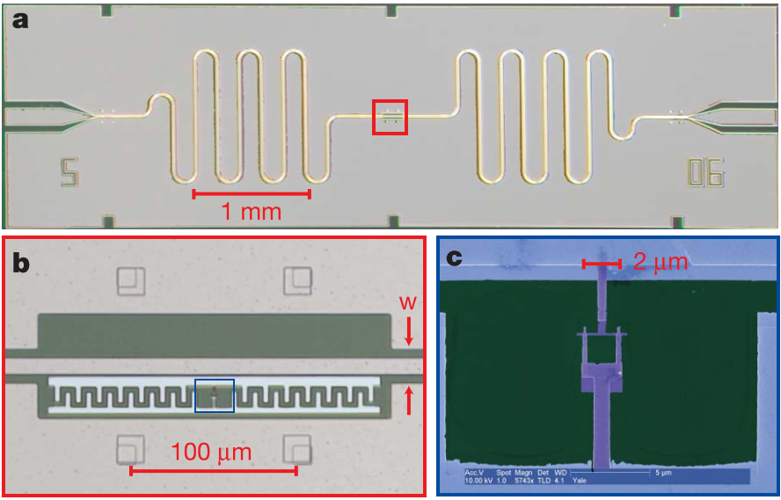
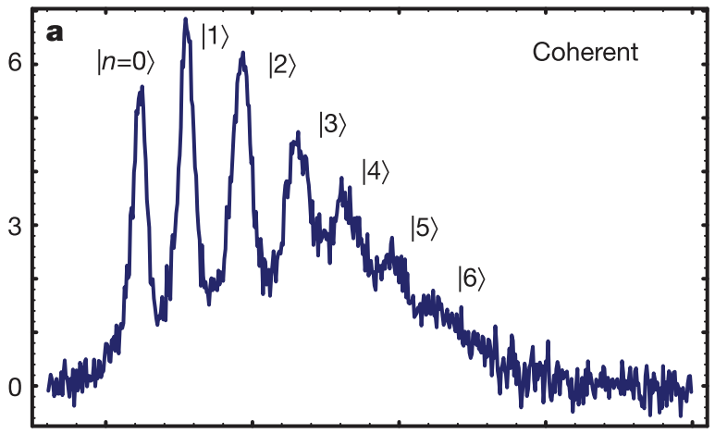
More Measurements
Schuster, D. I. et al. Resolving photon number states in a superconducting circuit. Nature 445, 515–8 (2007).

Slide 15
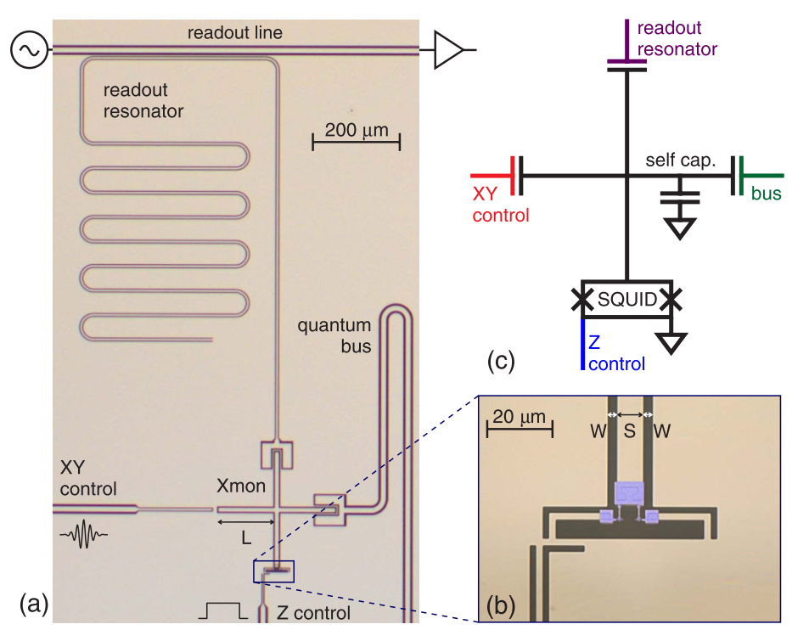
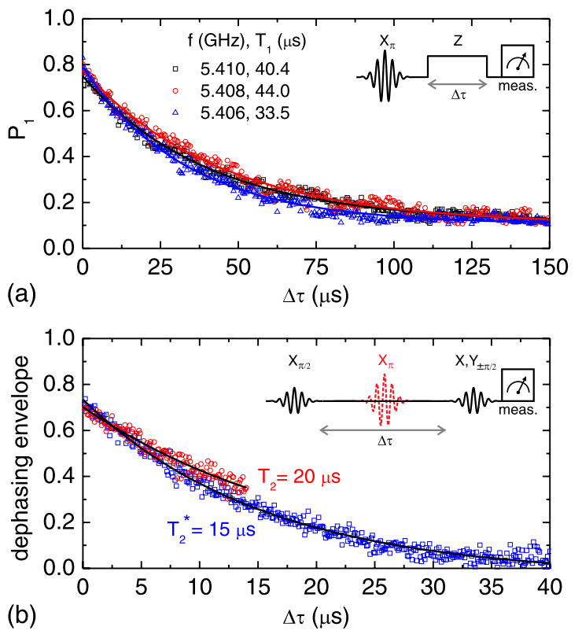
The (Not-So-Distant) Future
In 2013, Barends et al. demonstrated a variation of the transmon, the crossmon. They reported relaxation times on the order of 40 microseconds!
Barends, R. et al. Coherent Josephson Qubit Suitable for Scalable Quantum Integrated Circuits. Phys. Rev. Lett. 111, 080502 (2013).

Slide 16
References
Nakamura, Y., Pashkin, Y. A. & Tsai, J. S. Coherent control of macroscopic quantum states in a single-Cooper-pair box. Nature 398, 786–788 (1999).
Cottet, A. et al. Implementation of a combined charge-phase quantum bit in a superconducting circuit. Physics C: Superconductivity 367, 197–203 (2002).
Chiorescu, I., Nakamura, Y., Harmans, C. J. P. M. & Mooij, J. E. Coherent Quantum Dynamics of a Superconducting Flux Qubit. Science 299 , 1869–1871 (2003).
Clarke, J. & Wilhelm, F. K. Superconducting quantum bits. Nature 453, 1031–1042 (2008).
Koch, J. et al. Charge-insensitive qubit design derived from the Cooper pair box. Physical Review A 76, 42319 (2007).
Barends, R. et al. Coherent Josephson Qubit Suitable for Scalable Quantum Integrated Circuits. Phys. Rev. Lett. 111, 080502 (2013).
Josephson, B. D. Possible new effects in superconductive tunnelling. Physics Letters 1, 251–253 (1962).
Anderson, P. W. & Rowell, J. M. Probable Observation of the Josephson Superconducting Tunneling Effect. Phys. Rev. Lett. 10, 230–232 (1963).
Schreier, J. et al. Suppressing charge noise decoherence in superconducting charge qubits. Phys. Rev. B 77, 180502 (2008).
Chow, J. M. et al. Universal Quantum Gate Set Approaching Fault-Tolerant Thresholds with Superconducting Qubits. Phys. Rev. Lett. 109, 060501 (2012).
Schuster, D. I. et al. Resolving photon number states in a superconducting circuit. Nature 445, 515–8 (2007).

