Slide 1
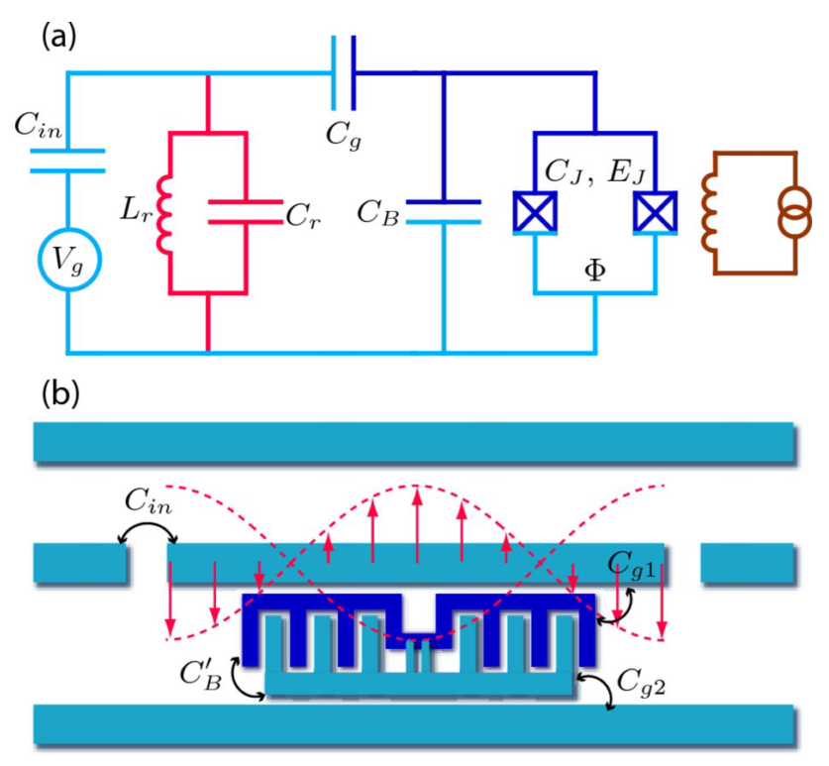
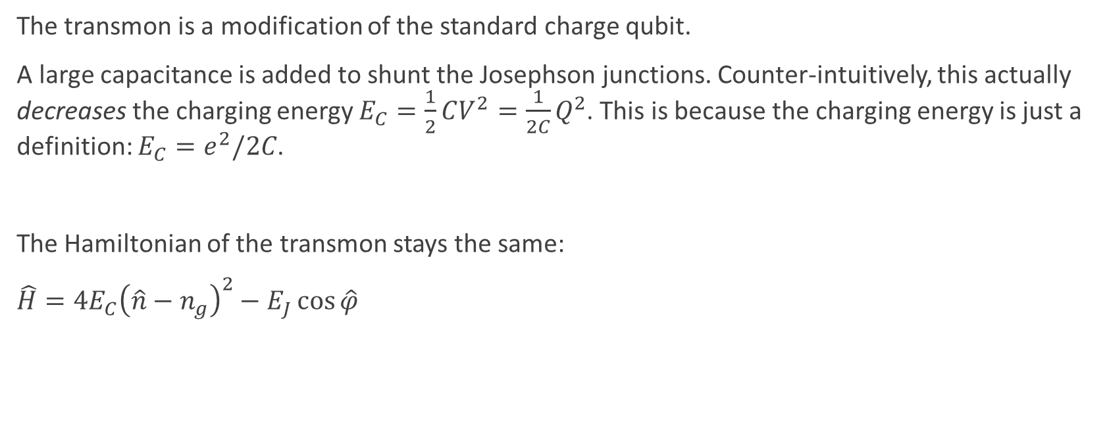
The Transmon
The transmon is a modification of the standard charge qubit.
A large capacitance is added to shunt the Josephson junctions. Counter-intuitively, this actually decreases the charging energy $E_{C}=\frac{1}{2}CV^{2}=\frac{1}{2C}Q^{2}$. This is because the charging energy is just a definition: $E_{C}=e^{2}/2C$.
The Hamiltonian of the transmon stays the same:
$\hat{H}=4E_{C}{\left(\hat{n}−n_{g}\right)}^{2}−E_{J}\cos{\hat{φ}}$
Koch, J. et al. Charge-insensitive qubit design derived from the Cooper pair box. Phys. Rev. A 76, 042319 (2007).

Slide 2
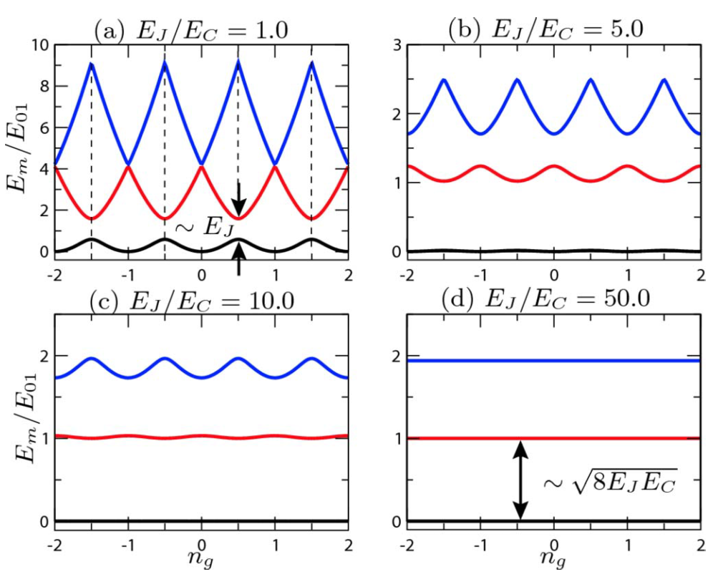
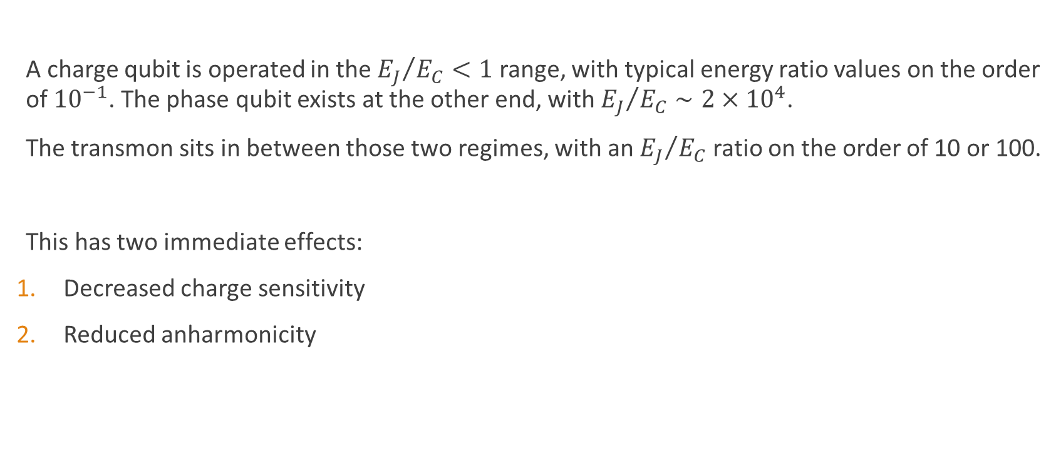
A New Regime
A charge qubit is operated in the ${E_{J}}/{E_{C}}<1$ range, with typical energy ratio values on the order of ${10}^{−1}$. The phase qubit exists at the other end, with ${E_{J}}/{E_{C}}∼2×{10}^{4}$.
The transmon sits in between those two regimes, with an ${E_{J}}/{E_{C}}$ ratio on the order of 10 or 100.
This has two immediate effects:
Decreased charge sensitivity
Reduced anharmonicity
Koch, J. et al. Charge-insensitive qubit design derived from the Cooper pair box. Phys. Rev. A 76, 042319 (2007).

Slide 3

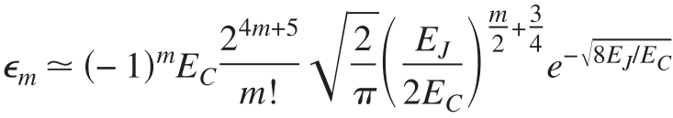
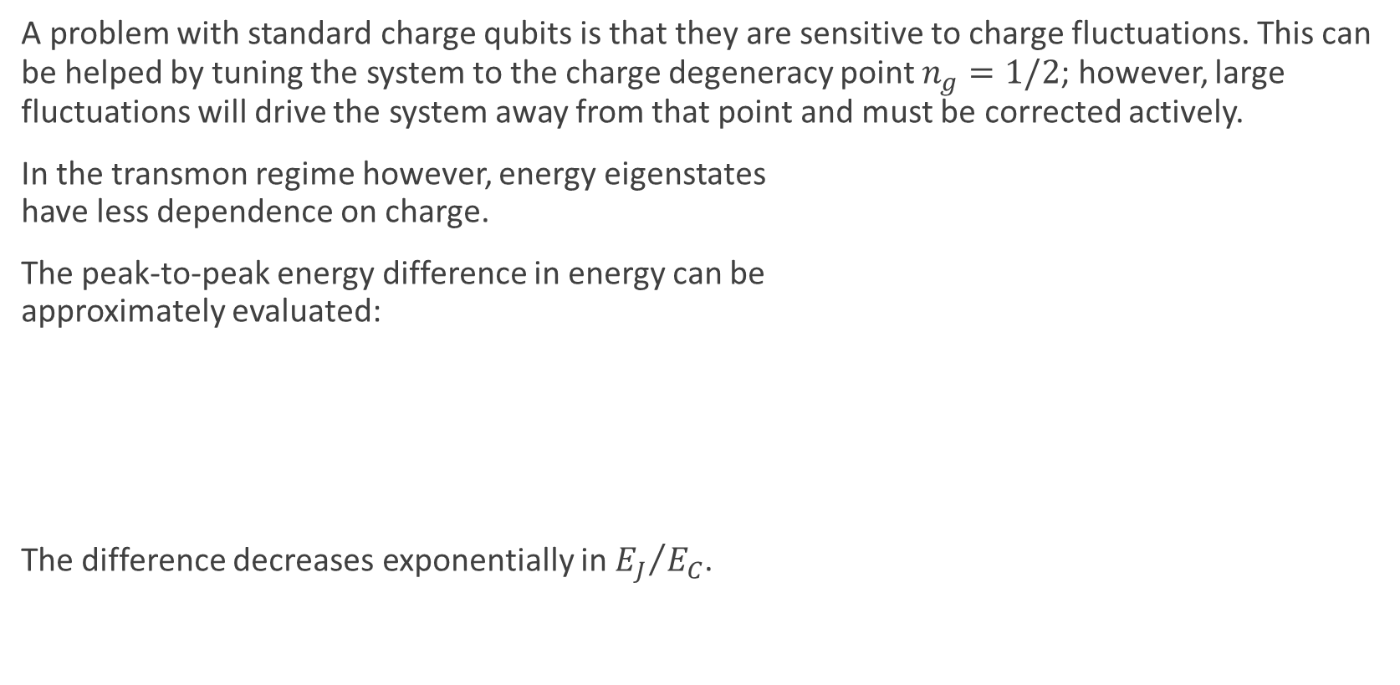
Decreased Charge Sensitivity
A problem with standard charge qubits is that they are sensitive to charge fluctuations. This can be helped by tuning the system to the charge degeneracy point $n_{g}=1/2$; however, large fluctuations will drive the system away from that point and must be corrected actively.
In the transmon regime however, energy eigenstates have less dependence on charge.
The peak-to-peak energy difference in energy can be approximately evaluated:
The difference decreases exponentially in ${E_{J}}/{E_{C}}$.
Koch, J. et al. Charge-insensitive qubit design derived from the Cooper pair box. Phys. Rev. A 76, 042319 (2007).

Slide 4
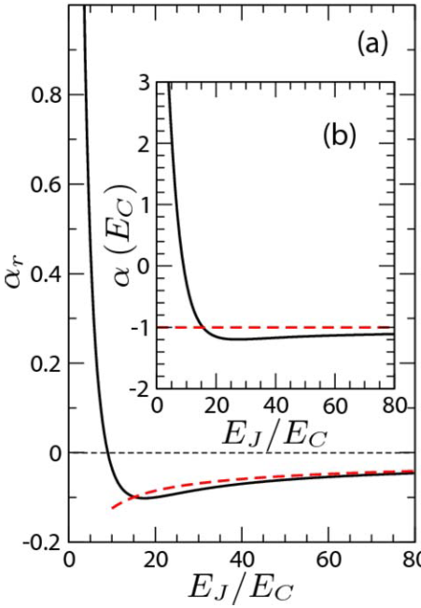


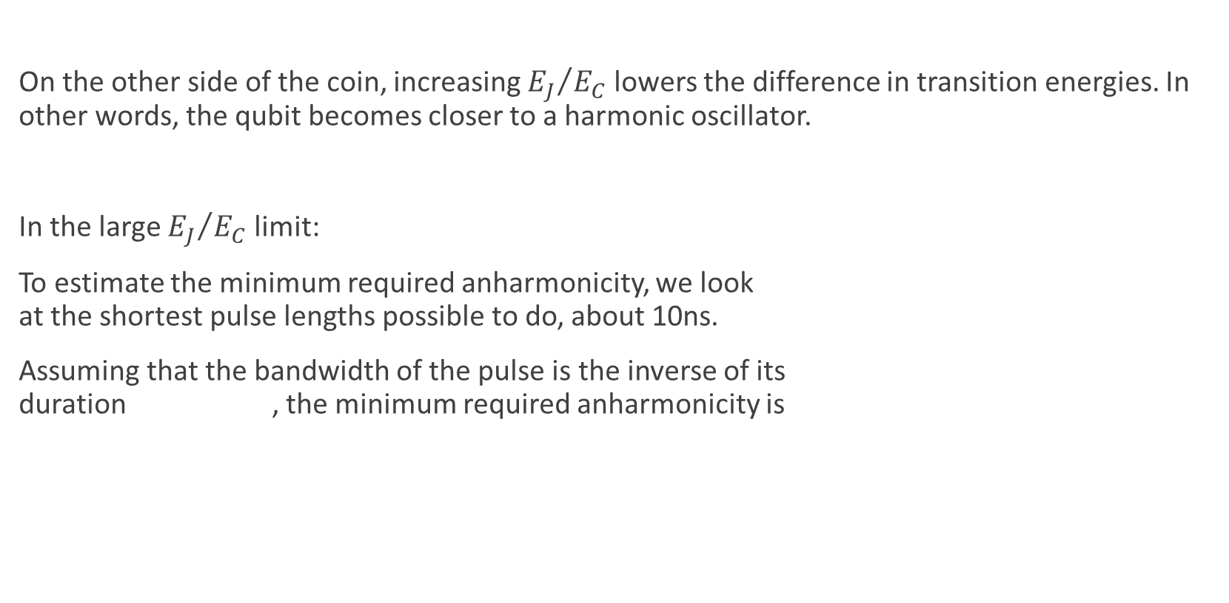
Reduced Anharmonicity
On the other side of the coin, increasing ${E_{J}}/{E_{C}}$ lowers the difference in transition energies. In other words, the qubit becomes closer to a harmonic oscillator.
In the large ${E_{J}}/{E_{C}}$ limit:
To estimate the minimum required anharmonicity, we look at the shortest pulse lengths possible to do, about 10ns.
Assuming that the bandwidth of the pulse is the inverse of its duration , the minimum required anharmonicity is
Koch, J. et al. Charge-insensitive qubit design derived from the Cooper pair box. Phys. Rev. A 76, 042319 (2007).

Slide 5
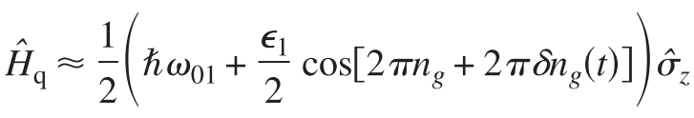

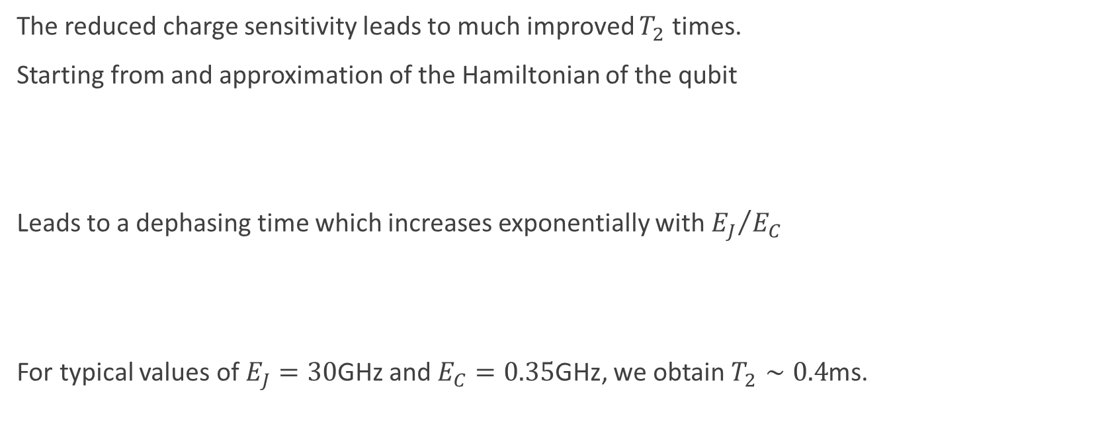
Longer Dephasing Times
The reduced charge sensitivity leads to much improved $T_{2}$ times.
Starting from and approximation of the Hamiltonian of the qubit
Leads to a dephasing time which increases exponentially with ${E_{J}}/{E_{C}}$
For typical values of $E_{J}=30$GHz and $E_{C}=0.35$GHz, we obtain $T_{2}∼0.4$ms.
Koch, J. et al. Charge-insensitive qubit design derived from the Cooper pair box. Phys. Rev. A 76, 042319 (2007).

Slide 6
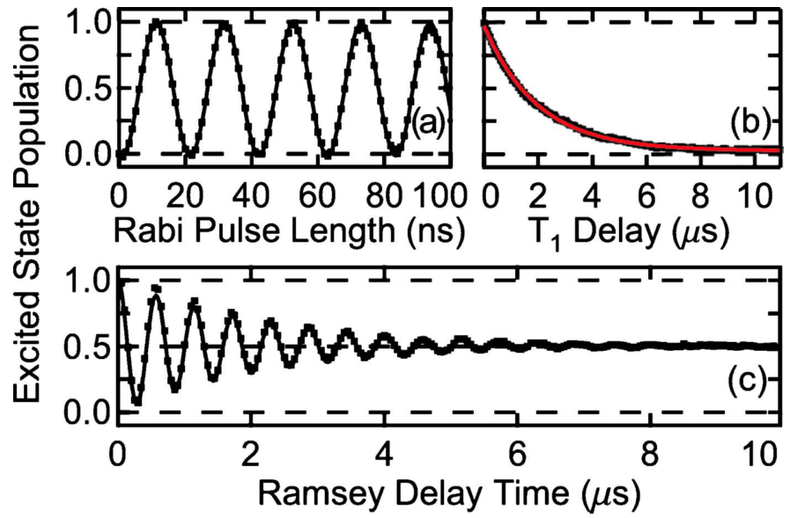
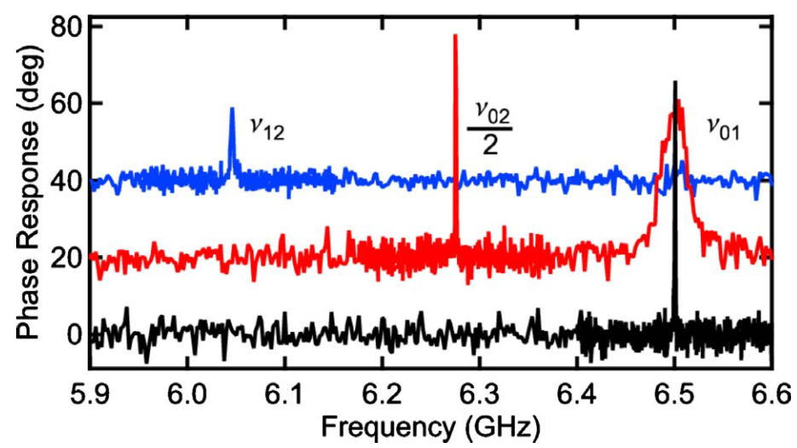

Measurements
The first decoherence measurements of transmon qubits were made by Schreier et al. in 2008. They reported a $T_{1}=1.87±0.02μs$ and $T_{2}^{∗}=2.22±0.03μs$.
More recently, in 2012, Chow et al. measured $T_{1}$ and $T_{2}$ on the order of 10 $μs$.
Schreier, J. et al. Suppressing charge noise decoherence in superconducting charge qubits. Phys. Rev. B 77, 180502 (2008).
Chow, J. M. et al. Universal Quantum Gate Set Approaching Fault-Tolerant Thresholds with Superconducting Qubits. Phys. Rev. Lett. 109, 060501 (2012).

Slide 7
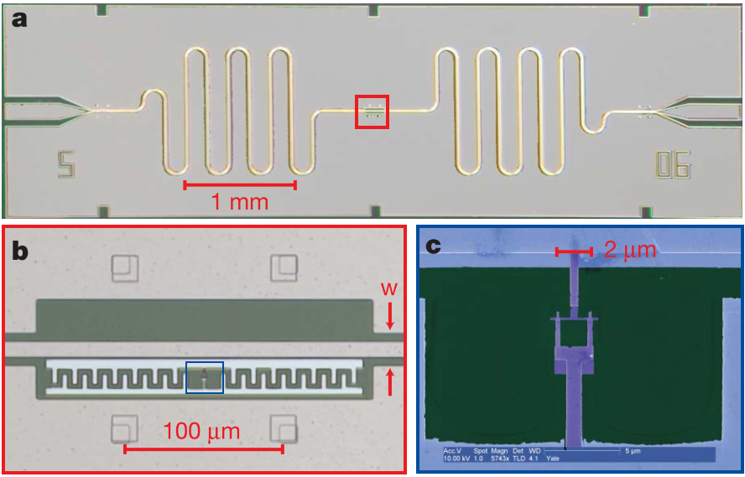
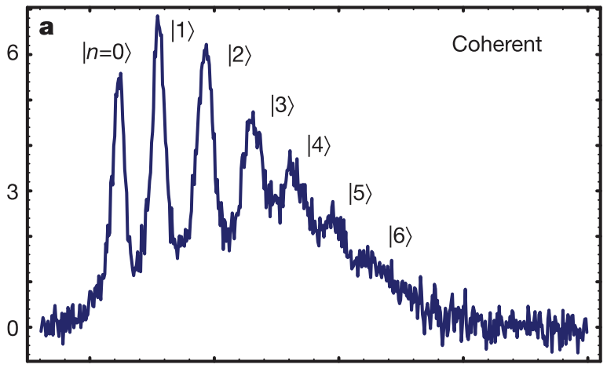
More Measurements
Schuster, D. I. et al. Resolving photon number states in a superconducting circuit. Nature 445, 515–8 (2007).

Slide 8
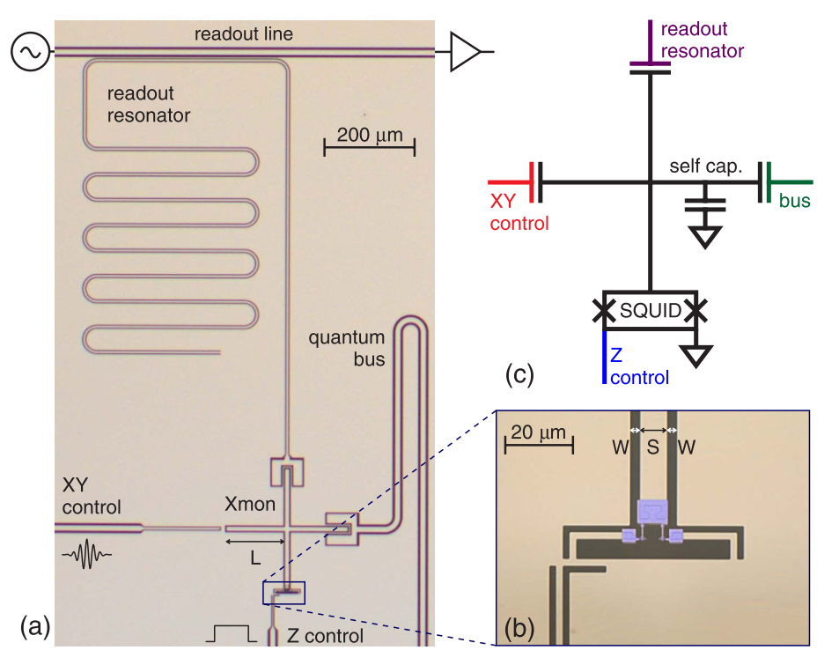
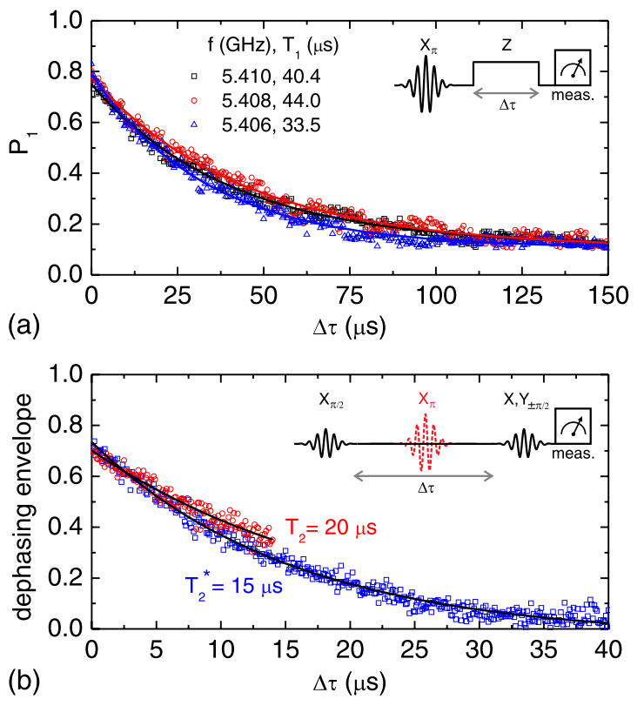
The (Not-So-Distant) Future
In 2013, Barends et al. demonstrated a variation of the transmon, the crossmon. They reported relaxation times on the order of 40 microseconds!
Barends, R. et al. Coherent Josephson Qubit Suitable for Scalable Quantum Integrated Circuits. Phys. Rev. Lett. 111, 080502 (2013).

