Slide 1
The Pinnacle of Superconducting Circuits: The Xmon

Slide 2

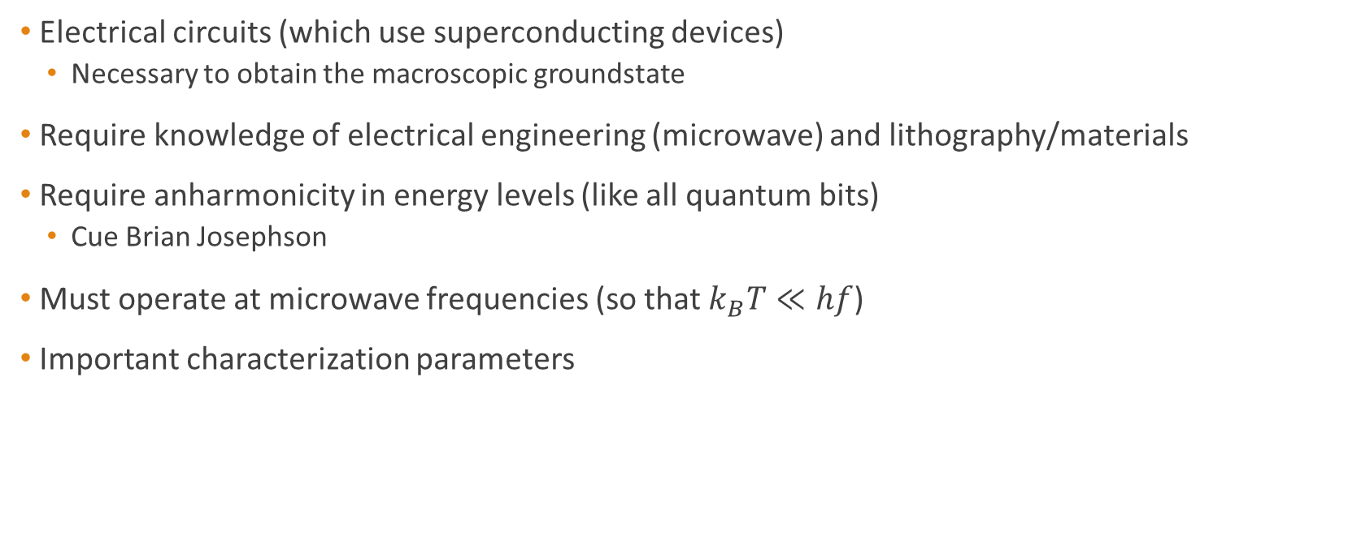

Superconducting Qubits Overview
Electrical circuits (which use superconducting devices)
Necessary to obtain the macroscopic groundstate
Require knowledge of electrical engineering (microwave) and lithography/materials
Require anharmonicity in energy levels (like all quantum bits)
Cue Brian Josephson
Must operate at microwave frequencies (so that $k_{B}T≪hf$)
Important characterization parameters
$$\frac{E_{J}}{E_{c}} , T_{1} , T_{2} , T_{2}^{∗}$$
$E_{J}≡\frac{I_{0}Φ_{0}}{2π}$ , $E_{c}≡\frac{{\left(2e\right)}^{2}}{2C}$

Slide 3
Evolution of Superconducting Qubits
1999
Nakamura designs and measures the quantum state of a Cooper Pair Box. [1]
2003
Chiorescu designs and measures the quantum state of a flux qubit.[3]
2013
Barends et. al. design, measure and characterize the first crossmon. [6]
1962
B.J. predicts the
Josephson Effect [7]
1962
Anderson and Rowell
measure and patent the Josephson Effect [8]
2002
Martinis designs and measures the performance of a large Josephson-junction qubit (phase qubit). [2]
2007
Koch, et. al. design and measure the first transmon reporting “drastically improved” decoherence times [5]

Slide 4
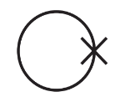
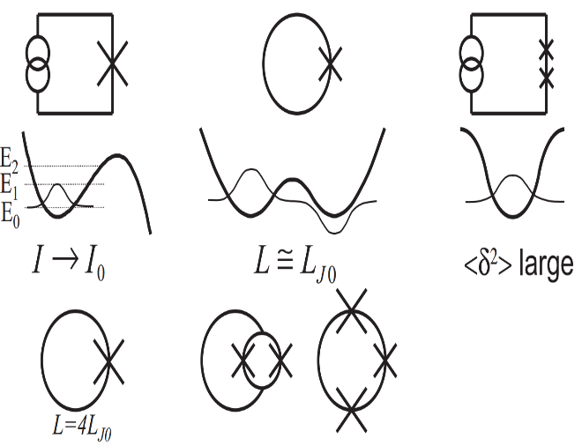
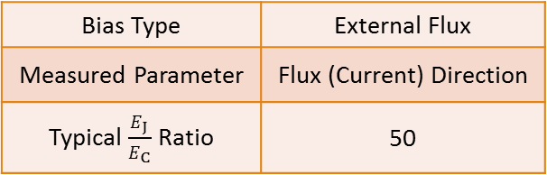
Flux Qubits
Circuit Schematic
Potential Diagram
Bias Type | External Flux
Measured Parameter | Flux (Current) Direction
Typical $\frac{E_{J}}{E_{C}}$Ratio | 50

Slide 5

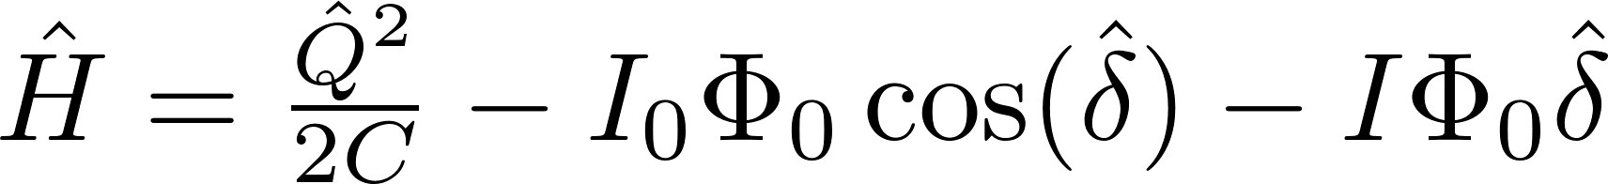
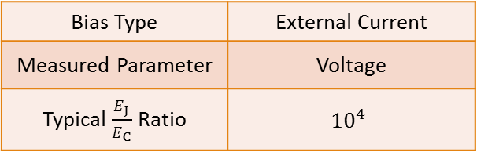
Phase Qubits
Circuit Schematic
Potential Diagram
Bias Type | External Current
Measured Parameter | Voltage
Typical $\frac{E_{J}}{E_{C}}$Ratio | $${10}^{4}$$

Slide 6
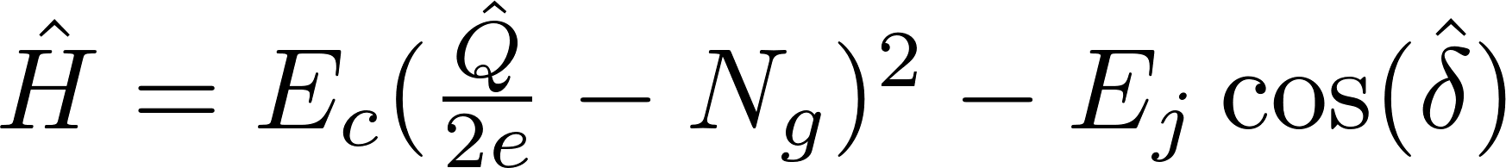
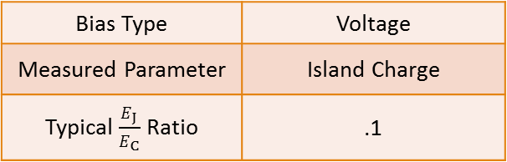
Charge Qubit (Cooper Pair Box)
Circuit Schematic
Potential Diagram
Bias Type | Voltage
Measured Parameter | Island Charge
Typical $\frac{E_{J}}{E_{C}}$Ratio | .1

Slide 7
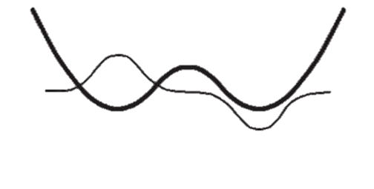
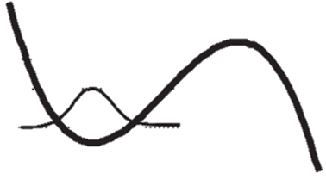
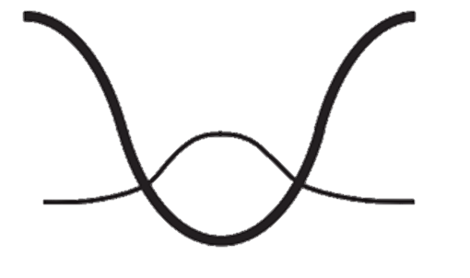
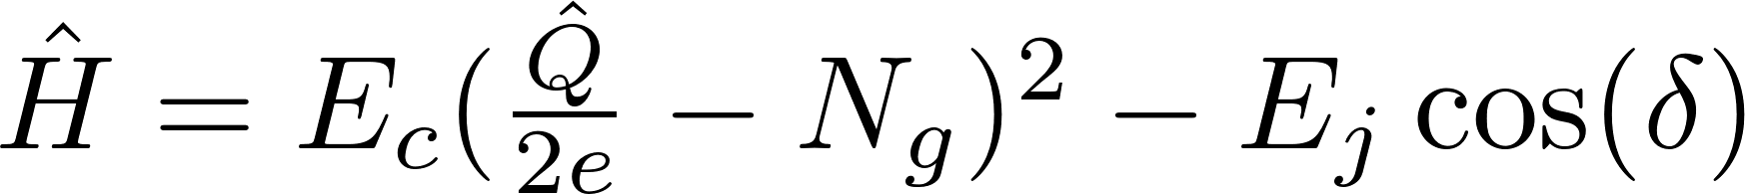
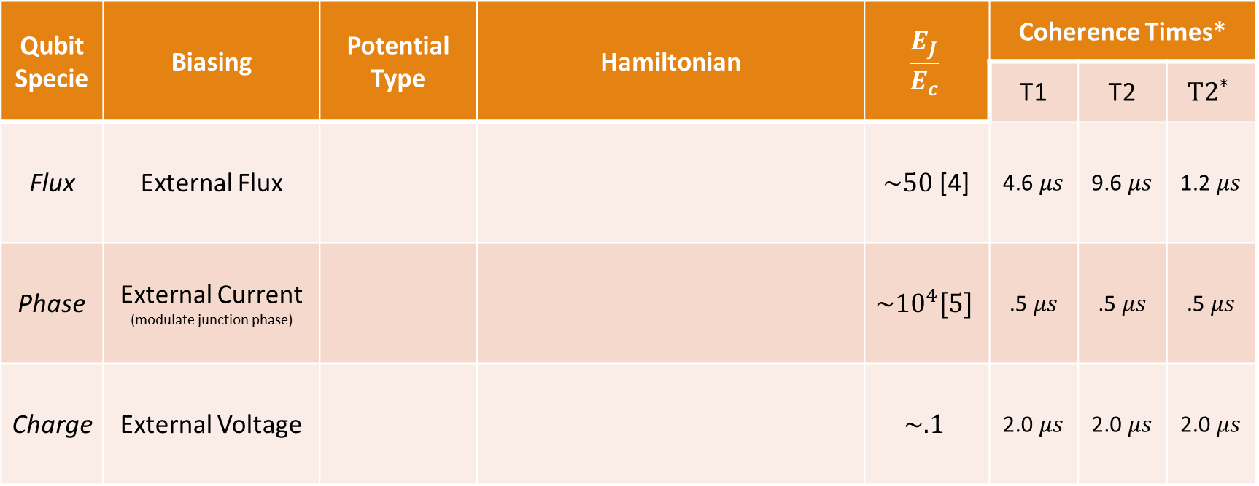
Overview of the Main Three
Qubit Specie | Biasing | Potential Type | Hamiltonian | $$\frac{E_{J}}{E_{c}}$$ | Coherence Times*
 |  |  |  |  | T1 | T2 | $${T2}^{∗}$$
Flux | External Flux |  |  | $\sim 50$[4] | 4.6 $μs$ | 9.6 $μs$ | 1.2 $μs$
Phase | External Current (modulate junction phase) |  |  | $${\sim 10}^{4}[5]$$ | .5 $μs$ | .5 $μs$ | .5 $μs$
Charge | External Voltage |  |  | $$\sim .1$$ | 2.0 $μs$ | 2.0 $μs$ | 2.0 $μs$
Double-Well
Tilted Washboard
Anticrossing
* Values obtained from Reference [4]

Slide 8
References
1. Nakamura, Y., Pashkin, Y. A. & Tsai, J. S. Coherent control of macroscopic quantum states in a single-Cooper-pair box. Nature 398, 786–788 (1999).
2. Cottet, A. et al. Implementation of a combined charge-phase quantum bit in a superconducting circuit. Physics C: Superconductivity 367, 197–203 (2002).
3. Chiorescu, I., Nakamura, Y., Harmans, C. J. P. M. & Mooij, J. E. Coherent Quantum Dynamics of a Superconducting Flux Qubit. Science 299 , 1869–1871 (2003).
4. Clarke, J. & Wilhelm, F. K. Superconducting quantum bits. Nature 453, 1031–1042 (2008).
5. Koch, J. et al. Charge-insensitive qubit design derived from the Cooper pair box. Physical Review A 76, 42319 (2007).
6. Barends, R. et al. Coherent Josephson Qubit Suitable for Scalable Quantum Integrated Circuits. Physical Review Letters 111, 80502 (2013).
7. Josephson, B. D. Possible new effects in superconductive tunnelling. Physics Letters 1, 251–253 (1962).
8. Anderson, P. W. & Rowell, J. M. Probable Observation of the Josephson Superconducting Tunneling Effect. Phys. Rev. Lett. 10, 230–232 (1963).

