Slide 1
From Classical To Quantum Channel Capacities
John Rinehart

Slide 2
Outline
Classical Information Theory (Framework)
Shannon Entropy
Classical Channel Capacity
Quantum Information Theory
Quantum Channel Capacity
Classical Zero-Error Capacity
Entanglement-Assisted Quantum Capacity
Specific Channels
Erasure Channel
Dephasing Channel
Amplitude Damping Channel
Ideal Channel

Slide 3
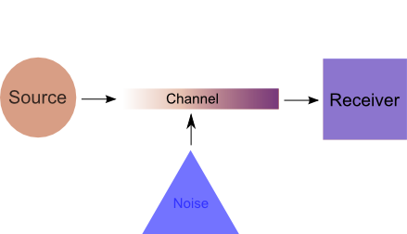
Communication Protocol

Slide 4
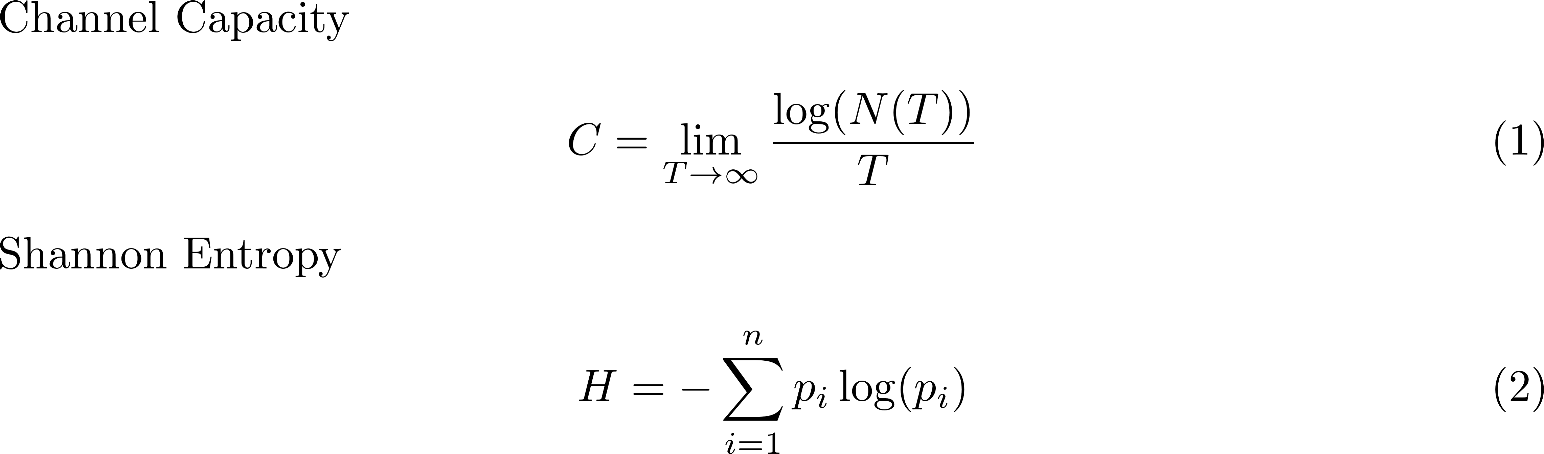
Definitions

Slide 5
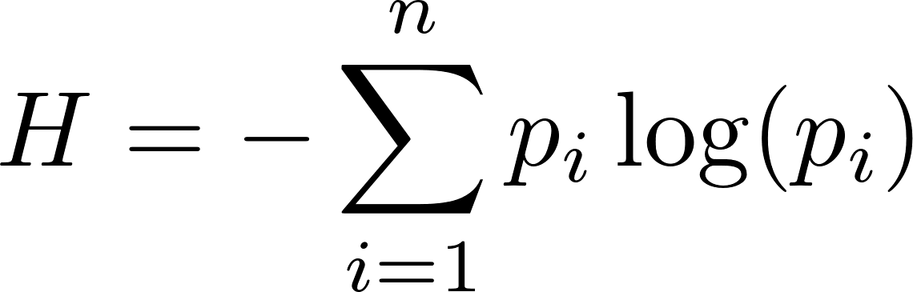
Shannon Entropy (cont’d)
The entropy only vanishes when only one ball is available for selection
The entropy is largest when all of the balls are selected with equal probability

Slide 6

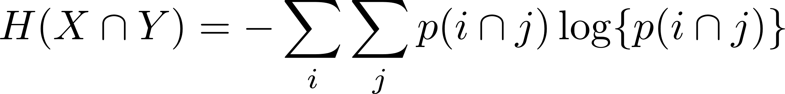
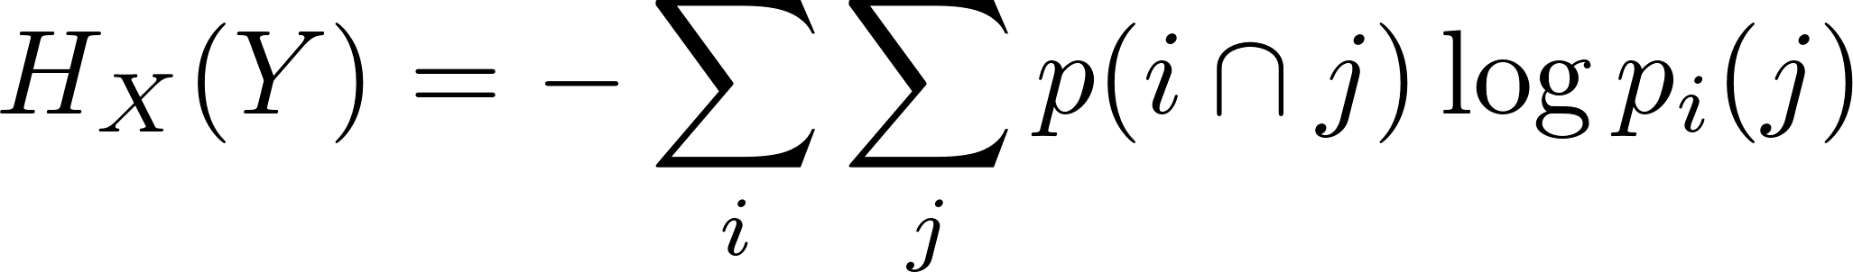
Shannon Entropy (cont’d)
Considering two events X and Y the entropy of the joint system formed by is

Slide 7
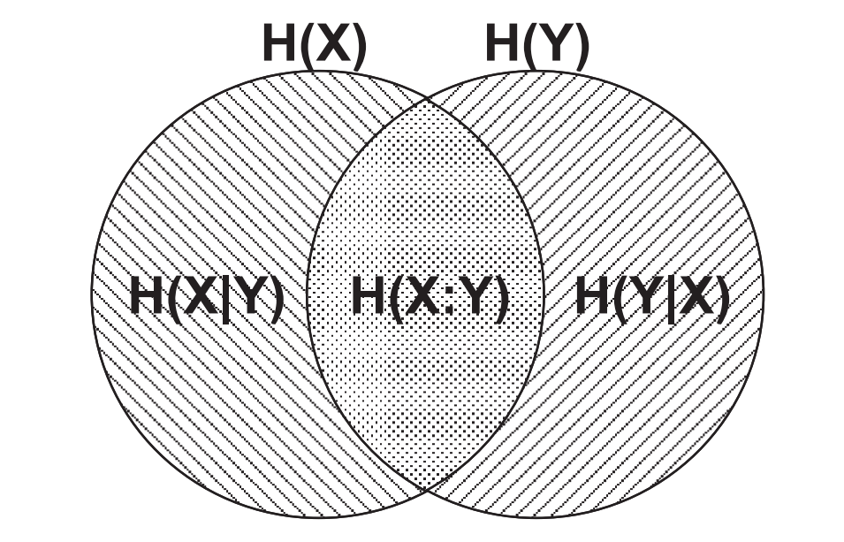
Entropy Venn Diagram

Slide 8
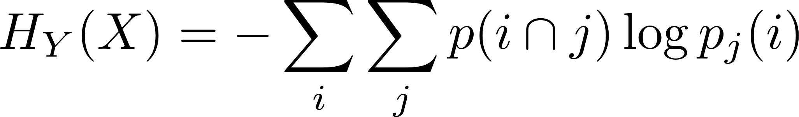
Classical Channel Capacity
Small, non-vanishing error probability
Can not preserve superposition (modeled as a complete dephasing channel)

Slide 9
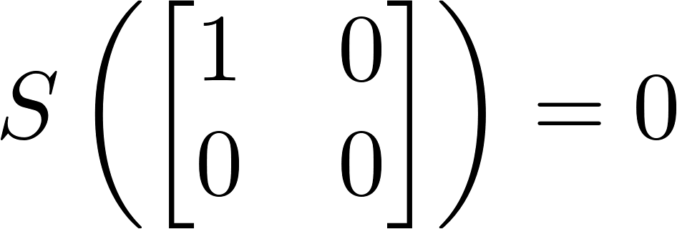
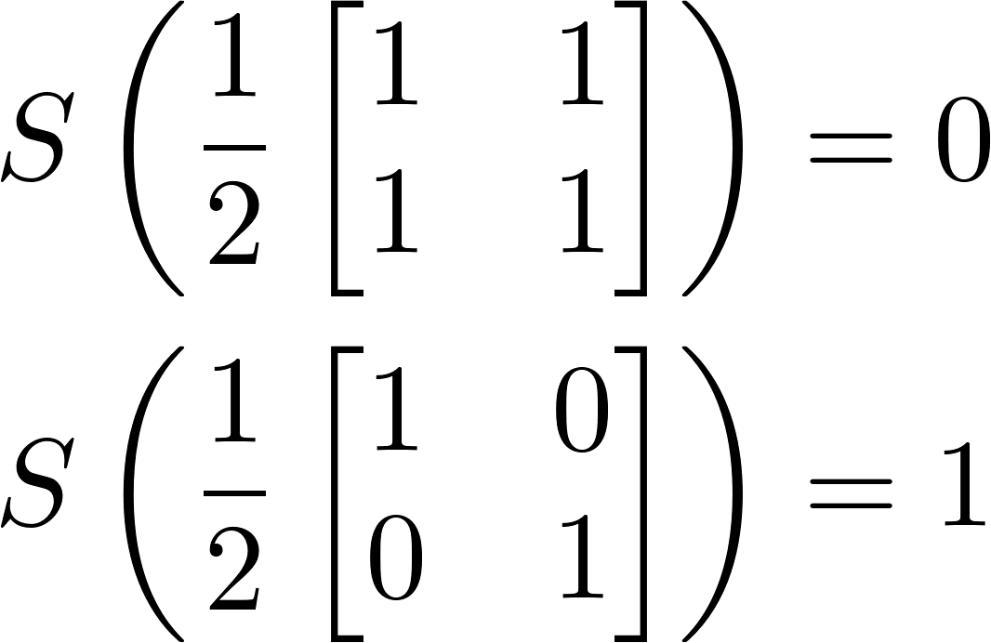
Von Neumann Entropy

Slide 10
Quantum Capacities
Inherently more complicated
Parallel classical channels can increase the capacity of quantum channels
Entanglement increases the capacity of quantum channels
Feedback can increase the quantum capacity (unlike the classical channel)
Multiple zero-capacity channels can have non-zero capacity when used together

Slide 11
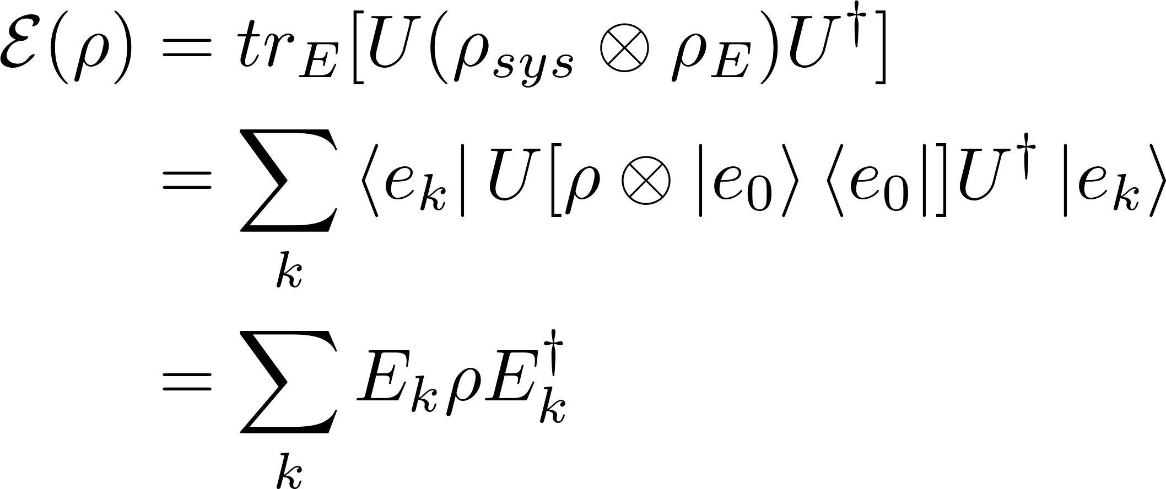
How to Model Noise
Treat the noise in the operator-sum formalism

Slide 12
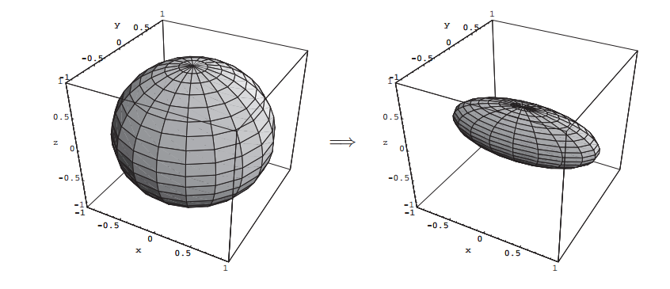
Bit Flip Channel

Slide 13
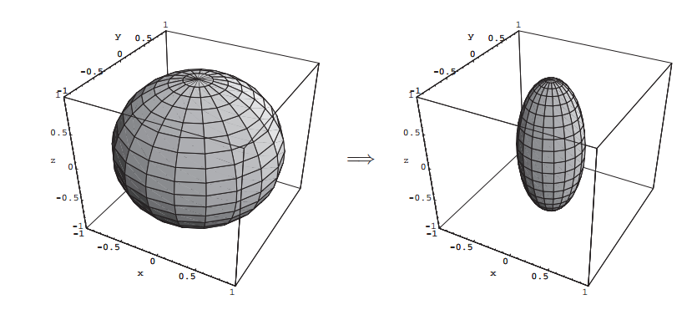
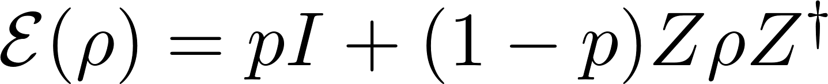
Phase Flip Channel

Slide 14
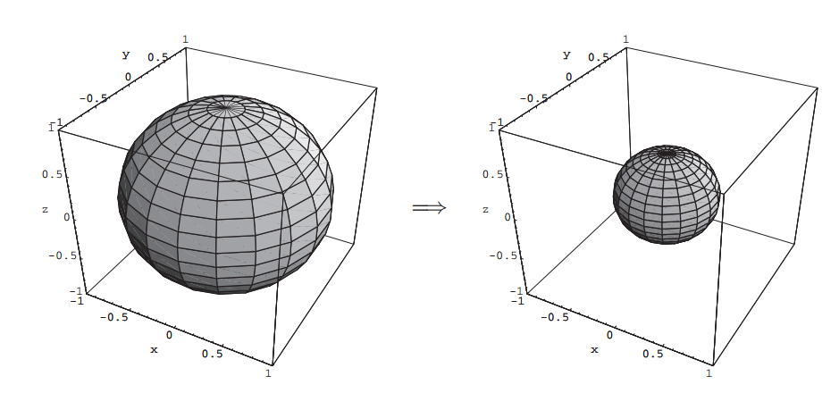
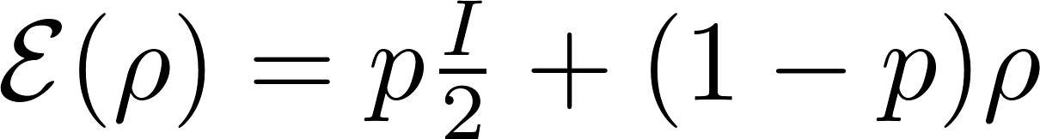
Depolarizing Channel

Slide 15
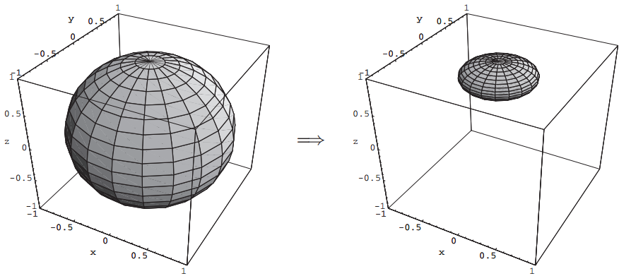
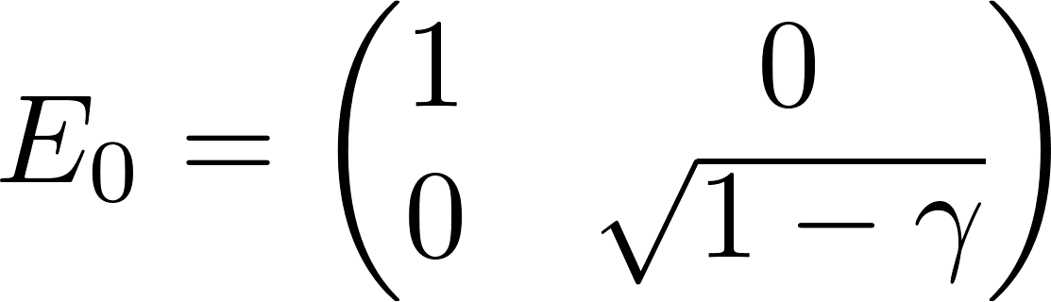
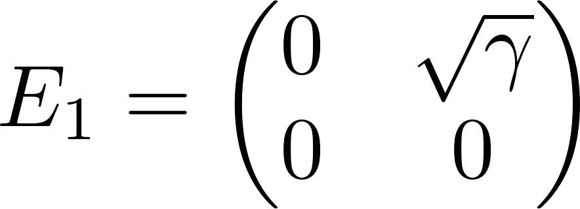
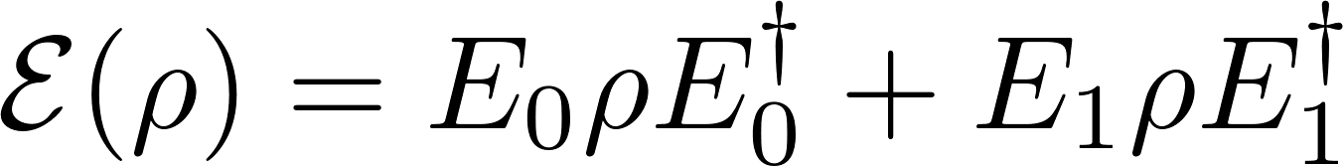
Amplitude Damping Channel
*Recognize this from assignment 4?

Slide 16
Quantum Channel used for Classical Communication
Holevo’s bound (1973) places a limit on the amount of accessible information using a quantum channel
This bound also limits the amount of bits that can be transmitted using N qubits (N bits).
The limit is attained (not only) when classical information is transmitted across the channel.
Capacity credited to Holevo, Schumacher and Westmoreland

Slide 17
Entanglement-Assisted Quantum Capacity
The above holds for classical information being sent over a quantum channel
Capacity credited to Bennett, Shor, Smolin, Thapliyal

Slide 18
Erasure Channel
Classical erasure channel limit is 1-p.

Slide 19
References
“Capacities of Quantum Channels and How to Find Them”, Peter W. Shor, ArXiv
“A Mathematical Theory of Communication”, Claude E. Shannon, The Bell System Technical Journal
Quantum Computation and Quantum Information, Isaac Chuang and Michael Nielsen, Cambridge Printing Press, 2001

