Slide 1
Simplified Real Frequency Technique Optimal Filter Design
John Rinehart
ECE 671 University of Waterloo

Slide 2
Overview
Simplified Real Frequency Technique
Transducer Gain
Kramers-Kronig Relations
Gewertz Method
Darlington Synthesis (Pole Extraction at Infinity)
MATLAB Implementation
Example
MATLAB Results
LTspice Simulation
ADS Simulation
Future Work

Slide 3
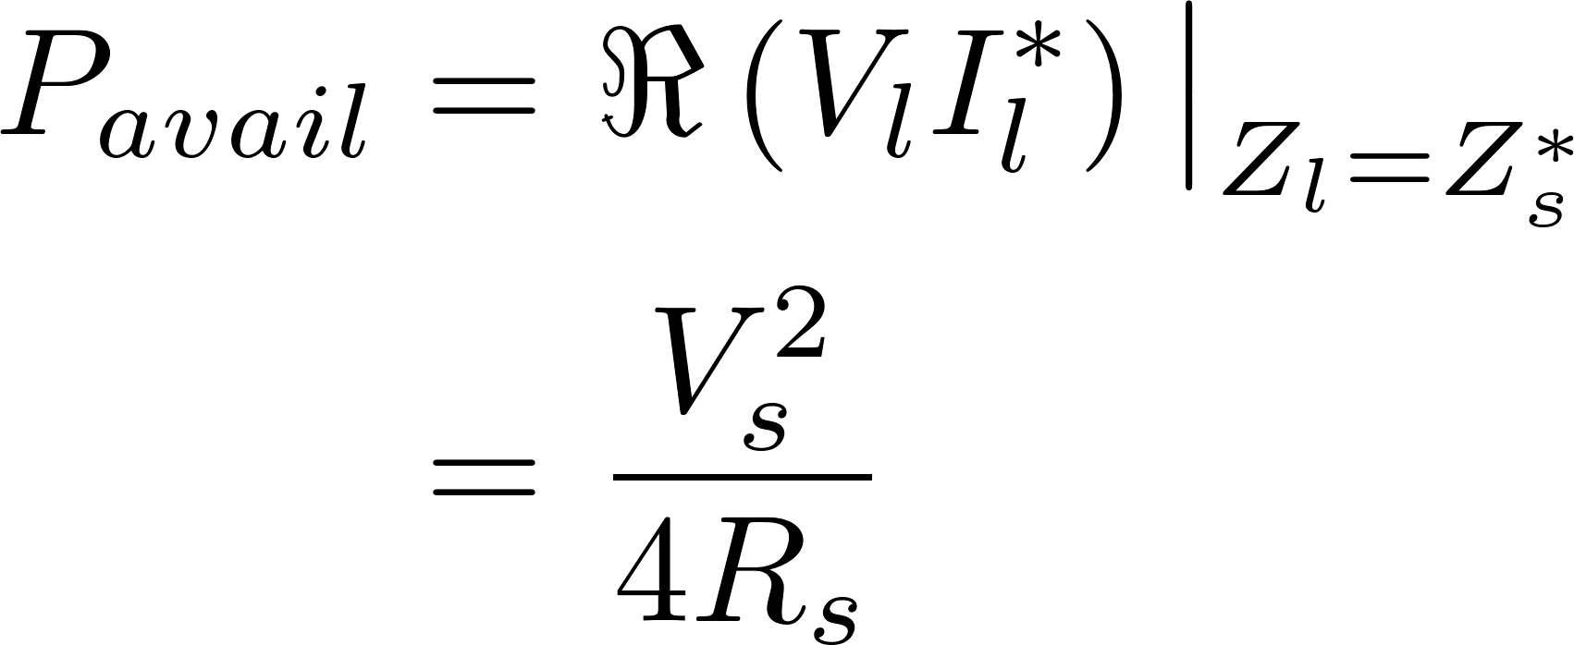
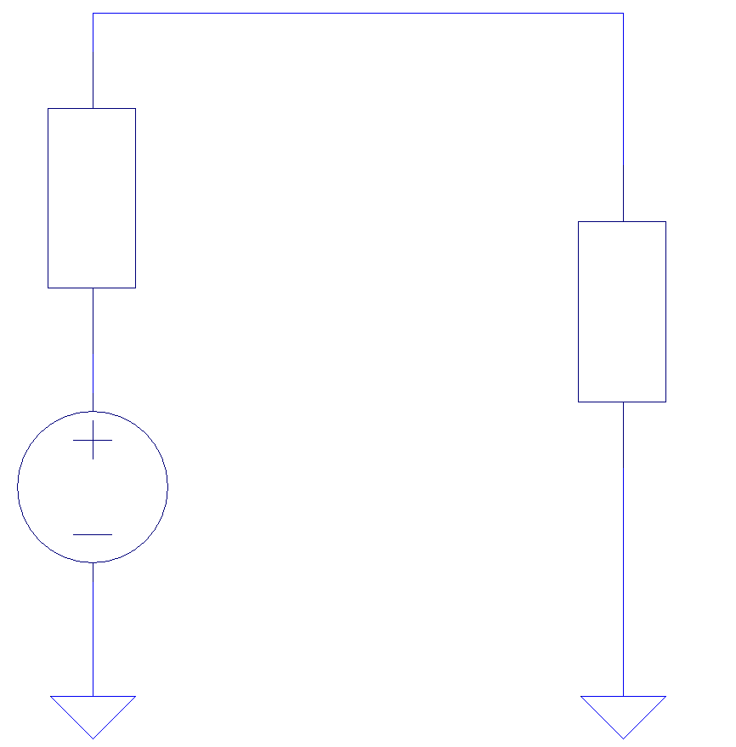
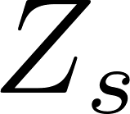
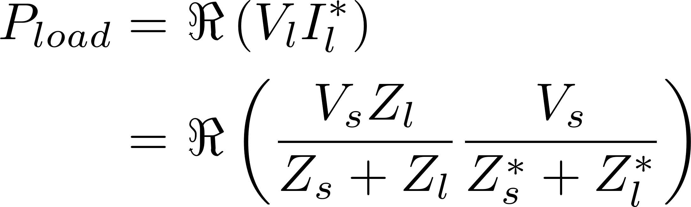
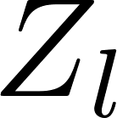

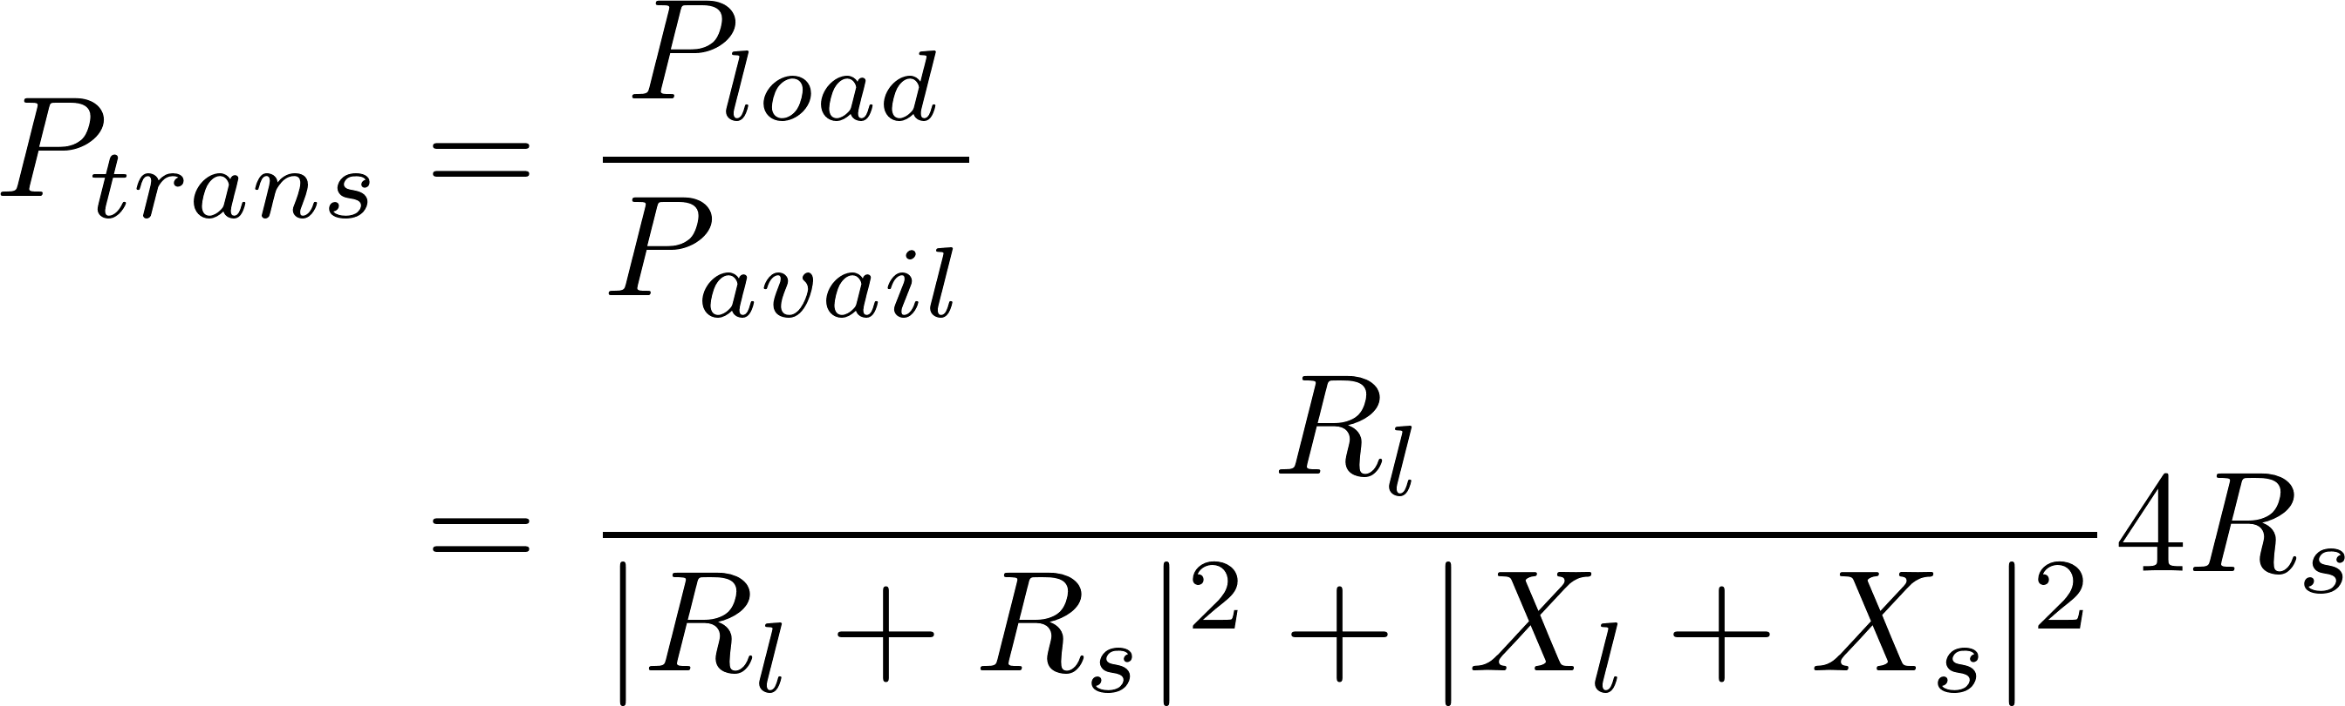
Transducer Gain
Simplified Real Frequency Technique
Transducer Gain
Kramers-Kronig Relations
Gewertz Method
Darlington Synthesis (Pole Extraction at Infinity)
MATLAB Implementation
Example
MATLAB Results
LTspice Simulation
Future Work

Slide 4
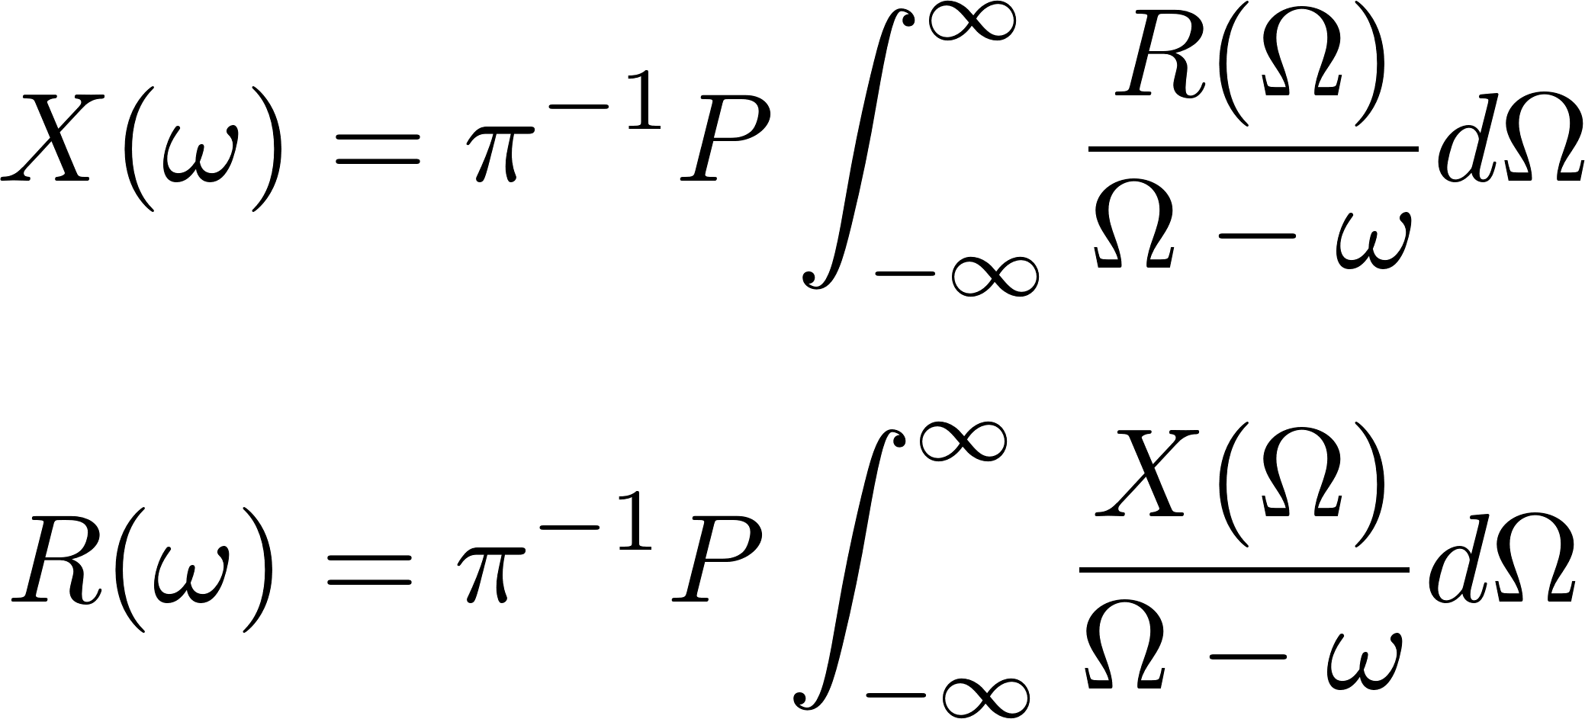
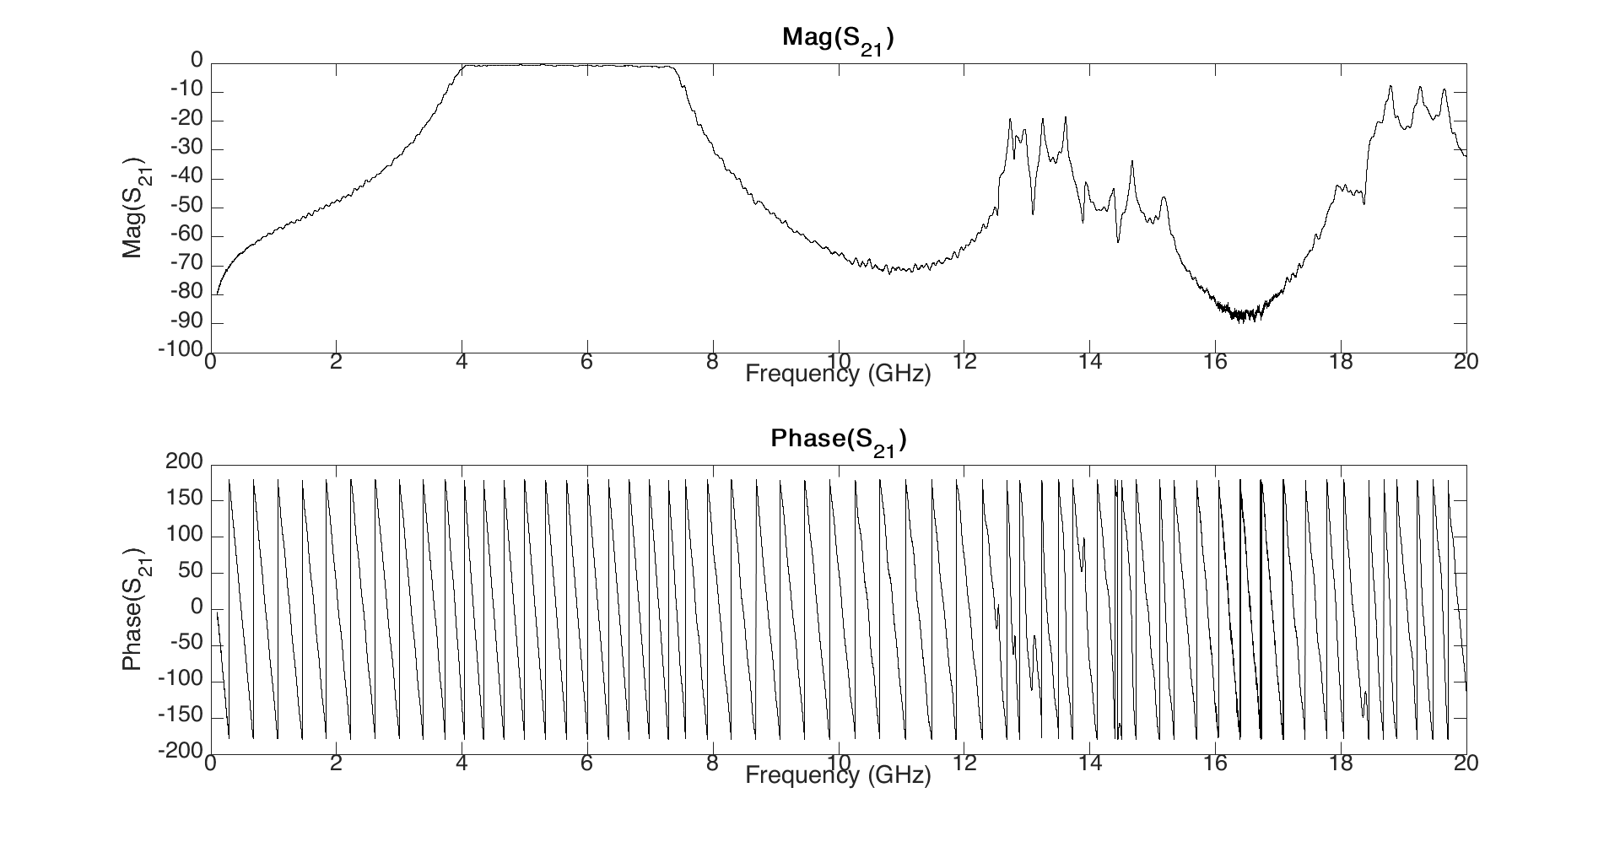
Kramers-Kronig Relations
Simplified Real Frequency Technique
Transducer Gain
Kramers-Kronig Relations
Gewertz Method
Darlington Synthesis (Pole Extraction at Infinity)
MATLAB Implementation
Example
MATLAB Results
LTspice Simulation
Future Work

Slide 5
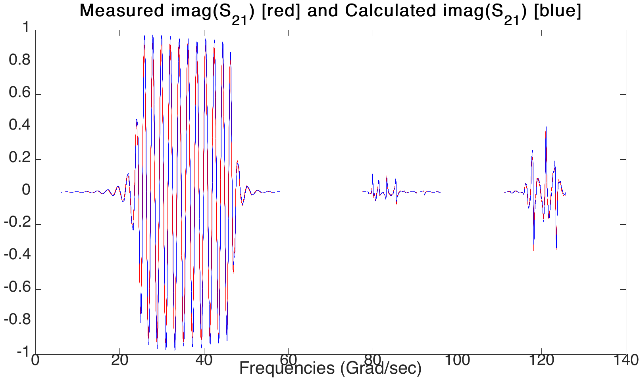
Kramers-Kronig Relations
Simplified Real Frequency Technique
Transducer Gain
Kramers-Kronig Relations
Gewertz Method
Darlington Synthesis (Pole Extraction at Infinity)
MATLAB Implementation
Example
MATLAB Results
LTspice Simulation
Future Work

Slide 6
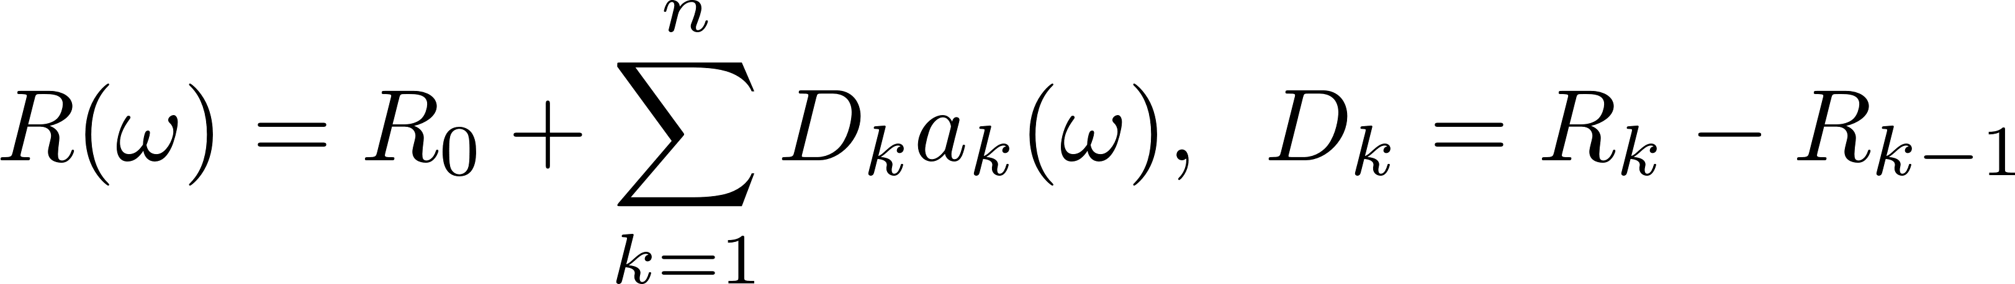
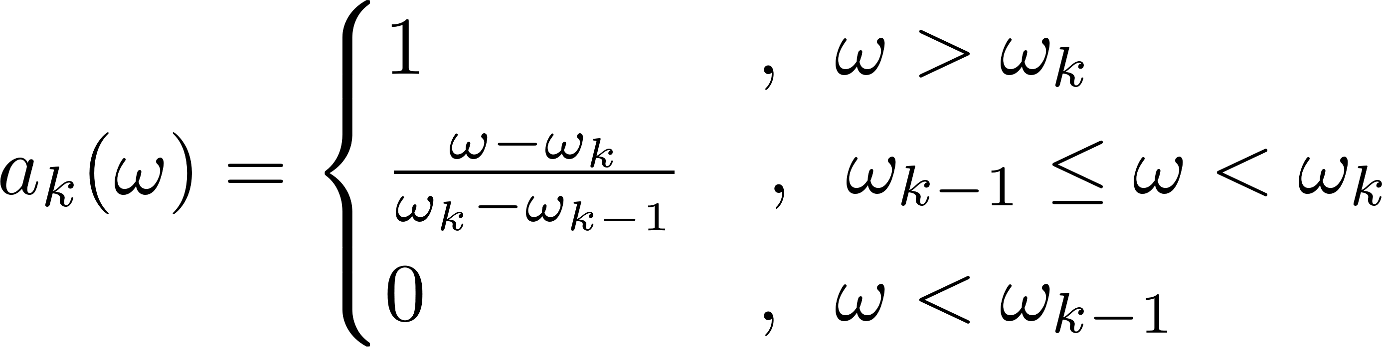
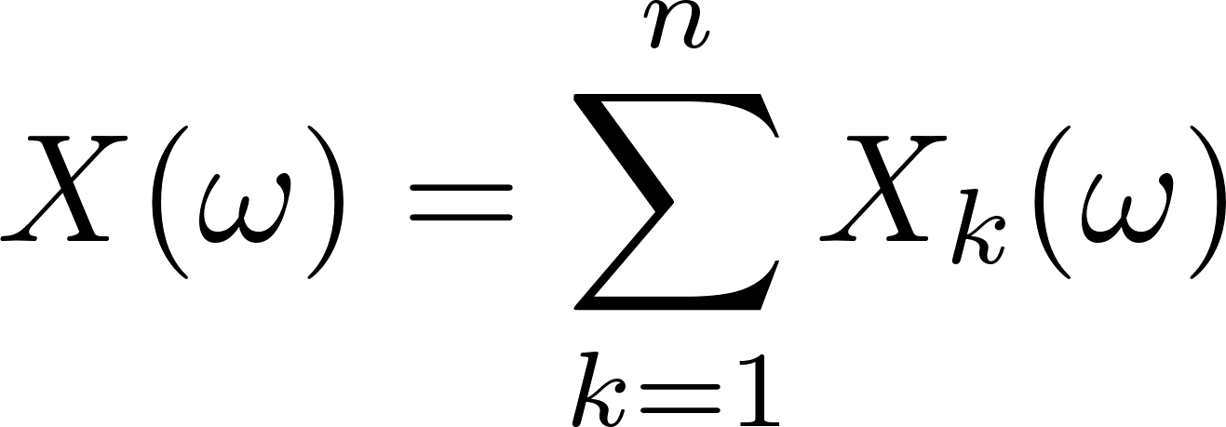
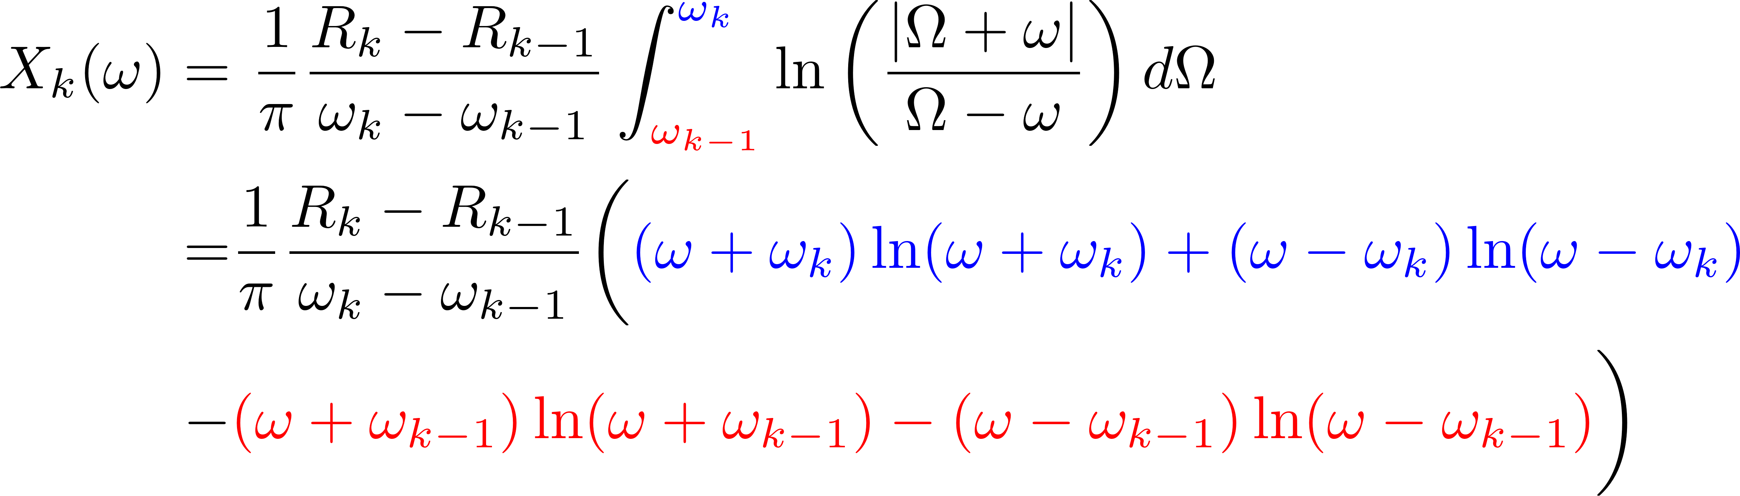
Kramers-Kronig Relations (contd)
Simplified Real Frequency Technique
Transducer Gain
Kramers-Kronig Relations
Gewertz Method
Darlington Synthesis (Pole Extraction at Infinity)
MATLAB Implementation
Example
MATLAB Results
LTspice Simulation
Future Work

Slide 7
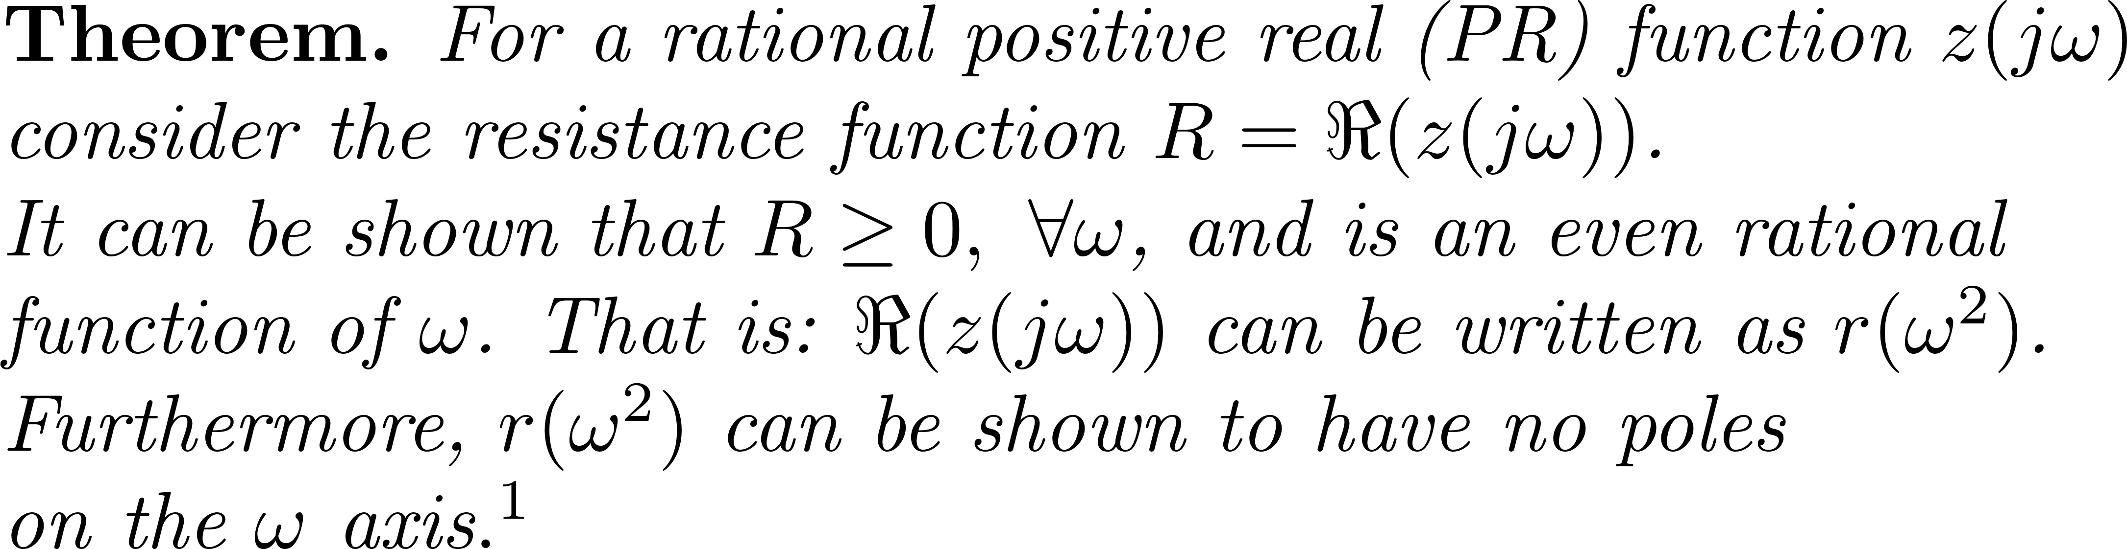
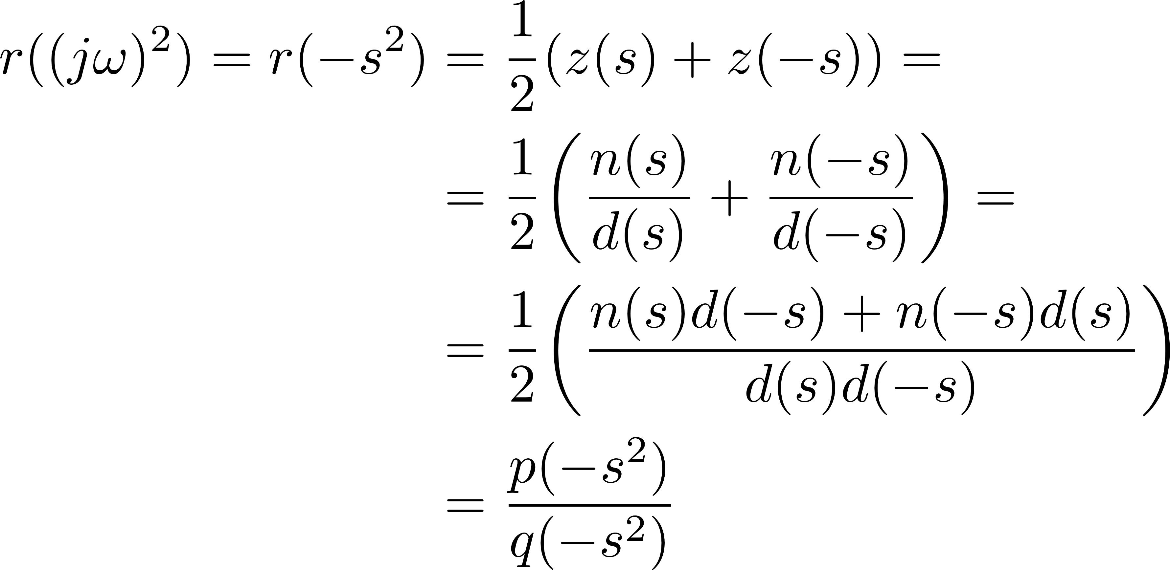
Gewertz Method
Simplified Real Frequency Technique
Transducer Gain
Kramers-Kronig Relations
Gewertz Method
Darlington Synthesis (Pole Extraction at Infinity)
MATLAB Implementation
Example
MATLAB Results
LTspice Simulation
Future Work

Slide 8
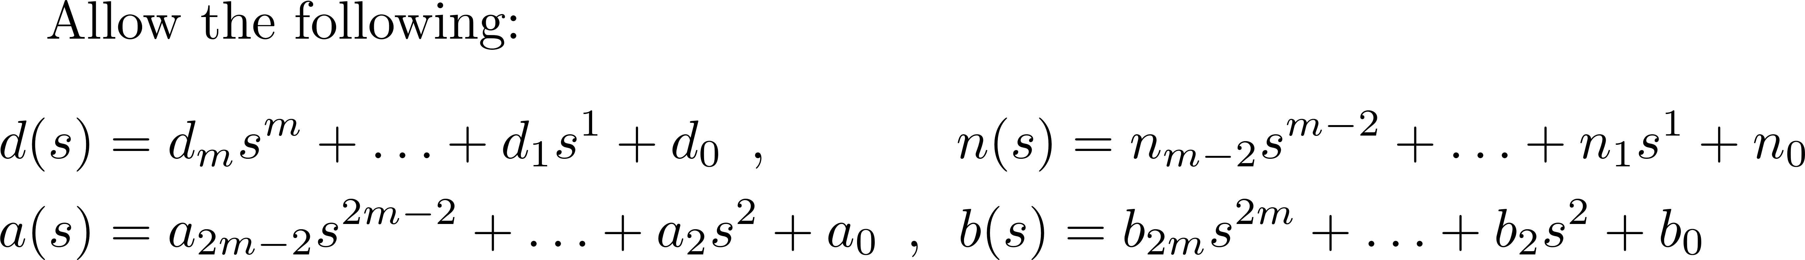
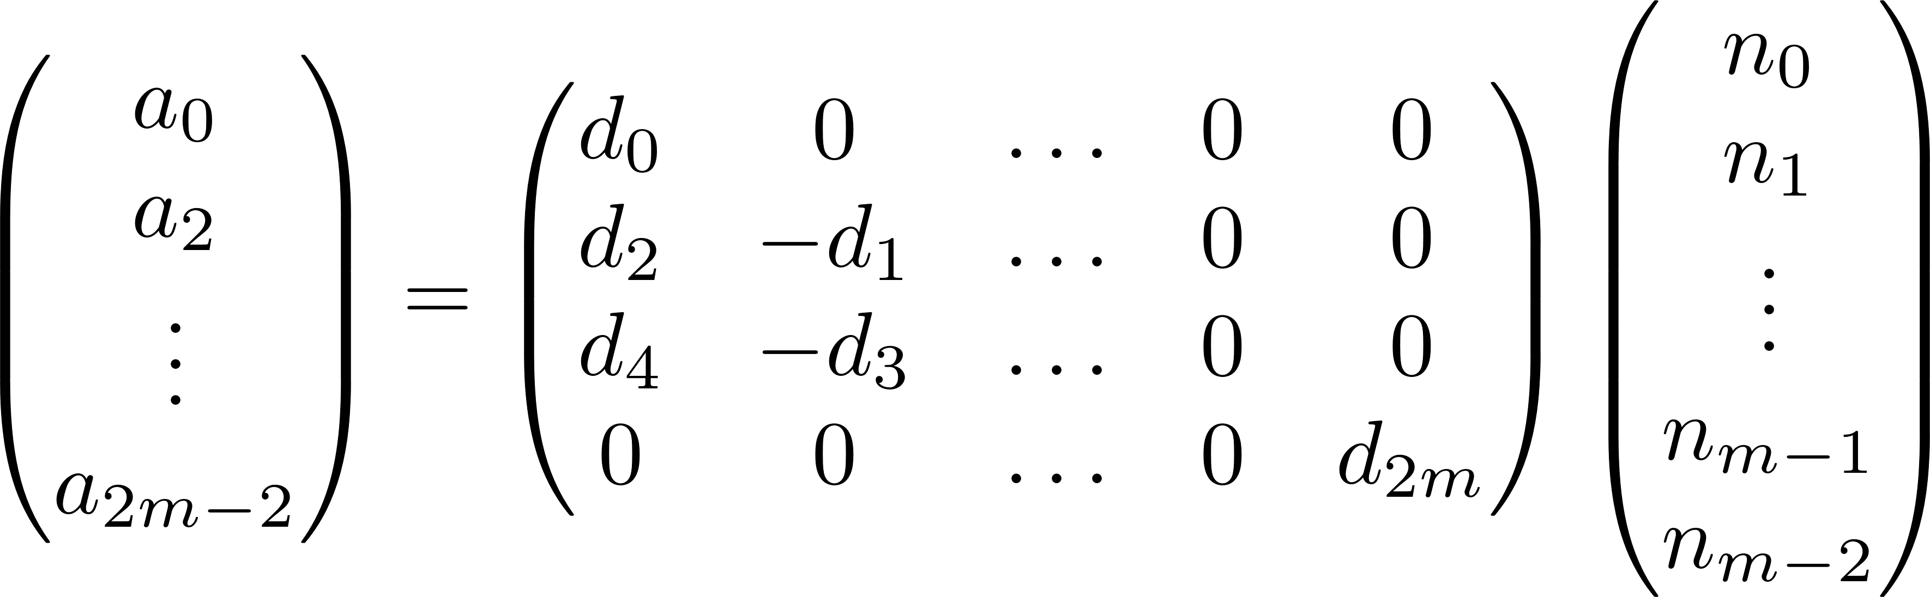
Gewertz Method
Simplified Real Frequency Technique
Transducer Gain
Kramers-Kronig Relations
Gewertz Method
Darlington Synthesis (Pole Extraction at Infinity)
MATLAB Implementation
Example
MATLAB Results
LTspice Simulation
Future Work

Slide 9
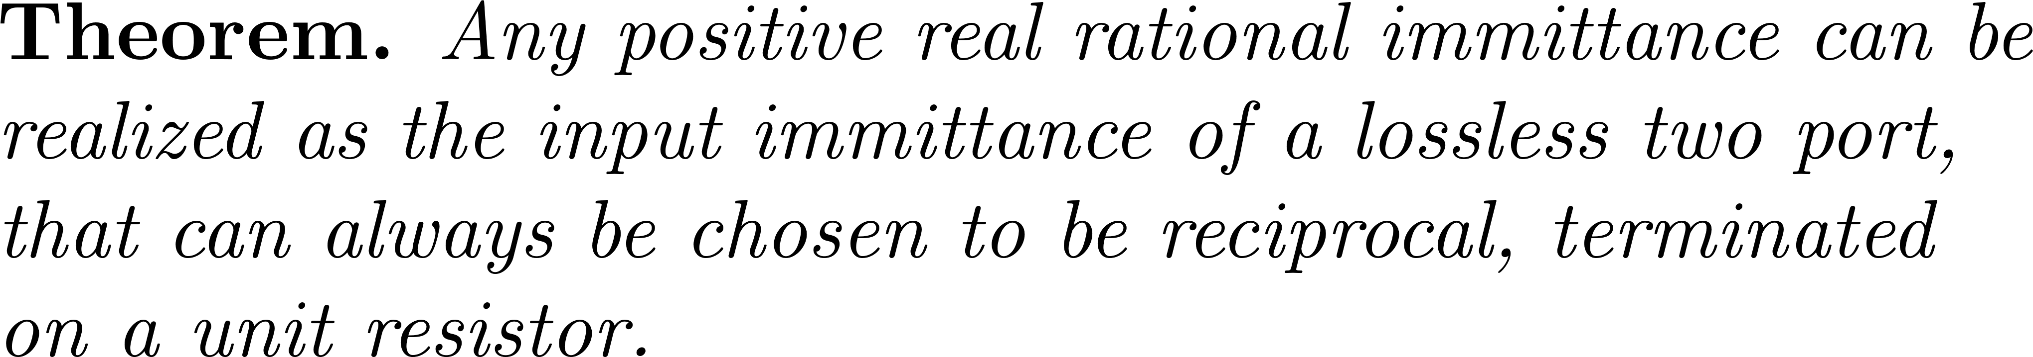
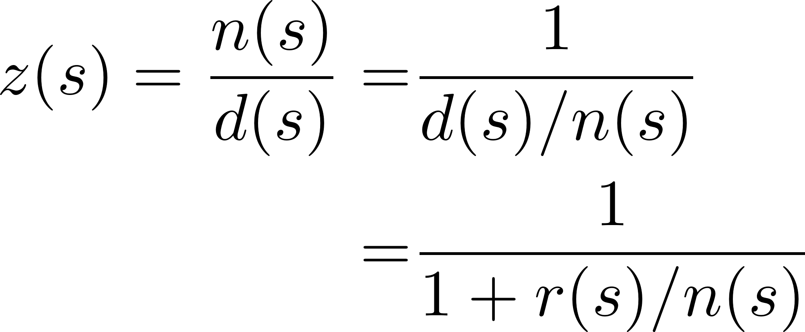
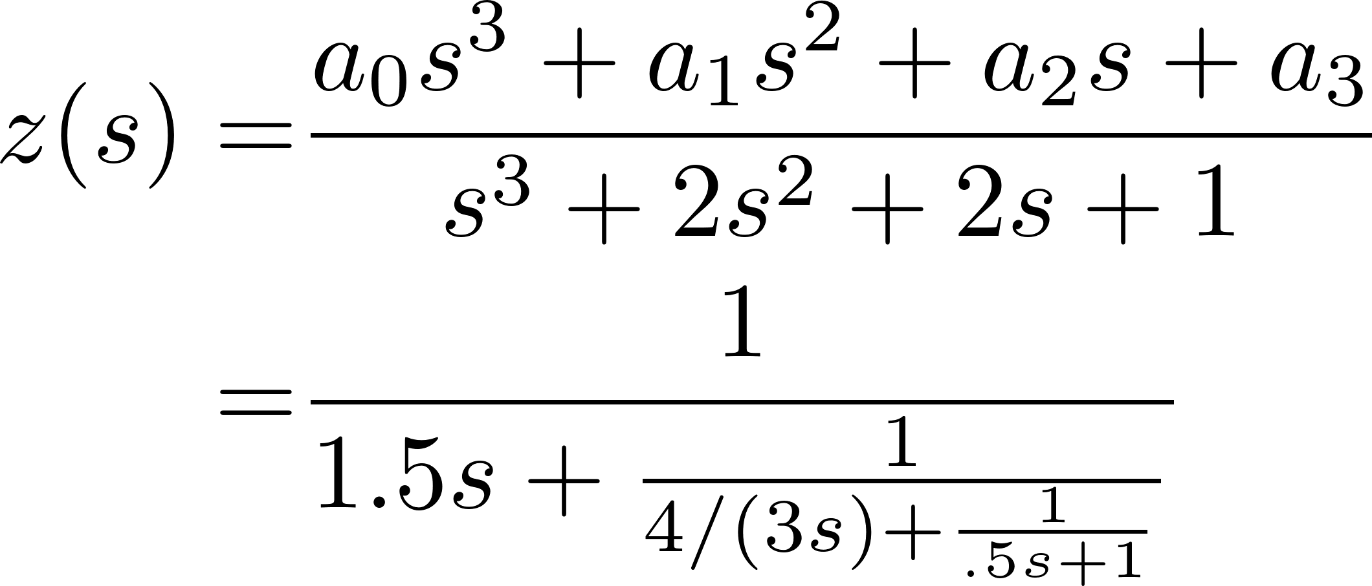
Darlington Synthesis
Simplified Real Frequency Technique
Transducer Gain
Kramers-Kronig Relations
Gewertz Method
Darlington Synthesis (Pole Extraction at Infinity)
Algorithm
Example
MATLAB Results
LTspice Simulation
Future Work

Slide 10
Algorithm
Simplified Real Frequency Technique
Transducer Gain
Kramers-Kronig Relations
Gewertz Method
Darlington Synthesis (Pole Extraction at Infinity)
Algorithm
Example
MATLAB Results
LTspice Simulation
Future Work
Optimize over some gain function by minimizing over the possible break resistances.
Approximate the resistance by a rational polynomial.
Find Z by the Gewertz method.
Synthesize the network via Darlington Synthesis

Slide 11
Algorithm
Simplified Real Frequency Technique
Transducer Gain
Kramers-Kronig Relations
Gewertz Method
Darlington Synthesis (Pole Extraction at Infinity)
Algorithm
Example
MATLAB Results
LTspice Simulation
Future Work
Optimize over some gain function by minimizing over the possible break resistances.
Approximate the resistance by a rational polynomial.
Find Z by the Gewertz method.
Synthesize the network via Darlington Synthesis

Slide 12
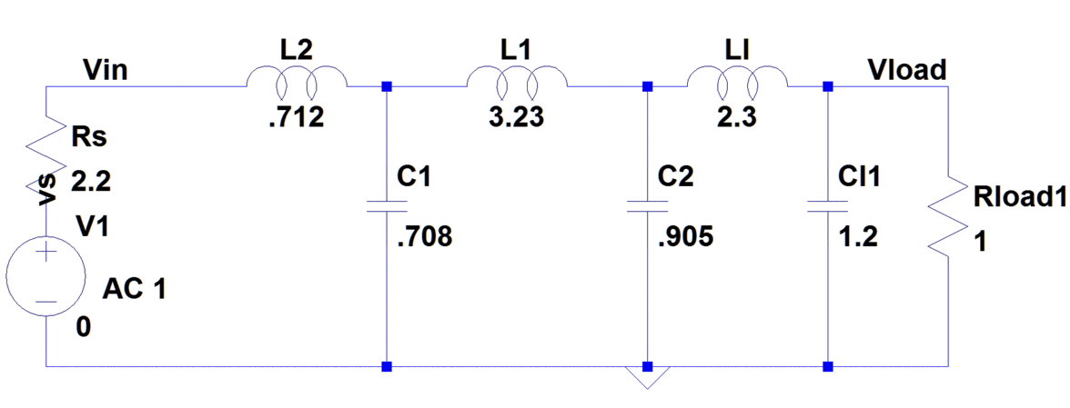
Example
Simplified Real Frequency Technique Theory
Transducer Gain
Kramers-Kronig Relations
Gewertz Method
Darlington Synthesis (Pole Extraction at Infinity)
Algorithm
Example
MATLAB Results
LTspice Simulation
ADS Simulation
Future Work

Slide 13
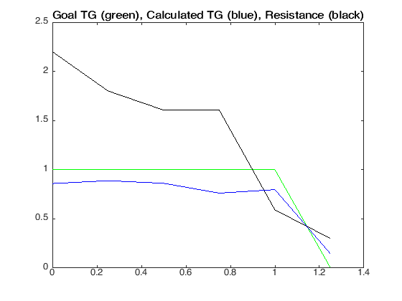
MATLAB Results
Simplified Real Frequency Technique Theory
Transducer Gain
Kramers-Kronig Relations
Gewertz Method
Darlington Synthesis (Pole Extraction at Infinity)
Algorithm
Example
MATLAB Results
LTspice Simulation
ADS Simulation
Future Work

Slide 14
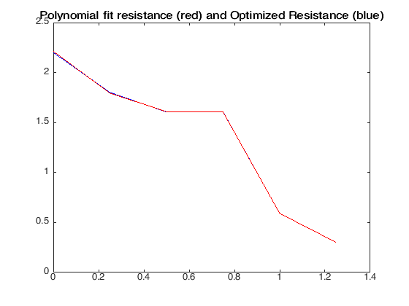
MATLAB Results
Simplified Real Frequency Technique Theory
Transducer Gain
Kramers-Kronig Relations
Gewertz Method
Darlington Synthesis (Pole Extraction at Infinity)
Algorithm
Example
MATLAB Results
LTspice Simulation
Future Work

Slide 15
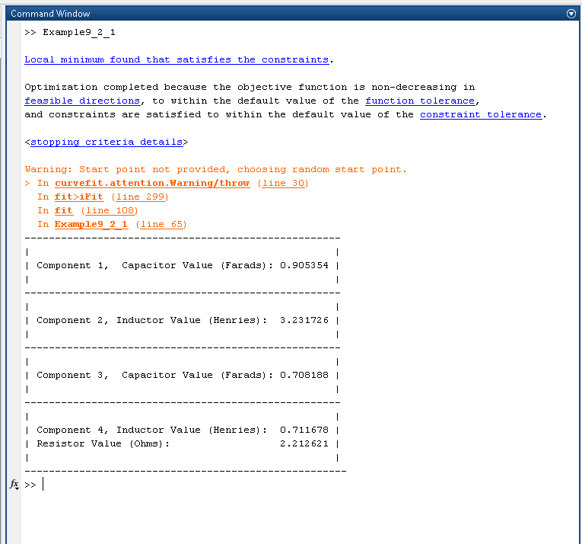
MATLAB Results
Simplified Real Frequency Technique Theory
Transducer Gain
Kramers-Kronig Relations
Gewertz Method
Darlington Synthesis (Pole Extraction at Infinity)
Algorithm
Example
MATLAB Results
LTspice Simulation
Future Work

Slide 16
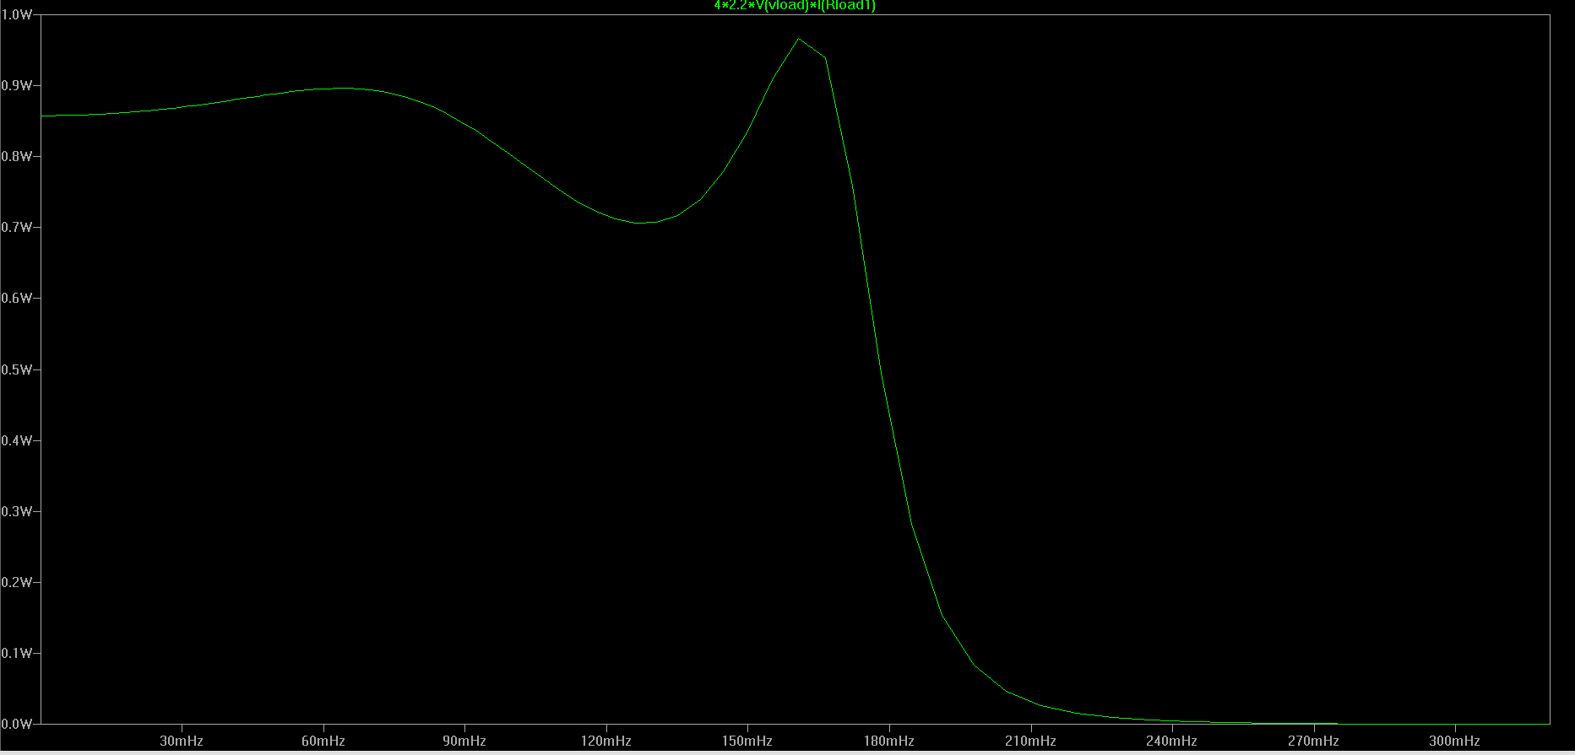
MATLAB Results
Simplified Real Frequency Technique Theory
Transducer Gain
Kramers-Kronig Relations
Gewertz Method
Darlington Synthesis (Pole Extraction at Infinity)
Algorithm
Example
MATLAB Results
LTspice Simulation
Future Work

Slide 17
Future Work
Try other loads
Try double matching problems
Avoid polynomial fitting
Increase interactivity/usability
Simplified Real Frequency Technique Theory
Transducer Gain
Kramers-Kronig Relations
Gewertz Method
Darlington Synthesis (Pole Extraction at Infinity)
Algorithm
Example
MATLAB Results
LTspice Simulation
Future Work

Slide 18
References
H.J. Carlin and P. Amstutz, “On Optimum Broad-Band Matching”, IEEE Trans. On Circ. And Sys., vol CAS-28, no. 5, pp. 401-405, May 1981
“Wideband Circuit Design”, H.J. Carlin, P.P. Civalleri, 1999, CRC Press
Carlin, H.J., "A new approach to gain-bandwidth problems," in Circuits and Systems, IEEE Transactions on , vol.24, no.4, pp.170-175, Apr 1977

