Slide 1
Transmon
transmission-line
shunted plasma oscillation qubit

Slide 2
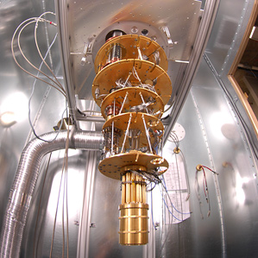
Quantum computer in a dilution fridge
20 mK = -273.13˚C = -459.634 ˚F
Using liquid helium

Slide 3
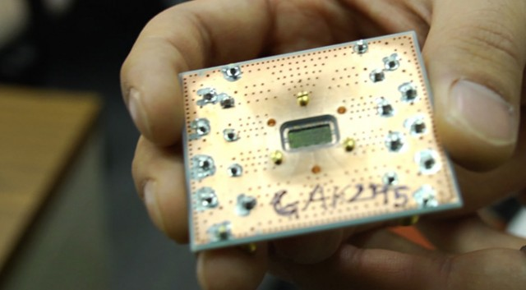
Quantum processor

Slide 4
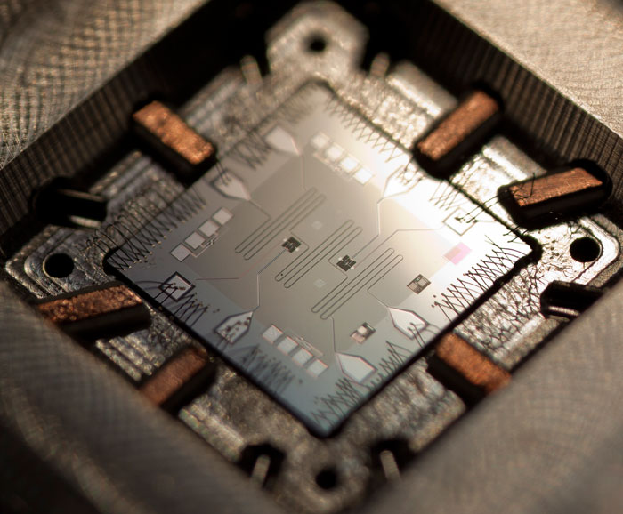
Quantum chip: 2 transmons

Slide 5
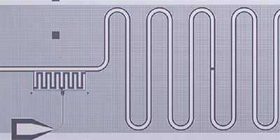
Transmon coupled to a 2D-cavity
2D – coaxial cable:
Needs to be long to fit one wavelength of several GHz wave signal.
F = c/λ - frequency
c = 300 000 000 m/s – speed of light
λ = 0.03 m – wavelength of RF signal
F = 300 000 000/0.03 = 10 GHz
Transmon:
charge qubit with a large capacitor
Artificial atom, with a huge dipole moment

Slide 6
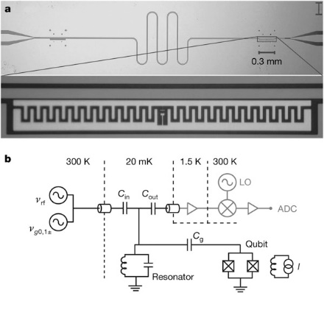
Transmon – CPB with a large capacitor

Slide 7
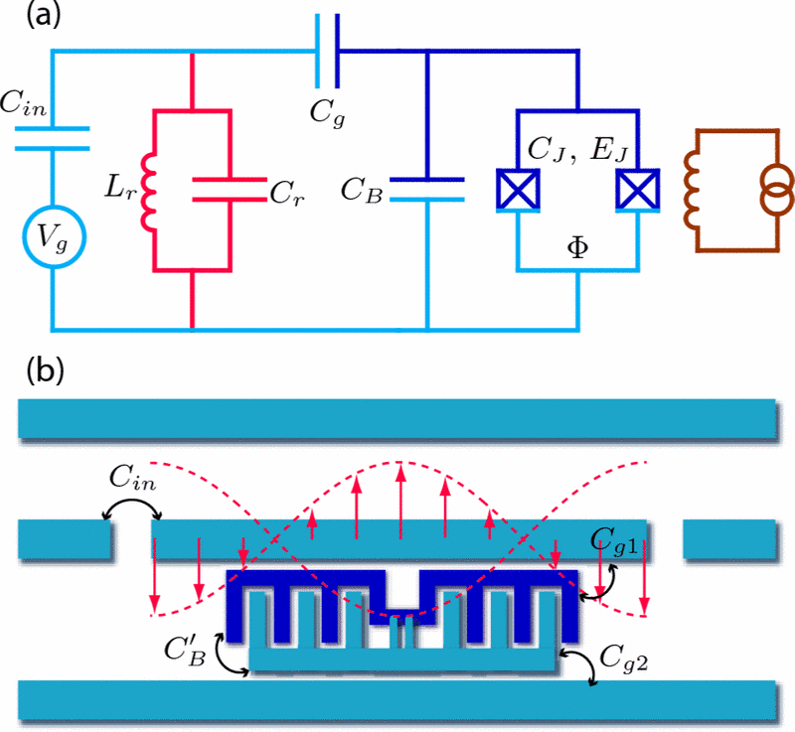
Cirquit diagram of a transmon

Slide 8
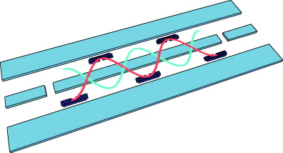
Coupling 5 transmons IBM public quantum computer

Slide 9
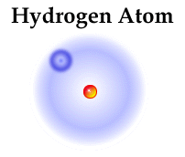
Real atom: hydrogen

Slide 10
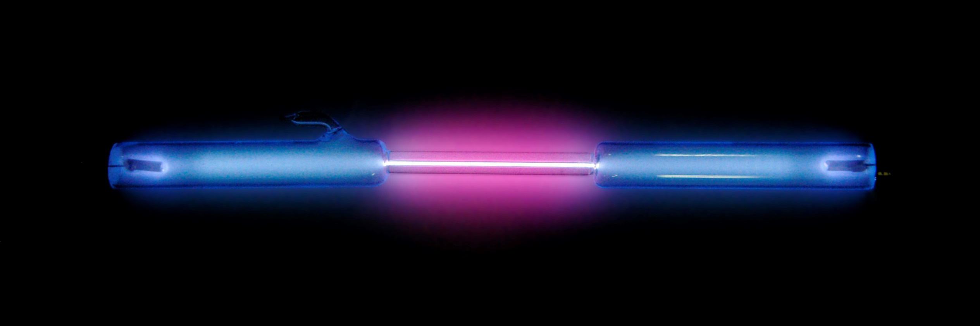
Hydrogen emits light when energy is supplied: high electric field, high temperature, etc

Slide 11

Hydrogen emission lines in visible spectrum
|6>
|5>
|4>
|3>

Slide 12
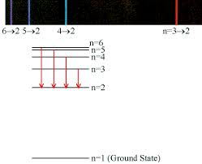
Electron energy transitions in hydrogen atom
Notice:
The energy levels are not equally spaced

Slide 13
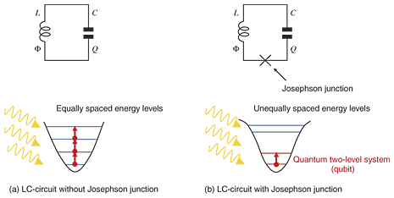
Artificial atom: quantum LC resonator – bad quantum JC resonator – good!

Slide 14
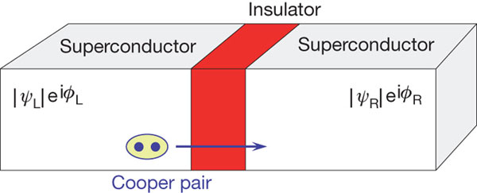
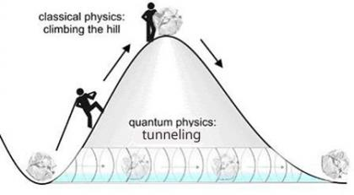
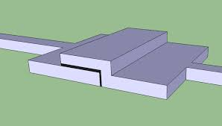
Josephson junction (non-linear inductor)

Slide 17
Superconductivity
Kamerlingh Onnes discovered in 1911 that mercury looses resistance at 4.2 K using liquid helium
Bardeen-Cooper-Schrieffer received the Nobel prize in 1972 on explaining the microscopic theory of superconductivity: electrons pair up into cooper-pairs and behave as bosons with lower energy in the ground state.

Slide 18
Josephson junction
Nobel prize in 1973 for discovering supercurrents of cooper-pairs that quantum-tunnel between two superconductors separated with a thin layer of a dielectric.

Slide 19
CryoPhysics
In 1978 Piotr Kapitsa received the nobel prize for discoveries in the area of low temperature physics: production of large quantities of liquid helium

