Slide 1
A COMPARISON OF TRAINING ERROR vs VALIDATION ERROR (USING KNN)

Slide 2
The Dataset
An automobile company has launched a new vehicle in the market. Given the age and the salary of the people, we need to predict whether they will buy the vehicle or not.
I’ve used KNN for predicting the sales of the vehicle.

Slide 3
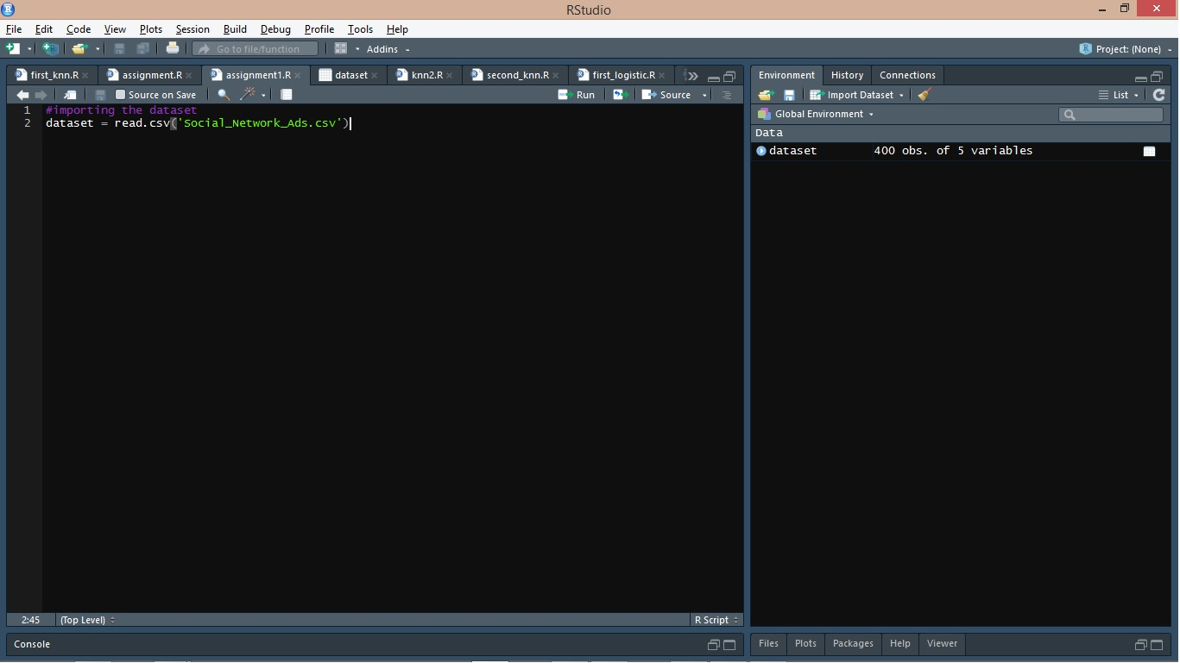
Notes:
I’ve imported the dataset

Slide 4
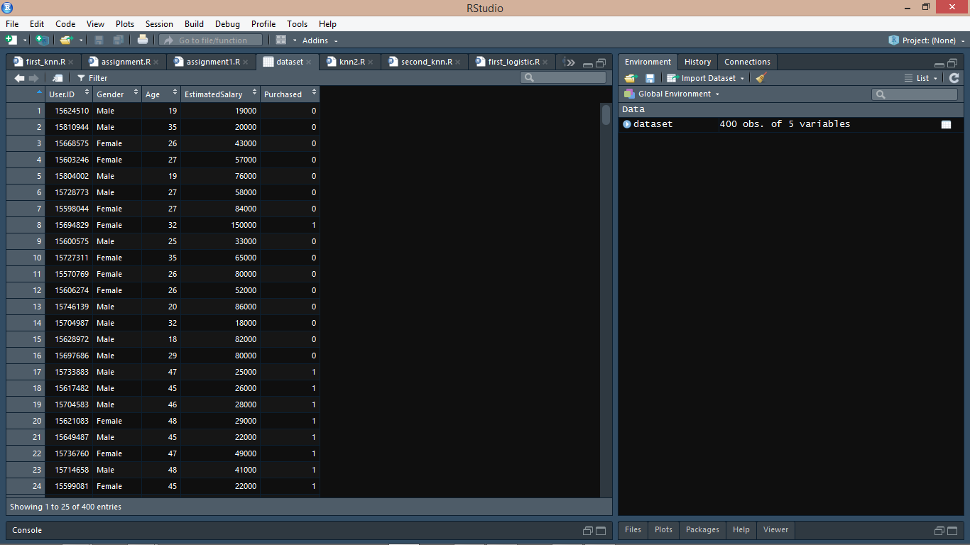
Notes:
The dataset consists of User_ID, Gender, Age, Estimated Salary and Purchased column. Since we only need the Age, Estimated Salary and Purchased, I will truncate the dataset to these three columns only.

Slide 5
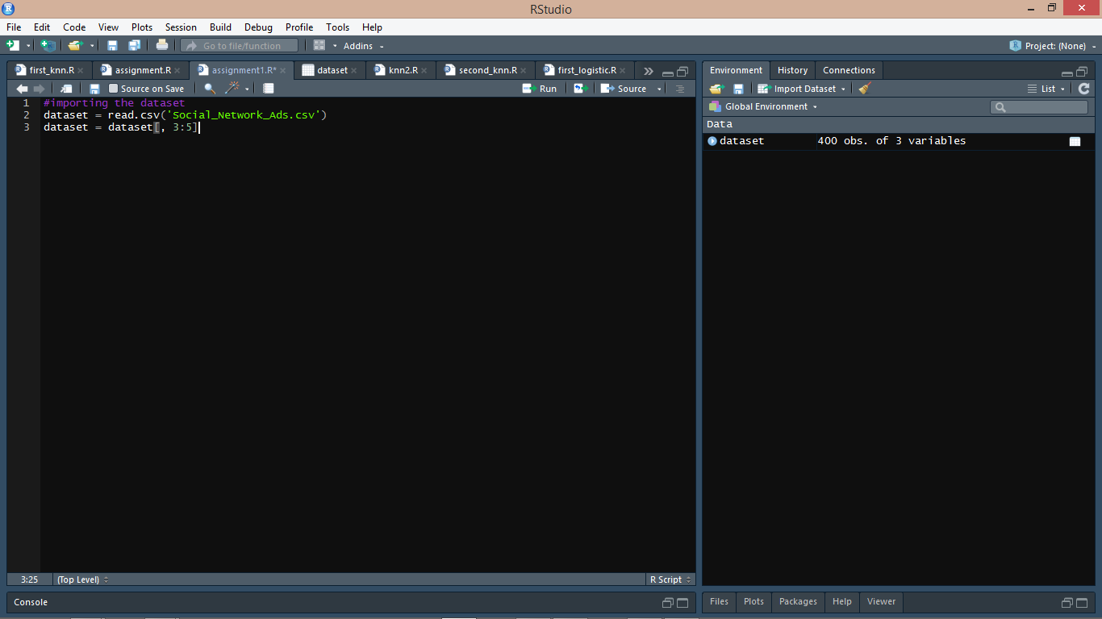
Notes:
The new dataset now has Age, Estimated Salary and purchased columns.
Here Age and Estimated Salary are the independent variables, and purchased is the dependent variable.

Slide 6
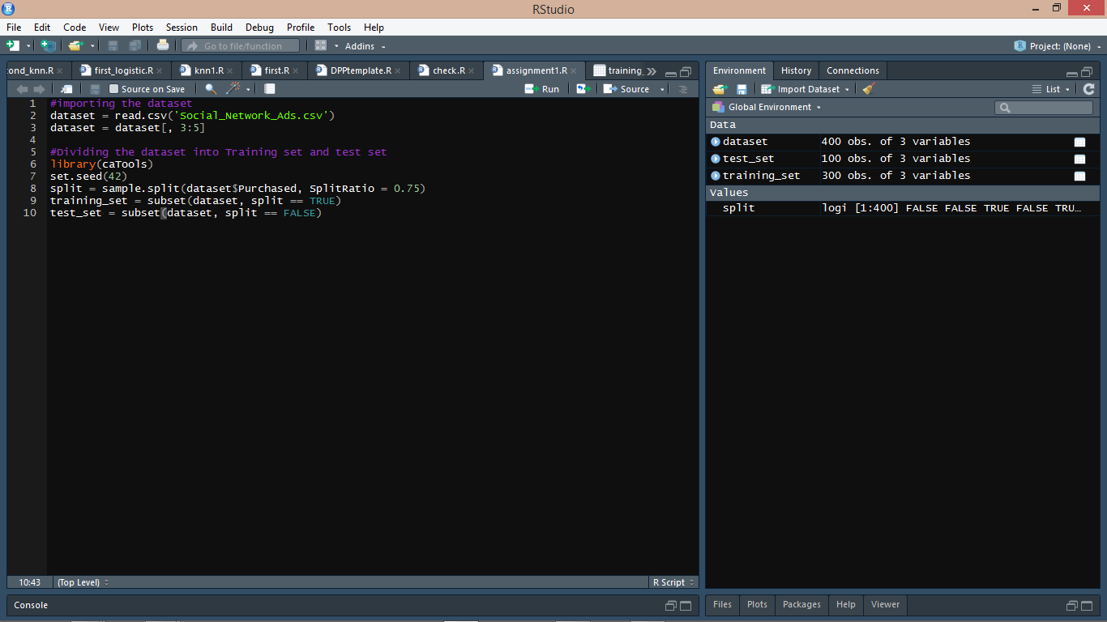
Notes:
Now I divide the dataset into test set and training set.

Slide 7
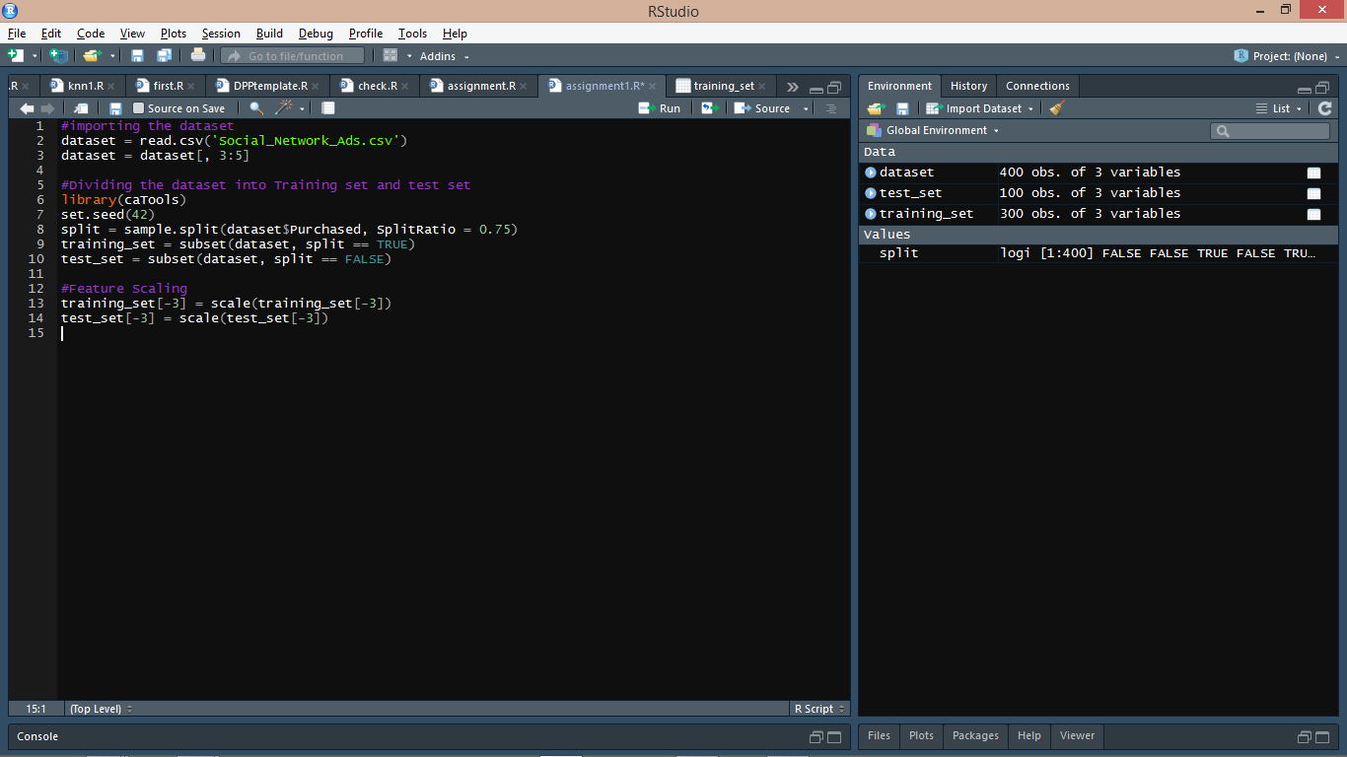
Notes:
Now, I scale the training set and test set

Slide 8
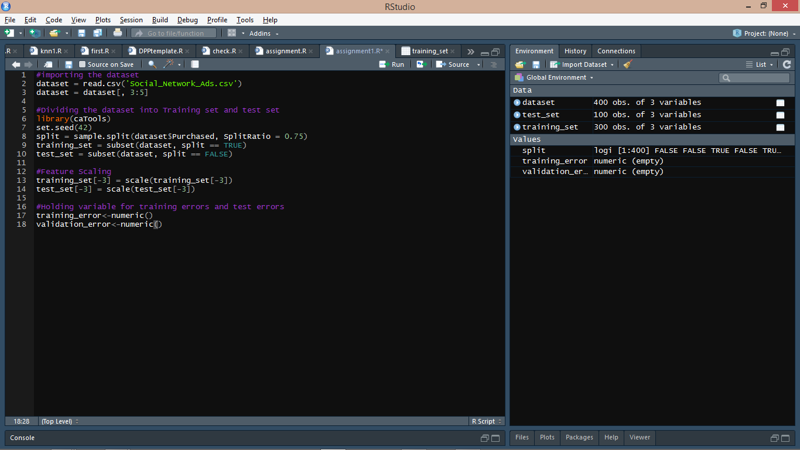
Notes:
Now, I create two new vectors – training_error and validation_error which hold the training errors and validation errors respectively.

Slide 9
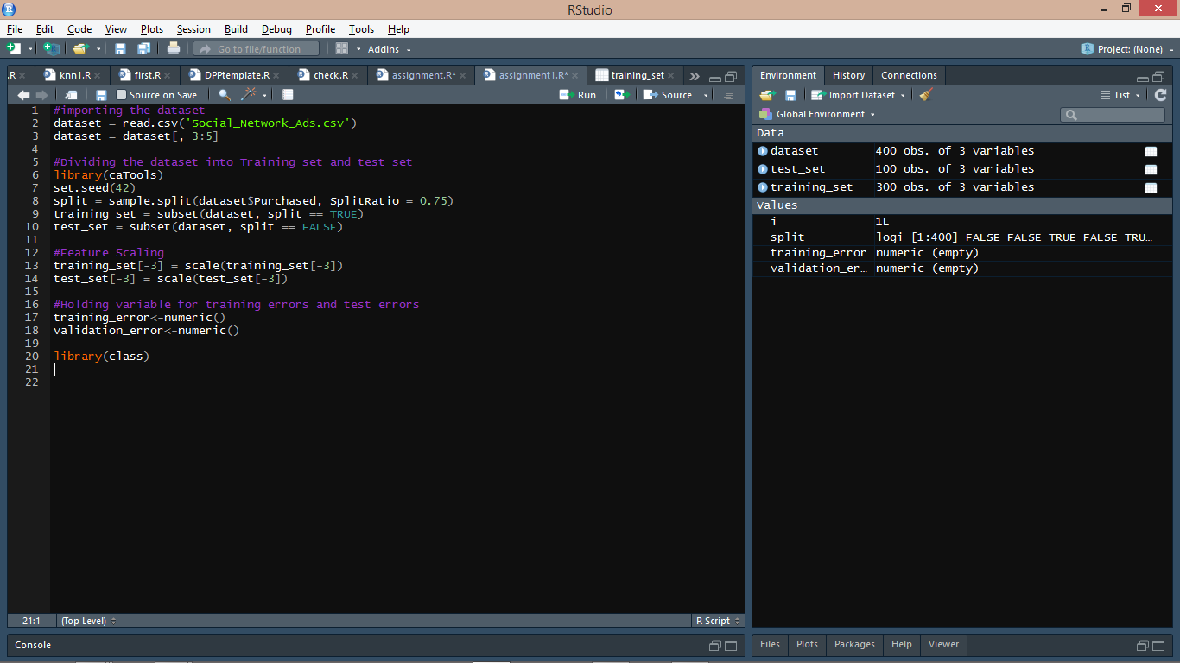
Notes:
Included the class library which contains the function KNN

Slide 10
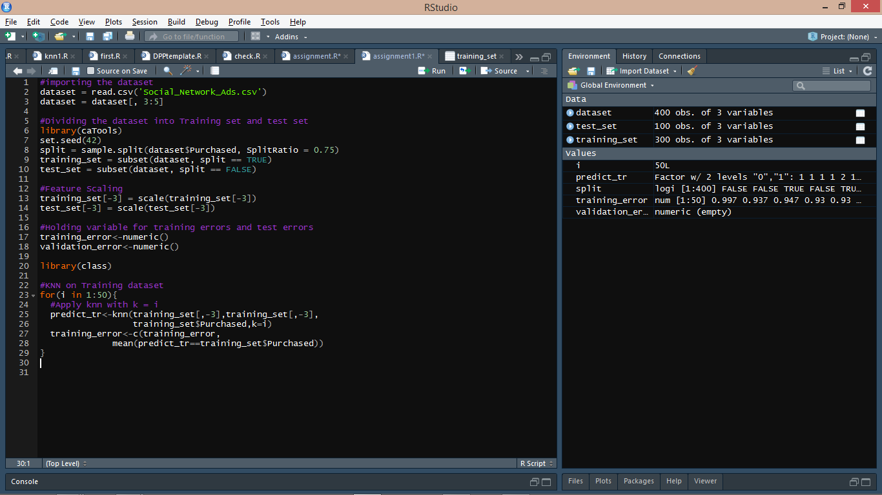
Notes:
Applying KNN for 1<K<50 on the dataset and storing the training error for each K in training_error

Slide 11
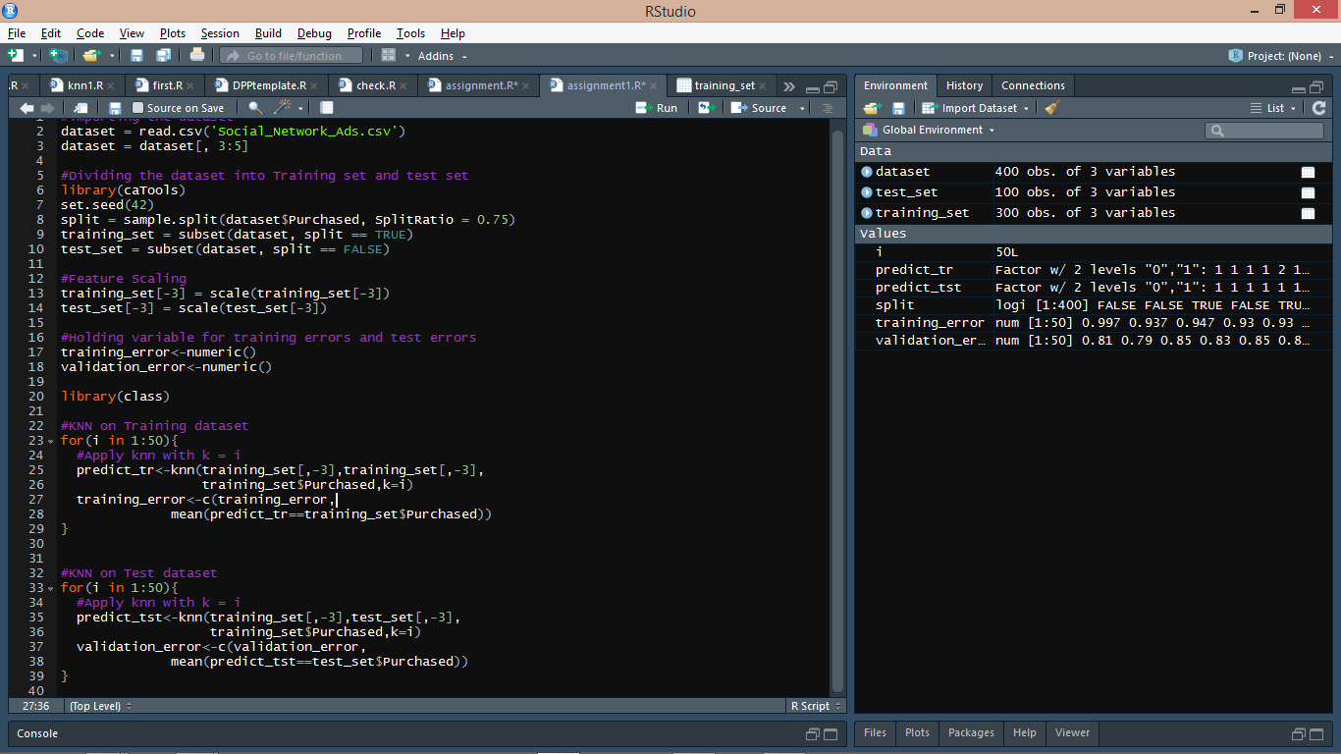
Notes:
Applying KNN for 1<K<50 on the dataset and storing the validation error for each K in validation_error

Slide 12
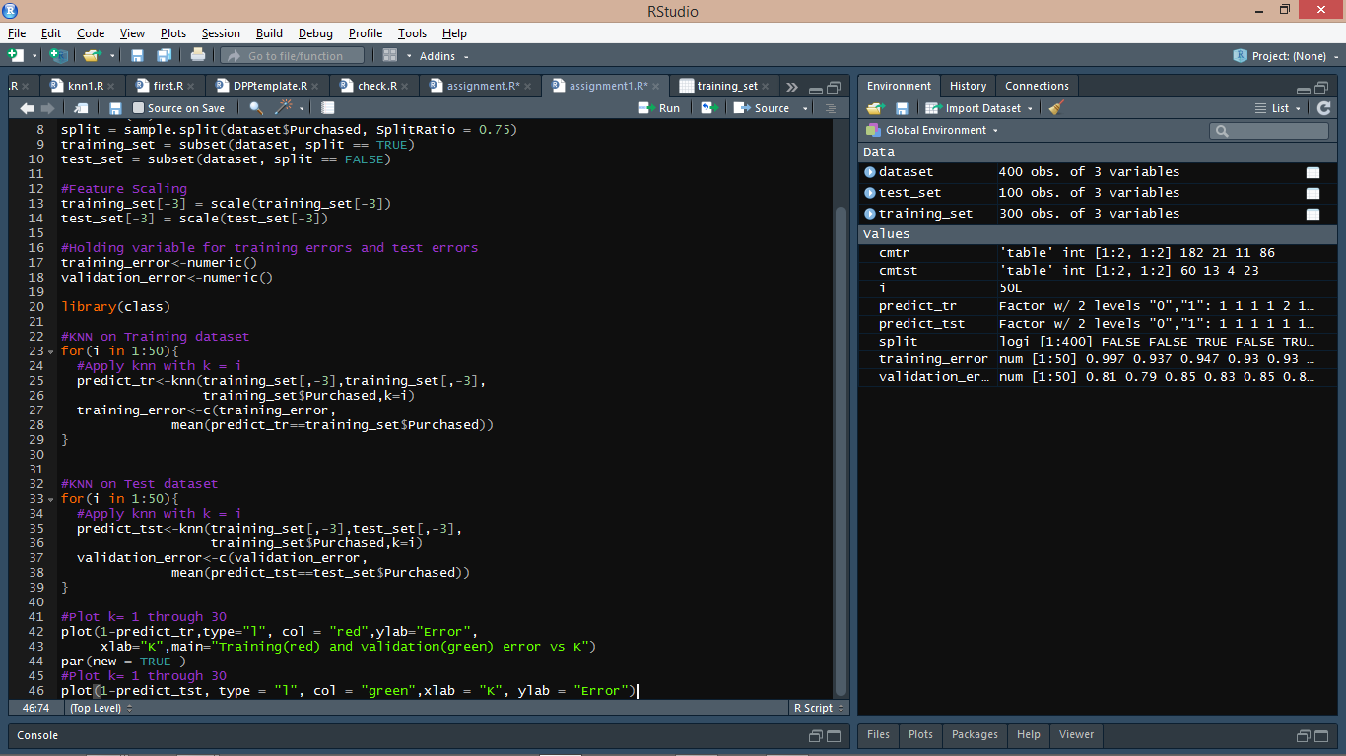
Notes:
Now, plotting the graphs for training error and validation error vs K

Slide 13
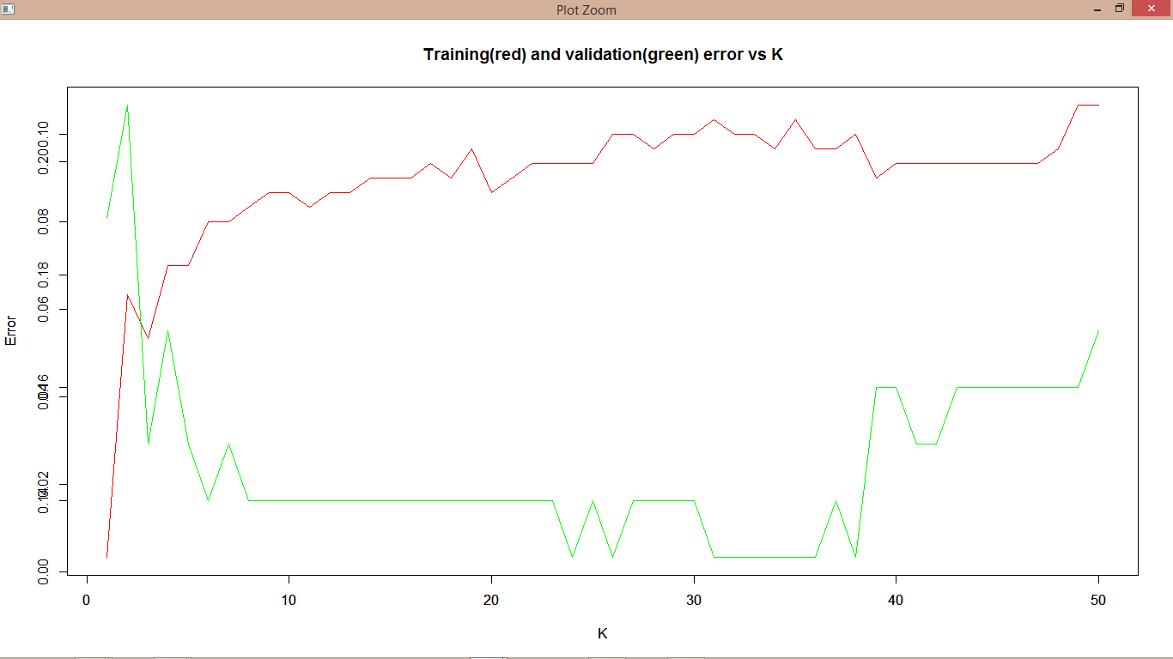
Notes:
This is the final plot which I obtained.

