Slide 1
Yasemin ceyhan
IBM HR Analytics Employee Attrition
Predicting Employee Attrition

Slide 2
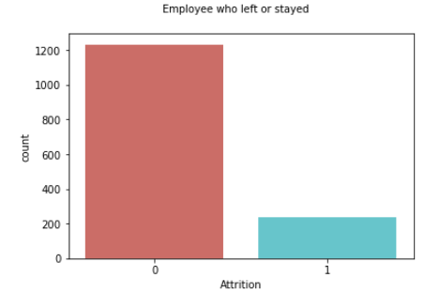
Employee attrition is a serious issue in order to compel companies to lose their competitive advantages.

Slide 3

The Problem
How employee attrition can be predicted or explained to reduce qualified employee turnovers?

Slide 4
Adaptive Solution
Identification of various factors having impact on employee attrition before revolution of HR policies.

Slide 5
How it works
Data Manipulation
Model Prediction
Decision
Data obtained from www.ibm.com and prepared before predicting of employee attrition by using some data wrangling methods.
Various machine learning algorithms used to predict turnovers.
The HR group will be ready to make more accurate decisions before introducing new human resources policies.

Slide 6


Slide 7
Models
Logistic Regression
Random Forest
Supported Vector Machine

Slide 8
Technical Details : The prediction of how often an employee in attrition displays highest precision with Support Vector Classifier model.
 | Logistic Regression | Random Forest Classifier | Support Vector Classifier
Precision | .75 | .97 | .99
Recall | .74 | .97 | .99

Slide 9
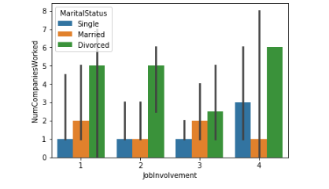
Model Combination
Top three main features having large influence of predicting employees’ turnover: ‘NumofCompaniesWorked’
‘JobInvolvement’ and‘MaritalStatus’.

Slide 10

Recommendations
Do we predict to find the best employee who is not likely to make turnover based on our findings?

Slide 11


Slide 12
Recommendations
Human Resources needs to follow more accurate strategies for employee retention process.
Based on our findings, people having experience in many companies and divorced with high job involvement are more likely to leave.
However, monthly or hourly rates do not play really effective role to have an attrition decision.

