Slide 1
B*-tree floorplan representation
Five blocks, one frame, and a tree that says where each block goes
learn_floorplanning — 03 bstar tree
Notes:
Five blocks, one frame, and a tree that says where each block goes. Can you build the picture from the tree alone? By the end, you will, and you will find the tightest picture of all.

Slide 2
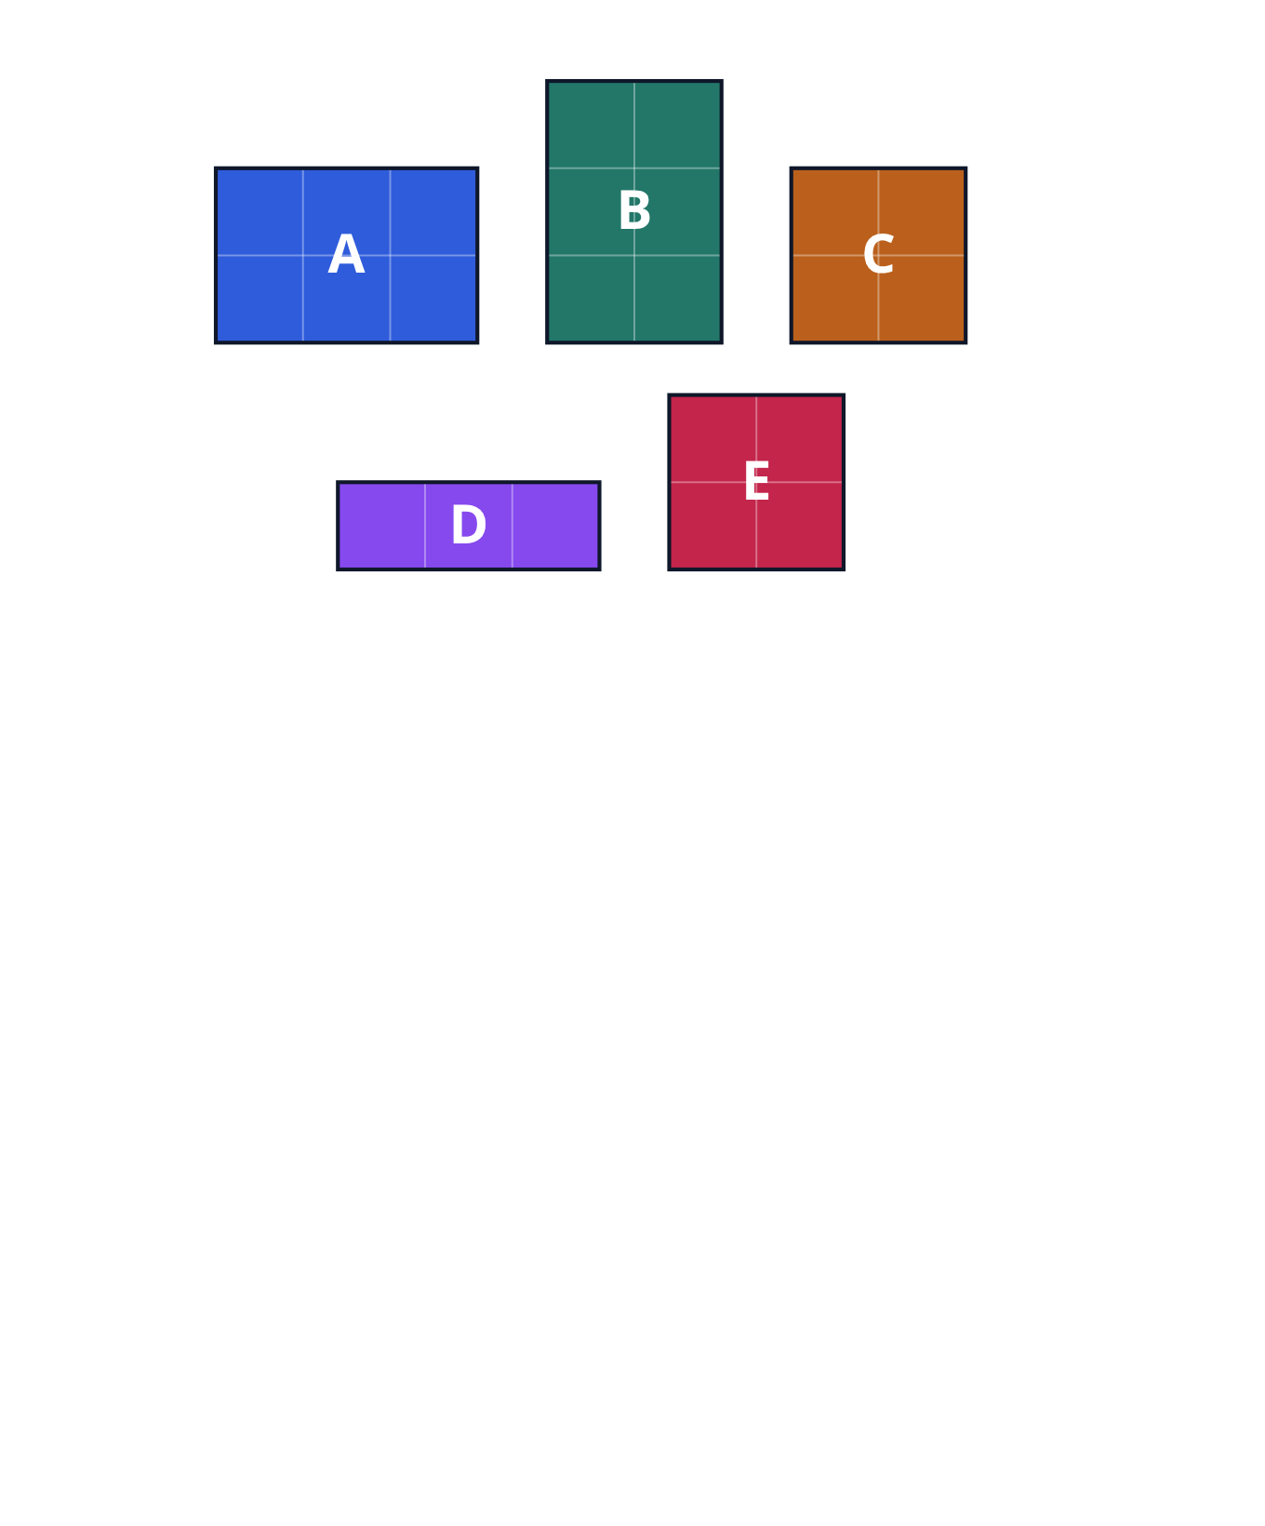
Five blocks
A chip is made of large rectangular parts, called blocks
Ours has five blocks, named A to E
They are drawn on squared paper, so you can count each width and height
learn_floorplanning — 03 bstar tree
Notes:
A chip is made of large rectangular parts, called blocks. Ours has five blocks, named A to E. They are drawn on squared paper, so you can count each width and height.

Slide 3
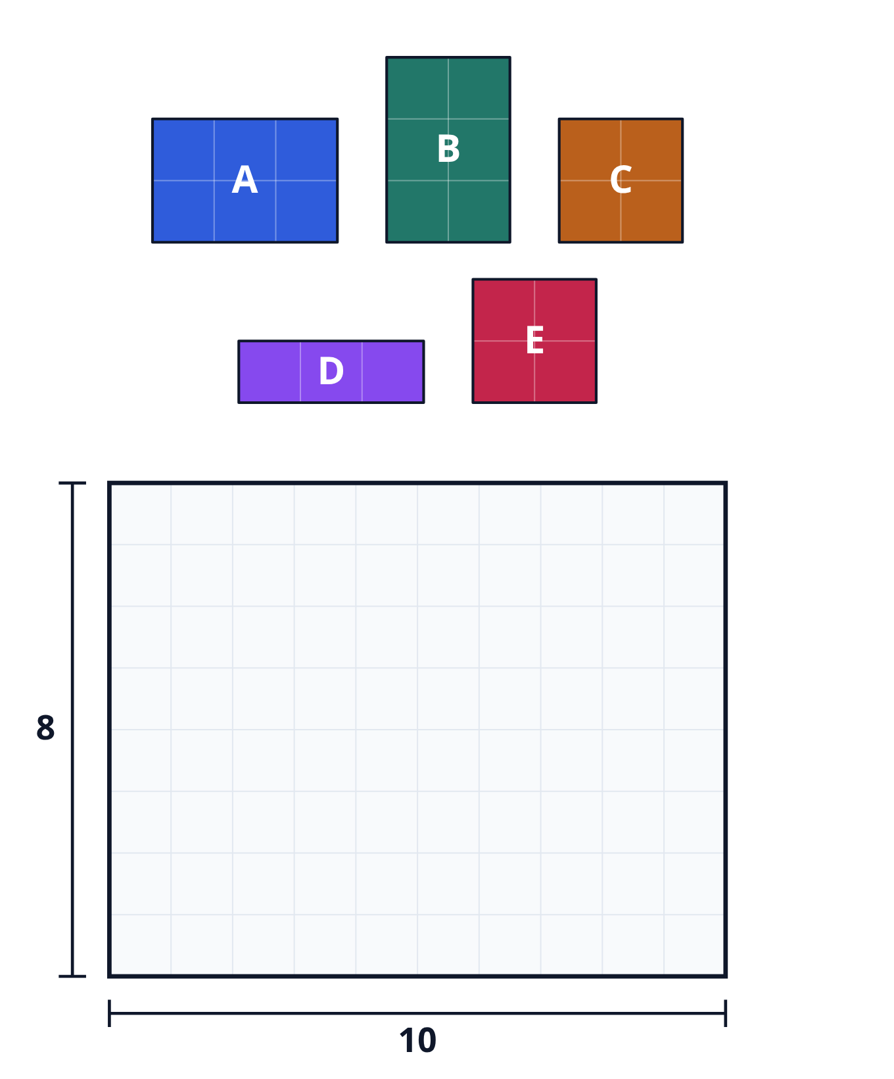
The outline
A floorplan says where each block sits on the chip
Every block must stay inside a frame called the outline
Our outline is ten squares wide and eight squares tall
The tighter the blocks are packed, the smaller the chip can be
learn_floorplanning — 03 bstar tree
Notes:
A floorplan says where each block sits on the chip. Every block must stay inside a frame called the outline. Our outline is ten squares wide and eight squares tall. The tighter the blocks are packed, the smaller the chip can be.

Slide 4
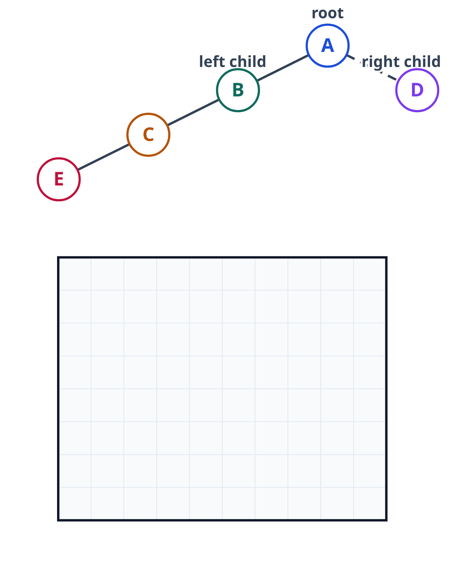
A tree as a recipe
Writing down every position is slow, so we use a recipe instead: a B-star tree
Each block is one node of the tree
The top node, A, is called the root
Each node can have two children: a left child and a right child
learn_floorplanning — 03 bstar tree
Notes:
Writing down every position is slow, so we use a recipe instead: a B-star tree. Each block is one node of the tree. The top node, A, is called the root. Each node can have two children: a left child and a right child.

Slide 5
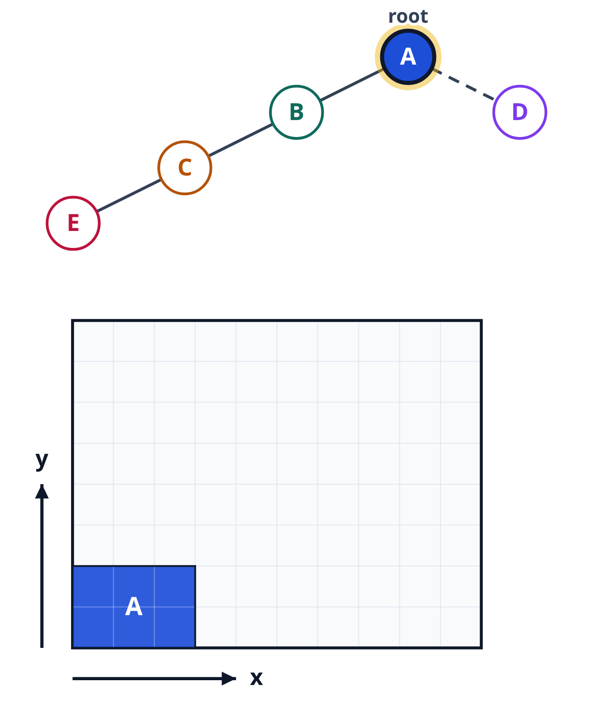
The root goes in the corner
The root goes in the lower-left corner of the outline
From that corner, x counts squares to the right, and y counts squares up
learn_floorplanning — 03 bstar tree
Notes:
The root goes in the lower-left corner of the outline. From that corner, x counts squares to the right, and y counts squares up.

Slide 6
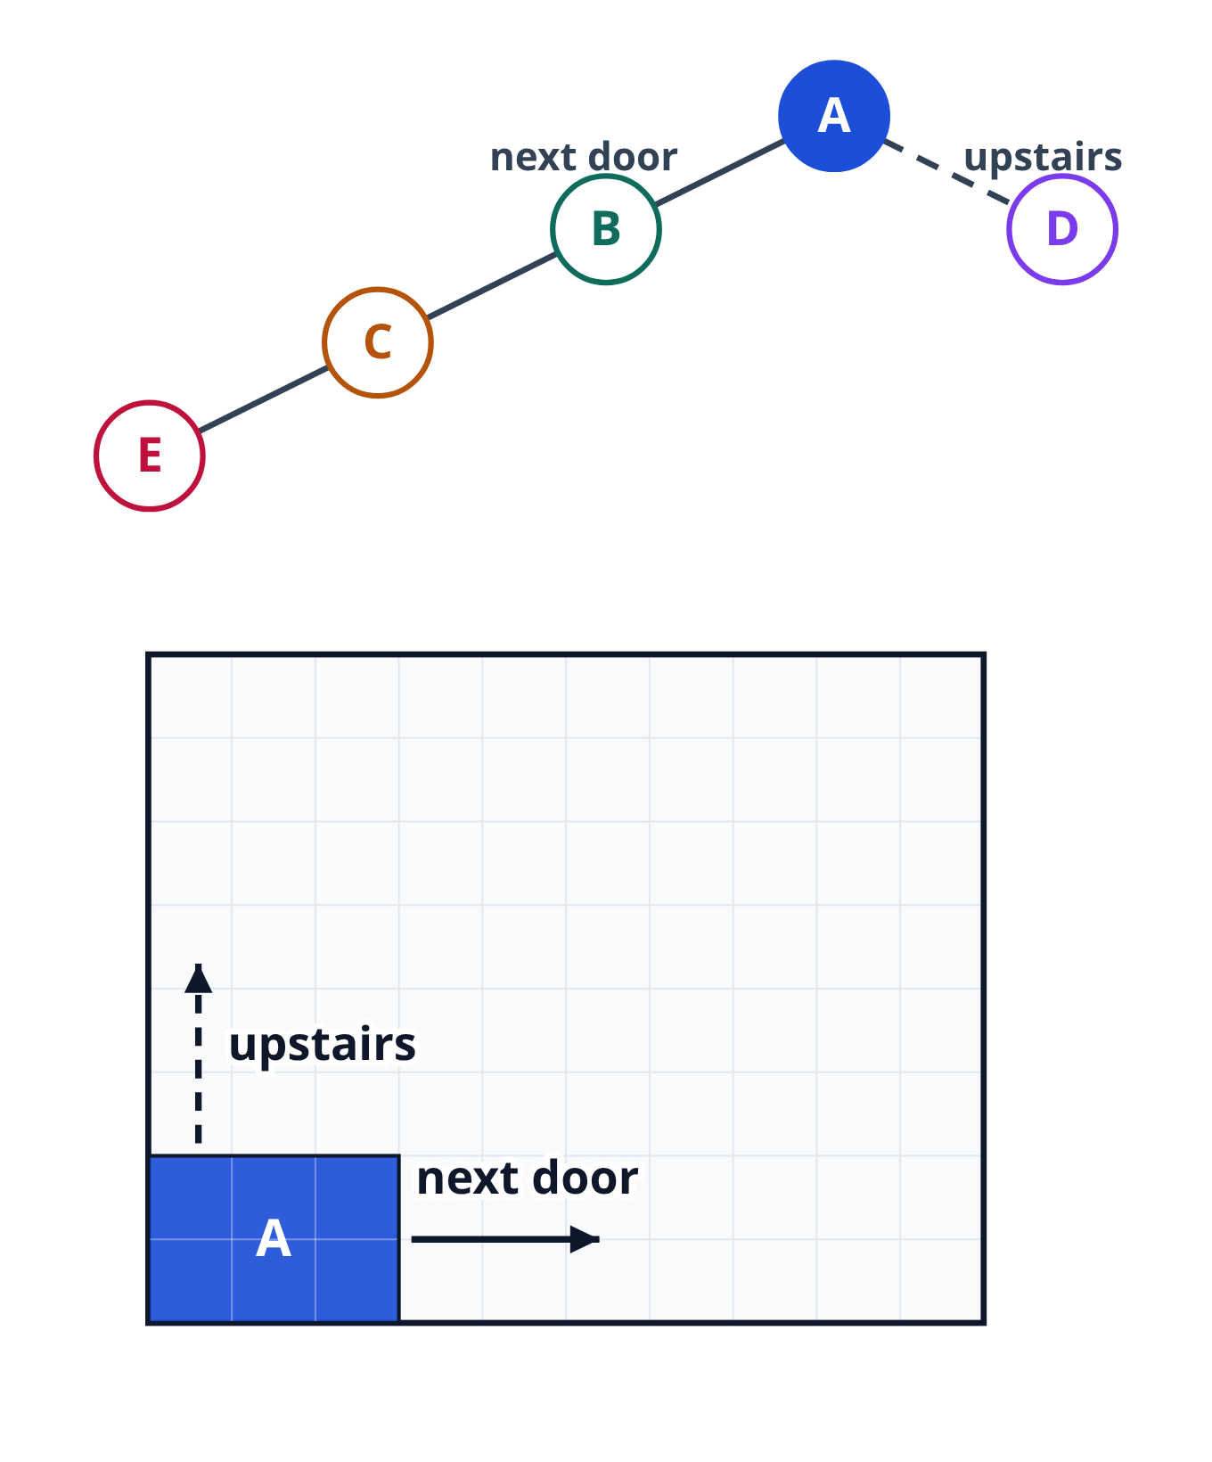
Left is next door, right is upstairs
A left child goes next door, right against its parent's right side
A right child goes upstairs, on top of its parent, with the same left edge
The names sound backwards, so remember: left means next door, right means upstairs
In the tree, a solid line means next door, and a dashed line means upstairs
learn_floorplanning — 03 bstar tree
Notes:
A left child goes next door, right against its parent's right side. A right child goes upstairs, on top of its parent, with the same left edge. The names sound backwards, so remember: left means next door, right means upstairs. In the tree, a solid line means next door, and a dashed line means upstairs.

Slide 7
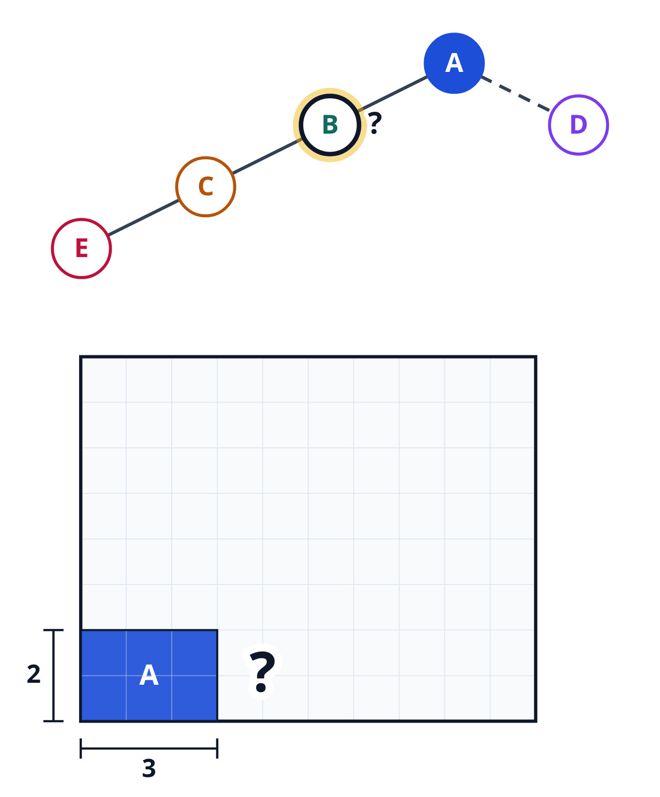
Where does B go?
A is three squares wide and two squares tall
B is A's left child
Pause and guess: where does B's left edge go?
learn_floorplanning — 03 bstar tree
Notes:
A is three squares wide and two squares tall. B is A's left child. Pause and guess: where does B's left edge go?

Slide 8
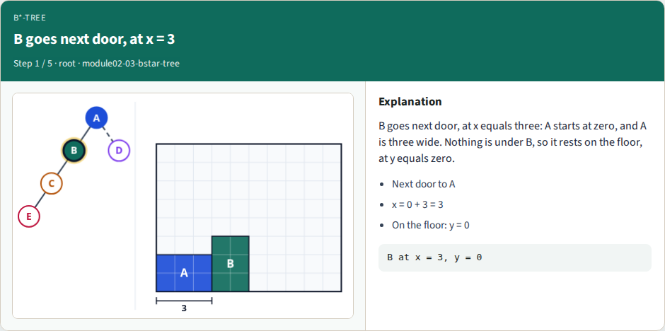
B goes next door, at x = 3
B goes next door, at x = 3
learn_floorplanning — 03 bstar tree
Notes:
B goes next door, at x equals three: A starts at zero, and A is three wide. Nothing is under B, so it rests on the floor, at y equals zero.

Slide 9
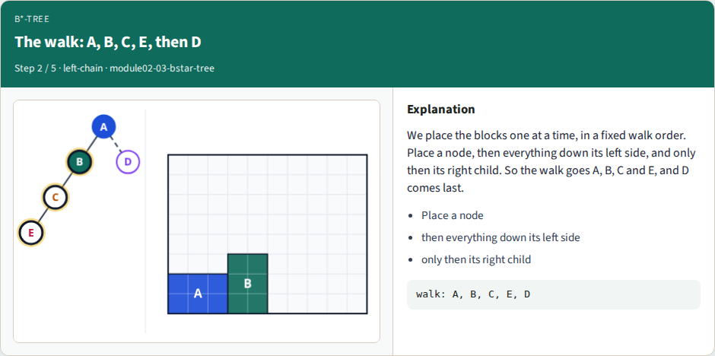
The walk: A, B, C, E, then D
The walk: A, B, C, E, then D
learn_floorplanning — 03 bstar tree
Notes:
We place the blocks one at a time, in a fixed walk order. Place a node, then everything down its left side, and only then its right child. So the walk goes A, B, C and E, and D comes last.

Slide 10
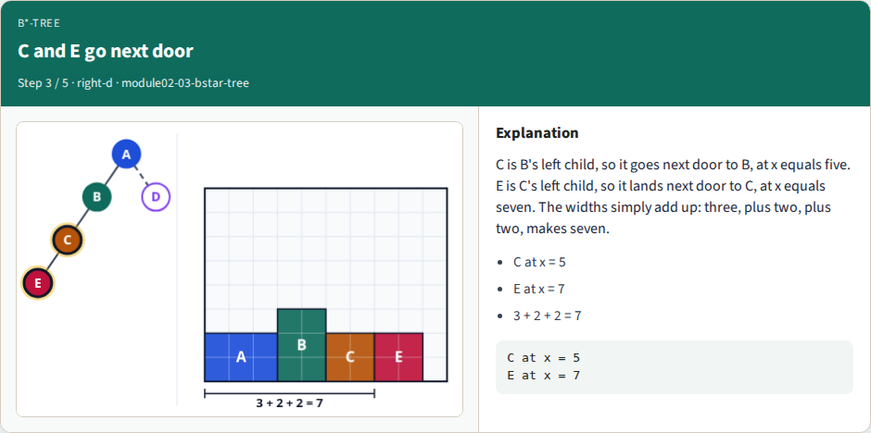
C and E go next door
C and E go next door
learn_floorplanning — 03 bstar tree
Notes:
C is B's left child, so it goes next door to B, at x equals five. E is C's left child, so it lands next door to C, at x equals seven. The widths simply add up: three, plus two, plus two, makes seven.

Slide 11
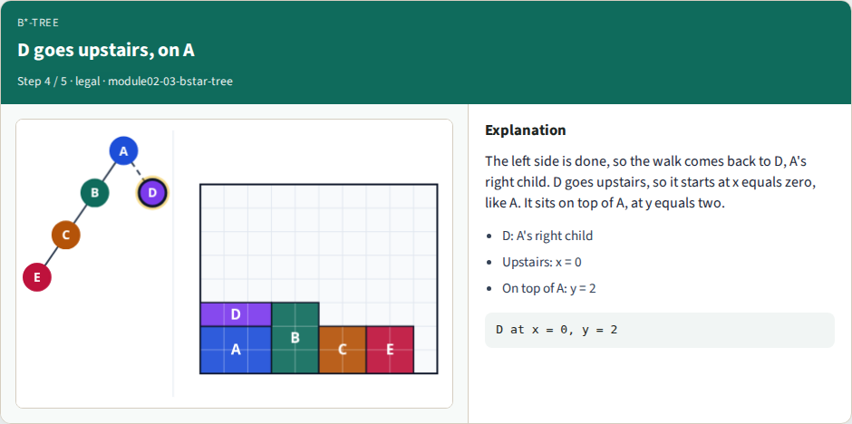
D goes upstairs, on A
D goes upstairs, on A
learn_floorplanning — 03 bstar tree
Notes:
The left side is done, so the walk comes back to D, A's right child. D goes upstairs, so it starts at x equals zero, like A. It sits on top of A, at y equals two.

Slide 12

Five blocks placed
Five blocks placed
learn_floorplanning — 03 bstar tree
Notes:
All five blocks are placed, and every one is inside the outline. Pause and guess: if we swap A and C in the tree, does D still land at y equals two?

Slide 13
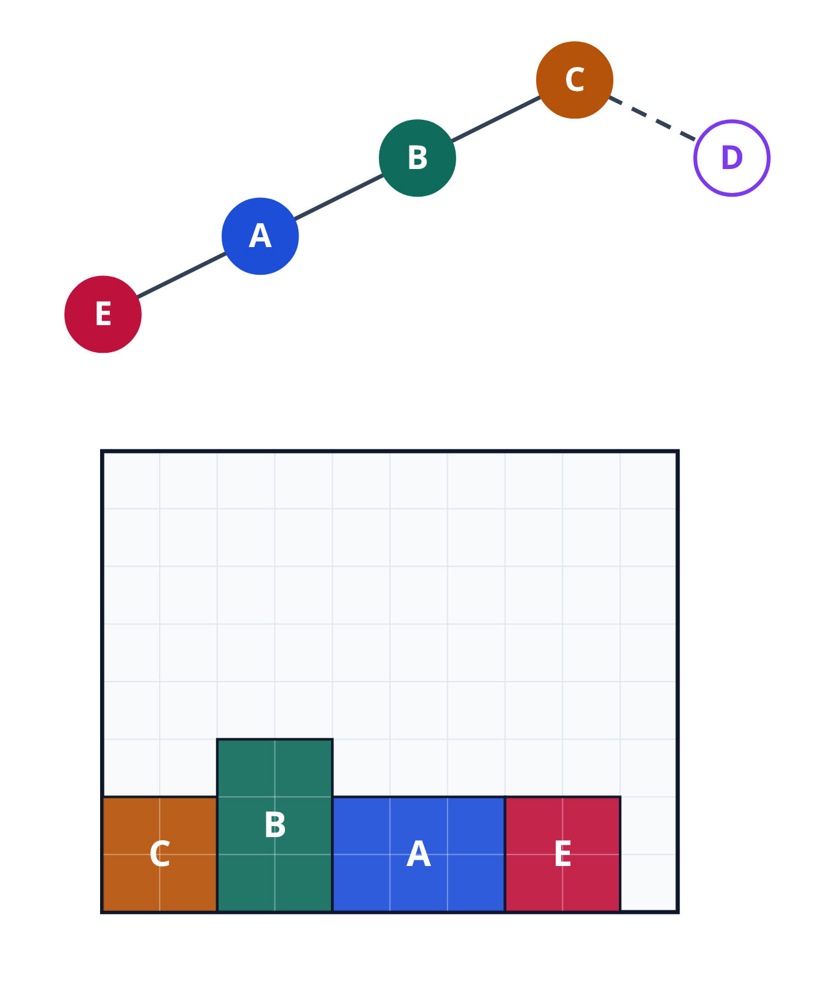
Swap A and C
No: D lands one square higher
Here is the tree with A and C swapped: C is the root, and A takes C's old place
C, B, A and E still go next door, one after the other
learn_floorplanning — 03 bstar tree
Notes:
No: D lands one square higher. Here is the tree with A and C swapped: C is the root, and A takes C's old place. C, B, A and E still go next door, one after the other.

Slide 14
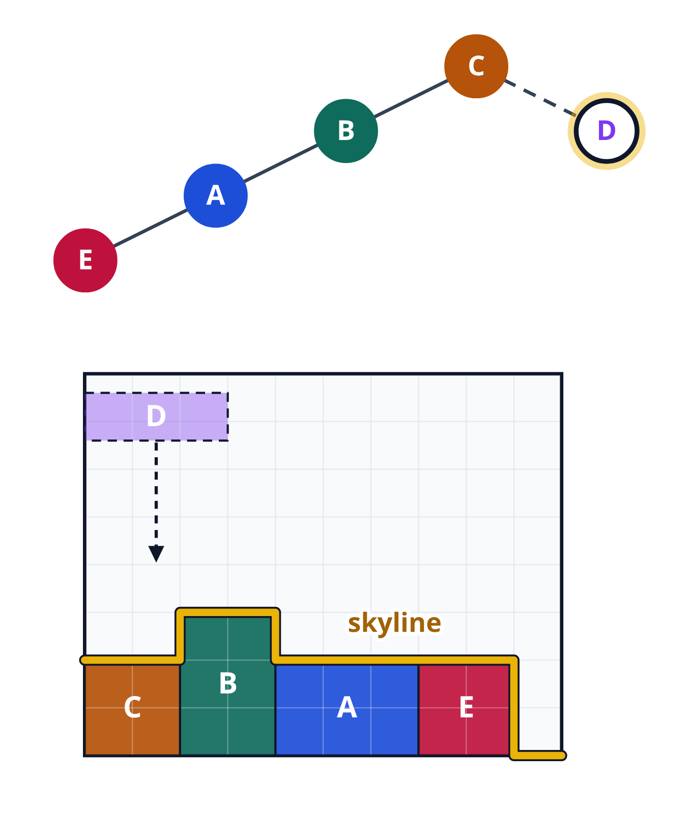
The skyline
Now picture the blocks as a city, seen from far away
The top edge of everything placed so far is the skyline
A new block drops from the sky, like a Tetris piece, until it touches the skyline
learn_floorplanning — 03 bstar tree
Notes:
Now picture the blocks as a city, seen from far away. The top edge of everything placed so far is the skyline. A new block drops from the sky, like a Tetris piece, until it touches the skyline.

Slide 15
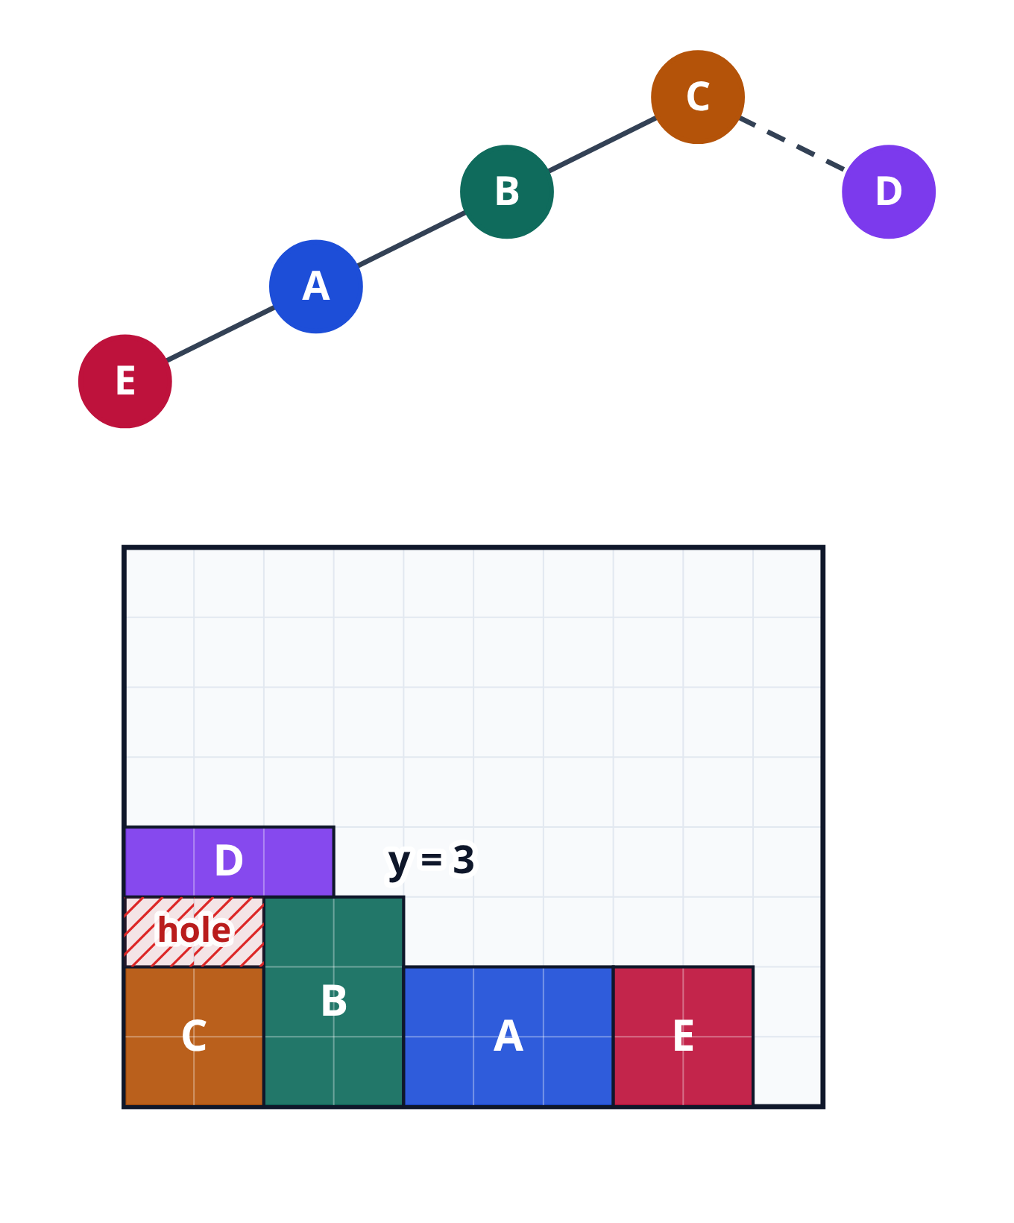
D lands on B
D is three wide, so it hangs over C and over part of B
B is three tall, so it stops D at y equals three
That leaves a hole of two empty squares above C
learn_floorplanning — 03 bstar tree
Notes:
D is three wide, so it hangs over C and over part of B. B is three tall, so it stops D at y equals three. That leaves a hole of two empty squares above C.

Slide 16
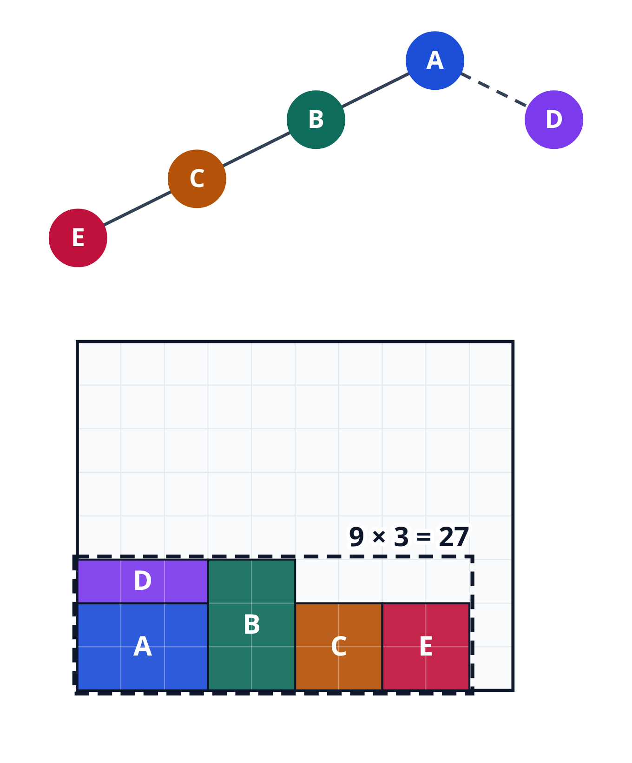
The bounding box
So which floorplan is better?
To compare, we draw the bounding box: the smallest rectangle around all the blocks
For the first tree, it is nine wide and three tall: twenty-seven squares
learn_floorplanning — 03 bstar tree
Notes:
So which floorplan is better? To compare, we draw the bounding box: the smallest rectangle around all the blocks. For the first tree, it is nine wide and three tall: twenty-seven squares.

Slide 17

Wasted space
The five blocks cover twenty-three squares
The other four squares in the box are empty: that is wasted space
Fewer wasted squares means a tighter floorplan
learn_floorplanning — 03 bstar tree
Notes:
The five blocks cover twenty-three squares. The other four squares in the box are empty: that is wasted space. Fewer wasted squares means a tighter floorplan.

Slide 18
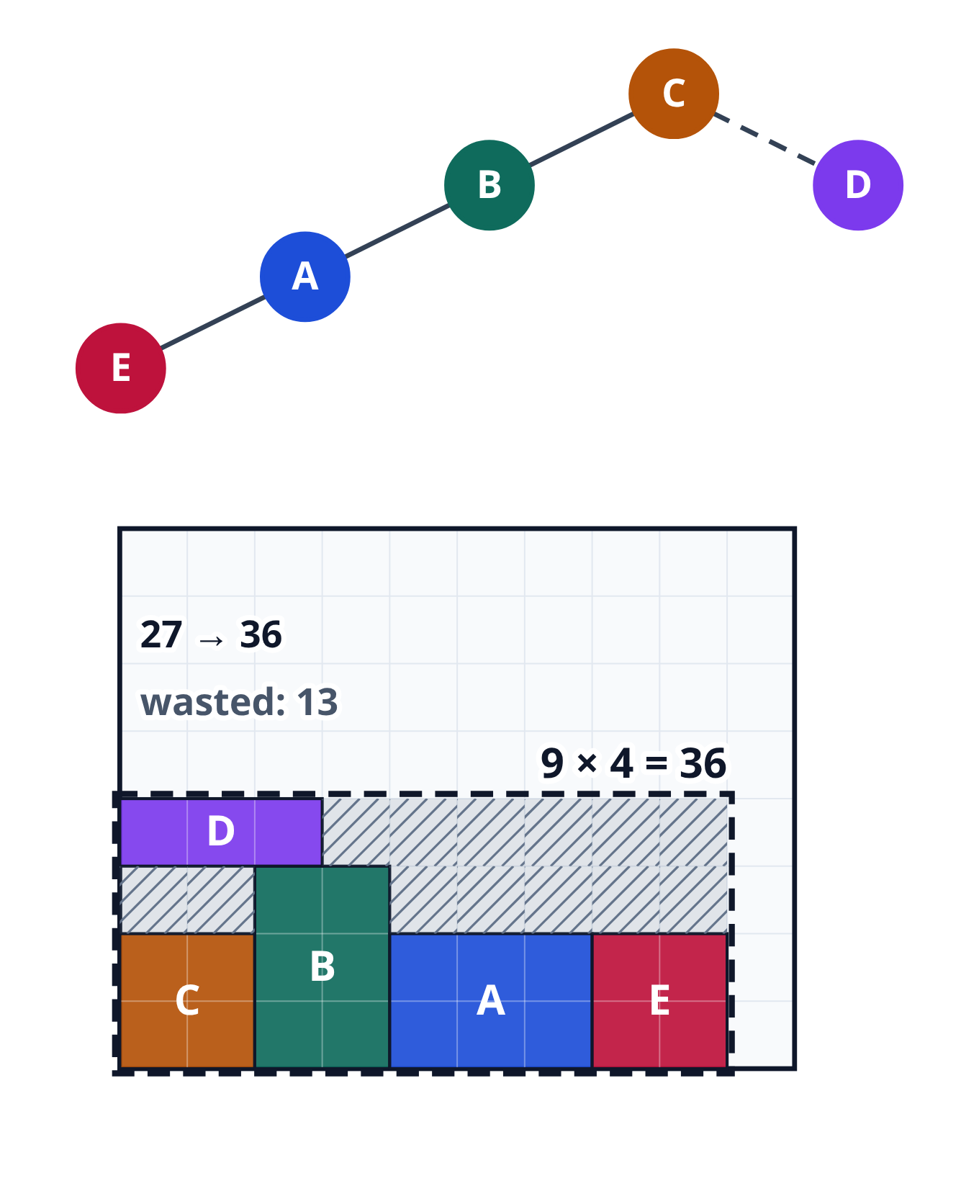
One swap, a worse score
The swapped tree needs a box nine by four: thirty-six squares, with thirteen wasted
So one swap of two names changed the picture and the score
Twenty-seven became thirty-six: the first tree is better
learn_floorplanning — 03 bstar tree
Notes:
The swapped tree needs a box nine by four: thirty-six squares, with thirteen wasted. So one swap of two names changed the picture and the score. Twenty-seven became thirty-six: the first tree is better.

Slide 19
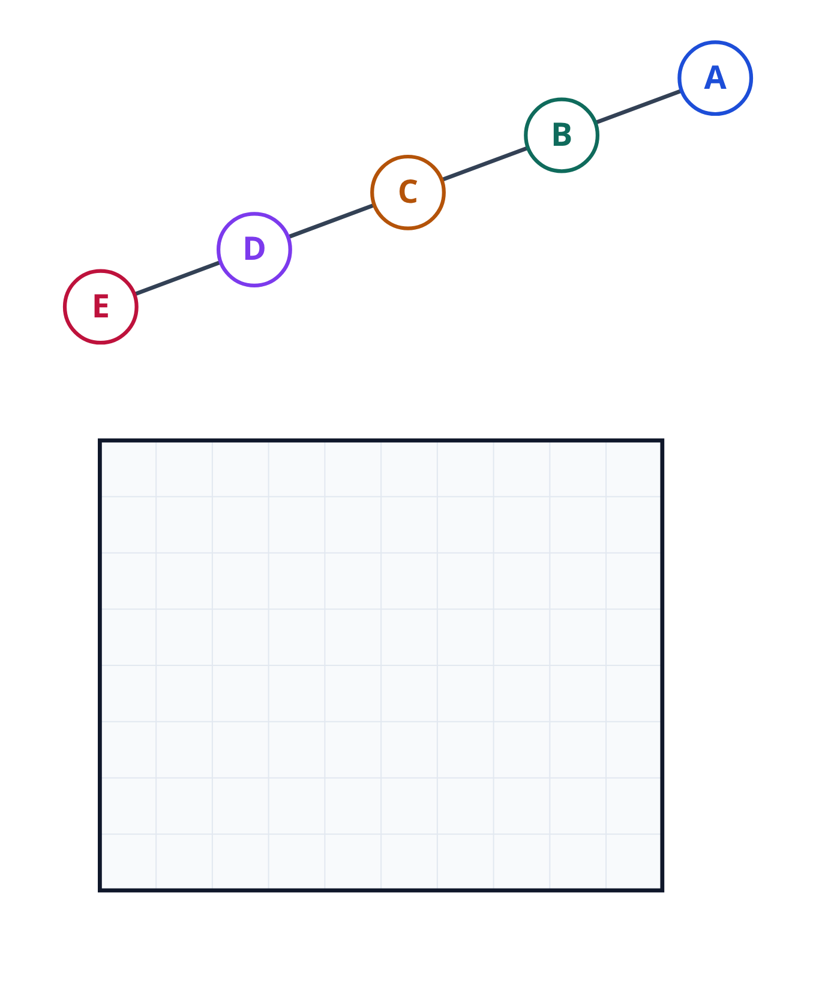
One long row
Now take a tree where every child is a left child
Pause and guess: will this long row fit inside the outline?
learn_floorplanning — 03 bstar tree
Notes:
Now take a tree where every child is a left child. Pause and guess: will this long row fit inside the outline?

Slide 20
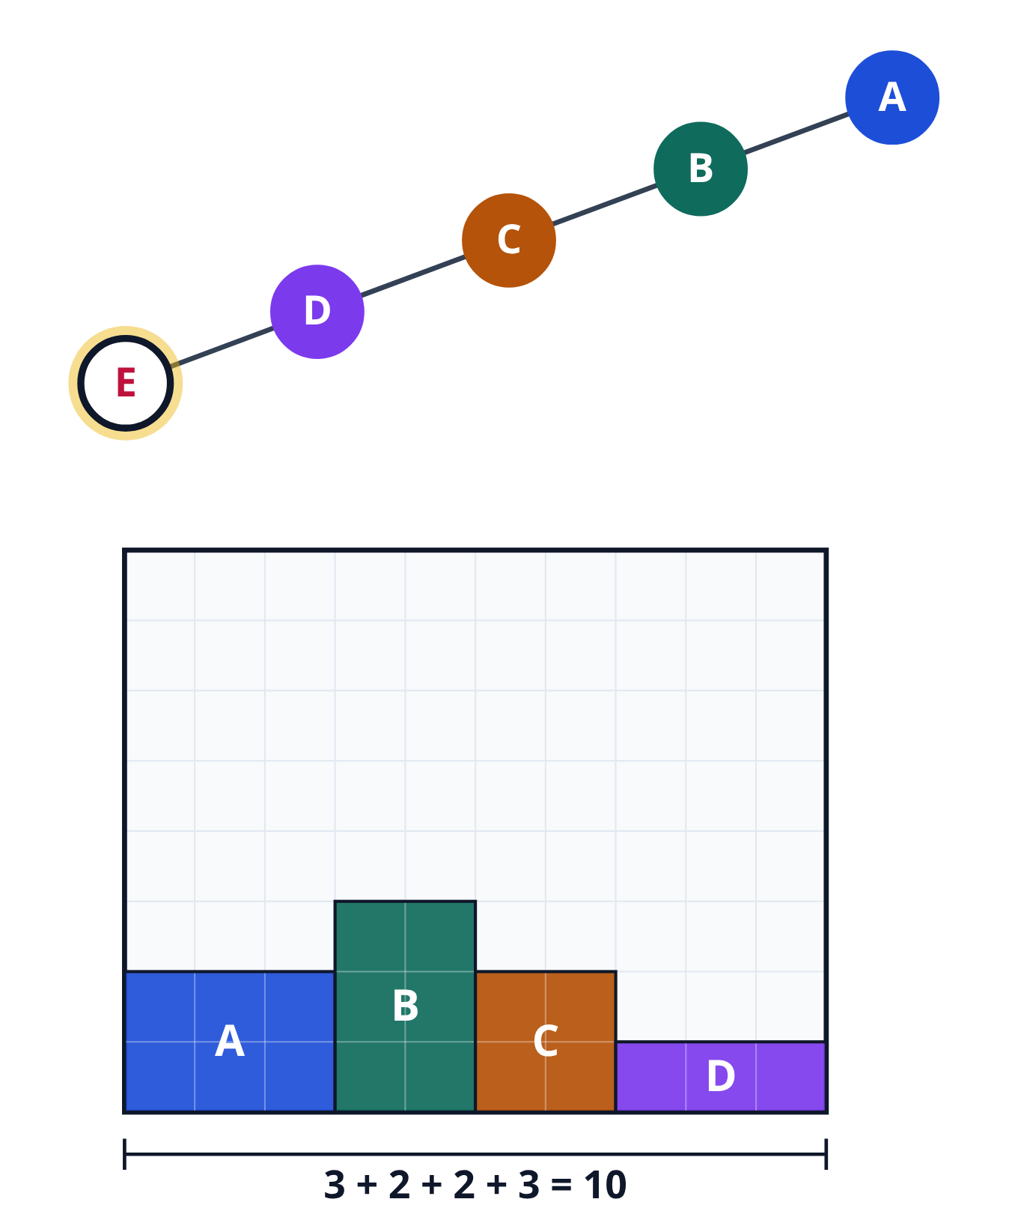
Every block next door
No, it will not fit
Every block goes next door: three, two, two and three make ten
The outline is already full, and E is still waiting
learn_floorplanning — 03 bstar tree
Notes:
No, it will not fit. Every block goes next door: three, two, two and three make ten. The outline is already full, and E is still waiting.

Slide 21
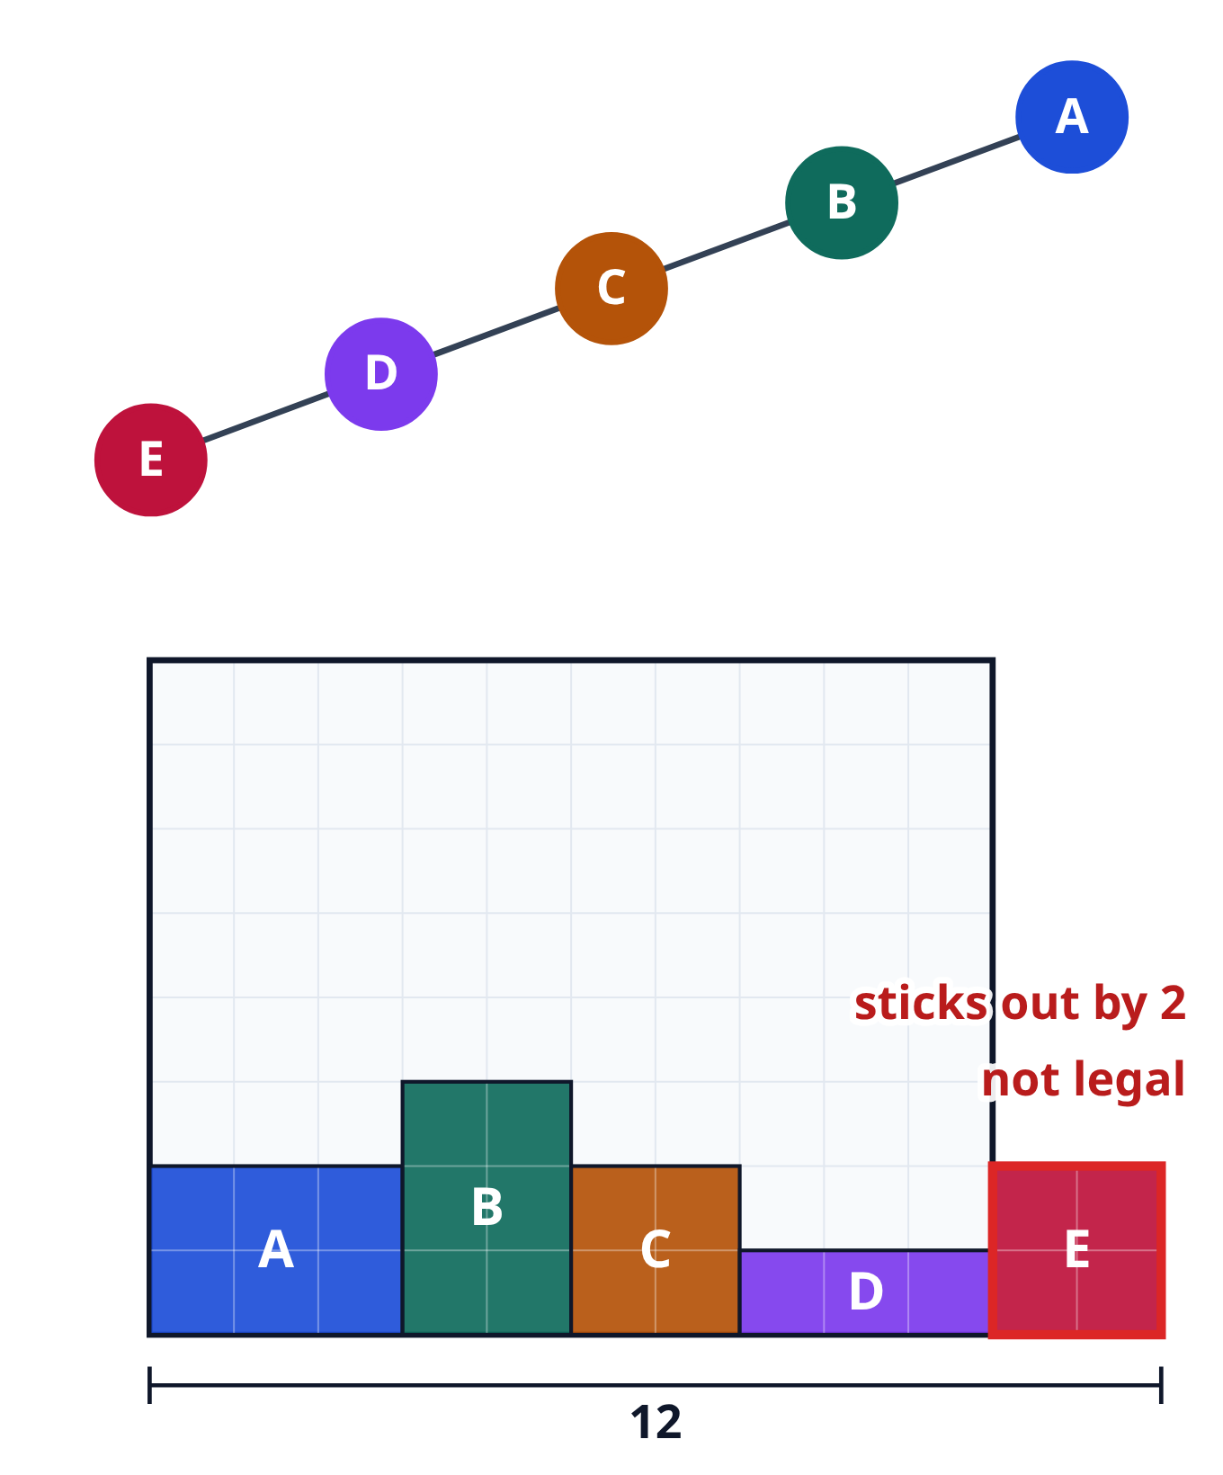
Sticking out
E lands at x equals ten, so the row is twelve squares wide
E sticks out of the outline by two squares
A floorplan is legal only when every block is inside the outline
So this row is not legal
learn_floorplanning — 03 bstar tree
Notes:
E lands at x equals ten, so the row is twelve squares wide. E sticks out of the outline by two squares. A floorplan is legal only when every block is inside the outline. So this row is not legal.

Slide 22
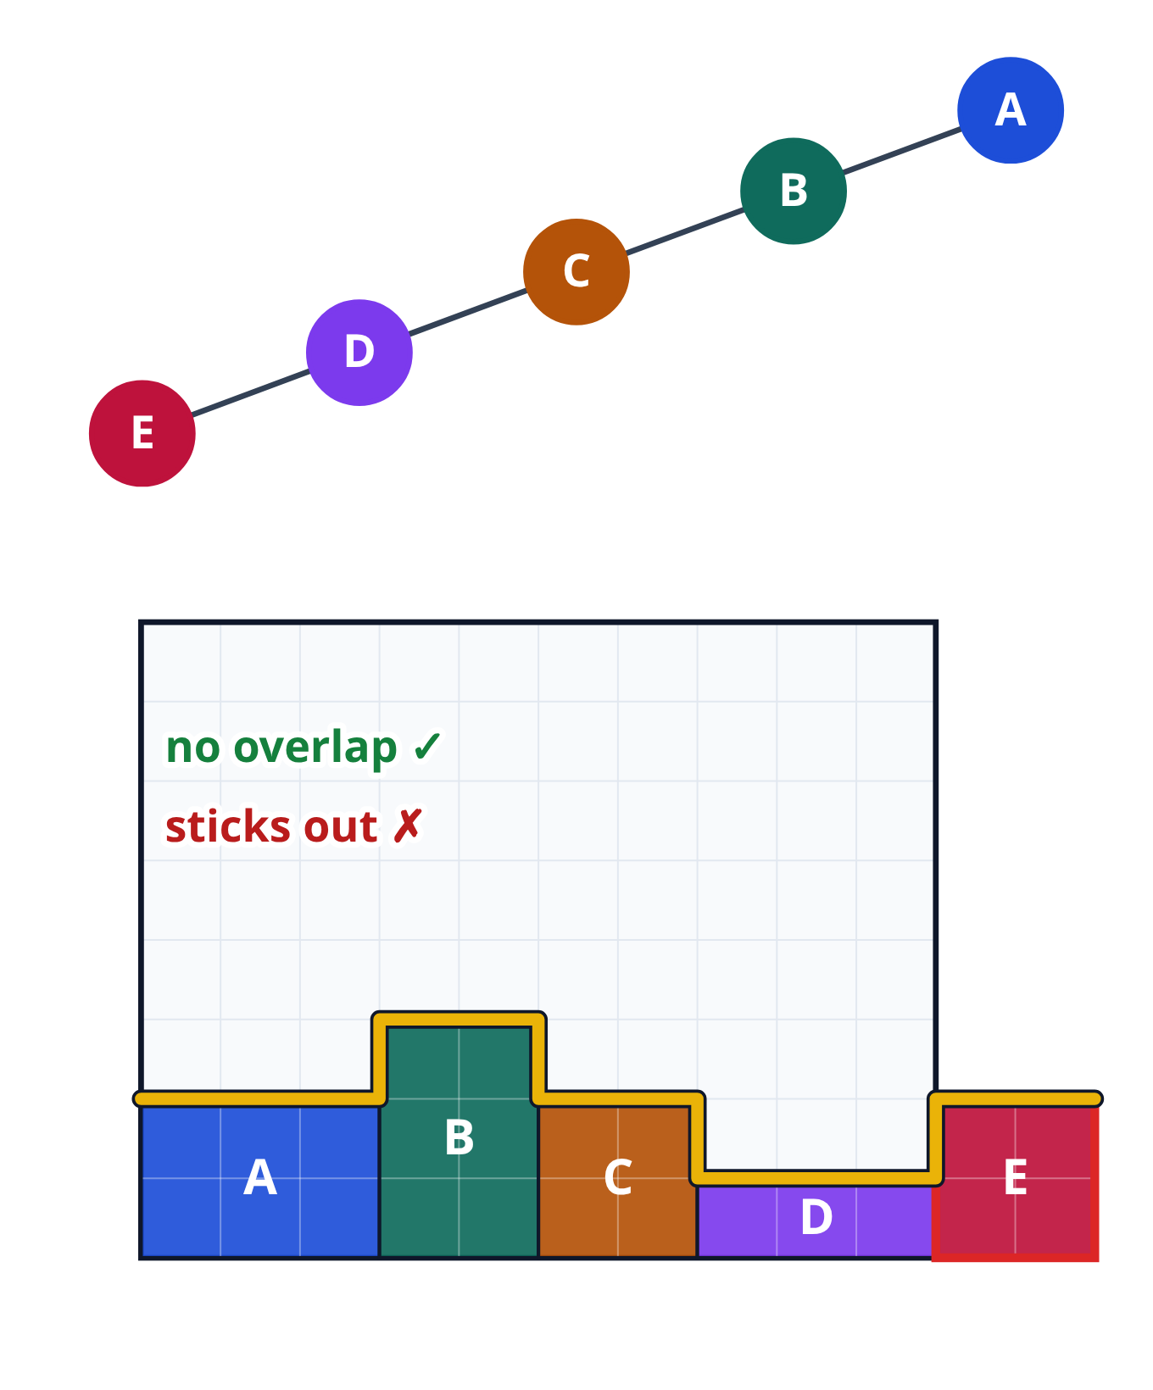
Never an overlap
Notice that the blocks never overlap
Each block drops onto the skyline, so it can never land inside another one
With a B-star tree, sticking out is the only way to fail
learn_floorplanning — 03 bstar tree
Notes:
Notice that the blocks never overlap. Each block drops onto the skyline, so it can never land inside another one. With a B-star tree, sticking out is the only way to fail.

Slide 23
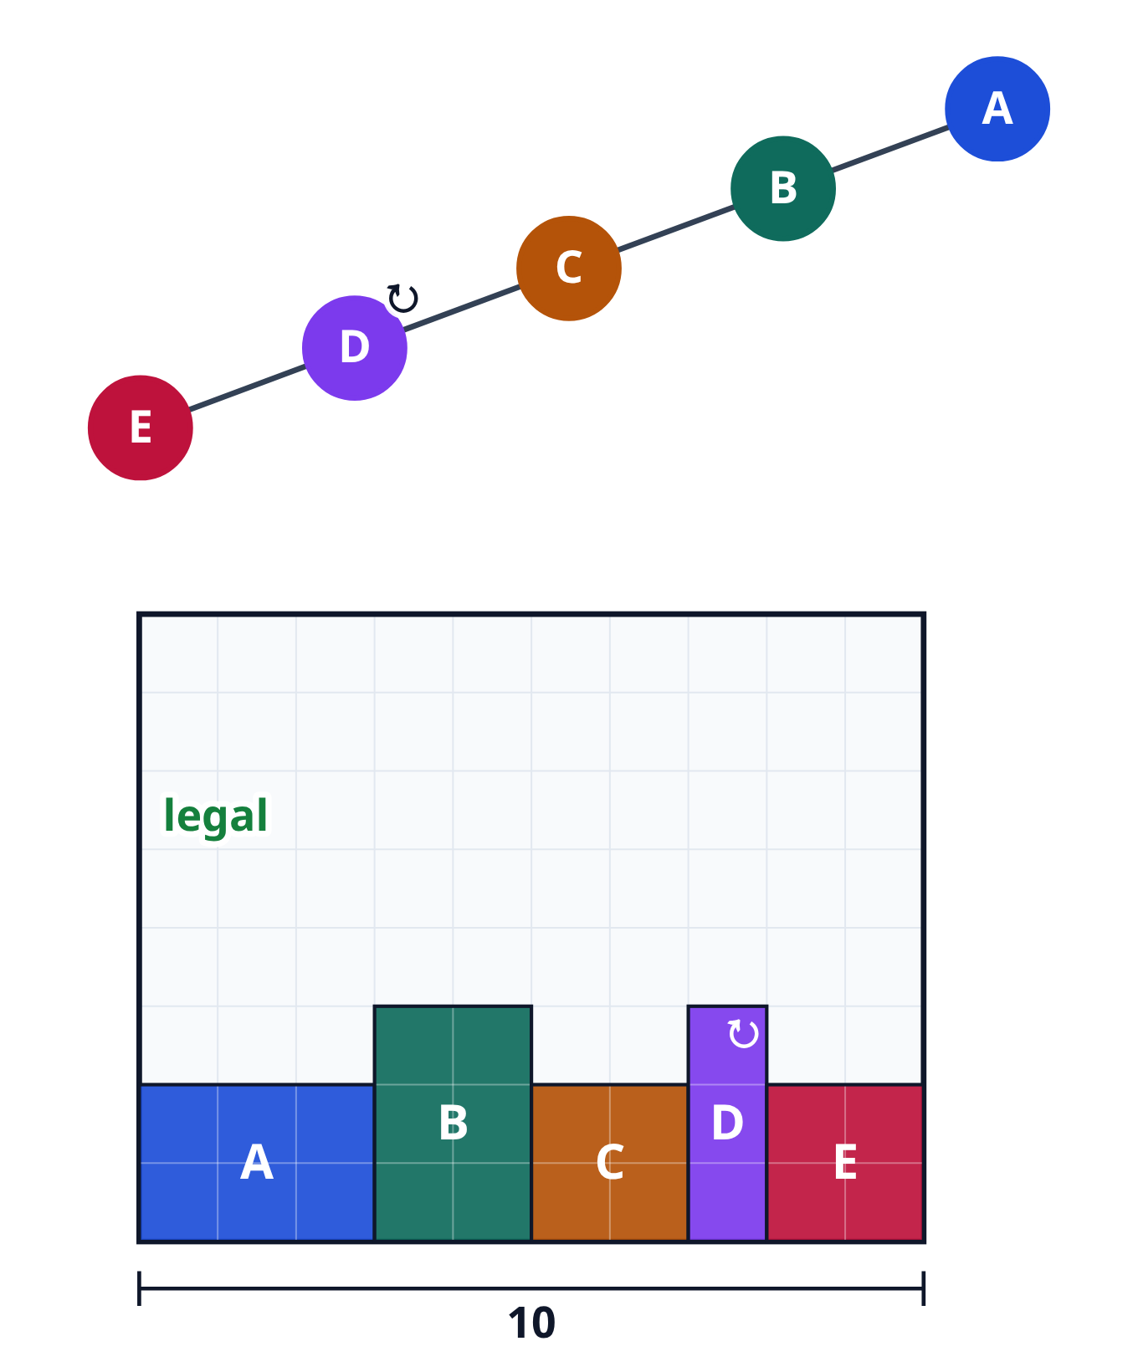
Turn one block
We can turn a block on its side, so its width and height swap
Turn D, and it becomes one wide and three tall
Now the row is ten wide, so it fits exactly, and it is legal again
learn_floorplanning — 03 bstar tree
Notes:
We can turn a block on its side, so its width and height swap. Turn D, and it becomes one wide and three tall. Now the row is ten wide, so it fits exactly, and it is legal again.

Slide 24
Three small changes
Turning is one of three small changes
You can also swap two names in the tree, as we did with A and C
Or move a leaf, a block with no children, to a free spot in the tree
Each change gives a new floorplan, with a new score
Pause and guess: can any tree beat twenty-seven squares, and what is the smallest box?
learn_floorplanning — 03 bstar tree
Notes:
Turning is one of three small changes. You can also swap two names in the tree, as we did with A and C. Or move a leaf, a block with no children, to a free spot in the tree. Each change gives a new floorplan, with a new score. Pause and guess: can any tree beat twenty-seven squares, and what is the smallest box?

Slide 25
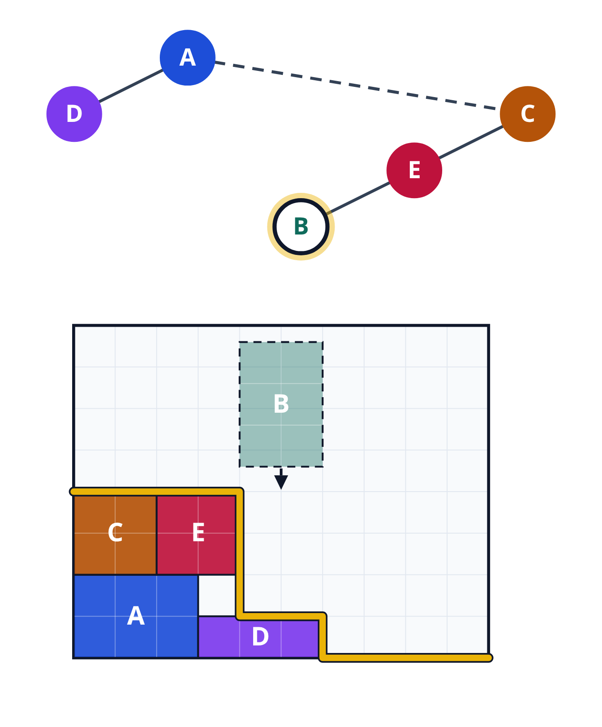
The tightest floorplan
Yes: many trees beat twenty-seven, and the best need only twenty-four squares
Here is one of the best trees
Its walk places A, D, C and E, and B comes last
learn_floorplanning — 03 bstar tree
Notes:
Yes: many trees beat twenty-seven, and the best need only twenty-four squares. Here is one of the best trees. Its walk places A, D, C and E, and B comes last.

Slide 26
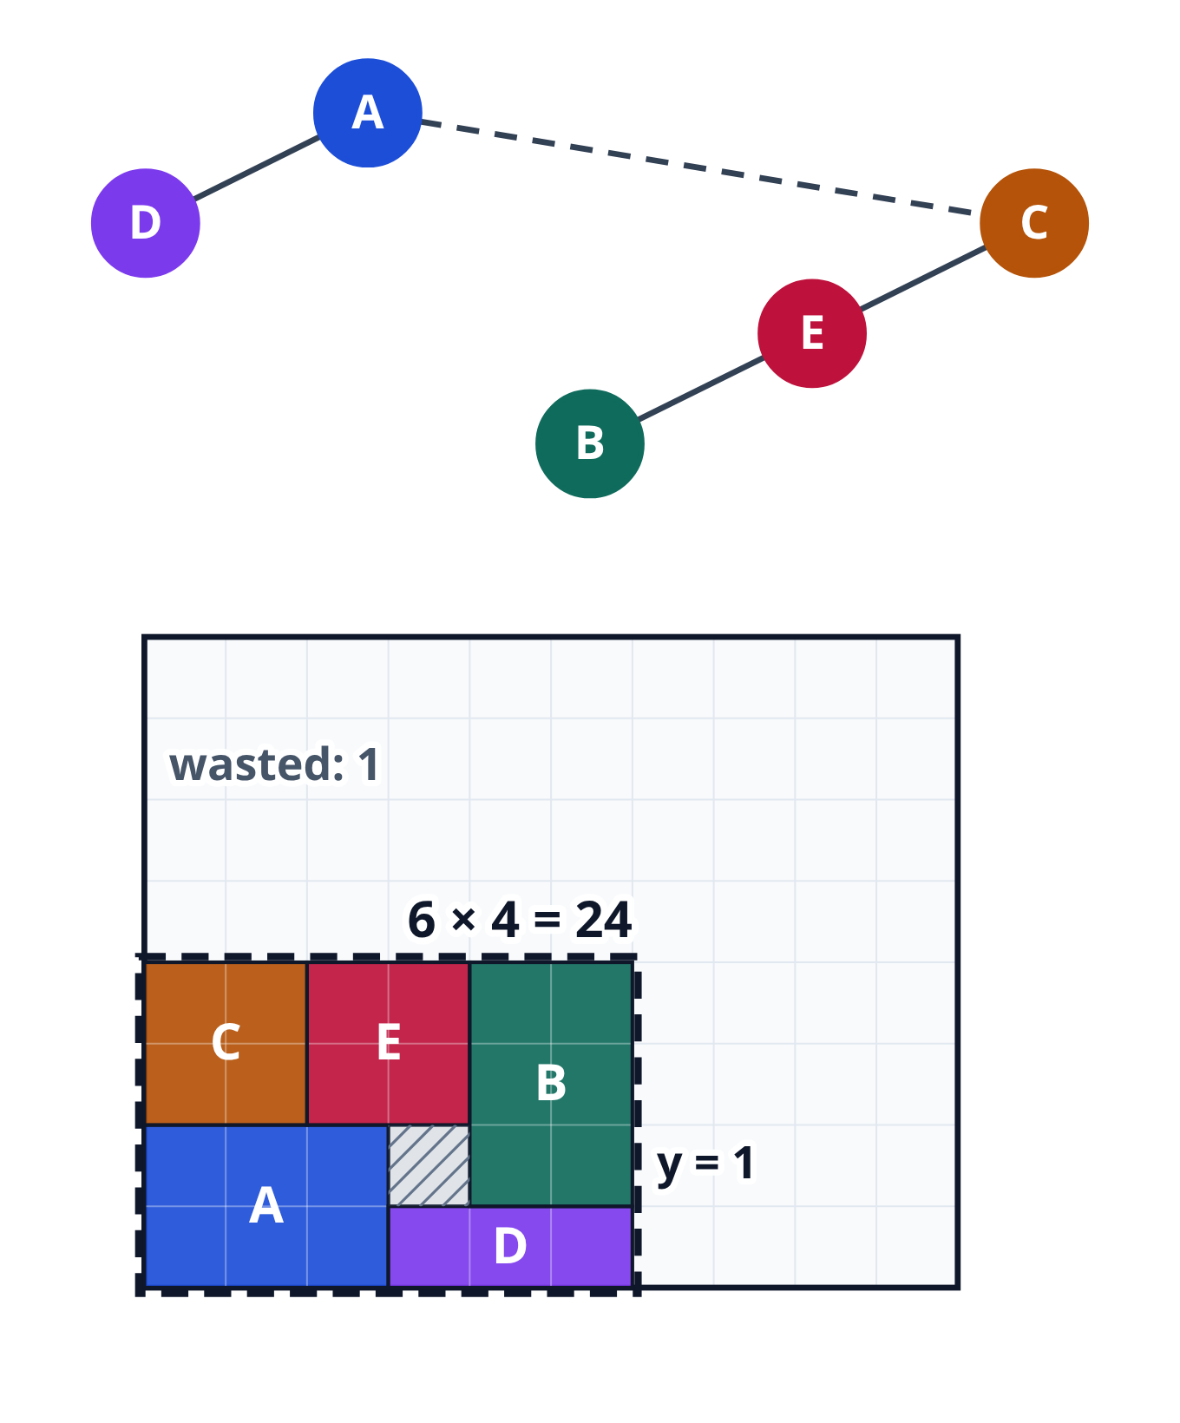
B is lifted by the skyline
Under B, the skyline is the top of D, so B lands at y equals one
It fills the gap, and the box is six wide and four tall: twenty-four squares
Only one square is wasted
learn_floorplanning — 03 bstar tree
Notes:
Under B, the skyline is the top of D, so B lands at y equals one. It fills the gap, and the box is six wide and four tall: twenty-four squares. Only one square is wasted.

Slide 27
Why not twenty-three?
Could a box of twenty-three squares, with nothing wasted, hold all five blocks?
Twenty-three squares only make a rectangle one square thick
Block B is too thick for that, so twenty-four is the best possible
learn_floorplanning — 03 bstar tree
Notes:
Could a box of twenty-three squares, with nothing wasted, hold all five blocks? Twenty-three squares only make a rectangle one square thick. Block B is too thick for that, so twenty-four is the best possible.

Slide 28
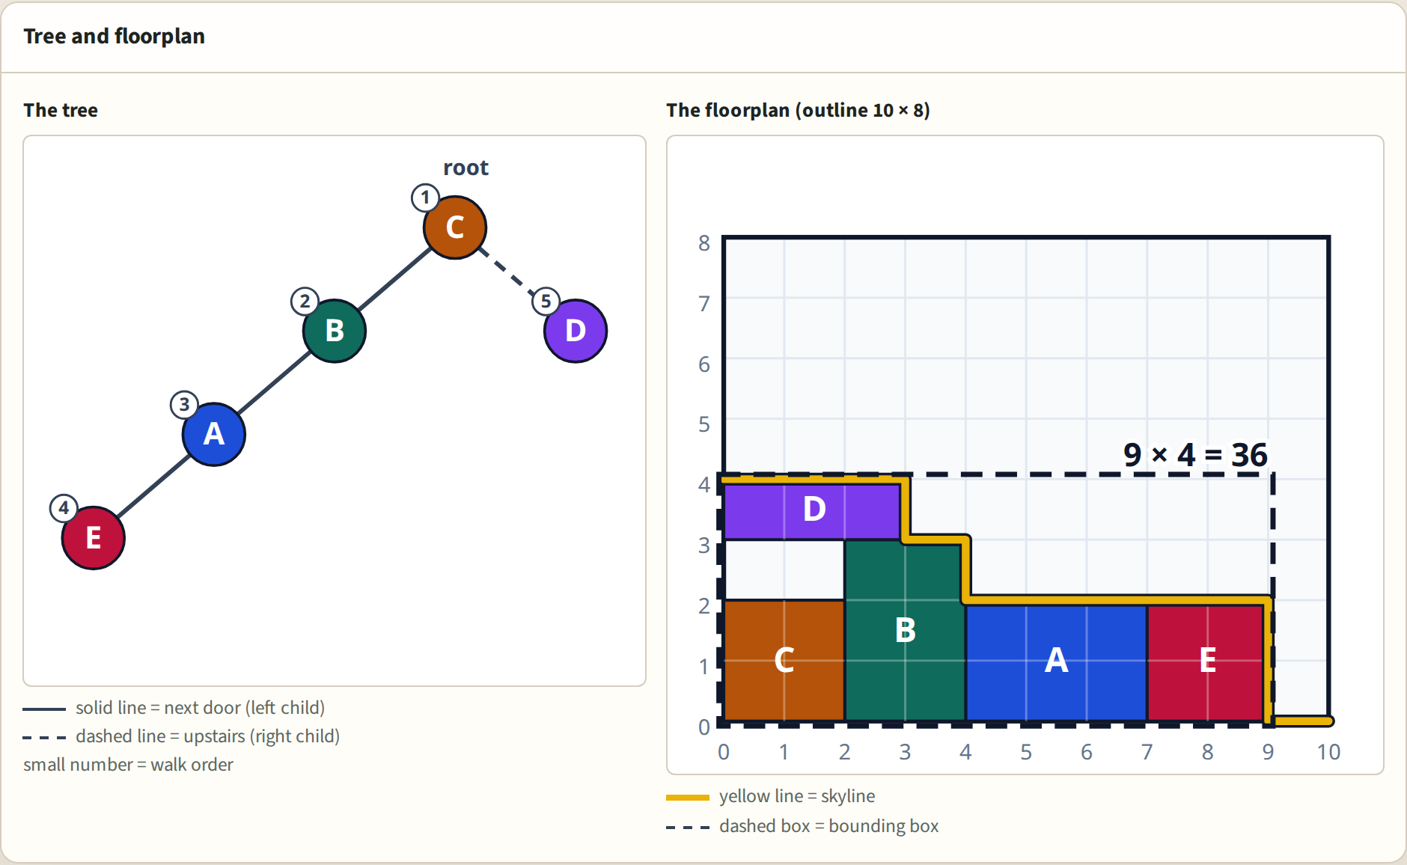
Browser lab track
Browser lab starter
learn_floorplanning — 03 bstar tree
Notes:
Now build floorplans yourself. In the browser lab, you edit the tree and watch each block drop onto the skyline. The challenges check the tree you built. Lift D higher, make the long row fit, and reach twenty-four.

Slide 29
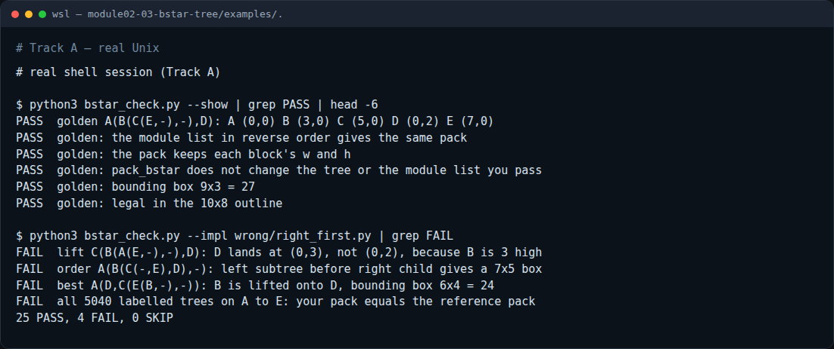
Implement track
Real shell session
learn_floorplanning — 03 bstar tree
Notes:
If you like programming, write the packer in Python. The examples file gives the exact rules. Run the checker once to print every correct answer, then run it on your own file. It compares your packer with the right one on all five thousand and forty trees.

Slide 30
Implement track — try these
# print every correct answer
python3 examples/bstar_check.py --show
# check your own functions
python3 examples/bstar_check.py --impl my_bstar.py
learn_floorplanning — 03 bstar tree

Slide 31
Remember
Left child: next door
Right child: upstairs, with the same left edge
Walk the tree: the node, its whole left side, then its right child
Each block drops until it touches the skyline
Score a floorplan with its bounding box, and count the wasted squares
A tree never overlaps, but it can stick out, so check the outline
learn_floorplanning — 03 bstar tree
Notes:
Left child: next door. Right child: upstairs, with the same left edge. Walk the tree: the node, its whole left side, then its right child. Each block drops until it touches the skyline. Score a floorplan with its bounding box, and count the wasted squares. A tree never overlaps, but it can stick out, so check the outline.

Slide 32
Your turn
Pick a track: the browser lab, Python, or both
Tick each box of the checklist, then take the short quiz
Next comes the sequence pair: two lists of names instead of a tree
Pause and guess: can two lists describe our best floorplan, with twenty-four squares?
Yes: two lists are enough
That's the sequence pair, in the next lab
learn_floorplanning — 03 bstar tree
Notes:
Pick a track: the browser lab, Python, or both. Tick each box of the checklist, then take the short quiz. Next comes the sequence pair: two lists of names instead of a tree. Pause and guess: can two lists describe our best floorplan, with twenty-four squares? Yes: two lists are enough. That's the sequence pair, in the next lab.

