Slide 1
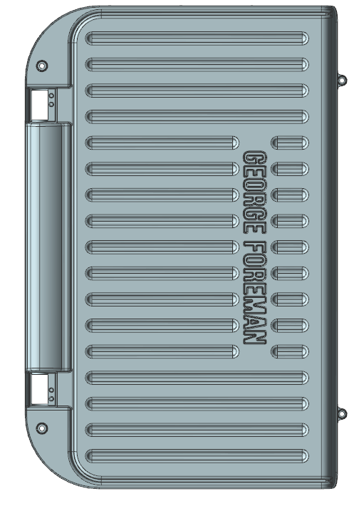

部件基本信息-General Part Information
Mold: | CH184-08A-UPPER
Part No:
No.of Cavity | 1*1
Mold Life(Shot) | 50K
Resin Material: | ADC12
Shrinkage Used: | 1.005
Material Density: | 2.7g/cm³
Part Volume: | 169.96/cm³
Part Weight: | 458g
Runner Weight:
Main Steel Insert: | 8407
General Hardness: | HRC47~48°
Mold Base Material | S50C
Runner (Cold/Hot)
Mold Type: | 2-Plate
Estimate Mold Size | 620/650/320
Estimate M/C Tonnage | 350T
Cosmetic requirements
333mm
221mm
41.6mm

Slide 2
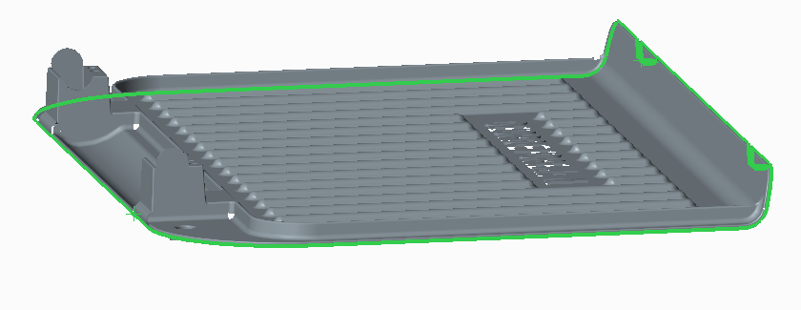
分型线-Define Parting Line (Cavity / Core Surface)
母模(CAVITY)
PL
公模（CORE）
分型线上的段差量和方向必须表达清楚。

Slide 3
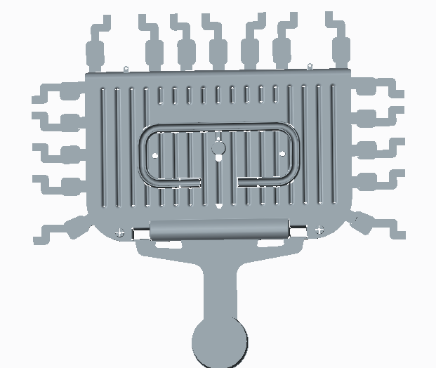
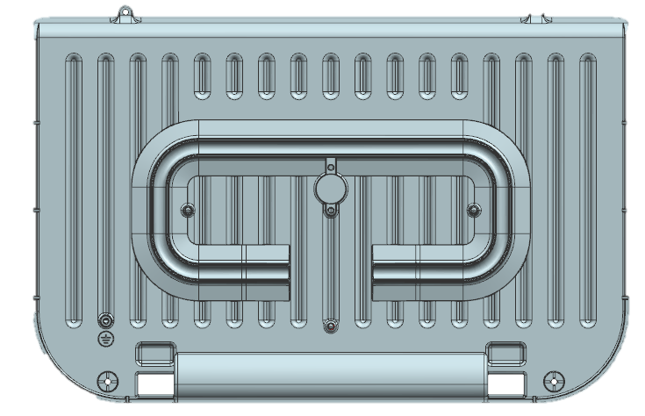
排位和浇口类型-Layout and Gating Type
天侧
浇口、流道、溢流块如图上图所示；溢流块数量：17

Slide 4
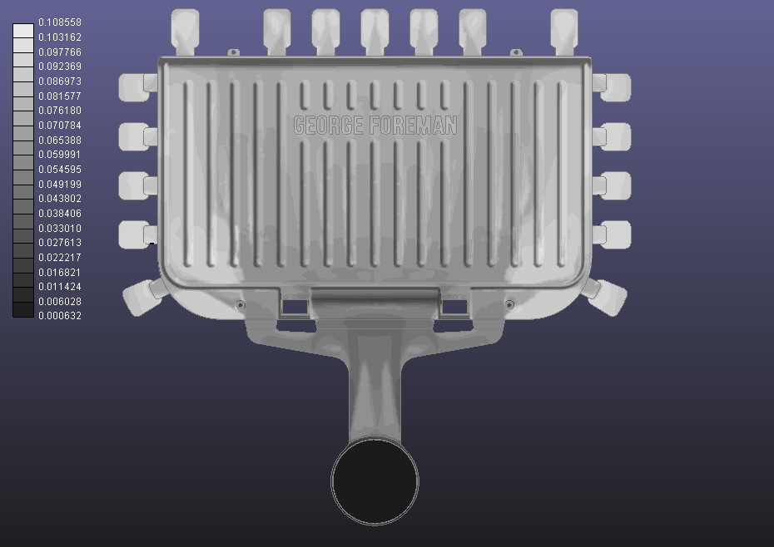
模流分析-Mold flow analysis
通过分析未见明显卷气现象，略微不良 可通过后续增加排气或调机解决

Slide 5
镶件线-Split line of Insert

Slide 6
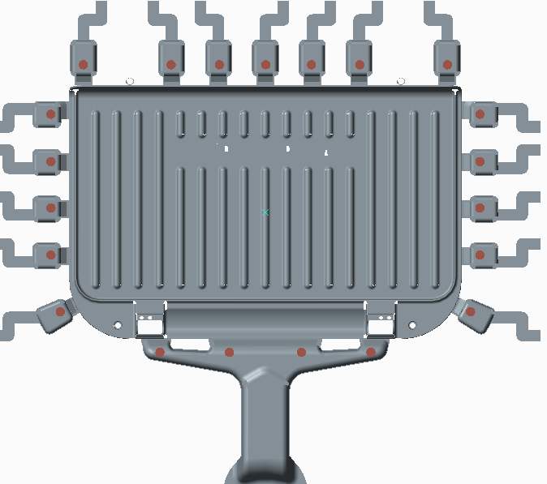
顶针位置和类型-PIN location and type
圆顶针
顶针位置图

Slide 7
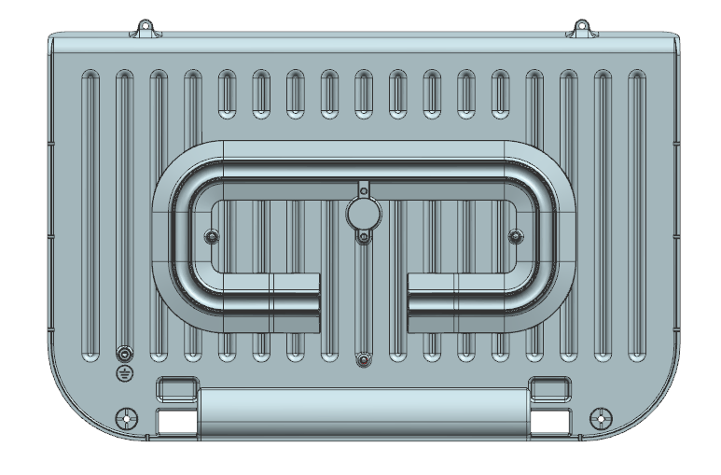
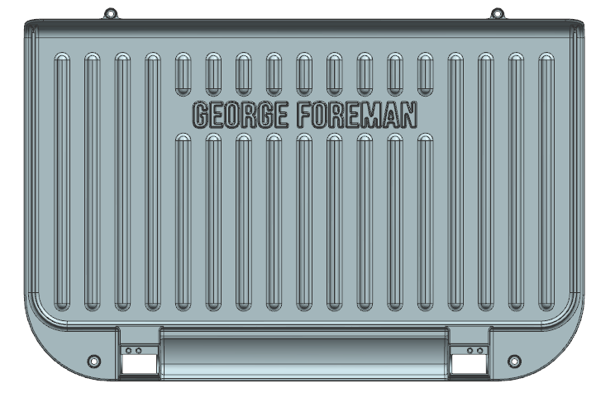
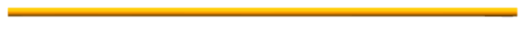
模具冷却水路-Tooling Cooling System proposal
Cav. Cooling System
Core Cooling System

Slide 8
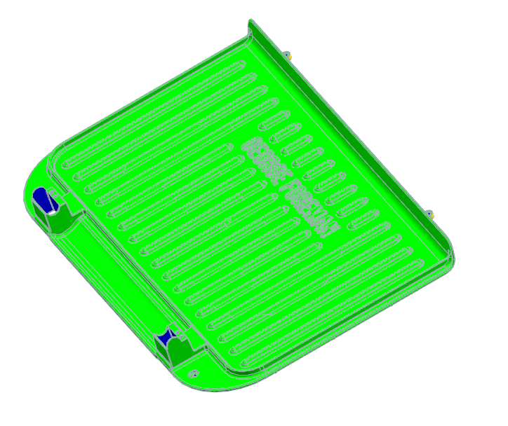
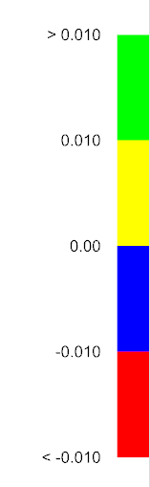
拔模角度/表面处理/外观要求-Draft Angle / Surface Finishing / Cosmetic Concern or Requirement

Slide 9
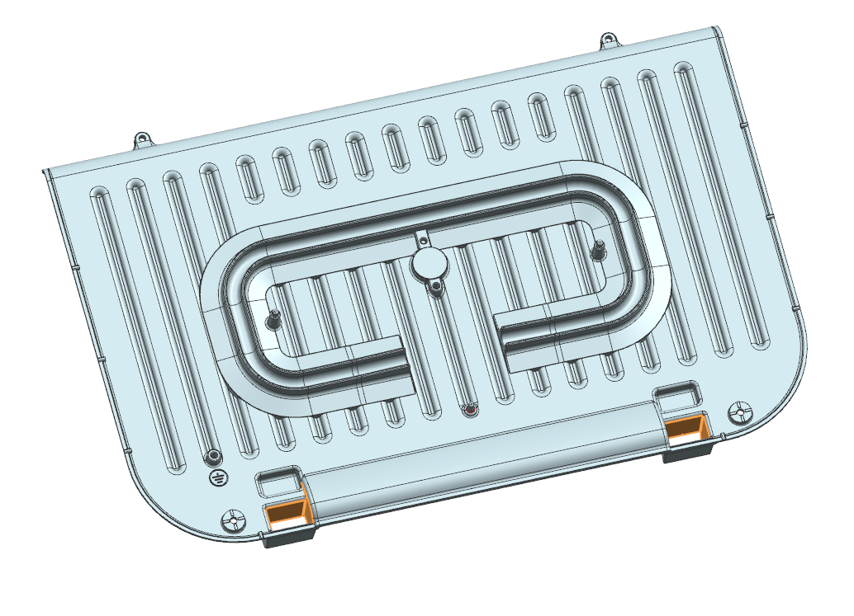
改善和建议-Proposal for structure
此处三个黄色面没有设计脱模斜度，建议修改到单边1.5度。

Slide 10
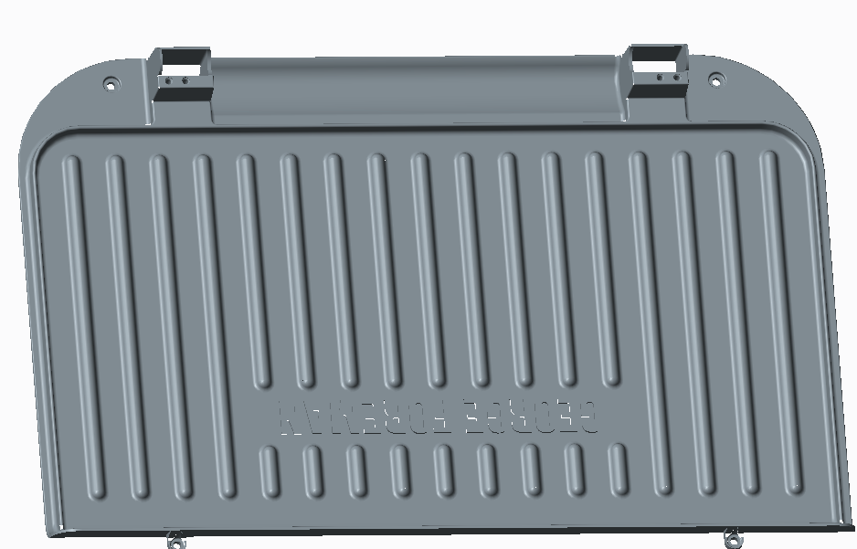
改善和建议-Proposal for structure
4支头部2.2的镶针需多做备用针。

