Slide 1
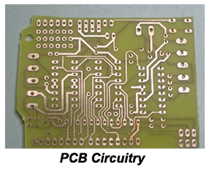
PRINTED CIRCUIT BOARDS (PCB) FABRICATION-ETCHING
(UV ETCHING MACHINE)
-Is the process of fabricating or making Printed Circuits in Copper boards.
Requirements:
Circuit PCB Layout,
UV Copper boards,
Transparent films/paper,
Laser jet Printer,
UV etching machine
Acid (HNO₃, HCl or H₂ SO4)
Base (NaOH, KOH),
Iso Propyl Alcohol (IPA) also known as Thinner.
Drilling Machine + Drilling bits

Slide 2
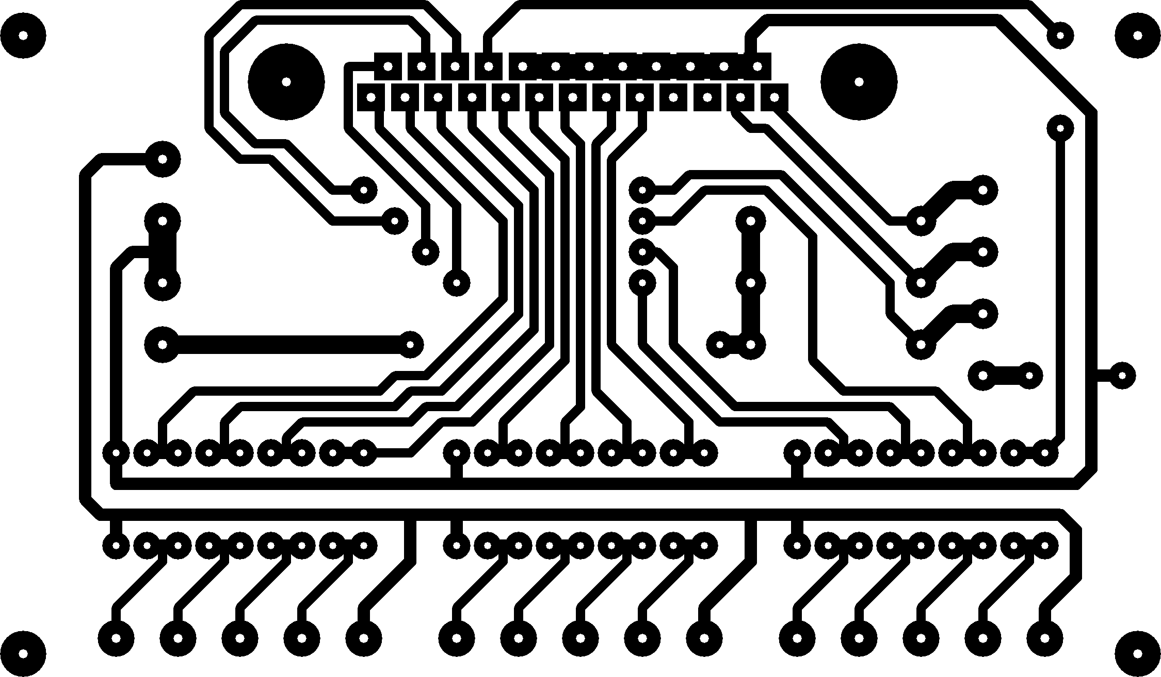
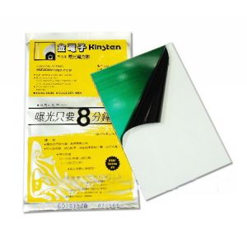
ETCHING PROCEDURES
Etching Procedures:
Circuit Design and PCB Layout Design using software's.
Printing the Designed PCB into Transparent paper using Laser jet Printer
Transferring the Printed Circuit (PCB) into the uv copper board using uv etching machine.
Applying Solutions (Acid, base and IPA – Thinner) to the uv copper body.
Drilling holes in the Produced PCB, ready for Soldering.

Slide 3
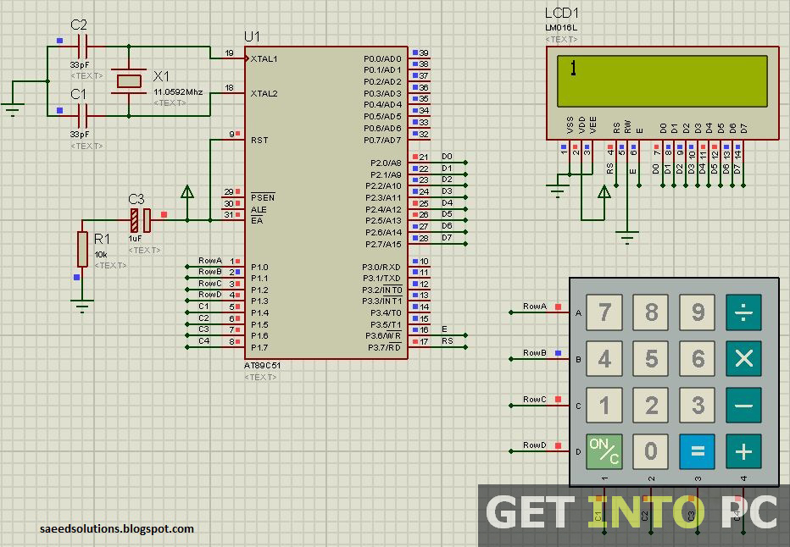
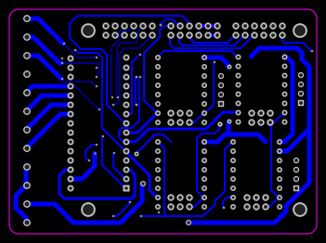
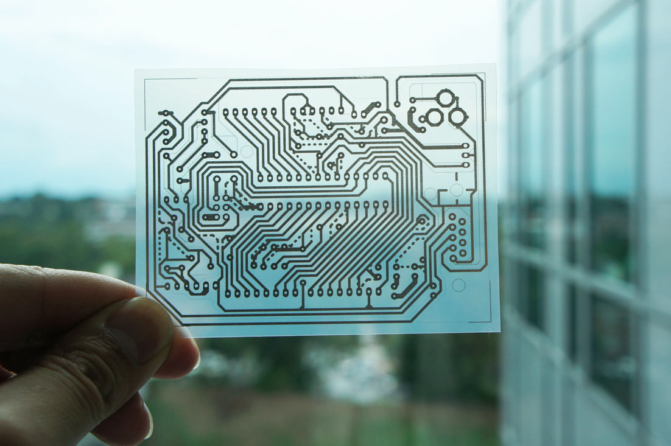
a)Circuit Design and PCB Layout Design using software's.
-The Required Circuit is Designed using software, eg. Proteus
- The PCB Layout of the Circuit is designed using software, eg. Proteus
b) Printing the Designed PCB into Transparent paper using Laser jet Printer (eg. Laser jet 1020)
-The Designed PCB Circuit is printed in a transparent film/paper

Slide 4
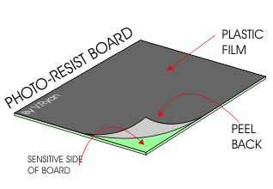
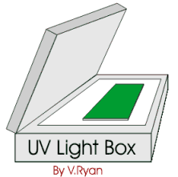
c) Transferring the Printed Circuit (PCB) into the uv copper board using uv etching machine.
- With the printed transparent film in hand, the plastic film of the UV Copper Board is removed and the Transparent paper is placed on top of it.
- Then the PCB Copper board with a printed Transparent film are placed in Etching machine ready to be exposed to UV light about 1 minutes.
- The Copper Board is taken out of the machine.

Slide 5
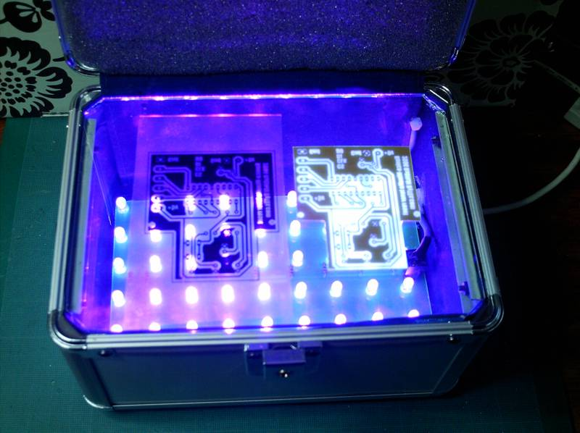
d) Applying Solutions (Acid, base and IPA – Tina) to the uv copper body.
After Copper board is taken out of the machine, is put in Basic Solution (Diluted basic solution) eg. Sodium Hydroxide (NaOH) or Potassium Hydroxide (KOH) for about 1 to 2 minutes .
From the base, the Copper body is washed in water and then is placed in Acidic solution eg. HCl, H₂ SO₄ or HNO₃ until all Copper dissolves leaving the Circuit routes/paths.
The Copper body is taken out from the Acid and cleaned using Iso Propyl Alcohol (IPA) also known as Thinner.
After cleaning the Copper board, is left to dry.

Slide 6
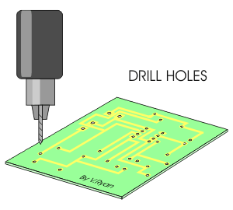
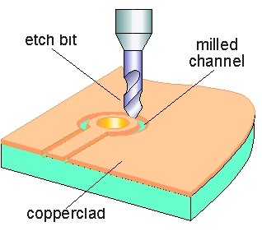
e) Drilling holes in the Produced PCB, ready for Soldering.
Holes are Drilled in pads of Copper board using a Drilling machine.
The Printed Copper Board is Ready for Soldering.

Slide 7
SPECIFICATIONS AND APPROXIMATE COST
FOR ETCHING PROCESS.
Requirements:
Circuit PCB Layout,
UV Copper boards,
Transparent films/paper,
Laser jet Printer,
UV etching machine
Acid (HNO₃, HCl or H₂ SO4)
Base (NaOH, KOH),
Iso Propyl Alcohol (IPA) also known as Thinner.
Drilling Machine + Drilling bits

Slide 8
