Slide 1

MACRO FRONT OFFICE TRANSFORMATION
Agentic AI for Macro Front Office
UI Transformation
PROMPT
Legacy .NET UI
Move legacy .NET front-office screens into governed Angular / React micro frontends running inside Macro Desktop.
current front-office screens
Figma Make accelerates the first UI draft. Macro MCP server and Macro MFE libraries inject guardrails, shared components, themes, auth, logging, and desktop patterns. GitHub + OpenShift complete the path to a desktop-ready release.
GOVERN
Governed MFE
Figma Make + Macro MCP + libraries
Prompt-first
Governed build
Desktop-ready
faster screen ideation
Macro standards embedded
run inside OpenFin Workspace
RUN
Macro Desktop
OpenFin Workspace runtime
Figma Make
Macro MCP Server
Macro MFE Libraries
GitHub
OpenShift
OpenFin Workspace
1

Slide 2

AGENTIC UI FACTORY
How the agentic UI factory works
AI accelerates the repetitive UI work; Macro standards, libraries, and platform hooks keep the output production-ready.
RUN
INPUT
AI DESIGN
GOVERN
COMPOSE
DEPLOY
1
2
3
4
5
Macro Desktop
Intake
Figma Make
Macro MCP
MFE libraries
GitHub +
OpenShift
host Angular / React MFEs in OpenFin Workspace
Legacy screen
workflow + criteria
First-pass UI
variants + flows
Guardrails
routes + desktop hooks
Auth, logger, grid
theme + components
Repo, PR, tests
build + deploy
Storefront
Dock
Color link
FDC3
Entitlements
Human review gates stay in control: UX sign-off • security / auth • PR quality • desktop UAT
Less greenfield coding
Standardized UX
Fewer handoffs
Desktop-ready delivery
boilerplate becomes scaffolded + reused
shared tokens and components keep parity
design-to-code moves in one flow
deployment and runtime hooks are built in
2

Slide 3
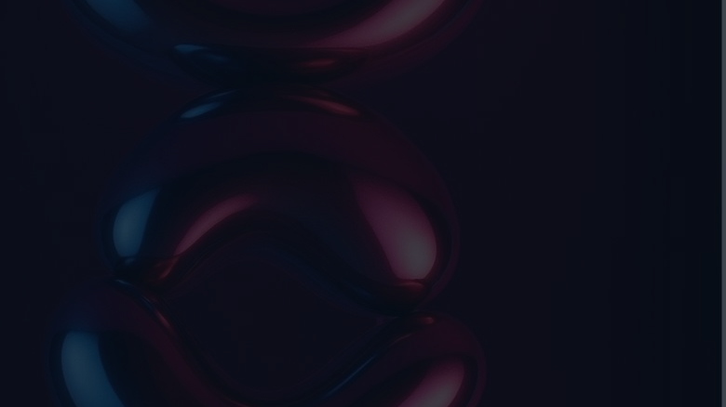
ONE-PAGE DELIVERY MODEL
One-page task outline for the new
approach
The work stays controlled by Macro teams, but more of the delivery path becomes standardized, reusable, and agent-assisted.
1
Product + UX
2
AI + UX
Intake & prompt pack
Prototype in Figma Make
• Capture the legacy screen, workflow, and success criteria
• Gather sample payloads, desktop context, and UX rules
• Generate the first-pass screen, interaction states, and flows
• Iterate quickly with the product owner and business team
3
AI + Platform
4
Front-end Eng
Generate governed MFE repo
Compose with Macro libraries
• Use Macro MCP server to stamp the Angular / React shell
• Add routes, desktop hooks, shared patterns, and repo structure
• Apply auth, logger, ag-Grid wrapper, themes, and components
• Replace generic AI output with Macro behavior and events
5
Platform
6
Desktop + Entitlements
Automate build & deployment
Onboard into Macro Desktop
• Push to GitHub, open PR, run tests, and build the release image
• Deploy to OpenShift and publish the version for validation
• Register in Storefront and Dock; enable color linking / FDC3
• Configure entitlements and complete desktop UAT
Human review stays in control: UX • security / auth • PR quality • deployment UAT. Net effect: a faster idea-to-desktop cycle with consistent UX and release patterns.
3

