Slide 1


Slide 2
Vision:
Enriching Canada through Indigenous education and by inspiring achievement.
Mission:
In partnership with Indigenous, private and public sector stakeholders, Indspire educates, connects and invests in Indigenous people so they will achieve their highest potential.

Slide 3
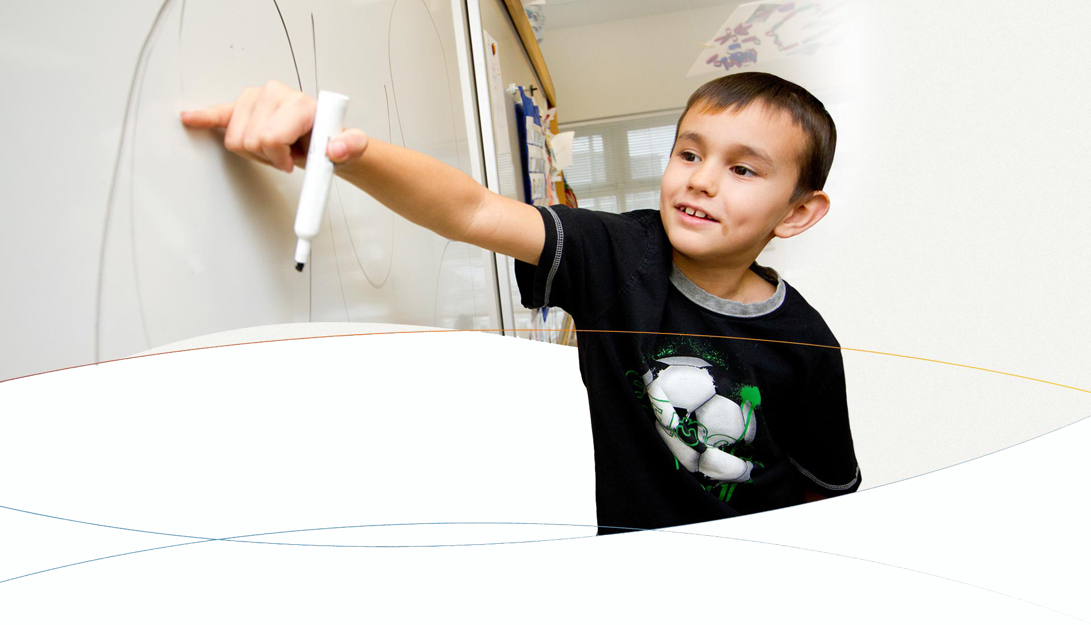
Who is Indspire
National registered charity led by Indigenous people for Indigenous people
Dedicated to raising funds to support Indigenous students across Canada: First Nation, Inuit, and Métis
With the support of our funding partners, we disburse financial awards, deliver programs, and share resources with the goal of closing the gap in Indigenous education.
Notes:
Introduce yourself briefly. Introduce Indspire.
Share that the spelling of Indspire – “d” is silent – comes from the combination inspiring Indigenous youth. Many people pronounce the “d” but that’s incorrect.

Slide 4
Who is Indspire? Indspire Continued…
Registered national charity in operation for more than 30 years.
Largest provider of bursaries and scholarships to Indigenous students other than the Government of Canada
CEO & President is Roberta Jamieson
Head office at Six Nations of the Grand River (Finance & Administration, Education)
Toronto office (Communications & Marketing, Development)
Currently over 30 staff
Notes:
CEO and president is Roberta Jamieson – she resides at Six Nations and is a busy woman traveling all over the country, and spreading time between the Six Nations and Toronto offices
Head office at Six Nations of the Grand River (Finance & Administration, Education) and Toronto office (Communications & Marketing, Development)
Started out with a small office at Six Nations and has grown to include 2 offices and over 30 staff

Slide 5

Notes:
Building Brighter Futures: Bursaries , Scholarships and Awards: –Indspire disburses bursaries and scholarships through its Building Brighter Futures program to Indigenous students who are enrolled in post-secondary programs.
Since 1985, Indspire has disbursed bursaries and scholarships to First Nation, Inuit, and Métis post-secondary students. It is the largest funder for Indigenous education outside of the federal government.
Indspire is here to help financially – help alleviate stress so students can focus on their studies and succeed!

Slide 6
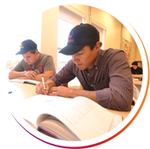
Building Brighter Futures: Bursaries, Scholarship and Awards
In 2016 – 2017 Indspire awarded 11.6 million through 3,764 scholarships and bursaries to Indigenous students across Canada.
Notes:
Indspire has awarded $79 million through almost 25,000 bursaries
and scholarships to First Nation, Inuit, and Métis students across Canada.*

Slide 7
Building Brighter Futures Annual Application Deadlines
Health Careers & Post-Secondary Education Awards
August 1, November 1, February 1
Apprenticeships, Skilled Trades, and Technology Programs
Post-Secondary Education Programs: August 1, November 1, February 1
Apprenticeships and Incentives: No deadline (open all year)
Legal Studies for Aboriginal People Pre-Law (LSAP) Bursary May 1
*deadlines may change or additional deadlines may be added (see website for updates)
Notes:
Additional deadlines at times become available – applicants are always encouraged to check the website frequently.
The August 1st/November 1st/February deadline are all for the same academic year.
Only one award per academic year. Applicants who are successful in receiving an award from the Aug 1st deadline are not eligible to reapply to the November of February deadline. They would wait and apply to the next Aug 1st deadline.
LSAP – for Non-Status FN and Metis students enrolled in a pre-law summer program. Bursary award of $1000 and $2500 tuition payable to the post-secondary institution.
Applicants can only apply to one category.

Slide 8
Building Brighter Futures Post-Secondary Education & Health Careers
Eligibility:
Canadian resident Indigenous individual who is First Nation, Inuit, or Métis
Must have proof of Indigenous status
Full-time/Part-time studies for the application year
Program at least one year in length
Accredited institutions
Studies outside of Canada must be enrolled in a full-time Masters or PhD program
Notes:
The Post-Secondary Education programs include studies in business, computers, science, law, education, engineering, social science and social work.
Health Programs include but not limited to studies in nursing, medicine, dentistry, pharmacy, optometry, lab technology, physiotherapy, nutrition, health administration, veterinarian medicine, and public health policy. A one year pre-nursing program would fall under the PSE, and once you are in an actual nursing program, then you would apply to the HC.
Medical, dentistry, Optometry programs are not considered graduate programs.
Students receiving BF are still eligible to apply as long as they show a financial need.
LIMITED FUNDS FOR PART-TIME

Slide 9
Building Brighter Futures Apprenticeship, Skilled Trades and Technology Program
Indspire provides bursaries and incentives for training and apprenticeships for careers in oil & gas, skilled trades, and technology
Three types of support are provided:
Post-secondary education support for skilled trades and technology: for those pursuing part-time or full-time certificate or diploma programs at an accredited post-secondary or training institute (programs may range from one month to four years)
Apprenticeship support: for those in a registered apprenticeship program (i.e. on-the-job training)
Completion incentive:
$1,000 awarded for successful completion of a program.
Notes:
Indspire provides bursaries and incentives for training and apprenticeships for careers in oil & gas, skilled trades and technology.
Eligible programs: general diploma, applied diploma or certificate programs in oil & gas, skilled trades and technology fields, pre-trades training and more.
Eligible fields of study – safety officer, heavy duty mechanic, gasfitter, ironworker, mechanic millwright, welder, machinist, electrician, steamfitter, and more.
Applicants cannot apply to both the Post Secondary Education and ASTT programs.

Slide 10
Building Brighter Futures Required Supporting Documents
Proof of First Nation, Inuit, or Metis status
Most recent grades
Proof of full-time enrollment
Letter from band/association/beneficiary organization confirming amount of school sponsorship (not applicable to Non-status First Nation)
Current Resume (Apprenticeship, Applied Trades & Technology program only)
education@indspire.ca
Notes:
Remind students to push the submit button when their application is complete. They will receive a confirmation email - if they forget to hit SUBMIT, their application sits in the draft stage and is not reviewed.
Email questions and documents to education@indspire.ca
Grades from last completed program are considered most recent grades. Always fall/winter marks of previous year. Make sure name is on the grades. Mature students required to submit grades from last academic program taken.
Proof of full-time enrolment must have student name, name of school and state clearly that student is in full time studies. Acceptance letters are NOT proof of enrolment. Examples- letter from school stating student is enrolled full-time, copy of class schedule showing classes enrolled in for the number of months that match their application (must include all terms).
Letter from Band- must come from funding organization they get funding from (GRPSEO example) and must be broken down stating how much student receives for tuition, books, monthly allowance and travel dollars. These amounts must be included in budget (and if not included, we will include it in budget and it could affect their award). IF students don’t know how much they’re getting, they need to estimate how much and enter it into application and inform Indspire once they have their letter (this includes scholarships).

Slide 11
Building Brighter Futures Documents Accepted for Proof of Indigenous Status
Status First Nation
Provide a front and back photo-copy of “Certificate of Indian Status” issued by:
Registrar of the Federal Government’s Indian Register;
Band within the meaning of the Indian Act that has control of its membership list: or
By an Indigenous group under a modern land claims agreement

Slide 12
Building Brighter Futures Documents Accepted for Proof of Indigenous Status Continued
Non-Status First Nation
Provide a front and back photo-copy of their parent(s) or grandparent(s) “Certificate of Indian Status” and either:
Long form birth certificate OR
Baptismal certificate
Documents must show the relationship to person identified
Members of Non-Status First Nation – letter from their registry office stating federal government designated and recognizes their nation as Non-status First Nation
Notes:
Non-Status means a person who identifies as an Indian or First Nations and is not registered on the Government of Canada’s Indian Register but who:
1. Is a direct descendant of a parent or grandparent

Slide 13
Building Brighter Futures Documents Accepted for Proof of Indigenous Status Continued…
Metis
Provide a front and back photo-copy of valid Metis citizenship, membership, registration or enrolment card
18 and over must have their own card
What if I just applied for my card?
Provide a front and back copy of parent(s) valid Metis card with baptismal certificate OR long form birth certificate
Award is held until applicants card is submitted
Inuit
Provide a photo-copy of a valid Inuit identity/beneficiary card

Slide 14
Building Brighter Futures Selection Process
Jury uses 3 criteria when assessing applications:
Financial need;
Involvement and contribution to the community; and
Academic merit.
All 3 criteria are assessed equally
Only applicants achieving the minimum score required will be eligible to receive an award
Students who do not obtain a minimum score are assessed at jury.
Notes:
Be sure to fill out budget section carefully and accurately. They must show financial need; cannot submit an application where your income is higher than your expenses.
Community Involvement and Volunteer – contribute and support the school of their children? Contribute and support their own school community? Their own or their children’s sports teams? Participate in cultural events or ceremonies? Any type of cultural and/or community involvement.

Slide 15
Building Brighter Futures Why was I unsuccessful?
Incomplete or blank budget
Supporting document not submitted
Volunteer Section on the application left blank – most common
Unsuccessful applicants receive an email with the above information and encouraged to apply to next deadline (if applicable)
Notes:
All applicants are contacted by email – importance of a valid email address. If budget is incomplete, or you show no financial need, you will be contacted and given the opportunity to submit this information.
Talk about volunteer experience – 10% of applicants are audited and this is only when your contacts would be contacted.
If unsuccessful for one deadline, student may submit missing document/information to complete and/or improve application for next deadline.

Slide 16
Building Brighter Futures Frequently Asked Questions
How much will I receive?
If I apply, will I receive an award?
When will I receive my award?
Can I reapply?
Notes:
How much will I receive? Minimum award is $1,000 – Average award is $2,600 - Awards range from $1,000 to $25,000 depending on your field of study, your location, sponsors available and number of applicants. For example one sponsor may want business students in certain cities and another sponsor may want students from certain bands.
Also, you cannot rely solely on Indspire awards to pay your schooling. It’s a supplement or an addition for the funds you’ve already secured for your schooling.
Can I reapply? You’re eligible to receive an award once per year throughout your post-secondary career. If unsuccessful in one deadline, you can reapply to the next deadline.

Slide 17
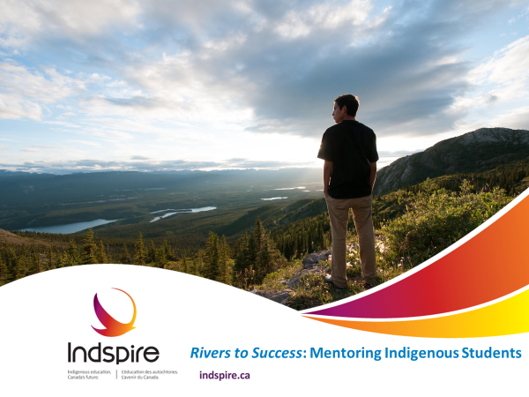

Notes:
The Rivers to Success program supports the academic success of Indigenous students through mentorship. Supporting students to have a smooth transition into their next steps of higher education or into the workplace.
Mentors will provide a valuable source of wisdom, insight and lessons from their life experience.
We all learn from sharing our stories and experiences, learning through mentorship connects individuals for education and career success.

Slide 18

Rivers to Success: Mentoring Indigenous Students 2 Streams of Mentorship
Post-Secondary to the Workforce
Matches post-secondary students to career professionals.
High School to Post-Secondary Education
Matches Indigenous High School students to Indigenous Post-Secondary students.
Parental engagement.
All mentors complete police back ground checks and reference checks.
18
Notes:
The Rivers program has two streams of mentorship to assist students in transition.
Rivers matches Indigenous College/University students to High School students to assist high school students (the mentees) in learning about post-secondary institutions, courses of study and to share knowledge the mentors have from their personal apprehensions and experiences attending post-secondary. If you are under 18 parental consent is required for involvement in the program.
Parents can also receive notes from your mentoring session and are asked to complete surveys in the program.
Rivers matches students near the end of their post-secondary education with professionals in a variety of fields. Mentors share their wisdom and provide guidance in career planning to ease the transition from school to the workforce.

Slide 19
Rivers to Success Why get a Mentor?
Mentors guide mentees in post secondary education, career pathways and personal goals related to career achievement.
Mentors & Mentees connect via skype, facetime, email or phone.
Get specific advice and tips to meet your goals.
Build your Network!
19
Notes:
Starting in high school you may want to continue on involved in mentorship, learning, growing and building your network.
For the Rivers workforce stream, mentors are career professionals with a minimum of five years experience, often leaders in their field or involved in recruitment for their company. Making new connections may take your education and career into new directions.
Mentorship can be a key to career and personal growth and workforce success.

Slide 20
Thank you!
indspire.ca
1.855.INDSPIRE (463.7747) x253
education@indspire.ca

