Slide 1
Authorization with OAuth 2.0
The industry-standard protocol for authorization is used in Capital One DevExchange APIs

Slide 2
What is OAuth?
An open protocol to allow secure authorization in a simple and standard method from web, mobile and desktop applications.

Slide 3
Capital One APIs require an access token to use.
OAuth 2.0 lets you securely authorize your client application to access the data that Capital One APIs provide
Capital One makes use of two styles of OAuth:
Client Credentials (Two-Legged)
Authorization Code (Three-Legged)

Slide 4
Client Credentials (Two-Legged)
Client Credentials flow is used to authorize server-to-server data. Data authorized with this flow is user-nonspecific and does not require a user to authorize access.
The Credit Offers and Bank Account Starter APIs use the Client Credentials flow.
Authorization is performed by POSTing the client_id and client_secret to /oauth2/token. The service will respond with a token which should be included in the Authorization header of future requests.

Slide 5
Authorization Code (Three-Legged)
Authorization Code flow is used to authorize data which requires a user’s permission to access. The data is user-specific and each user must approve the client individually.
The Rewards and SwiftID APIs use the Authorization Code flow.

Slide 6
Authorization Code Flow Diagram

Slide 7
Authorization Code Flow:
Client redirects user to Capital One server
Capital One asks user to log in with their account credentials and approve the client.
User is redirected back to client’s redirect URL with the authorization code
Client will exchange the authorization code, client id, and client secret with Capital One for an access token
Client adds access token to Authorization header of future requests

Slide 8
Refresh Token
Capital One APIs which require use of the Authorization Code flow also make use of refresh tokens.
Tokens should be refreshed before their expiry, otherwise a user’s session is terminated.
Tokens are easily refreshed by POSTing the refresh token to /oauth2/token. Capital One will respond with a new access token and refresh token.

Slide 9
Token Expiration
Capital One grants access tokens in-combination with an expiry in seconds.
The expiry can be found in the expires_in field on the response with your access token.
Capital One recommends that the client application check and pre-emptively renew the access token when the token is close to expiry. APIs which use the Client Credentials flow should re-authenticate themselves & APIs which use the Authorization Code flow should use the refresh tokens.

Slide 10
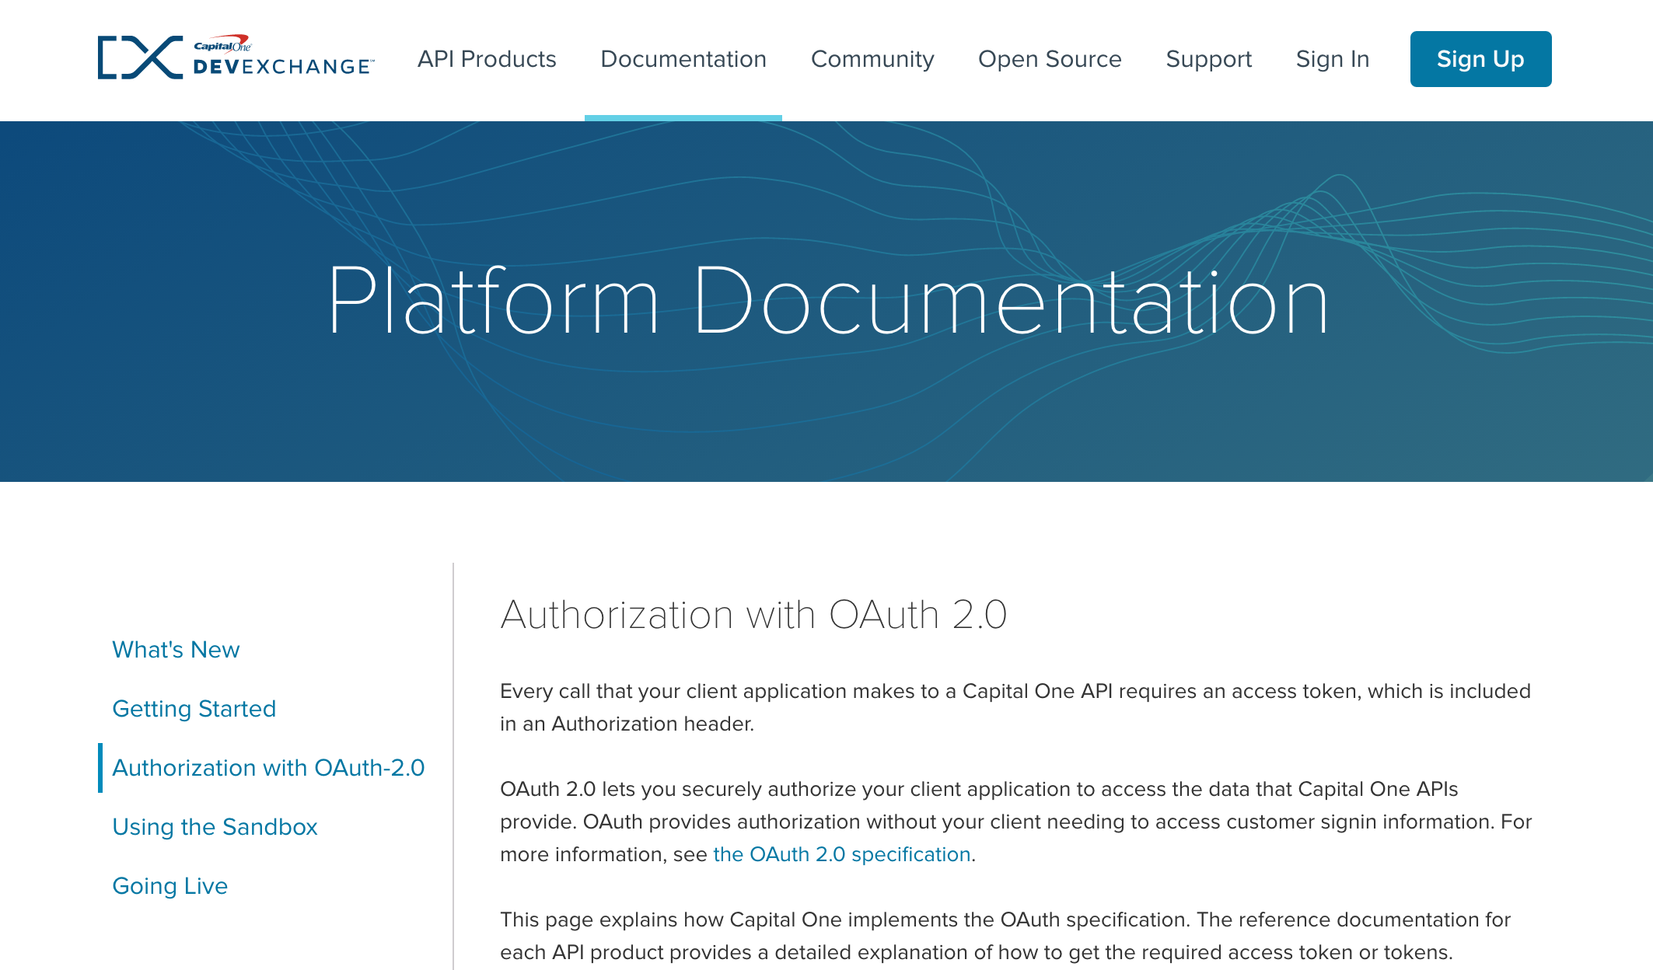
More Information
DevExchange OAuth Platform Documentation: https://developer.capitalone.com/platform-documentation/authorization-with-oauth-20/
The OAuth Bible: http://oauthbible.com/
The OAuth 2.0 Spec: https://tools.ietf.org/html/rfc6749

