Slide 1

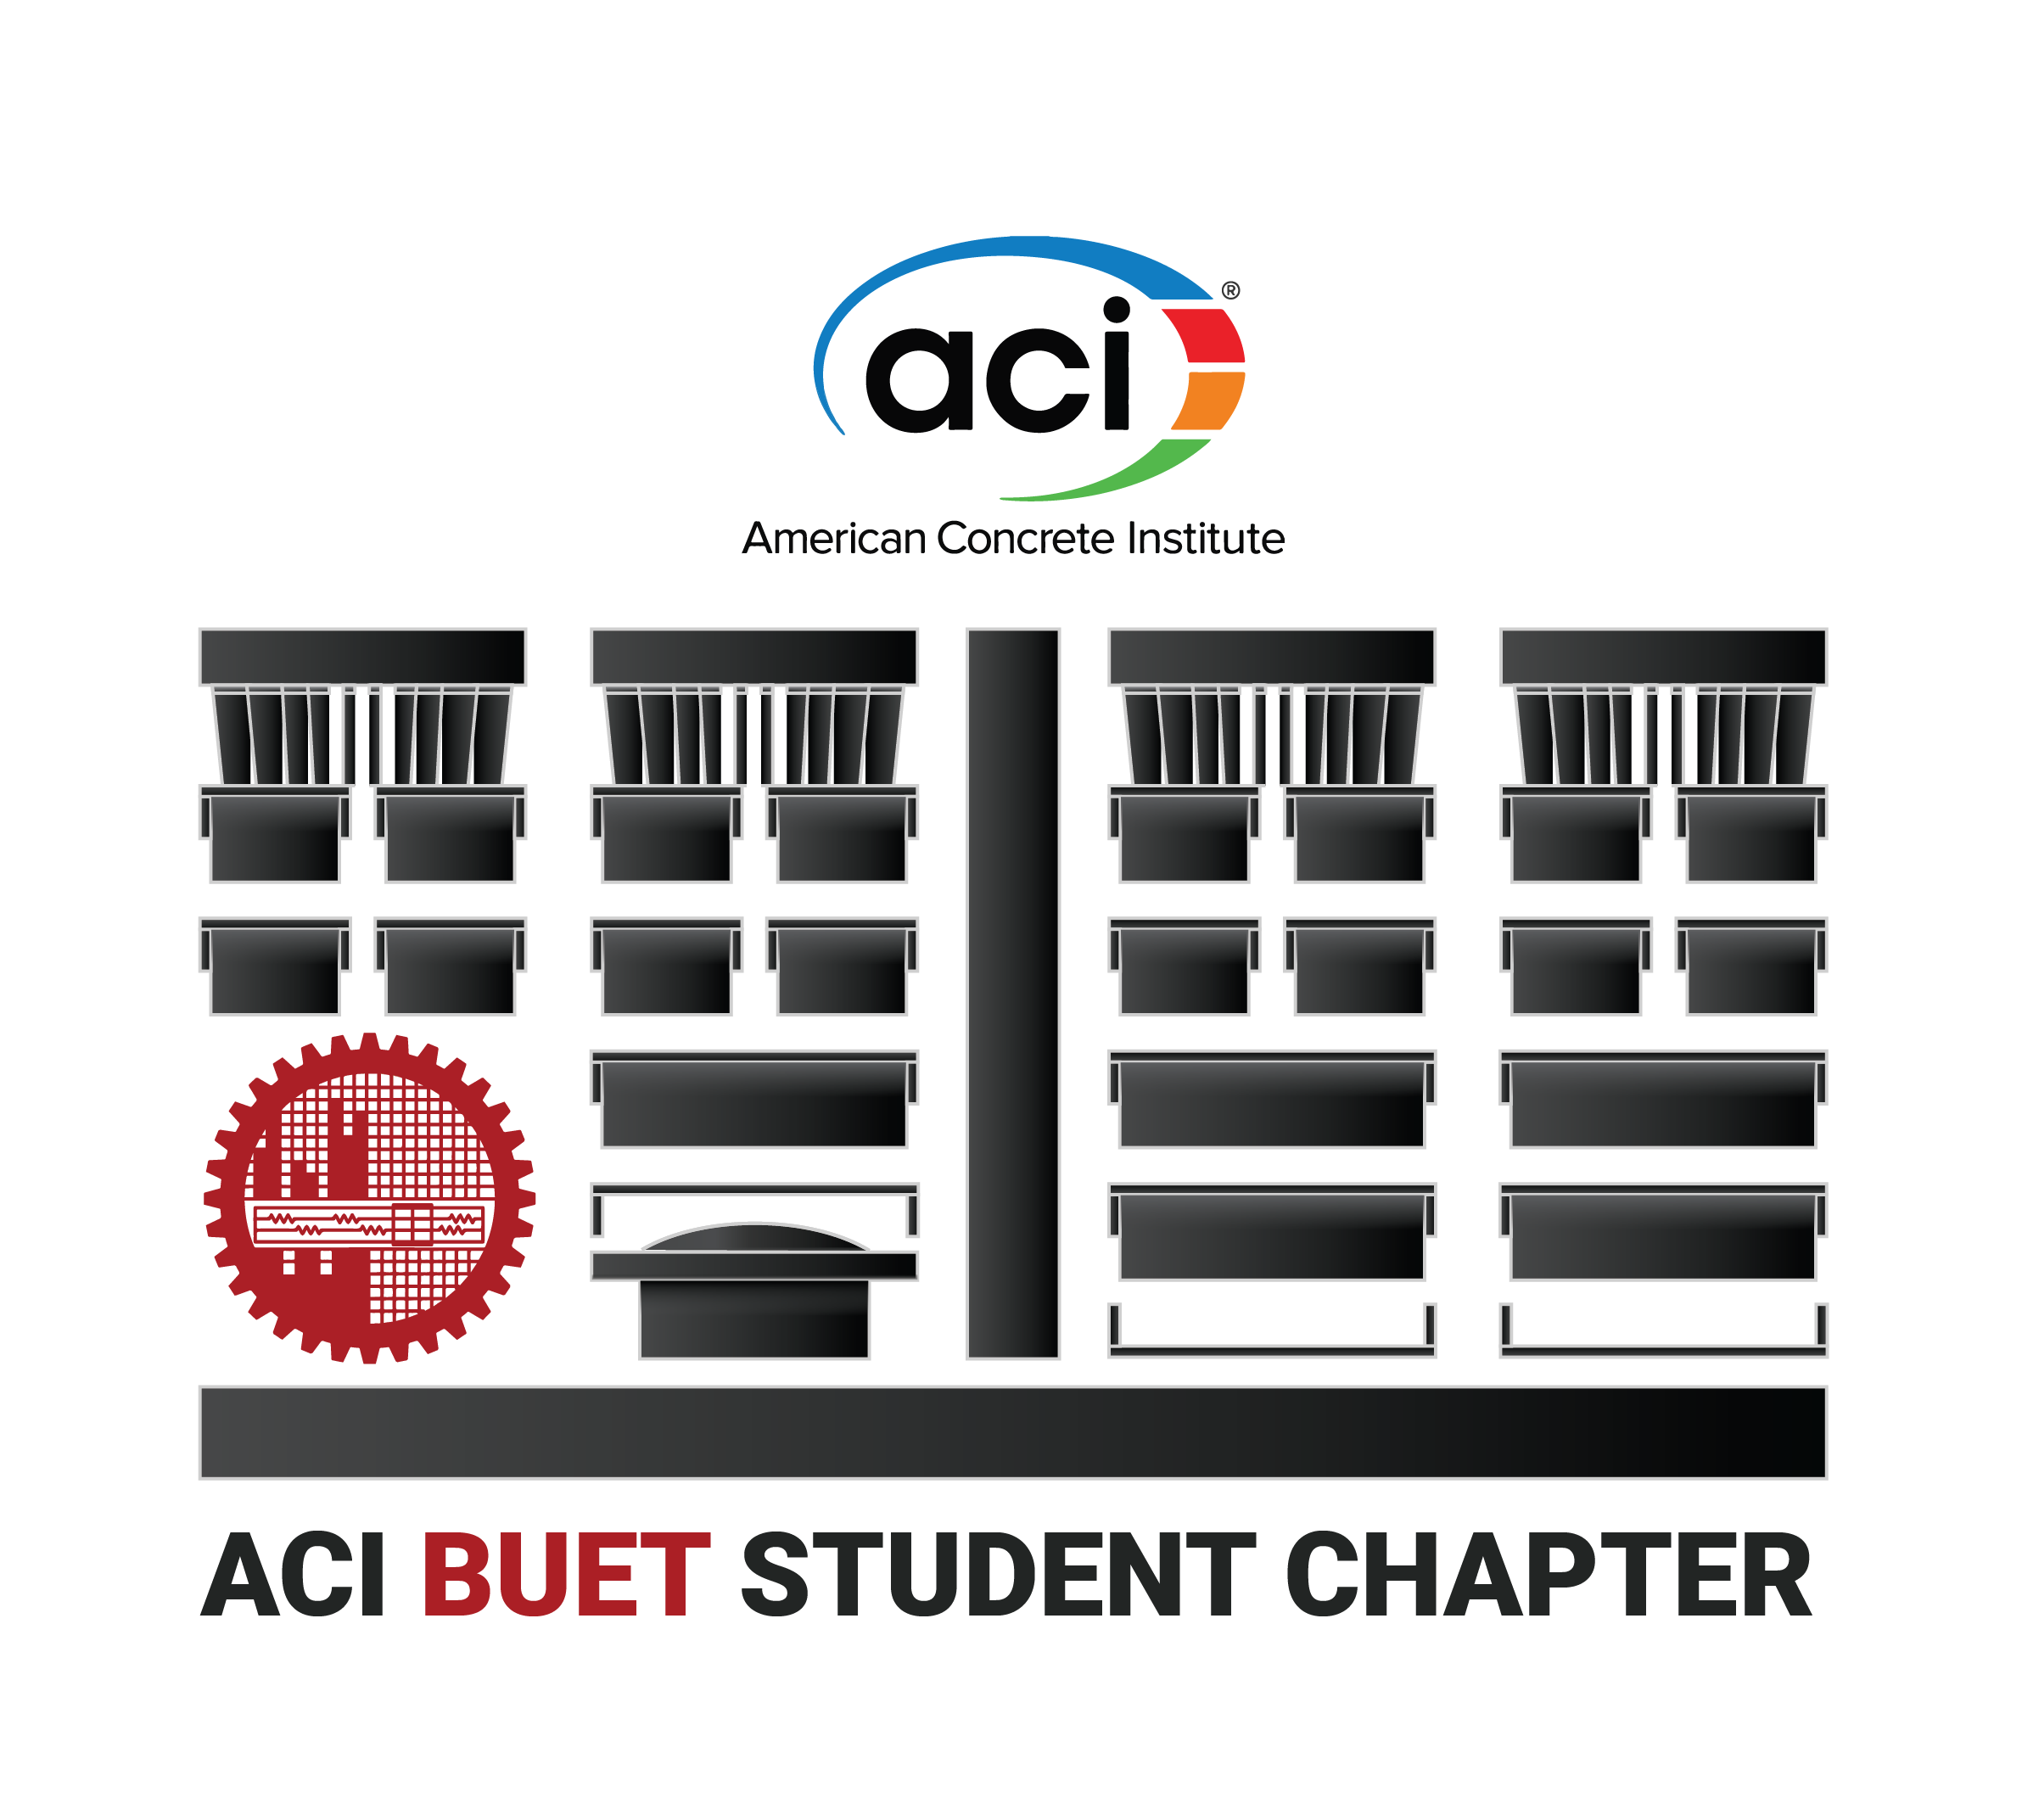




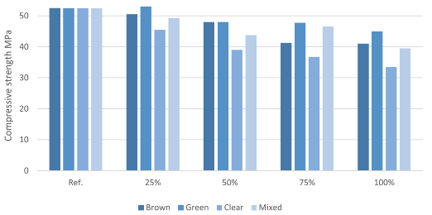

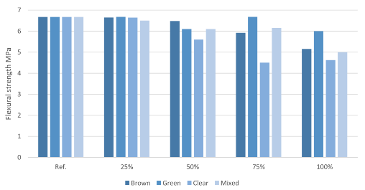


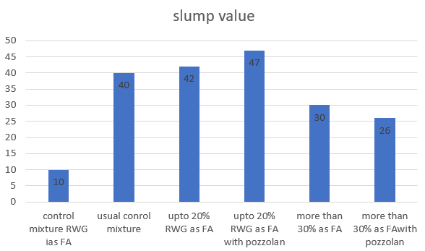

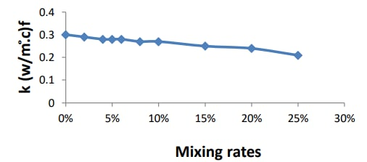

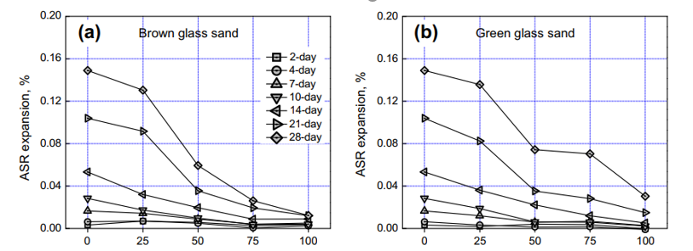

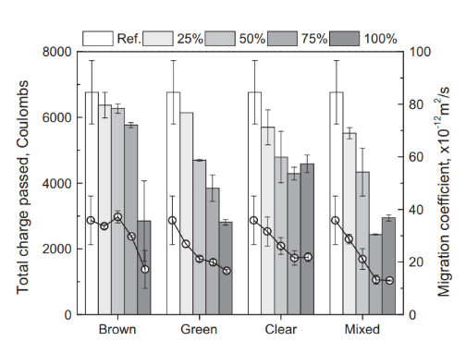


A REVIEW ON INCORPORATING RECYCLED GLASS WASTE
IN CONCRETE TO ENHANCE WASTE MANAGEMENT IN BANGLADESH
TEAM CONCRIO
Md. Kawsar Ahmed, Ariful Islam, Tanvir Ahmed Sijan
Background
Chemical Percentages of Glass Materials
Compressive and flexural strength
Compressive and flexural strength of concrete comprising (<0.60 mm) waste glass achieve satisfactory ^{[1]}
Conclusion
It takes a million years for a glass bottle to decompose in the environment. Various investigations were carried out on the utilization of Recycled Waste Glass (RWG) as fine aggregates and partial replacement to Portland cement in cementitious composites. It can also be utilized as a precursor in alkali activated composites on account of the high silica content. The use of waste glass in cementitious composites reduces the energy consumption, natural raw materials and CO₂ emission ^{[1]}
Satisfactory in compressive strength, up to 20-25% mix ratio in fine aggregate.
Better performance on expansion due to ASR and Chloride Attack 20-30%
More efficient in thermal insulation.
Applications
In Bangladesh, following wastes can be incorporated:
Electric bulbs, pharmaceutical glass wastes.
Mirrors, beverage bottles and daily produced glass wastes.
Produced glass e-wastes.
Results
Objective
Workability:
Increases up to 20% RWG as fine aggregate and then decreases ^{[2]}
Investigate the effect of the incorporation of glass as fine aggregates.
Use of glass waste as cementitious material.
Examine thermal influence at low and high temperatures.
References
Thermal Conductivity:
Decreases with increase of mix ratios ^{[4]}
[1] H. Hamada, A. Alattar, B. Tayeh, F. Yahaya, and B. Thomas, “Effect of recycled waste glass on the properties of high-performance concrete: A critical review.”
[2] K. H. Tan and H. Du, “Use of waste glass as sand in mortar: Part I – Fresh, mechanical and durability properties.”
[3] A. Tuaum, S. Shitote, and W. Oyawa, “Experimental Study of Self-Compacting Mortar Incorporating Recycled Glass Aggregate.”
[4] A. S. khalil, M. A. Mahmoud, A. AL-Hathal, M. K. Jawad, and B. M. Mozahim, “The effect of replaced recycled glass on thermal conductivity and compression properties of cement.”
Methods & Materials
Washing
Crushing
Grinding (as per ASTM C 33 requirement)
Finely Crushed & Mixed with Cement Clinker
Mixed as Fine Aggregate for Mortar & Concrete
Soda–lime waste glass, colored waste glass, e-waste glass materials.
Natural sand, cement, additive pozzolans,
Expansion due to Alkali–silica reaction (ASR):
Decreases rate of expansion with increase of % RWG^{[2]}
Rapid chloride permeability test:
Increases due to the lower porosity and permeability of glass particles ^{[3]}
Contacts
limonarif61@gmail.com
mdkawsar.ce@gmail.com
sijan002@gmail.com
Scan for more information

