Slide 1

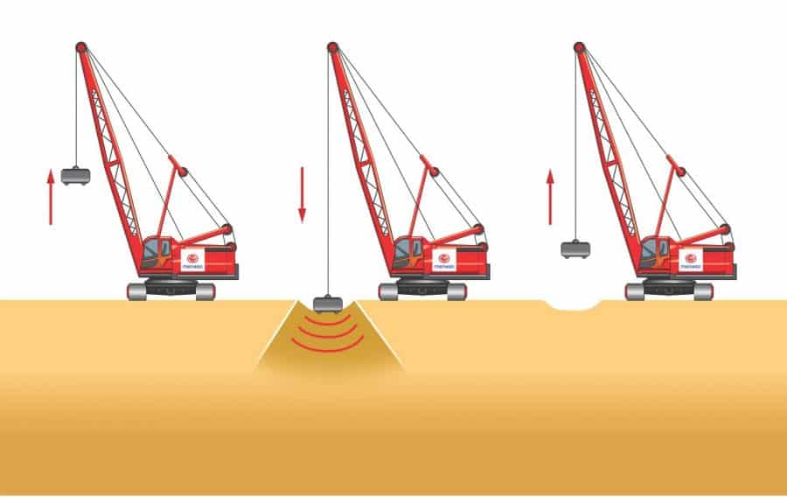
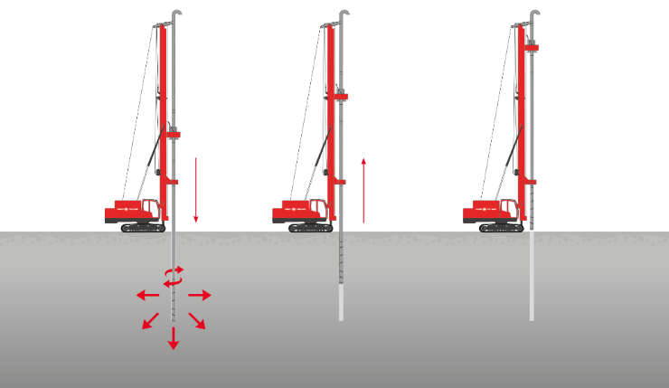
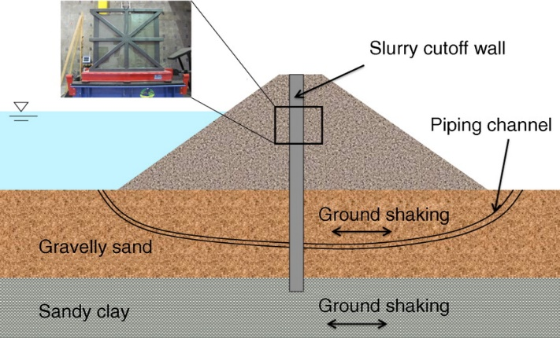

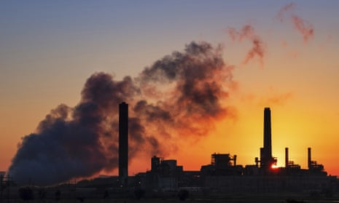



Presented By
Tanvir Ahmed Sijan (1904127)
Saif Rahman Sagor (1904122)
GROUND IMPROVEMENT TECHNOLOGIES
Alifuzzaman Alif (1904100)
Md. Shahriar Rahman Sakib (1904105)
Mahmudur Rahman (1904116)
for a sustainable world
Department of Civil Engineering, BUET
Introduction
Approach
Conclusion
In today’s world minimizing the carbon footprints has become a prime concern. Unfortunately, various sectors of construction industry are emitting huge amount of CO₂ into the atmosphere. To reduce carbon footprints, a few measures have been taken on ground improvement works. Three ground improvement methods - Dynamic Soil Compaction, Controlled Modulus Column and Soil-Bentonite Wall, are compared with traditional methods for their carbon footprints in light of case histories.
ws
Acceptable geotechnical solutions can directly mitigate unfavorable environmental impacts.
Material selection is one of the the most important factor to determine carbon footprint
Proper technique selection can help achieve long-term sustainability goal with no impact on quality, budget or schedule.
Case #1 Office Building
A ground improvement technique that densifies soils and fill materials by using a drop weight
Pittsburgh, Pennsylvania, USA
Dynamic Compaction
Case #2 Luxury Townhouse
Vertical, grouted elements that are used to control and reduce settlement and increase bearing capacity in soft or loose soils.
Weehawken, New Jersey, USA
Controlled Modulus Column
Case #3 Steelworks Facility
Typically excavated with a long reach excavator under a bentonite water slurry
Australia
Soil Bentonite Wall
Reduction (t eq. C)
Background
Construction industry alone accounts for 11% of global carbon emissions.
Conventional deep foundation techniques both directly and indirectly contribute to carbon emissions.
Raw material extraction, transportation, construction, operation, maintenance, and demolition all require energy.
Results
Comparison between Excavation and Dynamic Compaction (Case #1)
Comparative Emissions for H-Pile and CMC System in t eq. C (Case #2)
Excavation
References
Cortese, A. (2022, December 16). The embodied carbon conundrum: Solving for all emission sources from the built environment. Retrieved January 07, 2023, from https://newbuildings.org/embodied-carbon- conundrum-solving- for-all-emission-sources-from-the-built-environment/
Jones, S., Spaulding, C. and Smyth, P. (2007). " Design and construction of a deep soil-bentonite groundwater barrier wall at Newcastle, Australia " 10th Australian
Leone, M. (2005) – “The Quest for an Environmental Metric.” CFO Publishing Corporation 2007 http://www.cfo.com/printable/article.cfm/5300667
Building
Operations
Industry
30%
Global Carbon
Emissions
By Sector
Other
Building Material & Construction
Transportation
Acknowledgements
11%
Other
22%
Thanks to Charles Spaulding, Frederic Masse, Justin LaBrozzi, the respective authors of the paper.
9%
For more information scan the QR code

