Slide 1
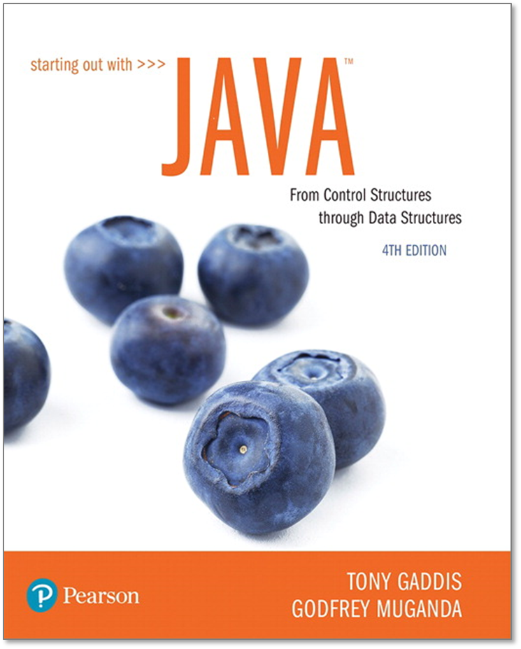
STARTING OUT WITH JAVATM
4th Edition
Chapter 3
Decision Structures

Slide 2
Chapter Topics (1 of 2)
Chapter 3 discusses the following main topics:
  The if Statement
  The if-else Statement
  Nested if statements
  The if-else-if Statement
  Logical Operators
  Comparing String Objects

Slide 3
Chapter Topics (2 of 2)
Chapter 3 discusses the following main topics:
  More about Variable Declaration and Scope
  The Conditional Operator
  The switch Statement
  Displaying Formatted Output with System.out.printf and String.format

Slide 4
The if Statement
The if statement decides whether a section of code executes or not.
The if statement uses a boolean to decide whether the next statement or block of statements executes.
  if (boolean expression is true)
  execute next statement.

Slide 5
Flowcharts (1 of 2)
If statements can be modeled as a flow chart.
Is it cold
outside?
Yes
if (coldOutside)
wearCoat();
Wear a coat.

Slide 6
Flowcharts (2 of 2)
A block if statement may be modeled as:
if (coldOutside)
{
wearCoat();
wearHat();
wearGloves();
}
Is it cold
outside?
Yes
Wear a coat.
Wear a hat.
Note the use of curly
braces to block several
statements together.
Wear gloves.

Slide 7
Relational Operators
In most cases, the boolean expression, used by the if statement, uses relational operators.
Relational Operator | Meaning
> | is greater than
< | is less than
>= | is greater than or equal to
<= | is less than or equal to
== | is equal to
!= | is not equal to

Slide 8
Boolean Expressions
A boolean expression is any variable or calculation that results in a true or false condition.
Expression | Meaning
x > y | Is x greater than y?
x < y | Is x less than y?
x >= y | Is x greater than or equal to y?
x <= y | Is x less than or equal to y.
x == y | Is x equal to y?
x != y | Is x not equal to y?

Slide 9
if Statements and Boolean Expressions
if (x > y)
  System.out.println("X is greater than Y");
if(x == y)
  System.out.println("X is equal to Y");
if(x != y)
{
  System.out.println("X is not equal to Y");
  x = y;
  System.out.println("However, now it is.");
}
Example: AverageScore.java

Slide 10
Programming Style and if Statements
(1 of 2)
An if statement can span more than one line; however, it is still one statement.
  if (average > 95)
  grade = ′A′;
is functionally equivalent to
  if(average > 95) grade = ′A′;

Slide 11
Programming Style and if Statements
(2 of 2)
Rules of thumb:
  The conditionally executed statement should be on the line after the if condition.
  The conditionally executed statement should be indented one level from the if condition.
  If an if statement does not have the block curly braces, it is ended by the first semicolon encountered after the if condition.
    if (expression)
    statement;
No semicolon here.
Semicolon ends statement here.

Slide 12
Block if Statements (1 of 2)
Conditionally executed statements can be grouped into a block by using curly braces {} to enclose them.
If curly braces are used to group conditionally executed statements, the if statement is ended by the closing curly brace.
  if (expression)
  {
  statement1;
  statement2;
  }
Curly brace ends the statement.

Slide 13
Block if Statements (2 of 2)
Remember that when the curly braces are not used, then only the next statement after the if condition will be executed conditionally.
  if (expression)
  statement1;
  statement2;
  statement3;
Only this statement is conditionally executed.

Slide 14
Flags
A flag is a boolean variable that monitors some condition in a program.
When a condition is true, the flag is set to true.
The flag can be tested to see if the condition has changed.
  if (average > 95)
  highScore = true;
Later, this condition can be tested:
  if (highScore)
  System.out.println("That′s a high score!");

Slide 15
Comparing Characters
Characters can be tested with relational operators.
Characters are stored in memory using the Unicode character format.
Unicode is stored as a sixteen (16) bit number.
Characters are ordinal, meaning they have an order in the Unicode character set.
Since characters are ordinal, they can be compared to each other.
char c = ′A′;
  if(c < ′Z′)
  System.out.println("A is less than Z");

Slide 16
if-else Statements
The if-else statement adds the ability to conditionally execute code when the if condition is false.
  if (expression)
  statementOrBlockIfTrue;
  else
  statementOrBlockIfFalse;
See example: Division.java

Slide 17
if-else Statement Flowcharts
No
Yes
Is it cold
outside?
Wear shorts.
Wear a coat.

Slide 18
Nested if Statements
If an if statement appears inside another if statement (single or block) it is called a nested if statement.
The nested if is executed only if the outer if statement results in a true condition.
See example: LoanQualifier.java

Slide 19
Nested if Statement Flowcharts
No
Yes
Is it cold
outside?
Wear shorts.
No
Is it
snowing?
Yes
Wear a jacket.
Wear a parka.

Slide 20
Nested if Statements
if (coldOutside)
{
if (snowing)
{
wearParka();
}
else
{
wearJacket();
}
}
else
{
wearShorts();
}

Slide 21
if-else Matching
Curly brace use is not required if there is only one statement to be conditionally executed.
However, sometimes curly braces can help make the program more readable.
Additionally, proper indentation makes it much easier to match up else statements with their corresponding if statement.

Slide 22
Alignment and Nested if Statements
if (coldOutside)
{
if (snowing)
{
wearParka();
}
else
{
wearJacket();
}
}
else
{
wearShorts();
}
This if and else
go together.
This if and else
go together.

Slide 23
if-else-if Statements (1 of 2)
if (expression_1)
{
statement;
statement;
etc.
}
else if (expression_2)
{
statement;
statement;
etc.
}
Insert as many else if clauses as necessary
else
{
statement;
statement;
etc.
}
If expression_1 is true these statements are executed, and the rest of the structure is ignored.
Otherwise, if expression_2 is true these statements are executed, and the rest of the structure is ignored.
These statements are executed if none of the expressions above are true.

Slide 24
if-else-if Statements (2 of 2)
Nested if statements can become very complex.
The if-else-if statement makes certain types of nested decision logic simpler to write.
Care must be used since else statements match up with the immediately preceding unmatched if statement.
See example: TestResults.java

Slide 25
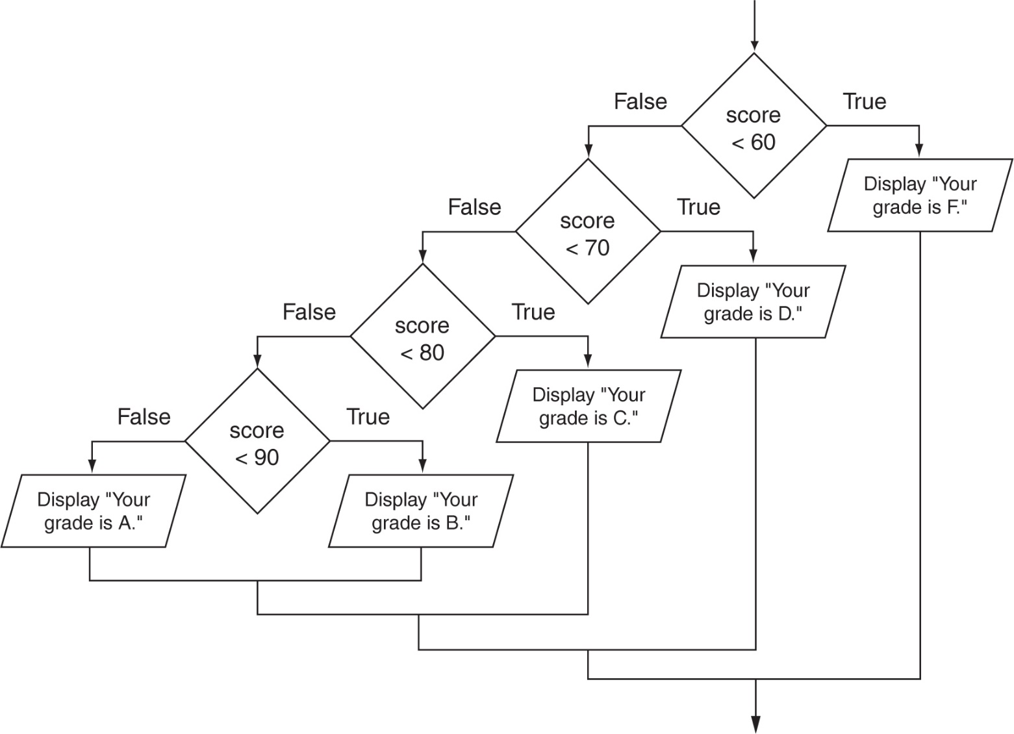
if-else-if Flowchart

Slide 26
Logical Operators (1 of 2)
Java provides two binary logical operators (&& and ||) that are used to combine boolean expressions.
Java also provides one unary (!) logical operator to reverse the truth of a boolean expression.

Slide 27
Logical Operators (2 of 2)
Operator | Meaning | Effect
&& | AND | Connects two boolean expressions into one. Both expressions must be true for the overall expression to be true.
|| | OR | Connects two boolean expressions into one. One or both expressions must be true for the overall expression to be true. It is only necessary for one to be true, and it does not matter which one.
! | NOT | The ! operator reverses the truth of a boolean expression. If it is applied to an expression that is true, the operator returns false. If it is applied to an expression that is false, the operator returns true.

Slide 28
The && Operator
The logical AND operator (&&) takes two operands that must both be boolean expressions.
The resulting combined expression is true if (and only if) both operands are true.
See example: LogicalAnd.java
Expression 1 | Expression 2 | Expression1 && Expression2
true | false | false
false | true | false
false | false | false
true | true | true

Slide 29
The || Operator
The logical OR operator (||) takes two operands that must both be boolean expressions.
The resulting combined expression is false if (and only if) both operands are false.
Example: LogicalOr.java
Expression 1 | Expression 2 | Expression1 || Expression2
true | false | true
false | true | true
false | false | false
true | true | true

Slide 30
The ! Operator
The ! operator performs a logical NOT operation.
If an expression is true, !expression will be false.
  if (!(temperature > 100))
  System.out.println("Below the maximum temperature.");
If temperature > 100 evaluates to false, then the output statement will be run.
Expression 1 | !Expression1
true | false
false | true

Slide 31
Short Circuiting
Logical AND and logical OR operations perform short-circuit evaluation of expressions.
Logical AND will evaluate to false as soon as it sees that one of its operands is a false expression.
Logical OR will evaluate to true as soon as it sees that one of its operands is a true expression.

Slide 32
Order of Precedence (1 of 2)
The ! operator has a higher order of precedence than the && and || operators.
The && and || operators have a lower precedence than relational operators like
< and >.
Parenthesis can be used to force the precedence to be changed.

Slide 33
Order of Precedence (2 of 2)
Order of Precedence | Operators | Description
1 | (unary negation) ! | Unary negation, logical NOT
2 | * / % | Multiplication, Division, Modulus
3 | + - | Addition, Subtraction
4 | < > <= >= | Less-than, Greater-than, Less-than or equal to, Greater-than or equal to
5 | == != | Is equal to, Is not equal to
6 | && | Logical AND
7 | || | Logical NOT
8 | = += -= *= /= %= | Assignment and combined assignment operators.

Slide 34
Comparing String Objects
In most cases, you cannot use the relational operators to compare two String objects.
Reference variables contain the address of the object they represent.
Unless the references point to the same object, the relational operators will not return true.
See example: StringCompare.java
See example: StringCompareTo.java

Slide 35
Ignoring Case in String Comparisons
In the String class the equals and compareTo methods are case sensitive.
In order to compare two String objects that might have different case, use:
  equalsIgnoreCase, or
  compareToIgnoreCase
See example: SecretWord.java

Slide 36
Variable Scope
In Java, a local variable does not have to be declared at the beginning of the method.
The scope of a local variable begins at the point it is declared and terminates at the end of the method.
When a program enters a section of code where a variable has scope, that variable has come into scope, which means the variable is visible to the program.
See example: VariableScope.java

Slide 37
The Conditional Operator (1 of 4)
The conditional operator is a ternary (three operand) operator.
You can use the conditional operator to write a simple statement that works like an if-else statement.

Slide 38
The Conditional Operator (2 of 4)
The format of the operators is:
  BooleanExpression ? Value1 : Value2
This forms a conditional expression.
If BooleanExpression is true, the value of the conditional expression is Value1.
If BooleanExpression is false, the value of the conditional expression is Value2.

Slide 39
The Conditional Operator (3 of 4)
Example:
  z = x > y ? 10 : 5;
This line is functionally equivalent to:
  if(x > y)
  z = 10;
  else
  z = 5;

Slide 40
The Conditional Operator (4 of 4)
Many times the conditional operator is used to supply a value.
  number = x > y ? 10 : 5;
This is functionally equivalent to:
  if(x > y)
  number = 10;
  else
  number = 5;
See example: ConsultantCharges.java

Slide 41
The switch Statement (1 of 4)
The if-else statement allows you to make true / false branches.
The switch statement allows you to use an ordinal value to determine how a program will branch.
The switch statement can evaluate an integer type or character type variable and make decisions based on the value.

Slide 42
The switch Statement (2 of 4)
The switch statement takes the form:
  switch (SwitchExpression)
  {
  case CaseExpression:
  // place one or more statements here
  break;
  case CaseExpression:
  // place one or more statements here
  break;
  // case statements may be repeated
  //as many times as necessary
  default:
  // place one or more statements here
  }

Slide 43
The switch Statement (3 of 4)
  switch (SwitchExpression)
  {
  …
  }
The switch statement will evaluate the SwitchExpression, which can be a byte, short, int, long, or char. If you are using Java 7, the SwitchExpression can also be a string.
If there is an associated case statement that matches that value, program execution will be transferred to that case statement.

Slide 44
The switch Statement (4 of 4)
Each case statement will have a corresponding CaseExpression that must be unique.
case CaseExpression:
  // place one or more statements here
  break;
If the SwitchExpression matches the CaseExpression, the Java statements between the colon and the break statement will be executed.

Slide 45
The case Statement
The break statement ends the case statement.
The break statement is optional.
If a case does not contain a break, then program execution continues into the next case.
  See example: NoBreaks.java
  See example: PetFood.java
The default section is optional and will be executed if no CaseExpression matches the SwitchExpression.
See example: SwitchDemo.java

Slide 46
The System.out.printf Method (1 of 15)
You can use the System.out.printf method to perform formatted console output.
The general format of the method is:
System.out.printf(FormatString, ArgList);

Slide 47
The System.out.printf Method (2 of 15)
System.out.printf(FormatString, ArgList);
FormatString is a string that contains text and/or special formatting specifiers.
ArgList is optional. It is a list of additional arguments that will be formatted according to the format specifiers listed in the format string.

Slide 48
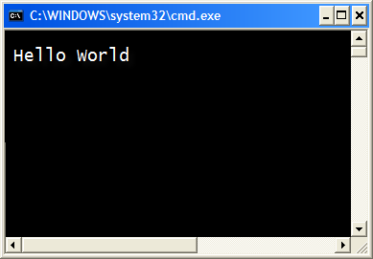
The System.out.printf Method (3 of 15)
A simple example:
System.out.printf("Hello World\n");

Slide 49
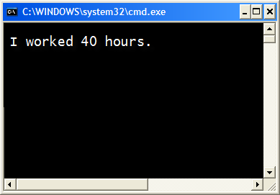
The System.out.printf Method (4 of 15)
Another example:
int hours = 40;
System.out.printf("I worked %d hours.\n", hours);

Slide 50
The System.out.printf Method (5 of 15)
int hours = 40;
System.out.printf("I worked %d hours.\n", hours);
The %d format specifier indicates that a decimal integer will be printed.
The contents of the hours variable will be printed in the location of the %d format specifier.

Slide 51
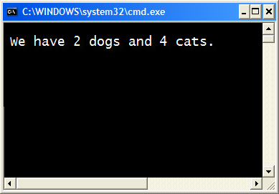
The System.out.printf Method (6 of 15)
Another example:
int dogs = 2, cats = 4;
System.out.printf("We have %d dogs and %d
cats.\n", dogs, cats);

Slide 52
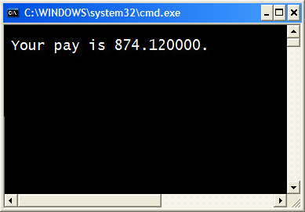
The System.out.printf Method (7 of 15)
Another example:
double grossPay = 874.12;
System.out.printf("Your pay is %f.\n", grossPay);

Slide 53
The System.out.printf Method (8 of 15)
Another example:
double grossPay = 874.12;
System.out.printf("Your pay is %f.\n", grossPay);
The %f format specifier indicates that a floating-point value will be printed.
The contents of the grossPay variable will be printed in the location of the %f format specifier.

Slide 54
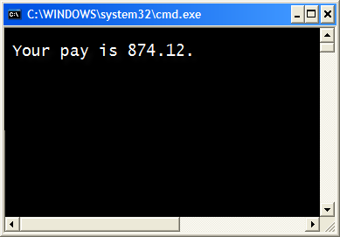
The System.out.printf Method (9 of 15)
Another example:
double grossPay = 874.12;
System.out.printf("Your pay is %.2f.\n",
grossPay);

Slide 55
The System.out.printf Method
(10 of 15)
Another example:
double grossPay = 874.12;
System.out.printf("Your pay is %.2f.\n", grossPay);
The %.2f format specifier indicates that a floating-point value will be printed, rounded to two decimal places.

Slide 56
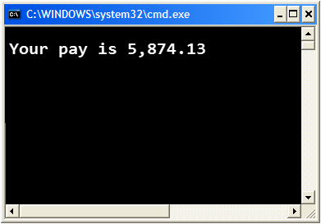
The System.out.printf Method
(11 of 15)
Another example:
double grossPay = 5874.127;
System.out.printf("Your pay is %,.2f.\n", grossPay);
The %,.2f format specifier indicates that a floating-point value will be printed with comma separators, rounded to two decimal places.

Slide 57

The System.out.printf Method
(12 of 15)
Another example:
String name = "Ringo";
System.out.printf("Your name is %s.\n", name);
The %s format specifier indicates that a string will be printed.

Slide 58
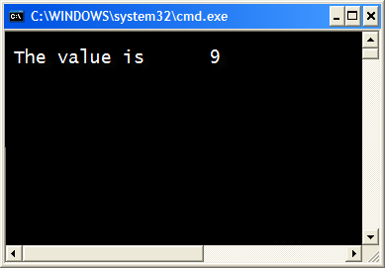
The System.out.printf Method
(13 of 15)
Specifying a field width:
int number = 9;
System.out.printf("The value is %6d\n", number);
The %6d format specifier indicates the integer will appear in a field that is 6 spaces wide.

Slide 59

The System.out.printf Method
(14 of 15)
Another example:
double number = 9.76891;
System.out.printf("The value is %6.2f\n", number);
The %6.2f format specifier indicates the number will appear in a field that is 6 spaces wide, and be rounded to 2 decimal places.

Slide 60
The System.out.printf Method
(15 of 15)
See examples:
  Columns.java
  CurrencyFormat.java

Slide 61
The String.format Method (1 of 3)
The String.format method works exactly like the System.out.printf method, except that it does not display the formatted string on the screen.
Instead, it returns a reference to the formatted string.
You can assign the reference to a variable, and then use it later.

Slide 62
The String.format Method (2 of 3)
The general format of the method is:
String.format(FormatString,ArgumentList);
FormatString is a string that contains text and/or special formatting specifiers.
ArgumentList is optional. It is a list of additional arguments that will be formatted according to the format specifiers listed in the format string.

Slide 63
The String.format Method (3 of 3)
See examples:
  CurrencyFormat2.java
  CurrencyFormat3.java

Slide 64

Copyright
This work is protected by United States copyright laws and is provided solely
for the use of instructions in teaching their courses and assessing student
learning. dissemination or sale of any part of this work (including on the
World Wide Web) will destroy the integrity of the work and is not permit-
ted. The work and materials from it should never be made available to
students except by instructors using the accompanying text in their
classes. All recipients of this work are expected to abide by these
restrictions and to honor the intended pedagogical purposes and the needs of
other instructors who rely on these materials.

