Slide 1
Expense Manager: Assessment Summary
Advanced Filtering | Validation | Archiving | Testing
Sankalp kulkarni

Slide 2
Exercise Overview & Implementation
Exercise 1: Filtering & Pagination
Backend: Added filters (category, date, amount), pagination (with Spring Data pagination support)
Frontend: Search inputs, category selection, dropdowns, paginated navigation
Exercise 2: Validation & Error Handling
Backend: Added data validation logic and custom exceptions, used @controllerAdvice for specific error handling
Frontend: User-friendly error messages on failure
Exercise 3: Soft Delete / Archiving
Backend: Soft delete flag, archiving logic for >30 days
Frontend: Archive toggle and archived view section
Exercise 4: Testing
Backend: Unit tests (Mockito), integration tests with SpringBootTest and MockMvc
Frontend: Jest to unit test and Vue Test Utils to test event emission

Slide 3
Key Challenges and Resolutions
Problem 1: Pagination and filtering combined, valid combinations and state management/ data refreshing
Solution: Clear filters when page size changes, reset to first page when any filter updates. Serve fresh data for every request
Problem 2: Vue component testing with Jest required the use of specific dependencies for Vue 2.7.6
Solution: Resolved Vue Jest testing issues by consulting docs, skimming forums, and identifying required dependencies through trial and error

Slide 4
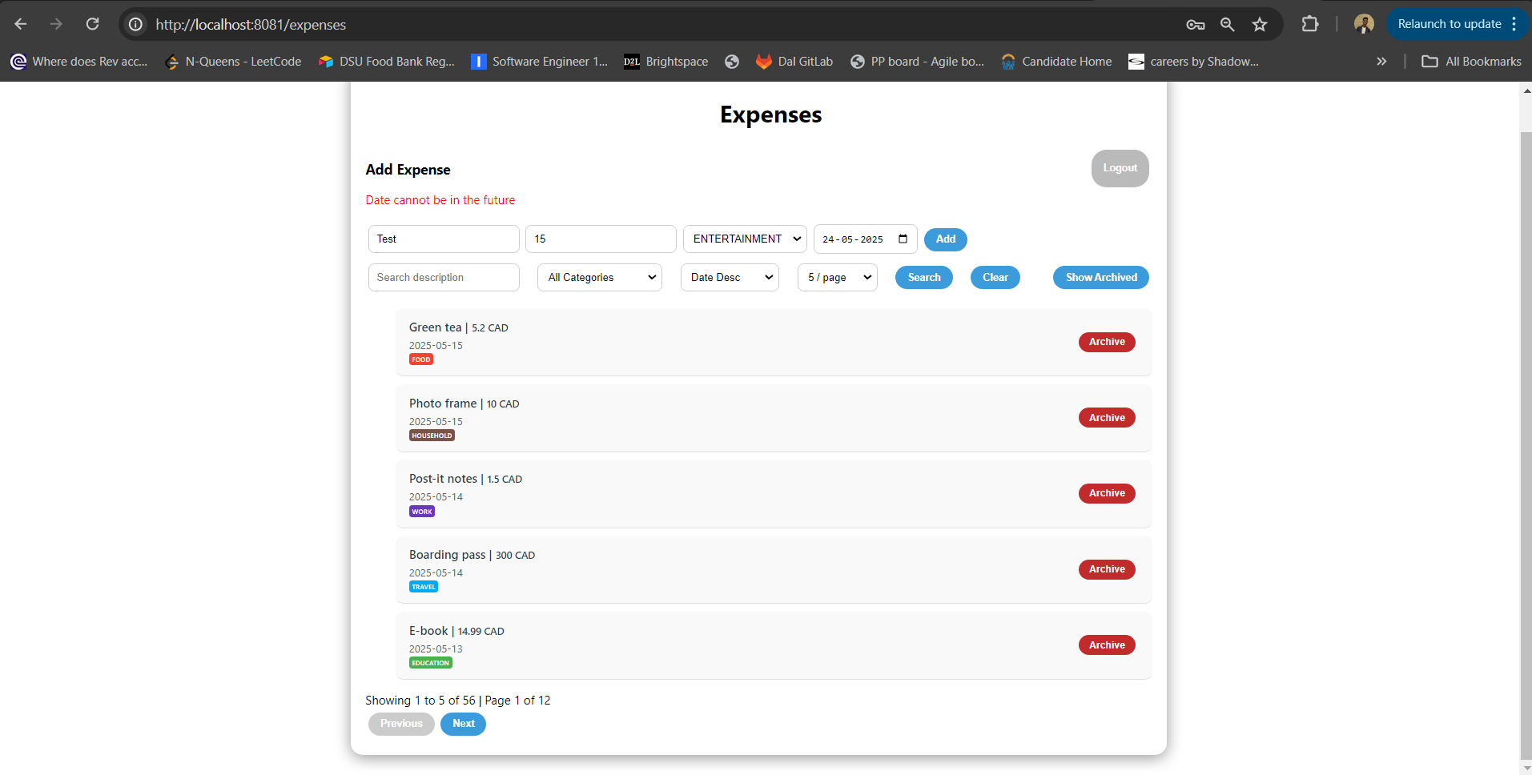
UI Improvements
Modular toolbar with filters
Styled category tags using scoped CSS (color-coded chips)
UX Enhancements: pagination UI, clear/reset actions, Archived section

Slide 5
Scaling and Optimization Ideas
Backend:
Use DTOs or projections to reduce payload and decouple DAO with DTO
Add indexes on filterable fields (category, date, amount) for fast retrieval
Apply caching (e.g., Spring Cache) for archived expenses, frequently viewed filters/ categories
Frontend:
Debounce search inputs to reduce API load
Implement infinite scroll or lazy loading
Use global state management (Vuex/ Pinia) for filter state

Slide 6
Questions or Feedback?
Contact: kulkarnisankalp21@gmail.com
GitHub: https://github.com/CapnSK/expense-tracker-main
Thanks for reviewing my work!

