Slide 1
MR.CREAMS — Investor Presentation (Ethiopia)
Confidential investor presentation | Generated by Enum | Enum Technologies

Slide 2
Vision & Mission
MR.CREAMS empowers emotional wellness through data-driven therapy, gamified engagement, and accessible digital care for Ethiopians.

Slide 3
Problem
• Over 20% of adults in Ethiopia experience mental health issues.
• Less than 1 psychiatrist per 500,000 citizens.
• Access barriers: stigma, cost, location.

Slide 4
Solution
A mobile-first digital mental health platform providing:
• AI-assisted emotion tracking
• Online therapy sessions
• Mood analytics
• Educational content in Amharic and English.

Slide 5
Market Opportunity
• Adult population (15+): 82.6M
• Smartphone users: 19.8M
• Target penetration: 0.5%–5%
• Paying users potential: 5K–50K+

Slide 6
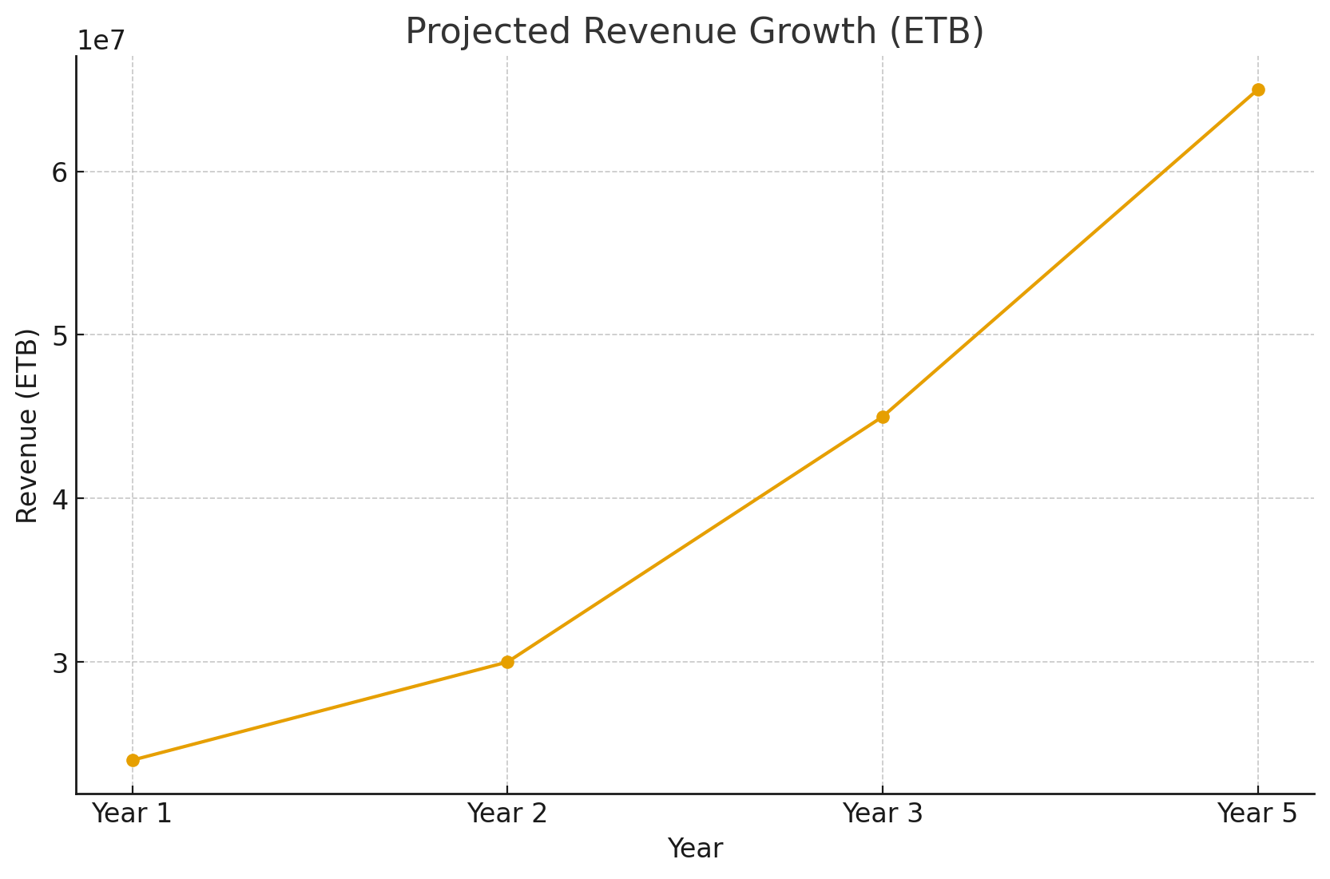
Market Growth & Revenue Forecast

Slide 7
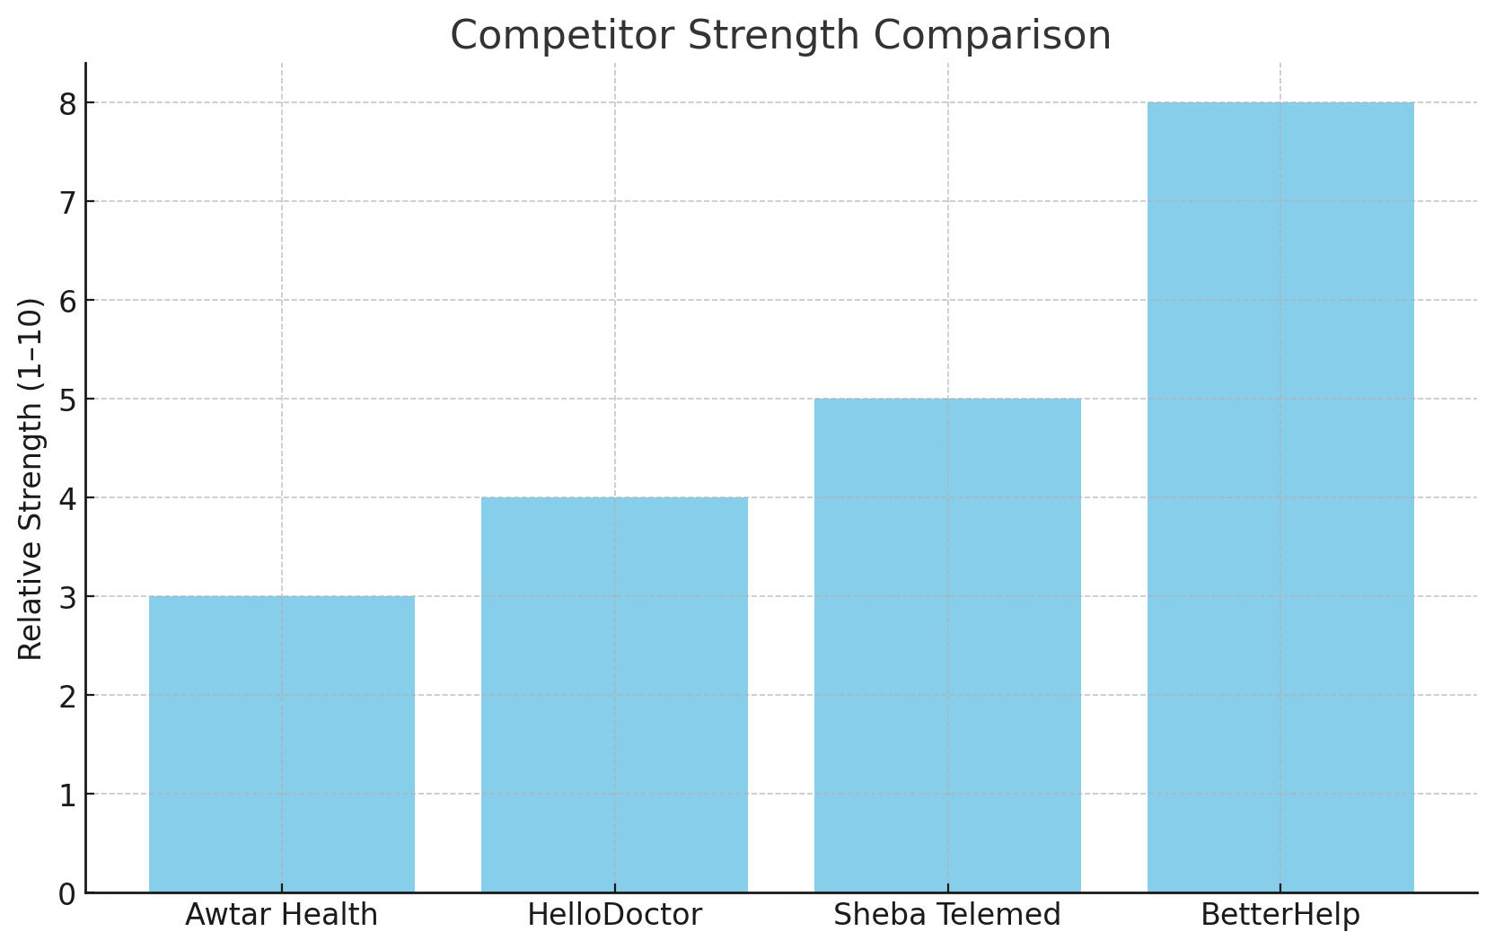
Competitive Landscape
MR.CREAMS stands out via cultural localization, affordability, and low-bandwidth optimization.

Slide 8
Financial Overview
Estimated annual operating costs: 9,000,000 ETB
Projected Year 3 revenue: 45,000,000 ETB
Break-even expected by Year 2.

Slide 9
Growth Strategy
• Pilot in Addis Ababa & universities
• Partner with NGOs and clinics
• Launch freemium app (Amharic/English)
• Scale nationwide within 3 years

Slide 10
Investment Ask
Seeking 12–15 million ETB seed investment to achieve national rollout by Year 3.
Funds allocated to development, marketing, and team expansion.
Expected ROI: 3x within 5 years.

Slide 11
Contact Information
ENUM Technologies| Addis Ababa
Contact: Fitsum Mulugeta (Founder)
Email: founder@enumtechnolgies.com
Confidential — For Investor Review Only.

