Slide 1
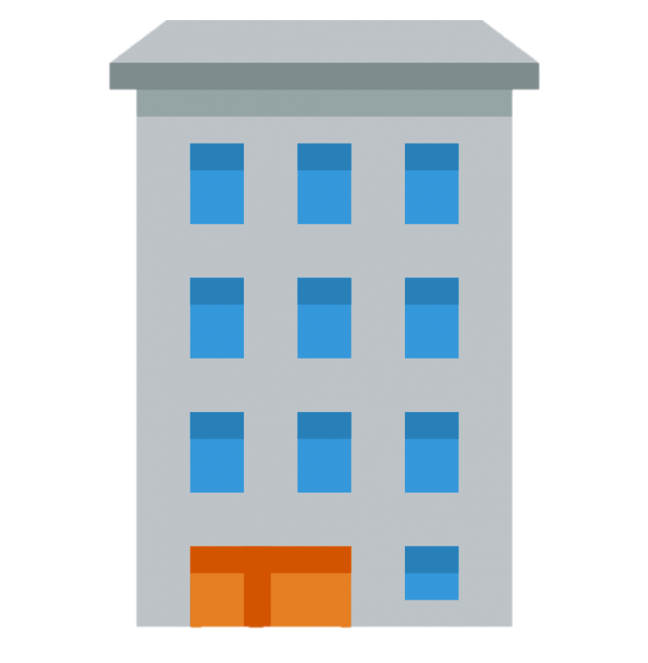
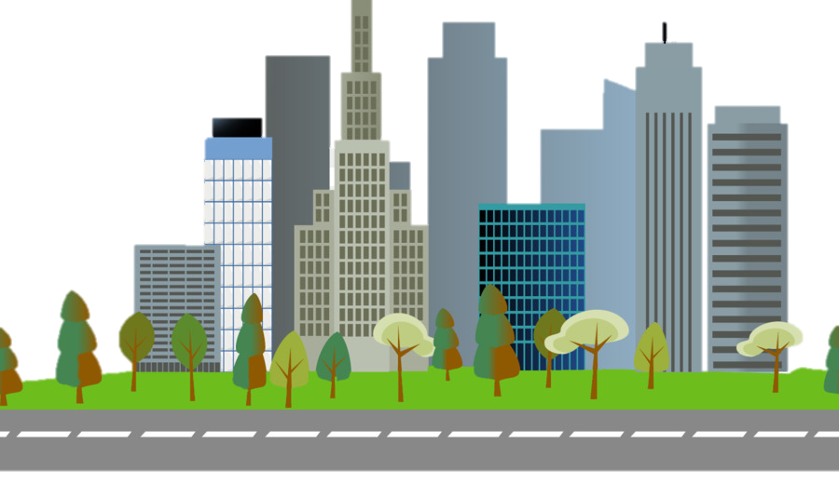

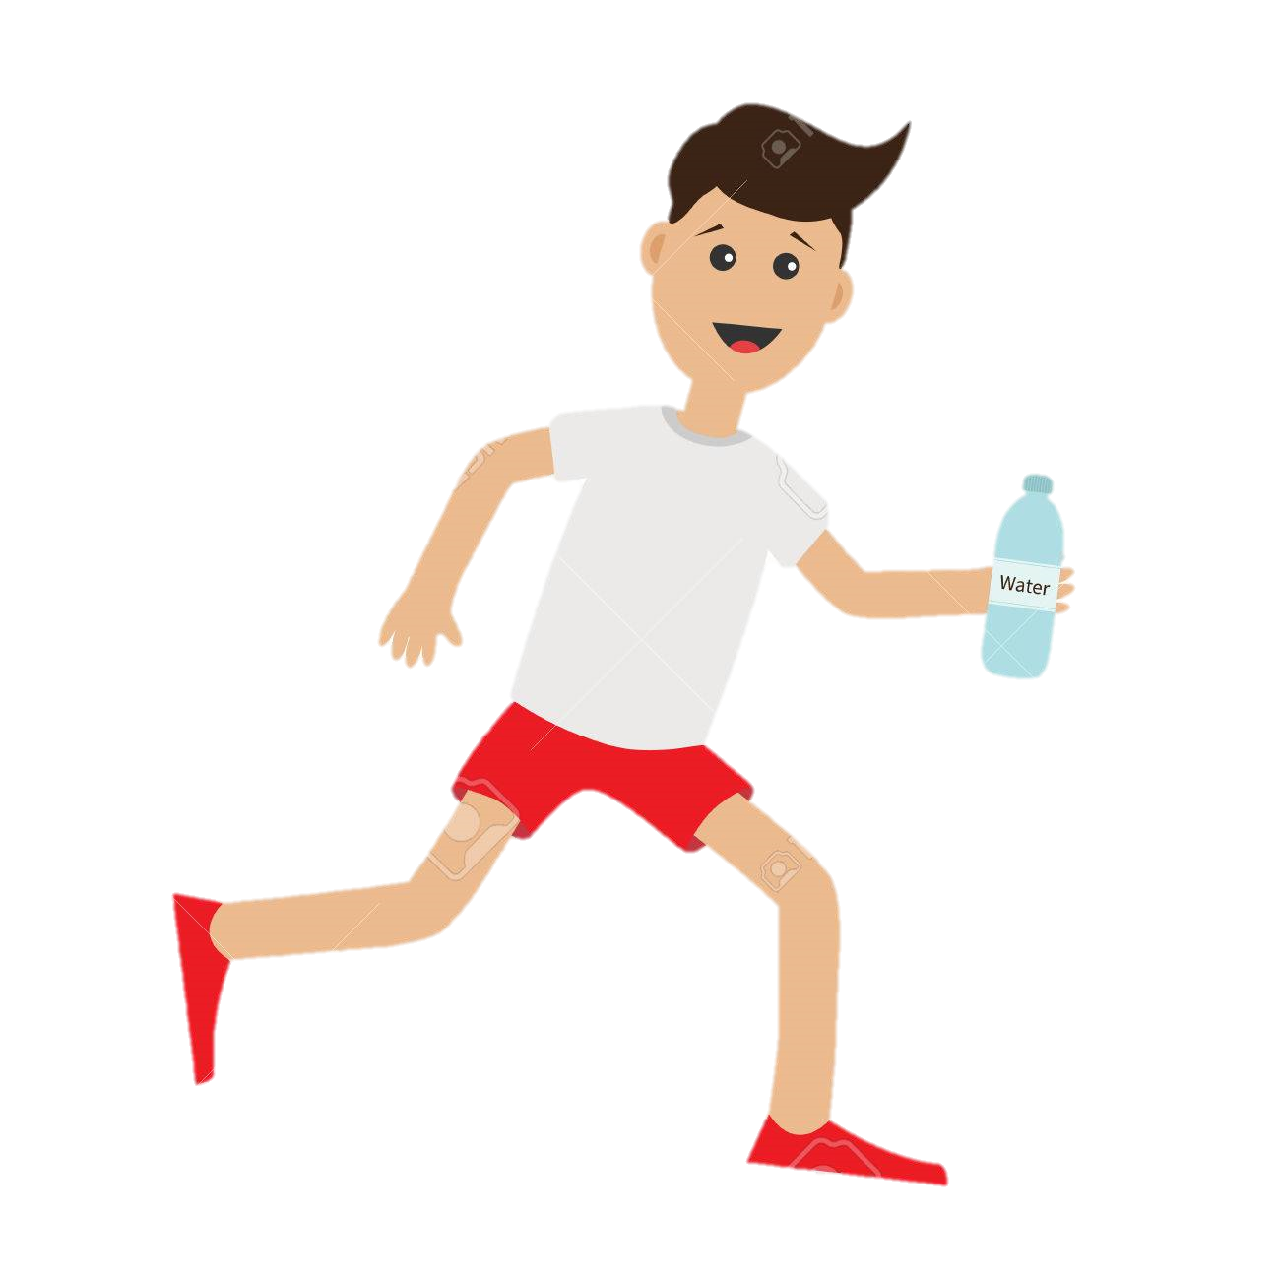
Jim has been working non-stop on classwork and other areas of his life and he just wants to get back out and exercise, so he goes on a run
Austin Cappuccio

Slide 2
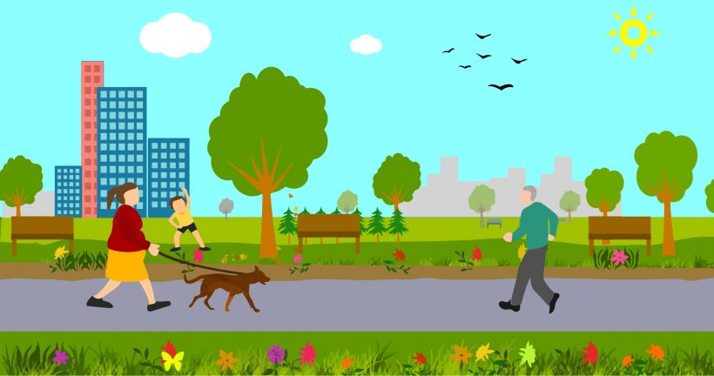
Jim runs into his friend Max at the park and Jim tells him that he is running out of water. Max tells him about a cool new app where all the water fountains on campus are located

Slide 3
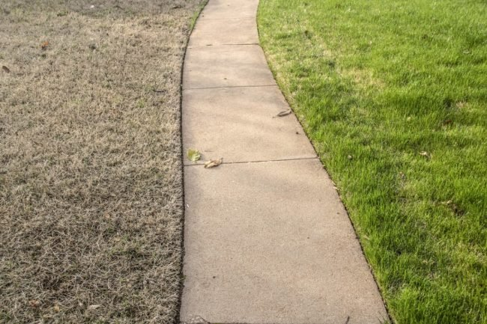
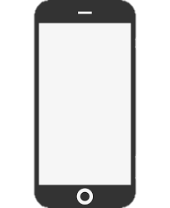
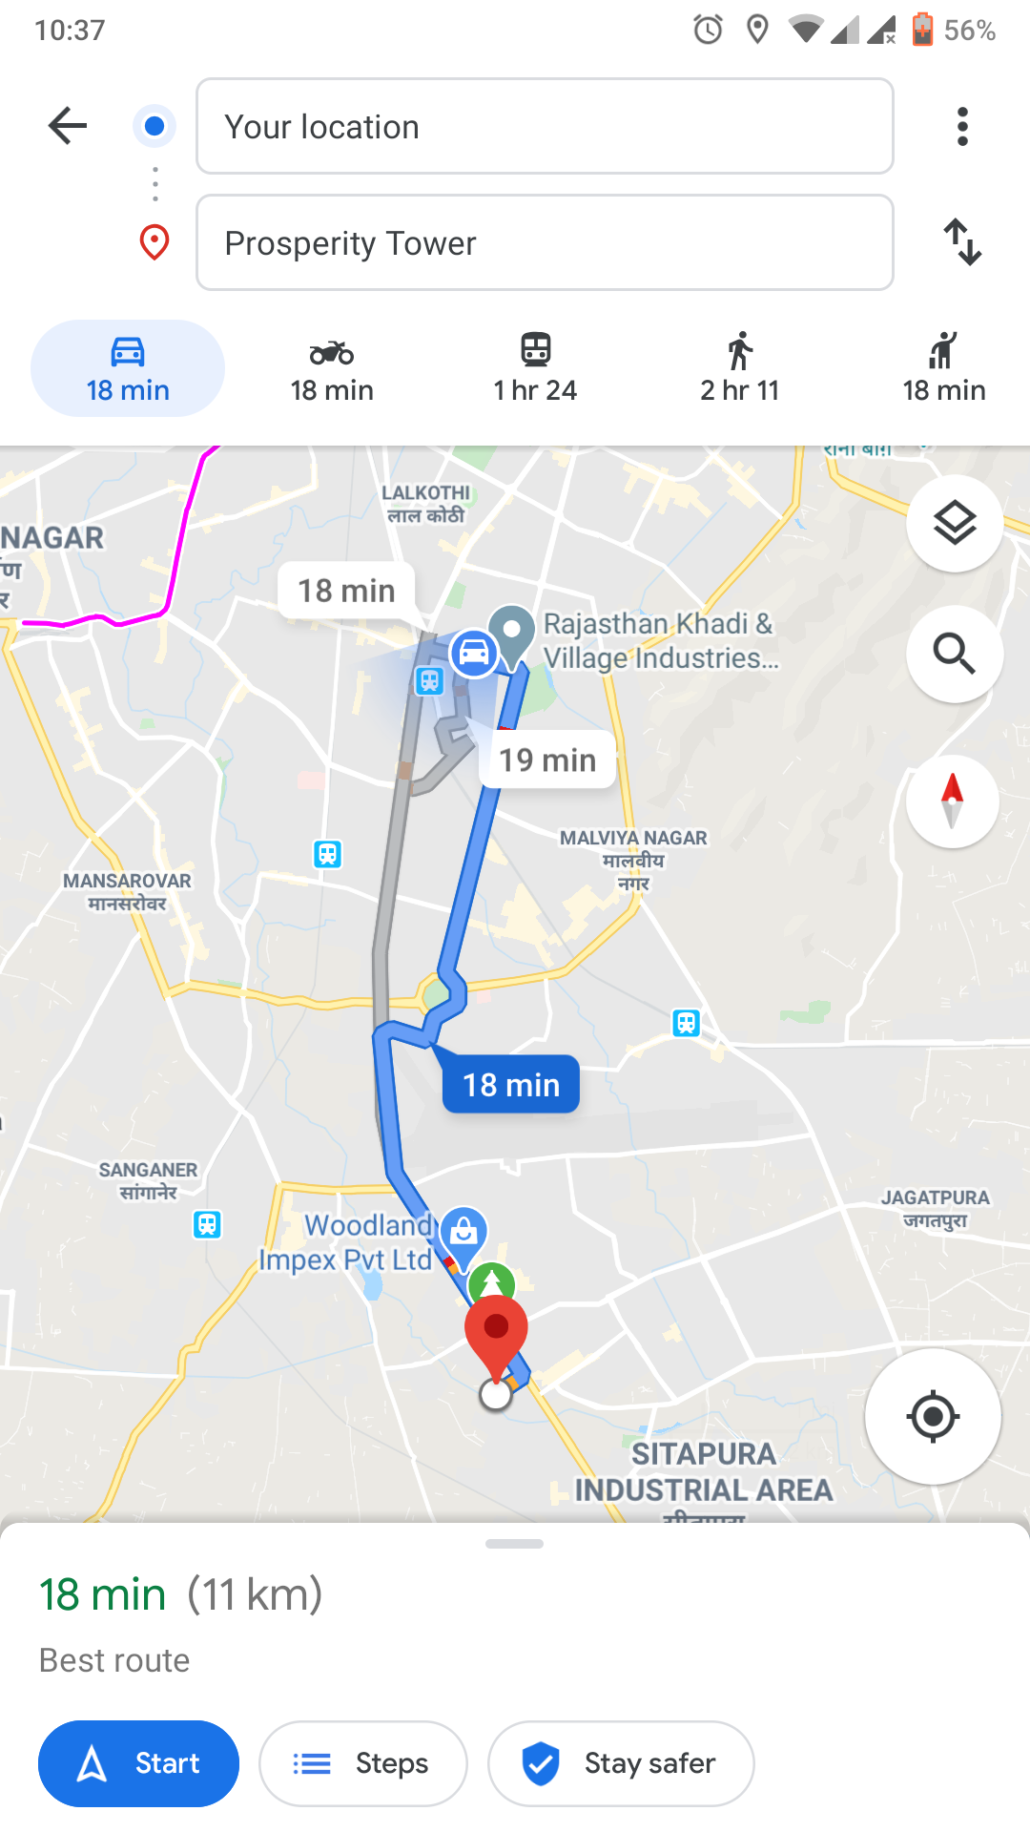
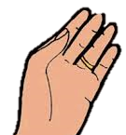
Nearest Station
Jim downloads the app and creates his profile. He discovers a nearby water bottle refilling station, and he starts to head over.

Slide 4
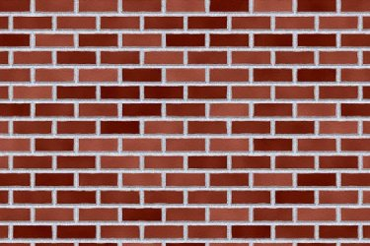
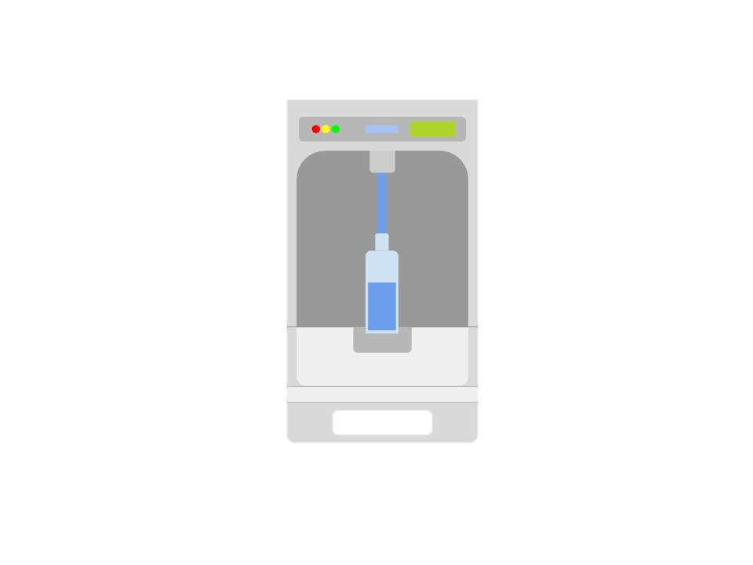
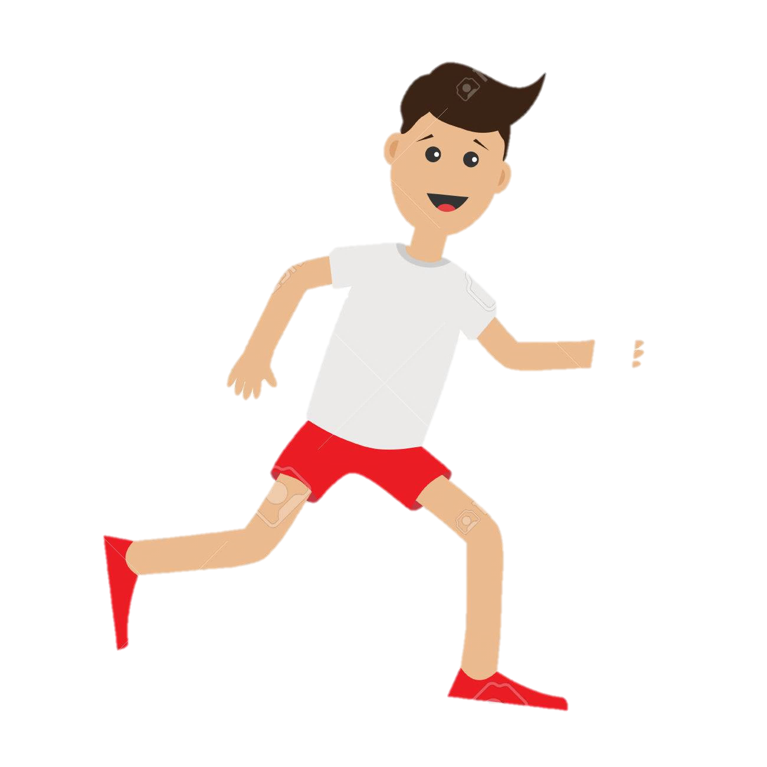

Jim arrives at the water bottle refiling station and continues his run with the app still open, which will save his route for next time he runs

Slide 5
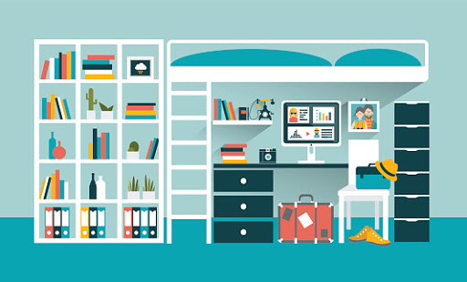
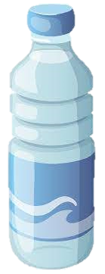
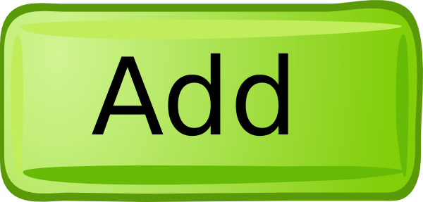
When Jim gets back to his dorm, he adds his friends on the app and joins a league where he can compete to see how much water he uses per week by using a water bottle refilling station and the app!

Slide 6
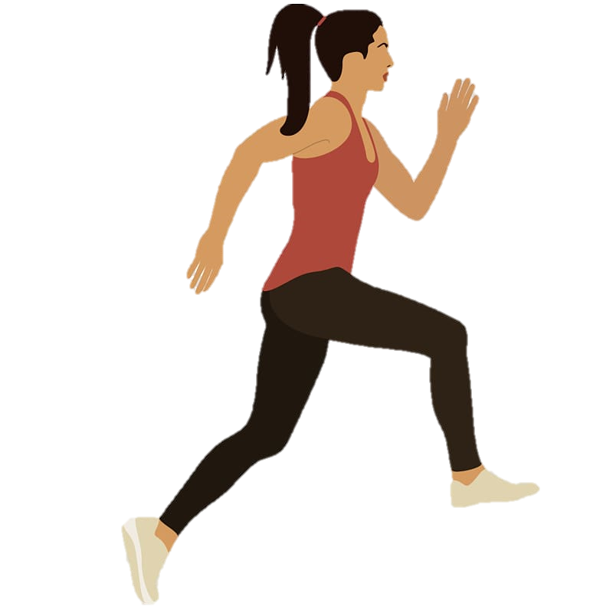
Jim now uses his new app to get out, connect with friends, and run more while staying hydrated on the way!
Austin Cappuccio

