Slide 1
TR-SPAD digit
classification
Gamma–exponential BOCPD and adaptive integration
Notes:
The objective is to classify a digit directly from a time-resolved photon recording through a sensor-proximal representation and a temporal neural network. Direct refers to avoiding a separate conventional image-reconstruction stage. The pipeline still produces spatial integration readouts, and those readouts are the input to the CNN. The presentation follows the proposed solution chapter, with numerical examples used only to explain timing and packing.
Source: User-supplied chapter, Proposed solution. This presentation explains the method as described in that chapter.
Sundar, Zhang, Jungerman and Gupta (2025). Quanta Neural Networks: From Photons to Perception. ICCV, 5091–5101. https://openaccess.thecvf.com/content/ICCV2025/html/Sundar_Quanta_Neural_Networks_From_Photons_to_Perception_ICCV_2025_paper.html
Suonsivu et al. (2024). Time-Resolved MNIST Dataset for Single-Photon Recognition. https://arxiv.org/abs/2410.16744

Slide 2
Problem formulation
One simulated TR-SPAD recording contains a variable number of photon detections.
INPUT
OBJECTIVE
S = {(xᵢ, yᵢ, tᵢ)}ᵢ₌₁ᴺ
Classify the digit
from the photon stream
Pixel coordinates: 0 to 27
Arrival times: seconds
Acquisition interval: [0, Tₐcq]
Use photon timing in a CNN-based pipeline that generalizes to unseen recordings.
The sensor-proximal layer supplies spatial readouts without a separate conventional reconstruction stage.
02
Notes:
Each recording has a ground-truth label from 0 through 9. N varies because detections are stochastic. Coordinates in this formulation are zero-based. File-loading code may use a different coordinate base and must convert it consistently. The proposed method uses the temporal information in individual detections. It does not send an unstructured event list straight into a conventional convolutional layer: it first organizes events and maintains an adaptive spatial accumulator.
Source: User-supplied chapter, Proposed solution. This presentation explains the method as described in that chapter.
Suonsivu et al. (2024). Time-Resolved MNIST Dataset for Single-Photon Recognition. https://arxiv.org/abs/2410.16744
Sundar, Zhang, Jungerman and Gupta (2025). Quanta Neural Networks: From Photons to Perception. ICCV, 5091–5101. https://openaccess.thecvf.com/content/ICCV2025/html/Sundar_Quanta_Neural_Networks_From_Photons_to_Perception_ICCV_2025_paper.html

Slide 3
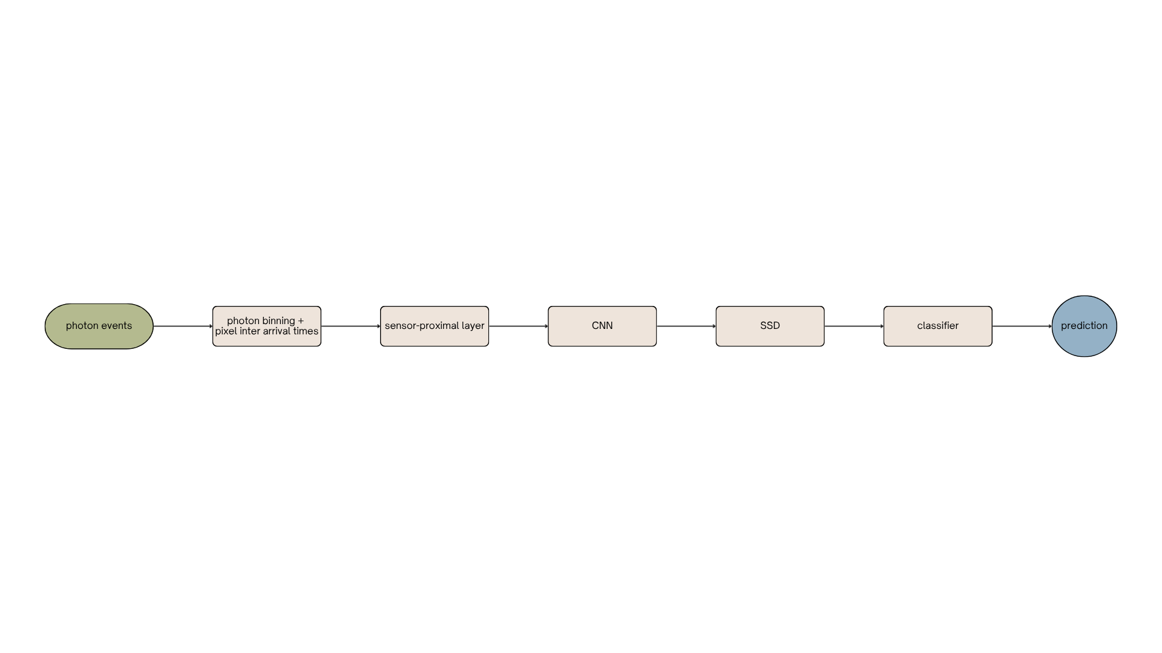
Pipeline overview
The sensor-proximal layer processes all events. The neural network receives selected spatial readouts.
03
Notes:
Packing preserves the individual interarrival times of photons while arranging them for processing across pixels. BOCPD models changes in the photon rate, and its forecaster ages and weights control a separate adaptive accumulator. Temporal subsampling records that accumulator every D raw bins. A CNN extracts spatial features from those readouts. The SSD layer carries temporal feature state, followed by pooling and the classifier. The diagram distinguishes the event-processing cadence from the readout cadence. Each digit recording starts with fresh state.
Source: User-supplied chapter, Proposed solution. This presentation explains the method as described in that chapter.
Sundar, Zhang, Jungerman and Gupta (2025). Quanta Neural Networks: From Photons to Perception. ICCV, 5091–5101. https://openaccess.thecvf.com/content/ICCV2025/html/Sundar_Quanta_Neural_Networks_From_Photons_to_Perception_ICCV_2025_paper.html

Slide 4
Photon-event tensor
Each recording uses a dense event-slot representation.
Δt cube [H, W, T, K]
Dimension | Description | Experiment
H, W | Pixel location | 28 × 28 pixels
T | Equal temporal bins | Δtbin = Tₐcq / T
K | Photon slots per pixel and bin | Maximum occupancy in the recording
A binary mask has the same shape. With batch size one, the implementation uses [1, H, W, T, K].
04
Notes:
The cube stores interarrival times, not a single photon count per temporal bin. First sort detections by time. For each pixel, subtract the previous arrival time, including arrivals in an earlier bin. The acquisition origin supplies the reference for its first detection. Each bin at each pixel has K slots, so a second photon does not overwrite the first. The mask identifies valid events. This matters because a stored zero may mean either padding or a genuine zero interval after timestamp quantization or clamping. Binning supplies a common processing clock while retaining individual photon intervals. Packing each camera packet may use a different K.
Source: User-supplied chapter, Proposed solution. This presentation explains the method as described in that chapter.
Suonsivu et al. (2024). Time-Resolved MNIST Dataset for Single-Photon Recognition. https://arxiv.org/abs/2410.16744

Slide 5
Binning preserves interarrival times
Illustrative single pixel, with 10 μs bins and acquisition starting at t = 0.
Arrival times: 4, 9, 13, 29 μs
Temporal bin | Photon times | Stored Δt slots | Mask
[0, 10) μs | 4, 9 | [4, 5] μs | [1, 1]
[10, 20) μs | 13 | [4, 0] μs | [1, 0]
[20, 30) μs | 29 | [16, 0] μs | [1, 0]
E.g. the interval at 29 μs is 29 − 13 = 1
05
Notes:
This example has K equal to two because the busiest pixel-bin group contains two events. The first interval is four microseconds from the acquisition origin. The next is five microseconds. The interval at 13 microseconds is four microseconds even though that photon lies in a new bin. The interval at 29 microseconds spans a bin boundary and is sixteen microseconds. The converter does not replace those intervals with the bin duration. The displayed microseconds are for readability; the implementation stores seconds. These are constructed explanatory numbers, not measurements from a dataset sample.
Source: User-supplied chapter, Proposed solution. This presentation explains the method as described in that chapter.

Slide 6
Photon arrival model
Assume a locally constant detection rate at each pixel.
OBSERVED INTERVAL
UNCERTAINTY ABOUT THE RATE
Δtᵢ = tᵢ − tᵢ₋₁
λ | α, β ∼ Gamma(α, β)
Δtᵢ | λ ∼ Exponential(λ)
α: shape
β: rate parameter, in seconds
Mean photon rate: α / β
f(d | λ) = λ exp(−λd)
06
Notes:
The exponential variable is the observed waiting time. The Gamma distribution describes uncertainty about the unknown photon rate, rather than a distribution over forecaster ages. Beta is the rate parameter of the Gamma density over lambda and has units of time, so alpha/beta has units of inverse seconds. Conjugacy keeps the posterior in the Gamma family after observing a complete exponential interval. Conditional independence is an idealized local model. The TR-MNIST simulator also includes sensor effects that can invalidate an exact iid exponential description of raw detection intervals. The first interval uses the acquisition start as its reference.
Source: User-supplied chapter, Proposed solution. This presentation explains the method as described in that chapter.
Ingle et al. (2021). Passive Inter-Photon Imaging. CVPR, 8585–8595. https://openaccess.thecvf.com/content/CVPR2021/html/Ingle_Passive_Inter-Photon_Imaging_CVPR_2021_paper.html
Suonsivu et al. (2024). Time-Resolved MNIST Dataset for Single-Photon Recognition. https://arxiv.org/abs/2410.16744

Slide 7
What each forecaster stores
Up to eight hypotheses represent different possible times of the latest rate change.
Stored quantity | Meaning | Used for
Birth bin / age rₛ | How long this rate regime may have lasted | Integration-time estimate
Gamma parameters αₛ, βₛ | Uncertainty about the photon rate | Predictive likelihood
Normalized weight νₛ | Relative support for this hypothesis | Weighted run-length estimate
Rate uncertainty and hypothesis weight play different roles.
07
Notes:
A forecaster is a candidate explanation of how far back the current approximately constant rate extends. Its age is elapsed time measured in bins. Its Gamma parameters summarize the rate observations assigned to it. Its weight measures its relative plausibility compared with the other retained candidates. Alpha and beta do not directly become integration weights. They determine predictive likelihoods, and those likelihoods update the forecaster weights. The integration-time calculation then combines the normalized weights with the candidate ages. Limiting the number of retained hypotheses to eight is an approximation for bounded memory and computation.
Source: User-supplied chapter, Proposed solution. This presentation explains the method as described in that chapter.
Adams and MacKay (2007). Bayesian Online Changepoint Detection. https://arxiv.org/abs/0710.3742
Sundar, Zhang, Jungerman and Gupta (2025). Quanta Neural Networks: From Photons to Perception. ICCV, 5091–5101. https://openaccess.thecvf.com/content/ICCV2025/html/Sundar_Quanta_Neural_Networks_From_Photons_to_Perception_ICCV_2025_paper.html

Slide 8
Update at a new photon
Use the full interval d since the previous photon at this pixel.
SCORE THE INTERVAL
αₛ
αₛ βₛ
Lₛ(d) =
(βₛ + d)
αₛ + 1
UPDATE HYPOTHESIS SUPPORT
Unnormalized continuing weight = (1 − γ) νₛ Lₛ(d)
Include the new-change candidate, then normalize retained weights.
UPDATE THE CONTINUING RATE POSTERIOR
αₛ ← αₛ + 1 βₛ ← βₛ + d
08
Notes:
Compute the predictive density from the hypothesis parameters before assimilating the current interval. Integrating the exponential likelihood against the Gamma rate posterior gives L_s(d) = alpha_s beta_s^alpha_s / (beta_s+d)^(alpha_s+1). The equation for continuing weights is an unnormalized branch of BOCPD. A complete implementation also creates a changepoint candidate, handles the finite hypothesis budget and normalizes weights. Those candidate details depend on the chosen BOCPD convention. After scoring, a continuing hypothesis receives alpha+1 and beta+d. Gamma controls the changepoint hazard per update in this event-driven model, so a constant gamma is a per-event setting. In the complete bin loop, the current bin already has a fixed integration time, and these updates influence the next bin.
Source: User-supplied chapter, Proposed solution. This presentation explains the method as described in that chapter.
Adams and MacKay (2007). Bayesian Online Changepoint Detection. https://arxiv.org/abs/0710.3742

Slide 9
Run length becomes an integration time
Compute one adaptive time constant per pixel at the beginning of each raw bin.
Compute one adaptive time constant per pixel at the beginning of each raw bin.
Compute one adaptive time constant per pixel at the beginning of each raw bin.
WEIGHTED AGE ESTIMATE
r̂ = exp[ Σₛ νₛ ln(1 + rₛ) ] − 1
r̂ is in “bin units”, to be usable for integration we first minpool over the local neighborhood and then convert it into seconds.
τₙ = spatially pooled r̂ₙ × Δtbin
A positive lower bound on τ avoids division by zero.
09
Notes:
The shifted weighted geometric mean combines forecaster ages. The added one permits a zero age, and subtracting one restores the original scale. Relative to the arithmetic mean, the geometric expression gives less influence to very old hypotheses. Spatial minimum pooling lets a nearby shorter run length shorten the local integration time, helping surrounding pixels react to a possible change. Convert the pooled age from bins to seconds before using it in an exponential with a time interval. A positive floor is needed for numerical validity. The estimated run length represents how long the current rate regime may have persisted. It is not an estimate of the waiting time to the next photon. This formulation follows the user's adaptation; the QNN paper writes a weighted arithmetic run-length estimate.
Source: User-supplied chapter, Proposed solution. This presentation explains the method as described in that chapter.
Sundar, Zhang, Jungerman and Gupta (2025). Quanta Neural Networks: From Photons to Perception. ICCV, 5091–5101. https://openaccess.thecvf.com/content/ICCV2025/html/Sundar_Quanta_Neural_Networks_From_Photons_to_Perception_ICCV_2025_paper.html

Slide 10
Adaptive exponential integration
A photon adds a contribution. Elapsed time decays the existing accumulator.
I ← exp(−δt / τₙ) I + 1 / τₙ
Short τ
Faster response and less temporal averaging
Long τ
Longer memory and stronger temporal averaging
10
Notes:
The accumulator represents a temporally smoothed photon-rate feature. The equation shown is the normalized event integration rule in the thesis: decay the current value over delta t, then add one over tau for a valid photon. Here delta t is time since the last accumulator update, not necessarily the full interarrival interval. For a fixed tau, an isolated event contributes exp(-(t-t_i)/tau)/tau, whose area is one. For a constant Poisson rate, the expected accumulator approaches that rate after startup. When tau adapts, interpret I as an adaptive rate-like feature. The chart is a calculated illustration for fixed time constants and five invented event times [10,25,50,100,120] microseconds. It is not an experimental result. All calculation uses the same recurrence in consistent units. The current tau remains fixed during each raw bin.
Source: User-supplied chapter, Proposed solution. This presentation explains the method as described in that chapter.

Slide 11
Two clocks at each pixel
BOCPD and the accumulator need different elapsed-time measurements.
Previous
photon
Previous
bin end
New
photon
0 μs
3 μs
10 μs
17 μs
20 μs
Clock | Interval at the new photon | Purpose
Last photon | 17 − 3 = 14 μs | BOCPD likelihood and update
Last accumulator update | 17 − 10 = 7 μs | Exponential decay
11
Notes:
At three microseconds, a photon updates both clocks. At ten microseconds, the bin-end operation decays the accumulator and advances only its update clock. When the next photon arrives at seventeen microseconds, the full photon waiting interval is fourteen microseconds, but the accumulator has already been decayed through ten microseconds. It therefore needs seven more microseconds of decay. Using fourteen microseconds for that decay would apply part of the elapsed time twice. Reset both clocks at the beginning of an independent recording and retain them across packets within that recording. All timestamps in this example are illustrative.
Source: User-supplied chapter, Proposed solution. This presentation explains the method as described in that chapter.

Slide 12
Temporal subsampling
D sets the readout cadence. All raw bins still update the sensor-proximal state.
Illustrative configuration | Value
Acquisition duration Tₐcq | 1 ms
Raw bins T and bin duration | 100 bins, 10 μs each
Subsampling factor D | 20 bins per readout
Readout interval and count | 200 μs, 5 readouts
BOCPD + integrator
Process every event
and every bin end
CNN + SSD
Process saved readouts
Readout times in this example: 0.2, 0.4, 0.6, 0.8 and 1.0 ms.
13
Notes:
Subsampling reduces downstream network work. It does not discard photon events or pause the adaptive integrator between readouts. A raw temporal bin, a camera packet and a network readout are different concepts. The illustration has T=100, an exposure of one millisecond and D=20, so the network receives five readouts. These numbers are the previously discussed configuration example, rather than a requirement for every run. Packet boundaries must preserve the global readout schedule within a clip. If a recording length is not divisible by D, the policy for the final partial interval must be specified consistently.
Source: User-supplied chapter, Proposed solution. This presentation explains the method as described in that chapter.

Slide 13
Spatial feature extraction
Each normalized integration readout enters the CNN as a single-channel image.
Input readout
Conv 1 + ReLU
Conv 2 + ReLU
1 × 28 × 28
64 × 26 × 26
128 × 24 × 24
BOTH CONVOLUTIONS
Each convolution reduces width and height by two pixels.
3 × 3 kernel
Stride 1
No padding
The normalization must match the convention used to train the checkpoint.
14
Notes:
The readout is a dense spatial tensor even though the original observations are sparse events. The first valid 3 by 3 convolution expands one channel into sixty-four channels and produces a 26 by 26 map. The second produces 128 channels at 24 by 24. ReLU follows each convolution. No padding means the convolution uses only locations where the whole kernel lies within the input. Normalization is a distinct operation from the normalized photon impulse in the integrator. The same readout scaling and clamping convention must be used when training and evaluating a saved model. The two-layer architecture and dimensions follow the supplied thesis chapter.
Source: User-supplied chapter, Proposed solution. This presentation explains the method as described in that chapter.

Slide 14
Temporal features and classification
The SSD layer combines each readout with state from preceding readouts.
CNN features
SSD state
Spatial pooling
128 × 24 × 24
Elapsed readout time
128 values / readout
Linear classifier
Temporal mean
State retained
within this digit
10 digit-class scores
Selected feature vectors
15
Notes:
The SSD layer follows the QNN architecture. It operates on CNN feature maps and maintains recurrent state over readouts, using their elapsed times. That learned temporal state is separate from the Gamma rate statistics and the sensor accumulator. Global average pooling then averages spatial positions independently for each feature channel, leaving 128 values per readout. A temporal mean combines those vectors. The linear layer maps the mean vector to ten class scores. During evaluation, use only feature vectors already available within the configured history window. QNN is the direct implementation source and Dao and Gu provide the foundational state-space duality reference.
Source: User-supplied chapter, Proposed solution. This presentation explains the method as described in that chapter.
Sundar, Zhang, Jungerman and Gupta (2025). Quanta Neural Networks: From Photons to Perception. ICCV, 5091–5101. https://openaccess.thecvf.com/content/ICCV2025/html/Sundar_Quanta_Neural_Networks_From_Photons_to_Perception_ICCV_2025_paper.html
Dao and Gu (2024). Transformers are SSMs: Generalized Models and Efficient Algorithms Through Structured State Space Duality. ICML, PMLR 235, 10041–10071. https://proceedings.mlr.press/v235/dao24a.html

Slide 15
Training and evaluation
Both modes reset the model state between independent digit recordings.
Operation | Training | Evaluation
Input delivery | Whole recording | Successive packets of new events
Within the digit | Process all bins chronologically | Retain state between packets
Prediction features | Selected readouts of the clip | Available readouts in the history window
At the next digit | Fresh state | Fresh state
A clip ends at the acquisition boundary, even if its final bins contain no photons.
16
Notes:
Camera-style evaluation emulates the arrival of new measurements during each digit recording. It sends each event only once, preserves interarrival intervals across packet boundaries and keeps the integrator, forecasters and SSD state between packets. Empty bins still advance time and decay the accumulator. At the end of the acquisition interval, the last-packet marker identifies clip completion. Reaching the last observed photon alone does not define the acquisition endpoint. Before the next independent digit, reset BOCPD, the accumulator, clocks, SSD state and feature history. This matches the intended evaluation objective after the earlier reset correction. Optional wall-clock pacing is distinct from the mathematical timing model and does not by itself prove real-time inference performance.
Source: User-supplied chapter, Proposed solution. This presentation explains the method as described in that chapter.

Slide 16
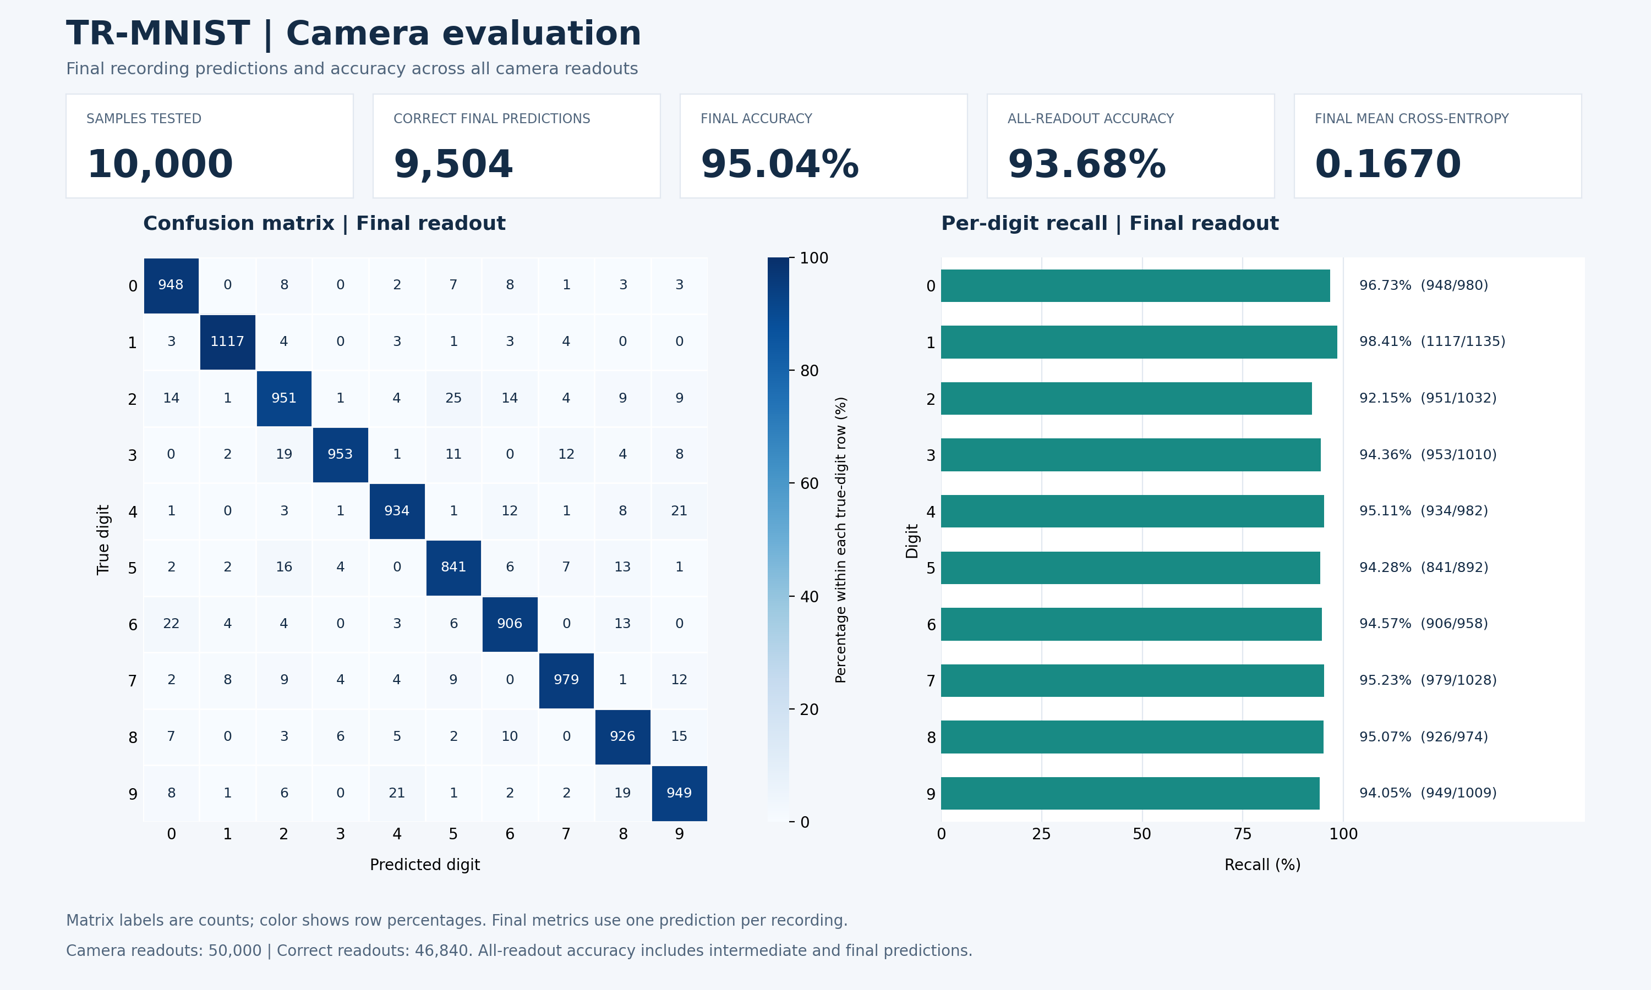
2650mlux evaluation

Slide 17

640mlux evaluation

Slide 18
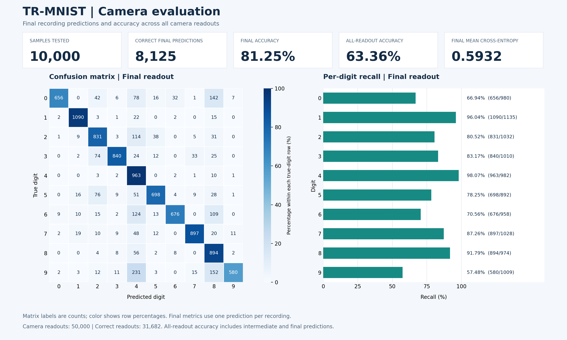
160mlux evaluation

