Slide 1

DATA SERIES 17.0
ARTIFICIAL INTELLIGENCE
MACHINE LEARNING
RAIHAN PRATAMA
#DATASERIES17

Slide 2
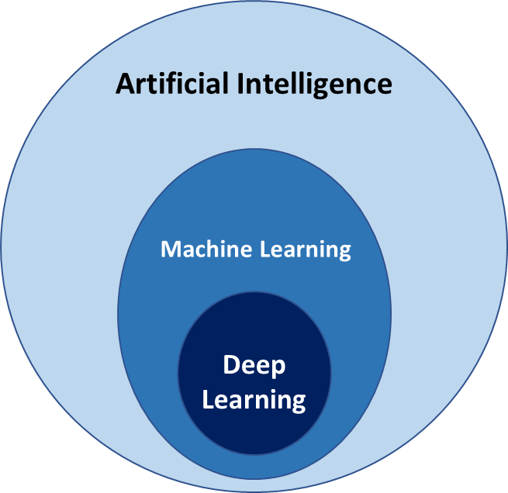
#DATASERIES17
WHAT IS AI/ML?
ARTIFICIAL INTELLIGENCE (AI) is a technology that enables computers and machines to AI is a way for machines to ‘learn’ and ‘think’ like humans who can do understanding, problem solving, decision making and creativity.
MACHINE LEARNING (ML) is a way for computers to ‘learn’ from experience (data) and make predictions, without having to be constantly instructed by humans. In other words, the more ‘training’ a computer receives, the smarter it becomes at recognizing patterns, making decisions, or predicting things.

Slide 3
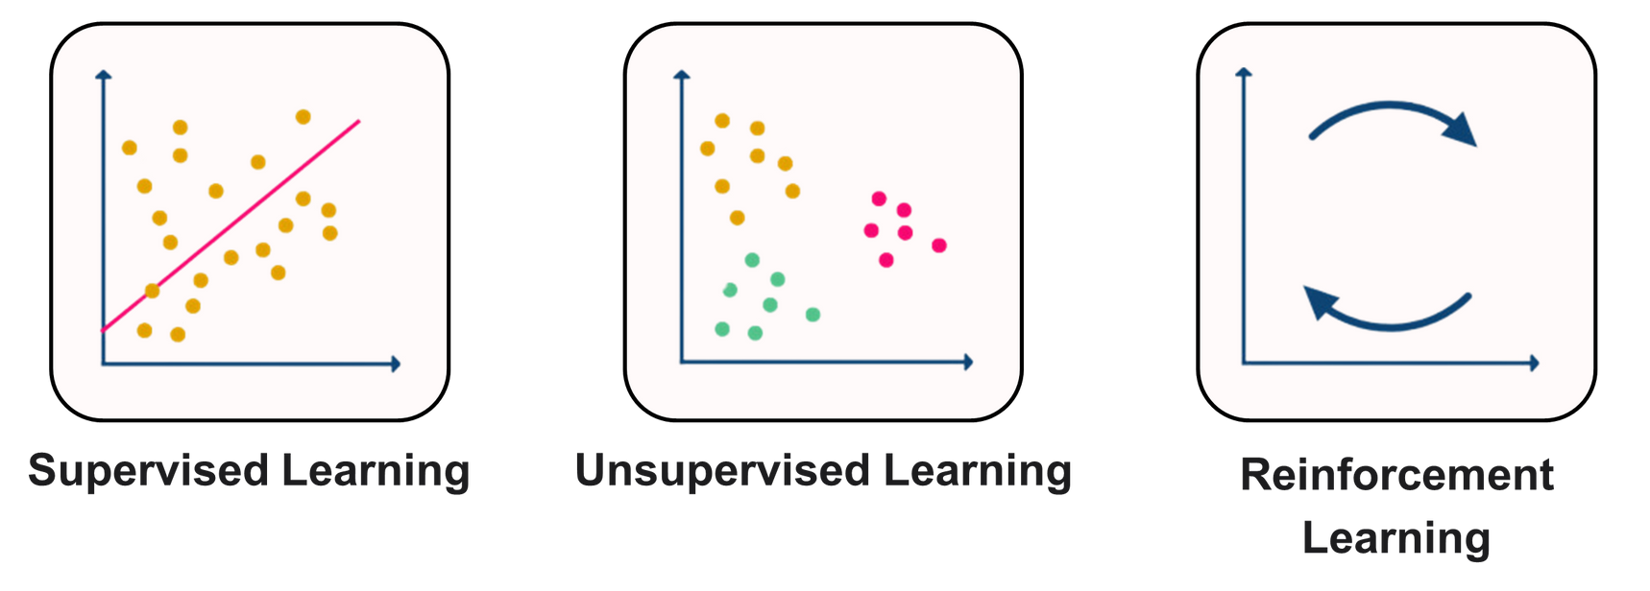
#DATASERIES17
CATEGORY OF
MACHINE LEARNING

Slide 4
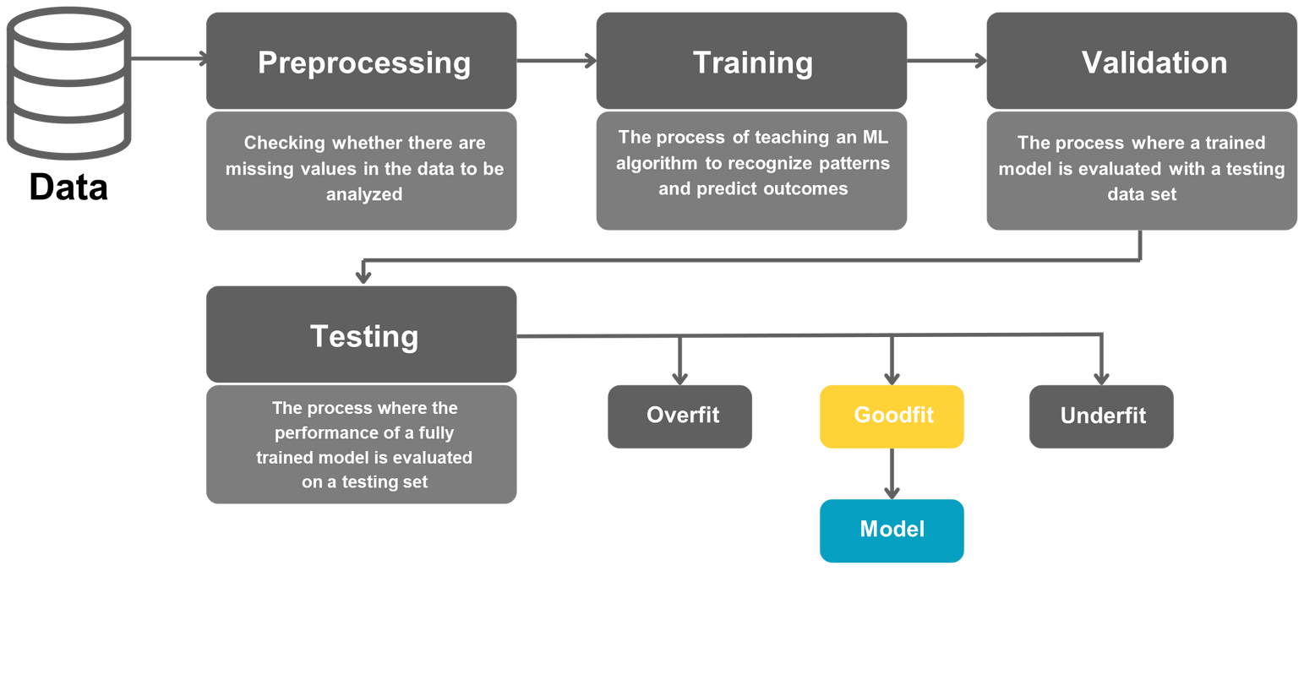
#DATASERIES17
MACHINE LEARNING PROCESS

Slide 5
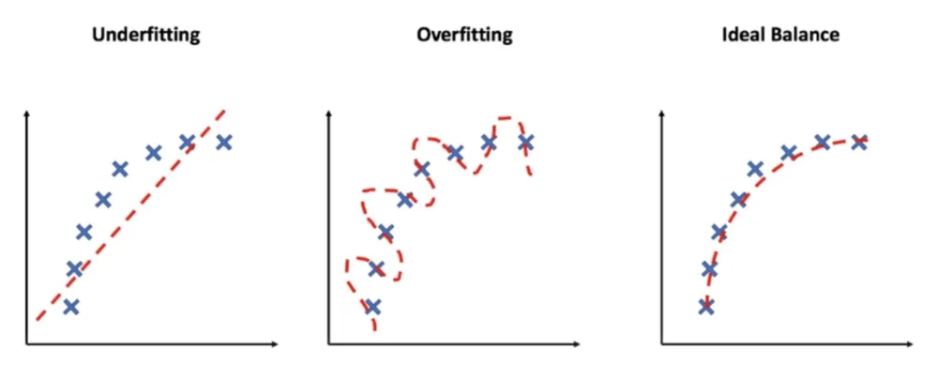
#DATASERIES17
WHAT IS
Overfitting/ Underfitting?
Overfitting is when a model becomes too focused on certain details and noise in its training data. As a result, the model may perform very well on the training set but fail to generalize when faced with new or previously unseen data.
Underfitting is the opposite scenario, where a model does not learn enough from the training data. It lacks the capacity to capture the essential patterns, leading to poor performance on both the training set and any new data.

Slide 6
#DATASERIES17
SUPERVISED LEARNING SALARY PREDICTION
FINAL PROJECT

Slide 7
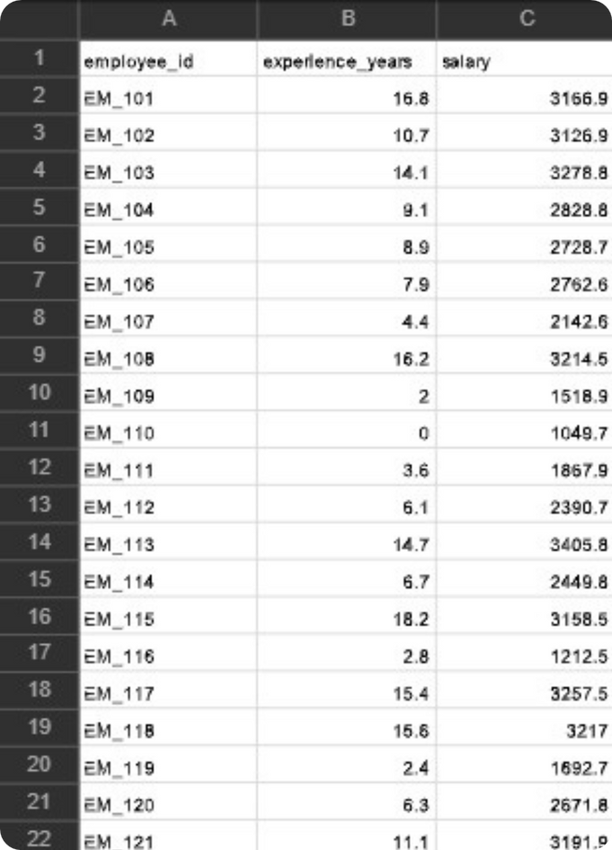
#DATASERIES17
SUPERVISED LEARNING SALARY PREDICTION
Imagine a system that can estimate an individual’s salary simply by looking at their years of professional experience. That’s precisely what this supervised learning project aims to achieve. Leveraging a dataset with 100 records—containing an ID, years of experience, and salary—the study puts three different models to the test: Linear Regression, Decision Tree, and Random Forest. The objective is to pinpoint which model delivers the most accurate salary predictions.

Slide 8
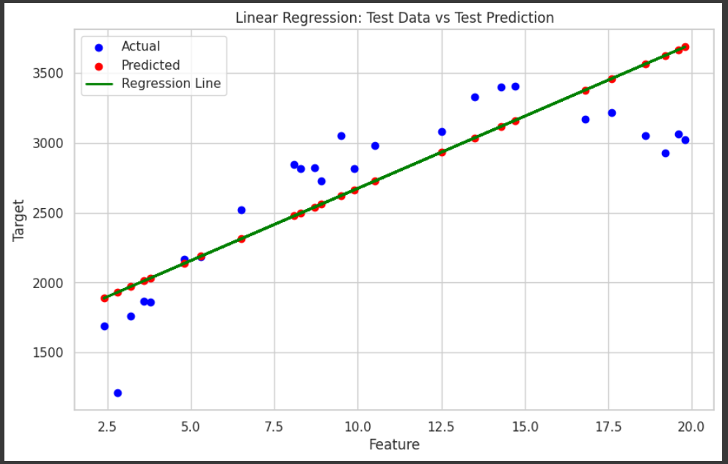
#DATASERIES17
LINEAR REGRESSION
This model applies Linear Regression to predict salaries from years of experience. It achieves an R² of 0.77 on the training set and 0.63 on the test set, indicating a decent fit for the training data but somewhat limited predictive power for unseen observations.
Performance Metrics
Mean Squared Error (MSE)
Training Data: 107,699.85
Test Data: 128,111.12
Difference: 20,411.27
R² Score
Train: 0.77
Test: 0.63

Slide 9
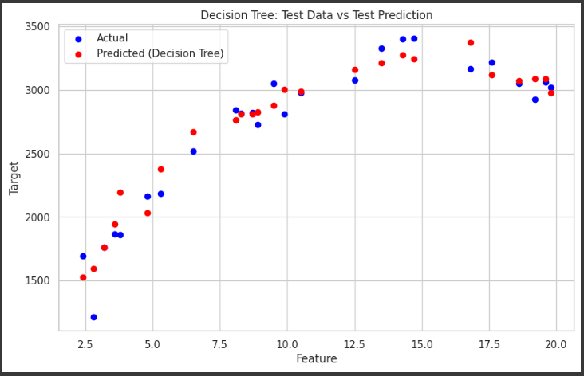
#DATASERIES17
DECISION TREE
The Decision Tree model demonstrates excellent performance on the training data, achieving an R² score of 1.00. On the test data, it remains strong with an R² of 0.93. However, the large gap in Mean Squared Error (MSE) between the training and test sets suggests potential overfitting—the model may be overly tailored to the training data, which can reduce its predictive power when encountering new or unseen patterns.
Performance Metrics
Mean Squared Error (MSE)
Training Data: 88.12
Test Data: 23,627.99
Gap: 23,539.87
R² Score
Train: 1.00
Test: 0.93

Slide 10
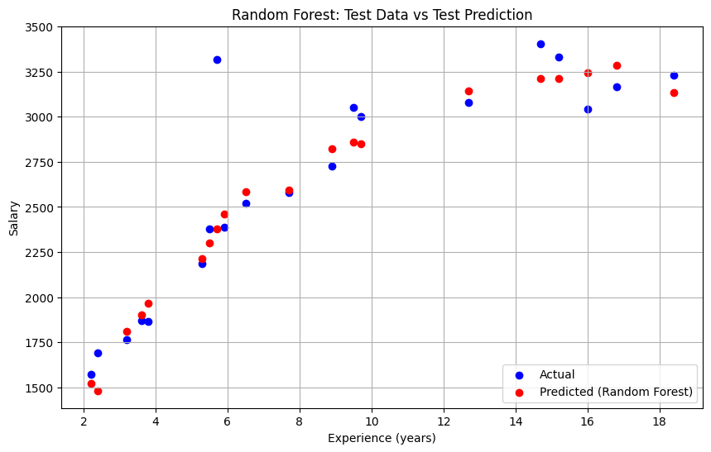
#DATASERIES17
RANDOM FOREST
Random Forest leverages an ensemble of multiple Decision Trees to predict salaries based on years of experience. This approach often delivers more stable predictions than a single tree, as the collective decision-making from multiple trees helps offset individual errors.
Performance Metrics
Mean Squared Error (MSE)
Train: 2,714.12
Test: 57,520.00
Gap: 54,805.88
R² Score
Train: 0.89
Test: 0.84
While the R² scores show strong performance on both training and test data, the sizeable gap in MSE may hint at slight overfitting or the influence of outliers.

Slide 11
#DATASERIES17
COMPARARISON
Linear Regresion
Decision Tree
Random Forest
Mean Squared Error (MSE)
Train: 107.699,85
Test: 128.111,12
Gap: 20.411,27
R² Score
Train: 0,77
Test: 0,63
Mean Squared Error (MSE)
Train: 88,12
Test: 23.627,99
Gap: 23.539,87
R² Score
Train: 1,00
Test: 0,93
Mean Squared Error (MSE)
Train: 3.737,44
Test: 21.744,73
Gap: 18.007,29
R² Score
Train: 0,99
Test: 0,94

Slide 12
#DATASERIES17
CONCLUSION
The Random Forest model displays robust performance, achieving an R² of 0.99 on the training data and 0.94 on the test data. This high coefficient of determination indicates excellent predictive power and minimal overfitting. Although the Mean Squared Error (MSE) is higher on the test set (21,744.73) compared to the training set (3,737.44), the gap of 18,007.29 suggests the model still generalizes effectively to unseen data. These results highlight the Random Forest’s capability to capture essential patterns in the dataset while maintaining strong overall stability.

Slide 13
#DATASERIES17
THANK YOU

