Slide 1
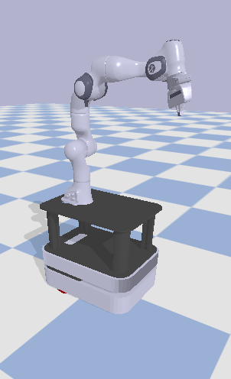
Implementing an RRT*-Smart Motion Planning Algorithm for a Mobile Manipulator in a simulated environment
Group 027
Annelouk van Mierlo - 4693746
Caspar Meijer - 4719298
Jurjen Scharringa - 4708652
Marijn de Rijk - 4888871

Slide 2
Model and Planning
Global planning
RRT*: RRT factor
RRT*-Smart: smart ratio, smart radius
Local planning
PD-controller

Slide 3
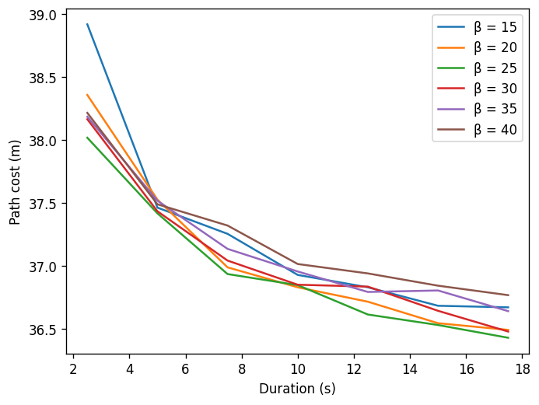
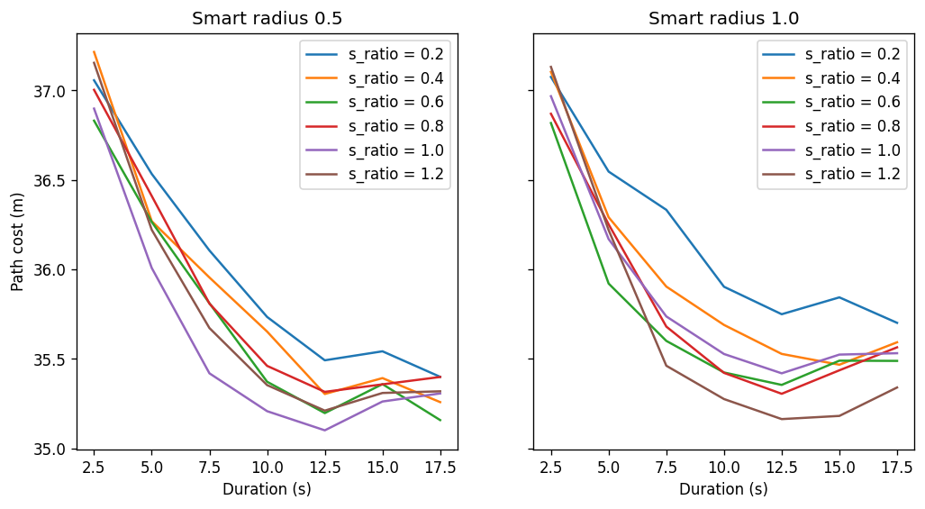
Results
Environment 1
RRT*
RRT*-Smart

Slide 4
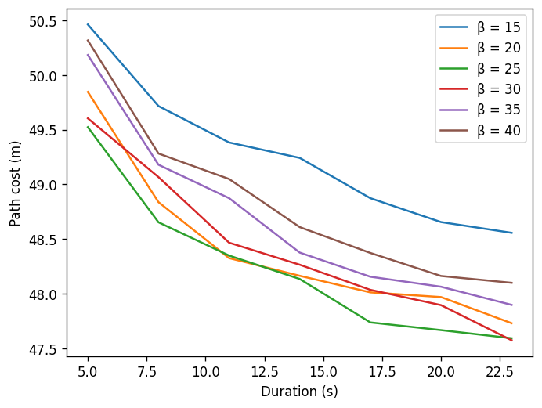
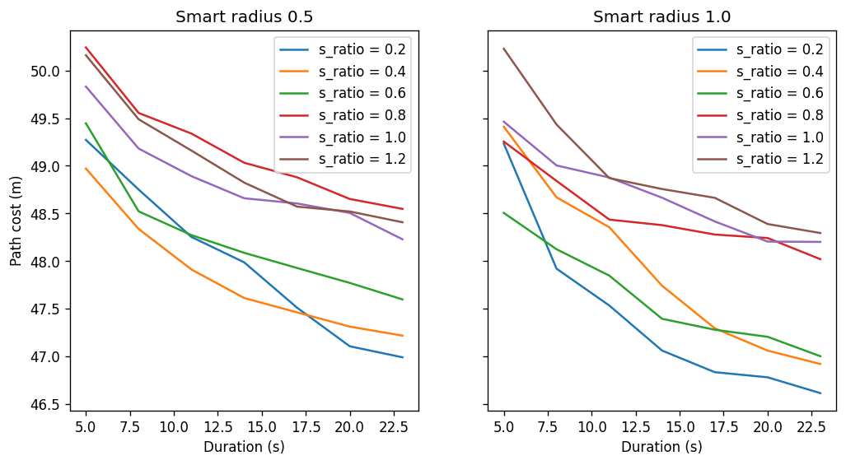
Results
Environment 2
RRT*
RRT*-Smart

Slide 5
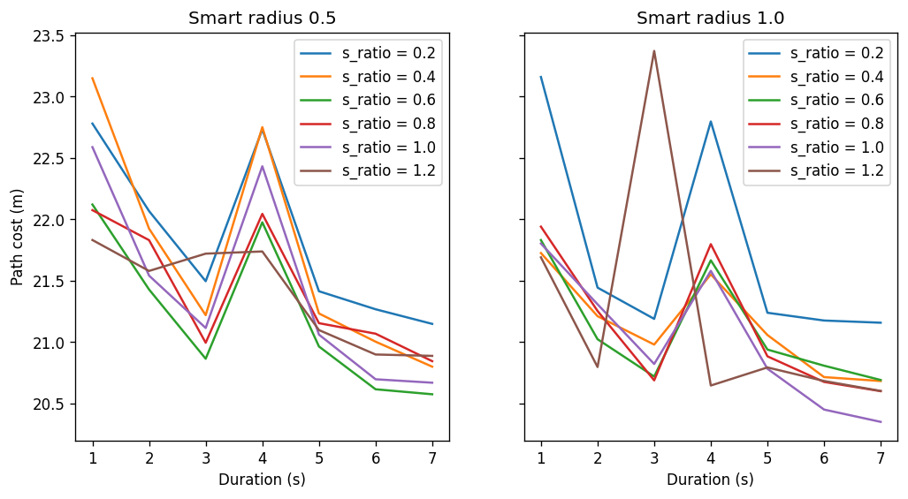
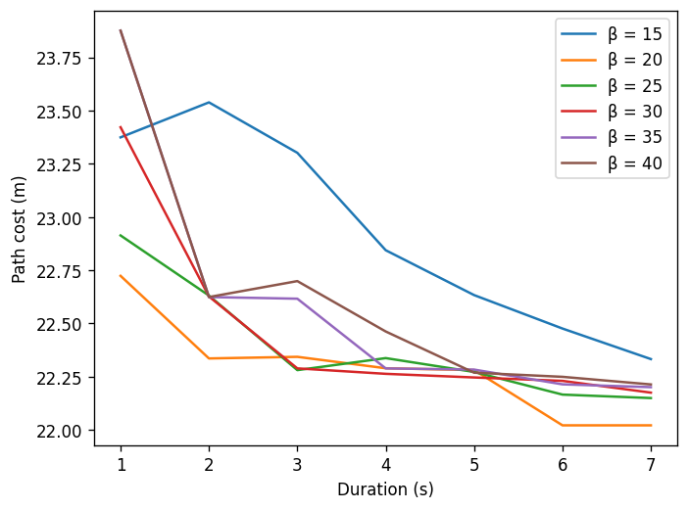
Results
Environment 3
RRT*
RRT*-Smart

Slide 6
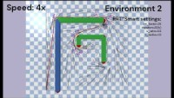
Results

Slide 7
Discussion
Evaluation
Future works

