Slide 1
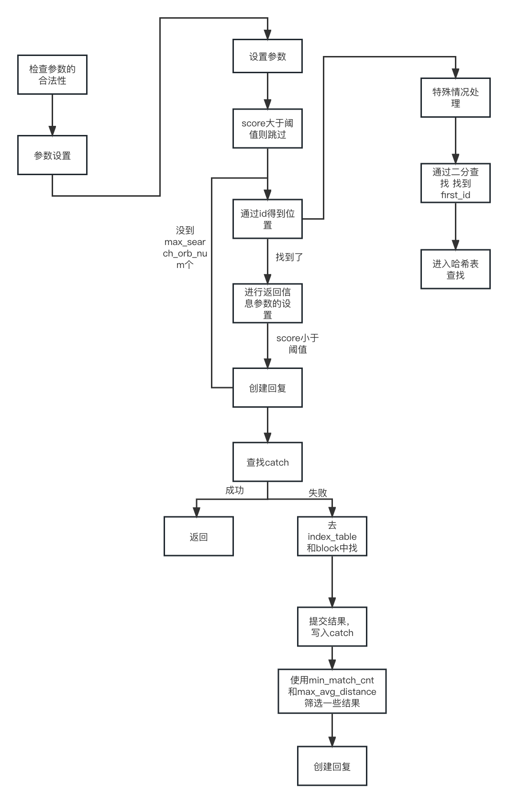
get_loc_by_id
do_search
batch_select

