Slide 1
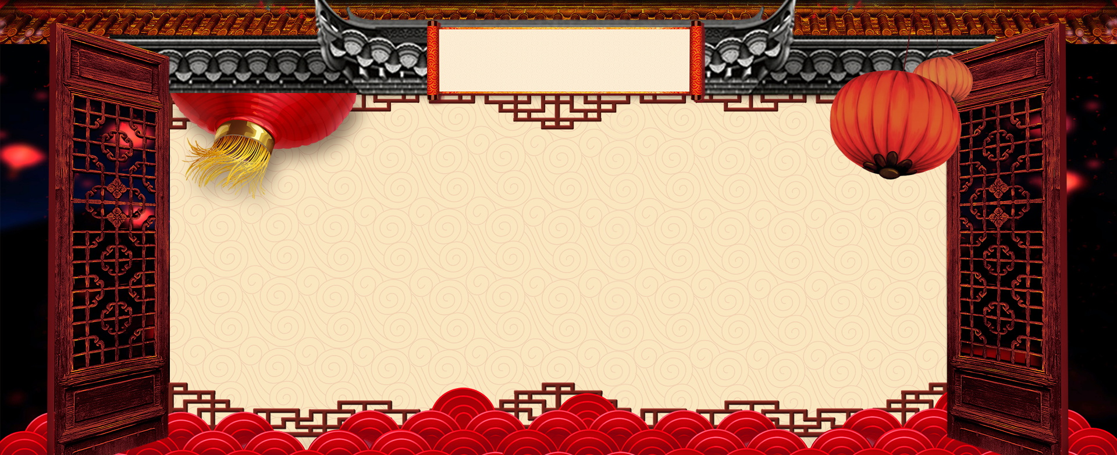
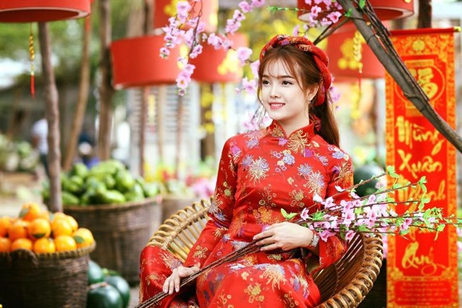


2020
Traditional Fashion of Vietnam
Happy
Lunar
New
Year
6th February 2020 - 10:30am to 12:30pm
Level 3, Room 1
545 Kent Street, Sydney NSW 2000 - Australia

