Slide 1
Lesson: Information Architecture and Sitemap Construction
1

Slide 2
Introduction to Design Thinking
User-centered problem-solving approach
Non-linear and iterative process
Aims for innovative, user-validated solutions
Aims for innovative, user-validated solutions
Aims for innovative, user-validated solutions

Slide 3
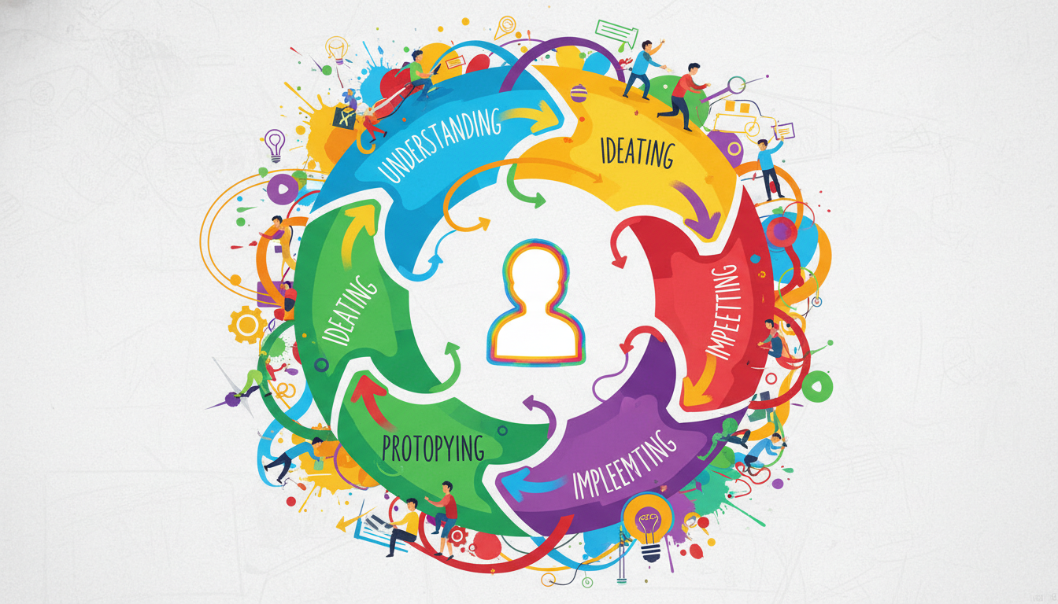
Introduction to Design Thinking
User-centered problem-solving approach
Non-linear and iterative process
Aims for innovative, user-validated solutions
The Empathize phase involves conducting research to understand users' experiences, needs, and pain points.

Slide 4

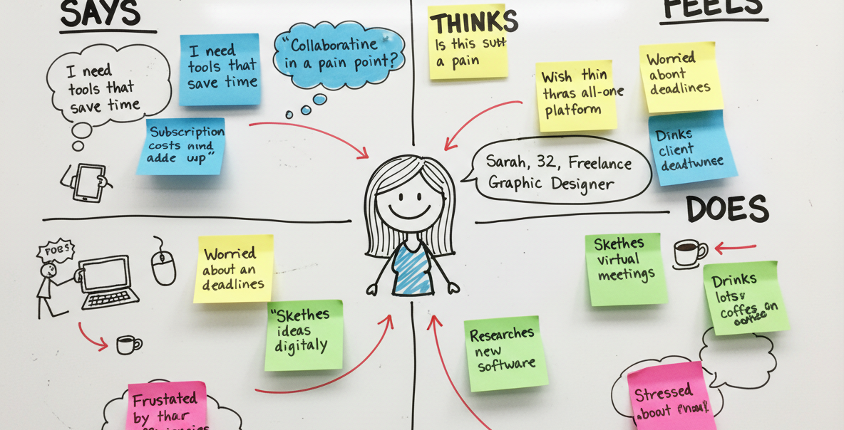
Introduction to Design Thinking
Deeply understand your users
Observe, engage, and immerse
Uncover unspoken needs and motivations
The Empathize phase involves conducting research to understand users' experiences, needs, and pain points.
Empathy maps and user personas help consolidate observations into a clear understanding of the target user.

Slide 5
Introduction to Design Thinking
Deeply understand your users
Observe, engage, and immerse
Uncover unspoken needs and motivations
The Empathize phase involves conducting research to understand users' experiences, needs, and pain points.
The Empathize phase involves conducting research to understand users' experiences, needs, and pain points.
The Empathize phase involves conducting research to understand users' experiences, needs, and pain points.

