Slide 1

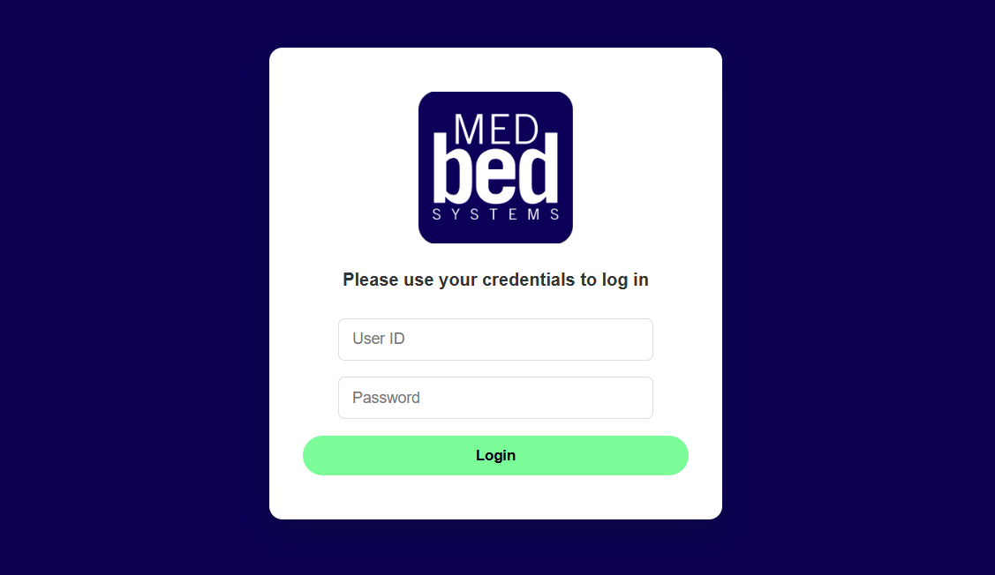
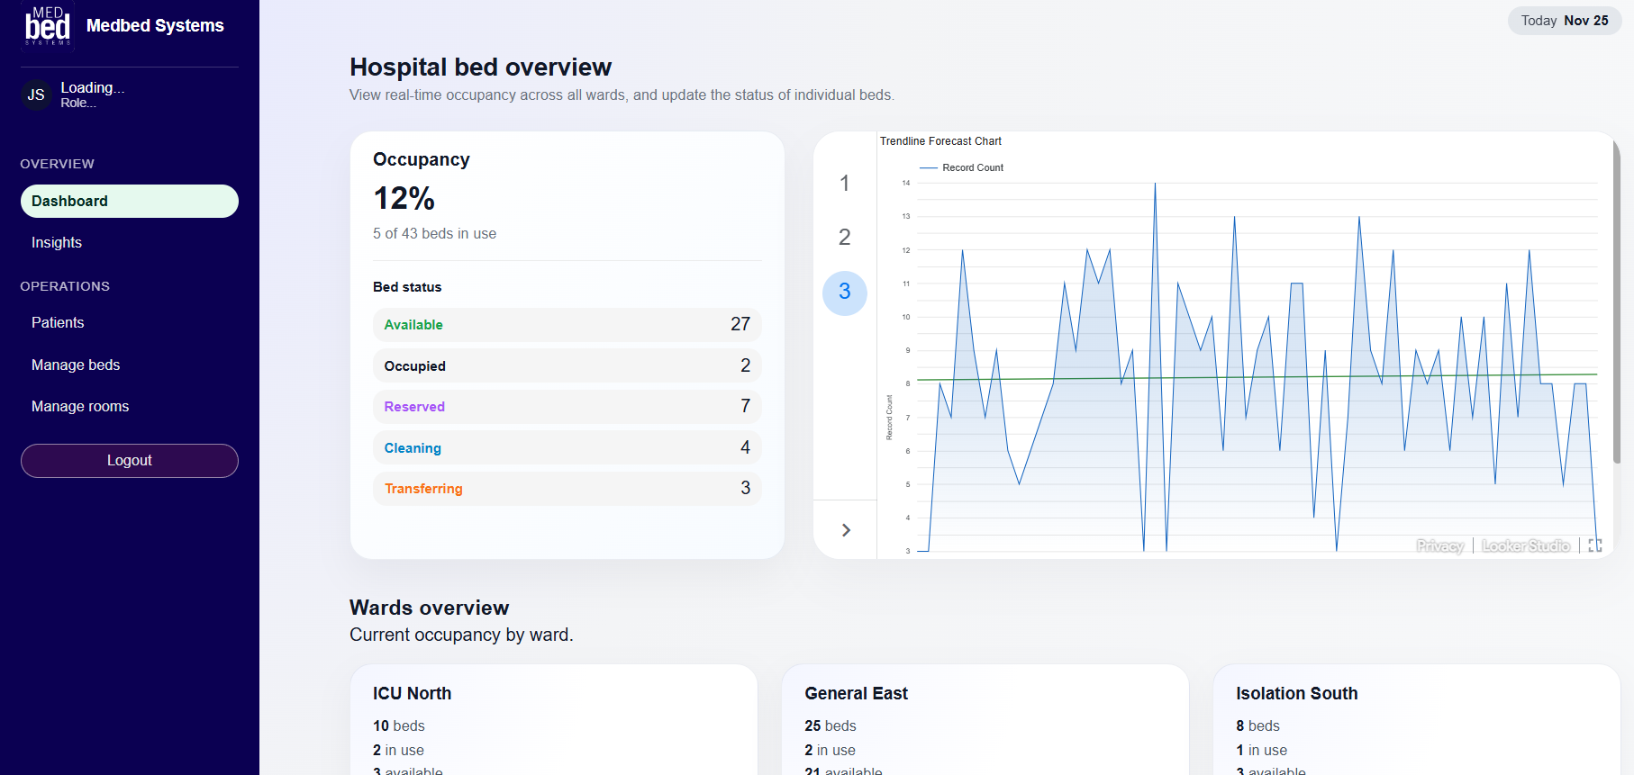
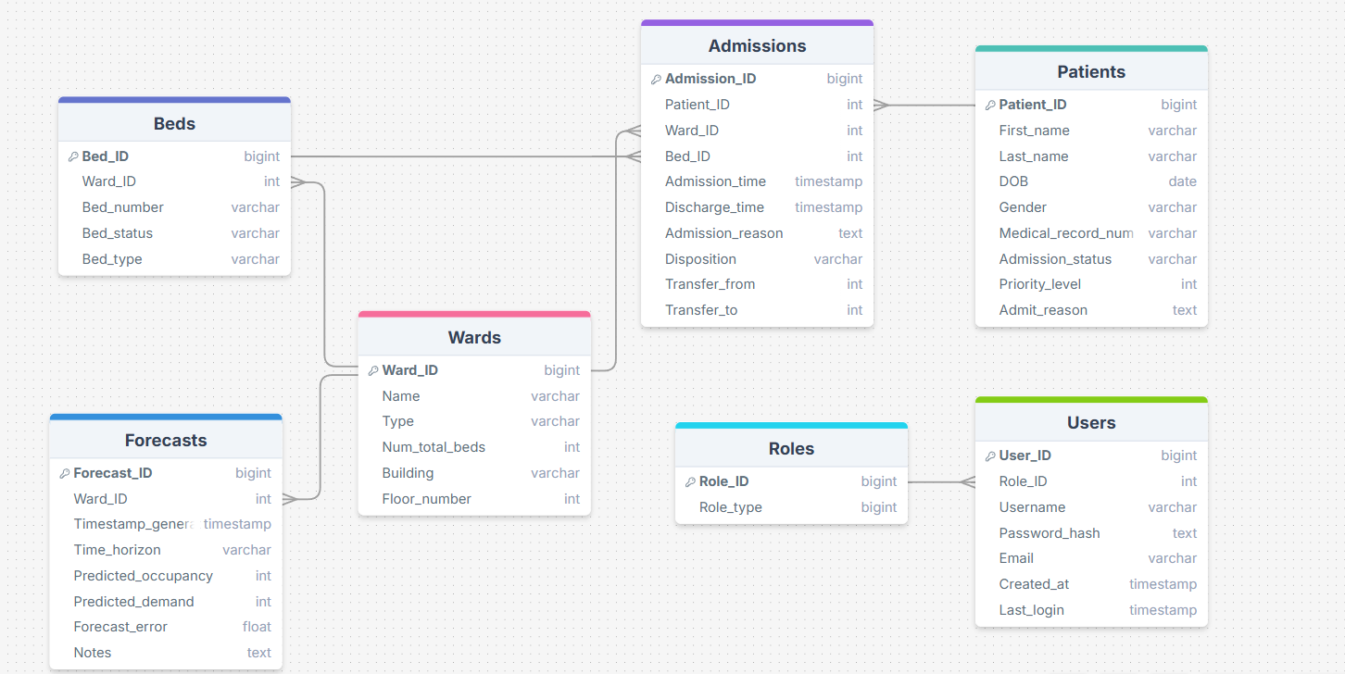
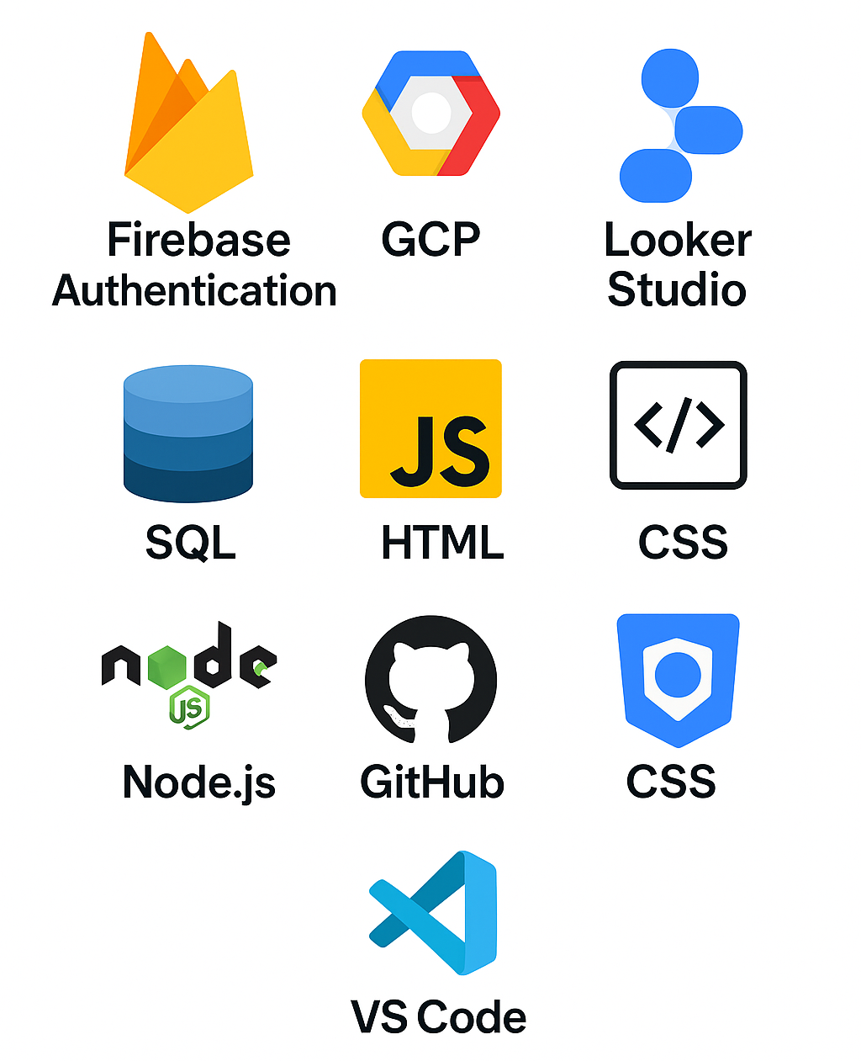
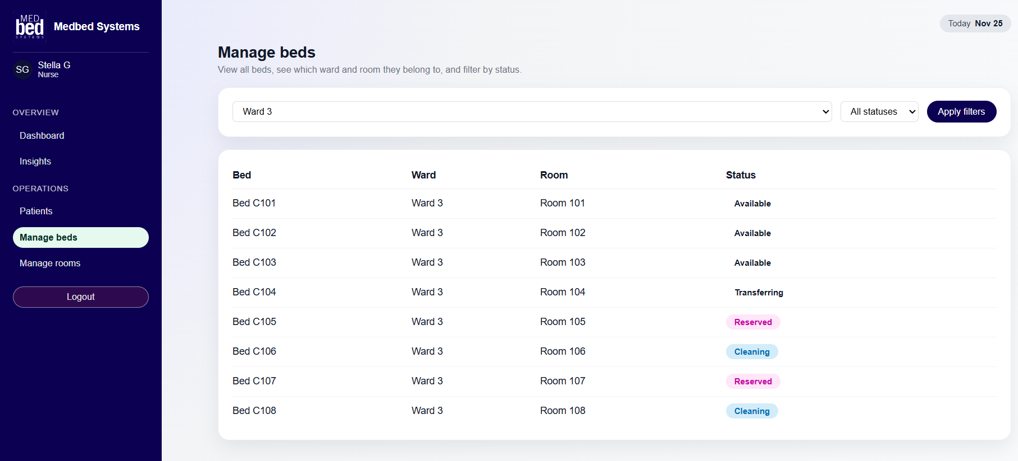
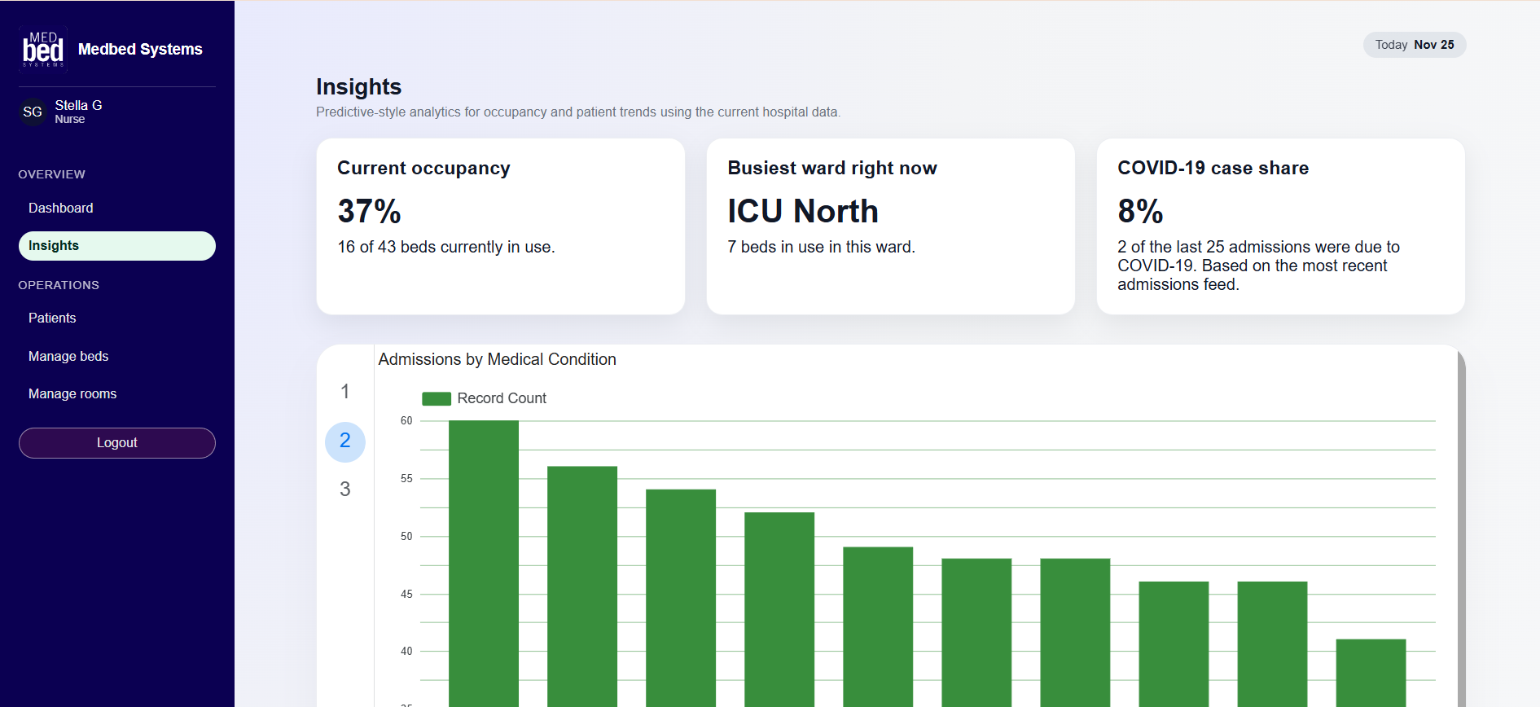
Hospital Bed Management System – Medbed Systems
Jasmine Kue, Jacob Schorr, Stella Goodrich | Advisor: Dr. Sorio Boit
Abstract
Medbed Systems is designed to improve efficiency in patient flow and resource management. The system provides a centralized, real-time view of bed availability, assignments, and patient status across hospital wards. Using cloud-based technologies, including Firebase Authentication, Google Cloud Platform, and a SQL database, the platform securely manages staff access and hospital data. Early results show improved visibility and faster decision-making, with planned predictive analytics to forecast bed demand during peak periods.
Results/Implementation
Authentication & Login
Login page uses implemented Firebase Authentication login that securely signs in hospital staff. Users are added and controlled via third party using Firebase Database collections
Backend (GCP)
API Overview: The backend API handles real-time management of beds, patients, and admissions through Google Cloud Run
Database: MySQL stores data on patients, beds, and admissions, enabling CRUD operations for dynamic hospital management
Cloud Storage: GCS buckets store CSV files, which are processed and imported into the MySQL database via Cloud Run
Real-time Operations: Eventarc triggers automatic updates to the database, ensuring data stays current across the system
Front End Code
Pages: Dashboard, Insights, Patients, Manage Beds, Manage Rooms
Dashboard & Insights: Overview of occupancy, ability to update bed status, Looker Studio visualizations
Patients, Manage Beds, & Manage Rooms: Search and filter patients, beds, and rooms across multiple wards
Looker Studio
Daily Admissions Line Chart: Displays last two weeks of November admissions, helps identify high-traffic days and staffing needs
Admissions by Medical Condition: Shows frequency of reasons for admittance, supports trend spotting for seasonal or recurring conditions
Trendline Forecast Visualization: Predictive admissions model based on recent data, forecast supports bed capacity and staffing decisions
Technical Details
Architecture
GCP-hosted architecture combining Cloud Run, Cloud SQL, Cloud Storage, and Eventarc
Backend written in JavaScript (Node.js) and deployed as a containerized service
All communications secured using HTTPS and Google IAM policies
Data Flow
Mock data CSVs uploaded → Cloud Storage
Eventarc detects upload → triggers Cloud Run
Backend parses file → updates Cloud SQL tables
Dashboard & Insights pages refresh with new data
Tools & Technologies
Frontend: HTML, CSS, JavaScript
Backend: Node.js (Cloud Run)
Database: Cloud SQL (MySQL)
Auth: Firebase Authentication
Analytics: Google Looker Studio
Dev Tools: GitHub, VS Code, Docker
Database Schema Tables:
Patients, Beds, Wards, Admissions, Users, Forecasts
Introduction
Hospitals face ongoing challenges managing bed availability due to increasing patient demand, complex workflows, and disconnected systems. Many hospitals still rely on manual tracking or outdated software, leading to delays in admissions, longer wait times, and reduced quality of care. Efficient bed management is essential for patient safety, proper resource allocation, and emergency response. By improving visibility and coordination, hospitals can make faster decisions and better support both staff and patients.
Our objectives were to:
Build a secure authentication system for staff login
Create a real-time dashboard showing bed occupancy and patient data
Integrate analytics to visualize admissions trends and capacity forecasting
Figure 1. Medbed login screen built with Firebase Authentication.
Figure 2. Dashboard view showing real-time bed occupancy/statistics.
Future Work
Add detailed role-based access control (admins, nurses, physicians)
Expand dashboard interactivity with filters and drill-down options
Implement real-time alerts for bed availability and occupancy thresholds
Develop automated bed assignment recommendations
Integrate predictive modeling for hospital flow and staffing needs
Figure 3. Manage beds page showing real time availability/filtering options.
Figure 4. Insights page with Looker Studio admissions/forecasting analytics.

