Slide 1
Capstone Matching

Slide 2
Application Introduction
The Capstone Matching process involves the process of matching students with suitable projects or clients based on their skills, interests, and the requirements of the project or client needs.
Goal: consolidate all parts of the Capstone Matching process into one place and reduce manual aspects

Slide 3
Key Aspects
Student Form: Students input their demographic information, resume (optional), and project ranking, so that they can be scored on these factors.
Matching Process: Ranking students with appropriate projects based on criteria such as technical skills, expertise, project scope, student preferences, and sponsor restrictions/preferences.
Admin Control: Oversee the entire matching process: managing project listings, form submission timelines, handle user accounts (including student and faculty profiles), configure the matching algorithm.
Professor Dashboard: View the student's matching score for a particular project, view details of all the projects and submit projects preferences.

Slide 4
Matching Algorithm
3 Key Considerations:
Student Preference
Time Submitted
Resume Match
Other Factors:
Sponsor Restrictions
Sponsor Preferences

Slide 5
Design
UI/UX: We used Ruby on Rails with Bootstrap for styling, to ensure our front-end is well integrated with the back-end of our application while having a simple, appealing user interface
Authentication and Access Control: Google OAuth facilitates secure user authentication via Google credentials without exposing user passwords.
Database: Rails’ compatibility with popular databases like SQLite and PostgreSQL simplifies database interactions. We were able to use SQLite for our development environment and PostgreSQL for our production environment.
Resume Matching Algorithm: Using TF-IDF algorithm it finds Cosine Similarity, student resumes and project requirements can be compared quantitatively, enabling efficient matching based on skill alignment and preferences.
Deployment: Our application is deployed on Heroku using a PostgreSQL database allowing for a streamlined deployment process and scalability

Slide 6
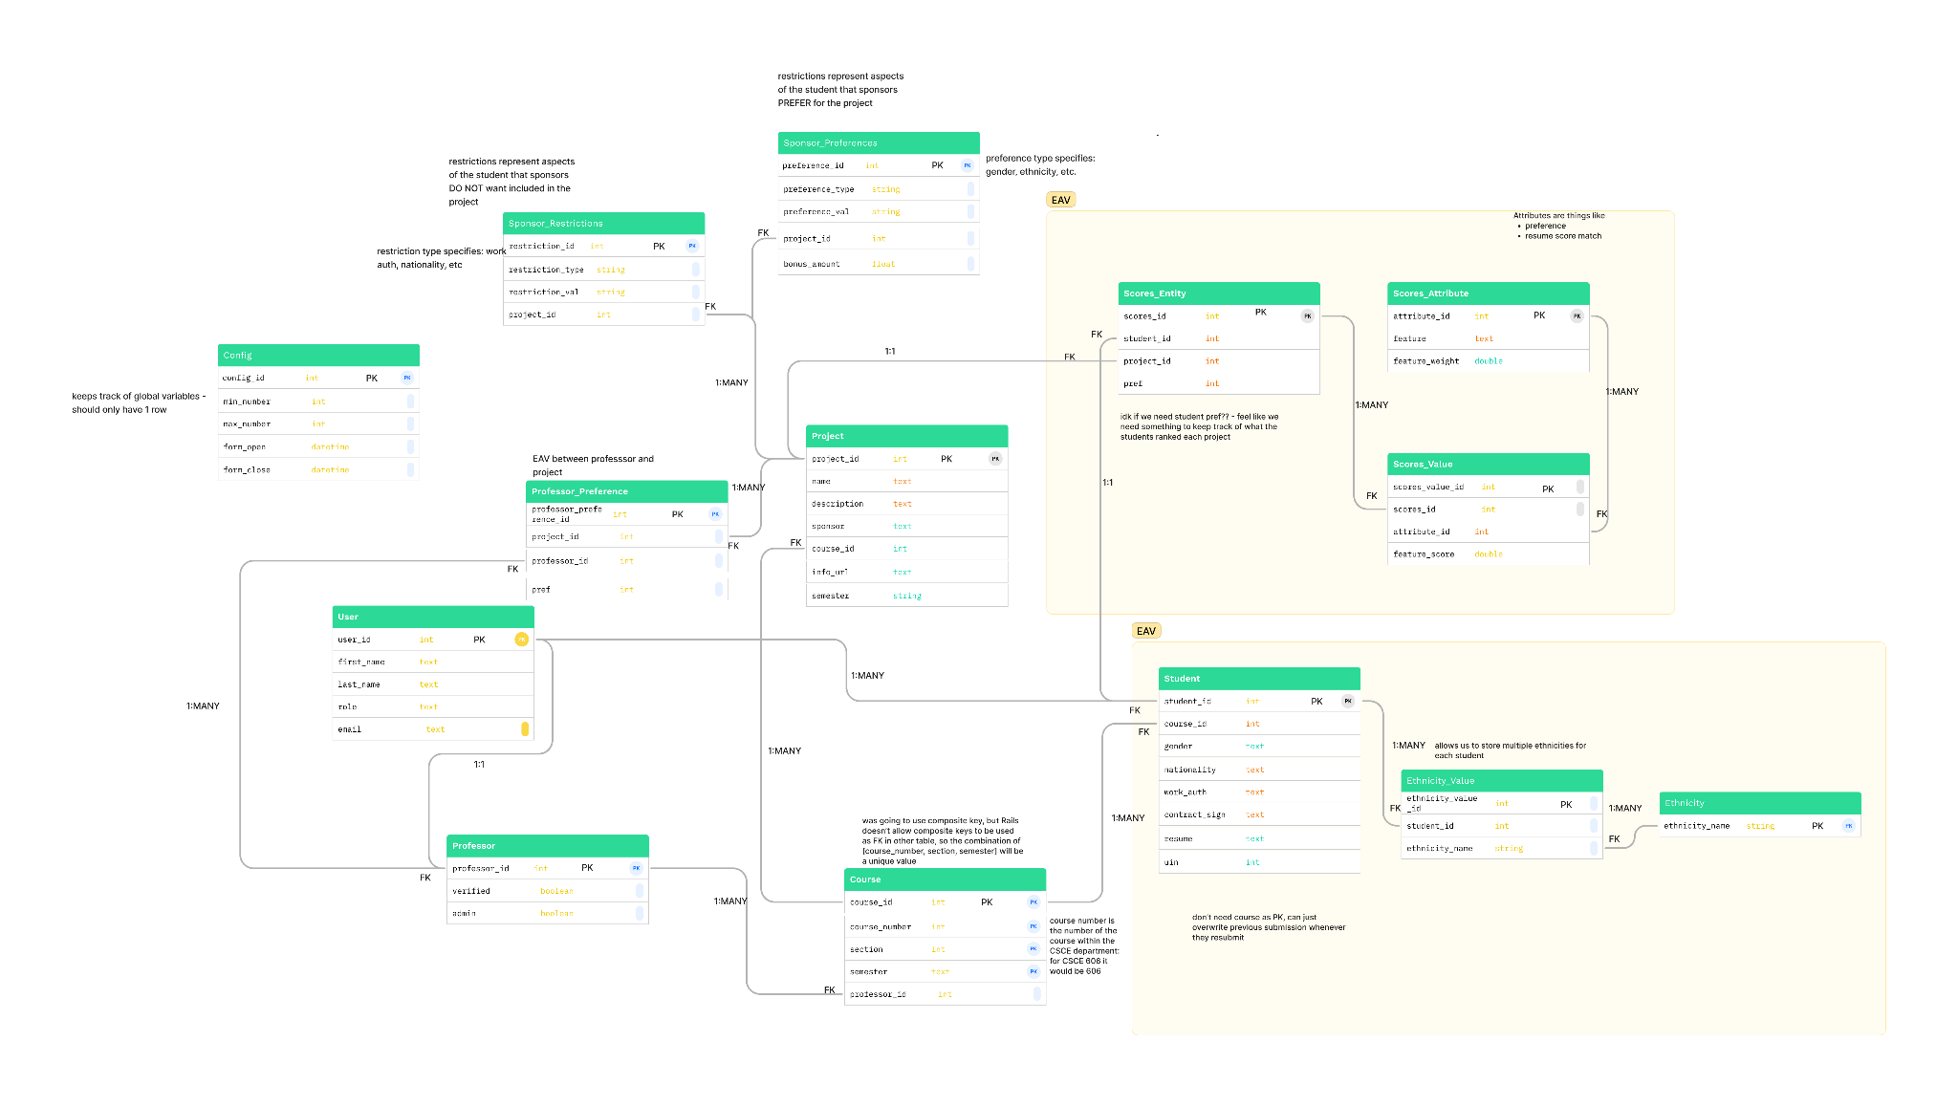
Design Diagram

Slide 7
Challenges
Database Design Complexity: Handling complexities in database design, ensuring efficiency and scalability
Cucumber Test Implementation: Implementing effective cucumber tests for behavior-driven development of features involving OAuth and JavaScript.
Timeline Pressures: Handling tight deadlines while ensuring quality deliverables.

Slide 8
Lessons Learned
Scope agreement: Clear project boundaries prevent scope creep, manage expectations, and maintain focus.
Agile Development: Iterative approach fosters flexibility, responsiveness, and continuous improvement.
Test-Driven Approach: Writing tests first ensures code quality, better design, and reduced bugs, ensuring more reliable and maintainable software.
Clean Code Practices: Prioritizing readability and adherence to standards ensures maintainable and efficient code.

