Slide 1
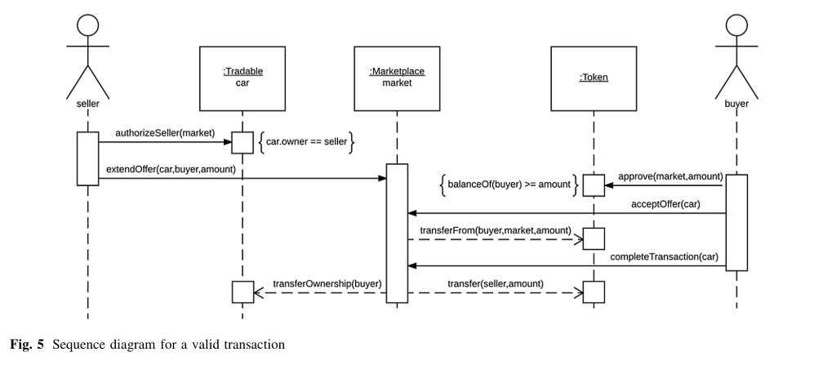
5th Research and Fair Week: “Emerging technologies for sustainable socioeconomic development”
Asset Tokenization Platform
Transforming Asset Management and Trading with Blockchain Technology
Why: The platform is designed to improve asset liquidity, reduce investment barriers, and enhance transparency in asset trading by leveraging blockchain technology.
When: The project timeline begins in 2024, with phased rollouts to address regulatory compliance and platform scalability.
How: Utilizing Ethereum blockchain, smart contracts for token creation and transaction, and developing a user-friendly interface for seamless asset tokenization and trading.
Gemechis Urgessa, Getnet Adugna, Jebessa Dejene, Petros Beyene, Zeamanual Feleke, Ephrem Alemayehu
Background
Context: Sengor Highland's unique market needs for diversified investment opportunities and enhanced asset liquidity.
Relevance: The platform addresses local economic conditions by providing a decentralized marketplace for a wide range of assets, thus democratizing access to investment.
Objective
Main Goal: To develop a secure, efficient, and user-friendly platform for tokenizing a wide array of assets, enabling fractional ownership and global trading.
Innovation Drive: Empower Sengor Highland's market with digital solutions to traditional asset management challenges.
Findings
Expected Impact: Increase in asset liquidity and a reduction in entry barriers for investors, fostering a more inclusive financial ecosystem.
Security Enhancements: Implementation of advanced security protocols to safeguard transaction integrity and asset ownership.
Methods
Technology Implementation: Integration of Ethereum blockchain to secure asset ownership.
Smart Contract Development: Creation and enforcement of contracts for asset management.
User Interface Design: Designing intuitive navigation for asset tokenization and management.
Fig.1. Example Sequence diagram showing a valid transaction
Authors: Gemechis Urgessa, AAiT, gemechis.urgessa@aait.edu.et; Getnet Adugna, AAiT; Jebessa Dejene, AAiT; Petros Beyene, AAiT, petros.beyene-ug@aau.edu.et; Zeamanual Feleke, AAiT ; Ephrem Alemayehu, AAiT;

