Slide 1
Web Security Research Proposal
Team: 3 2021.09.24
남득윤, 문태의, 한영진
Notes:
Hello This is 남득윤 from team 3 and we would do research on web security

Slide 2
01
Motivations
02
General Issues
index
03
Project Goals
Notes:
It is the index of todays presentation.

Slide 3





01
Motivations
Web is in everywhere
Web Service diversity
Notes:
Web is in everywhere
The world wide web is used by millions of people everyday.
We use it from our computers, our phones, even our cars.
Web Service have become more diverse. Unlike the web service of the past, which merely provide information,
SNS/ sharing videos/ cloud web service leads the explosion on web service.

Slide 4






01
Motivations
Web vulnerabilities are everywhere
DB/ DB server
AP Server
Web Server
client
Notes:
Compared to the explosive growth of web services, web security is far behind. Web security incidents are destructive enough to affect society as a whole.
Web hacking involves various attacks such as illegal login, injecting malicious code into server-side, and stealing personal information such as public Certificate or password.

Slide 5
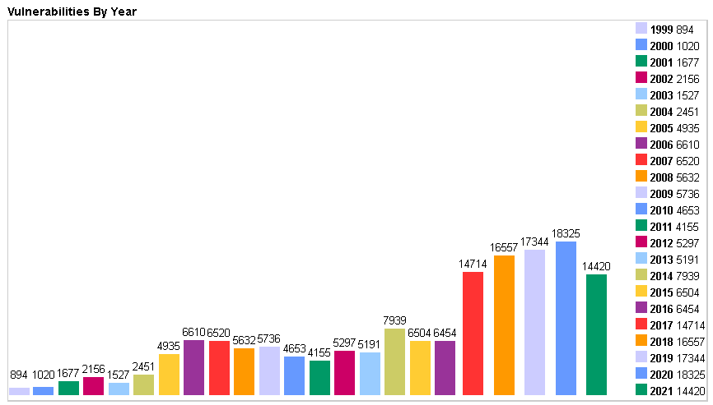

01
Motivations
Web vulnerabilities are everywhere and even rising!
Notes:
The Graph is from CVE which is a non-profit organization for cyber security.
They identify, define, and catalog publicly disclosed cybersecurity vulnerabilities
CVE does not only focus on “web security” but they mainly focus on web security.
And you can see the ascending trends in the types of vulnerabilities by year

Slide 6

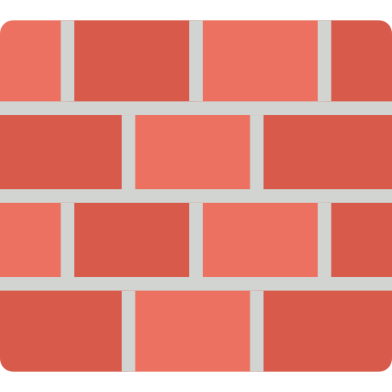





01
Motivations
Why the web is vulnerable to security
HTTP
IDS/IPS
Server-Side
AP Layer
FireWall
Notes:
Why the web is vulnerable to security
First/.Malicious attacks through HTTP 80 port, which even firewalls cannot block, are delivered to the web server as it is.
Secondly. security devices such as firewall, IDS, and IPS, cannot block attacks on the application layer.
Firewall, IDS/IPS they protect malicious attack in Network Layer and Transport Layer.
Not in AP layer. It detects and controls the destination IP and port. But It cannot detect the attacks on data

Slide 7

02
General Issues
OWASP 2021 Draft
A01:2021-Broken Access Control
A02:2021-Cryptographic Failure
A03:2021-Injection
A04:2021-Insecure Design
A05:2021-Security Misconfiguration
A06:2021-Vulnerable and Outdated Components
A07:2021-Identification and Authentication Failures
A08:2021-Software and Data Integrity Failures
A09:2021-Security Logging and Monitoring Failures
A10:2021-Server-Side Request Forgery
Notes:
In this section I would introduce some General Issues in web security
The International Web Security Standards Organization announces Internet OWASP-10 (Web Vulnerabilities ranking top 10) every three or four year.
And Draft of owasp 2021 has been released
I would introduce two of them
A01:2021-Broken Access Control
A03:2021-Injection

Slide 8
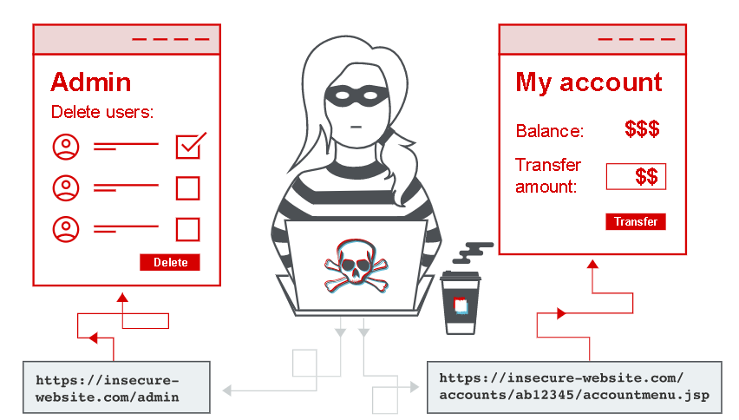
02
General Issues
A01 Broken Access Control
figure from https://portswigger.net/web-security/access-control
Notes:
Access control enforces policy such that users cannot act outside of their intended permissions.
A01 Broken Access Control occurs when such policy fails
Failures typically lead to unauthorized information disclosure, modification, or destruction of all data or performing a business function outside the user's limits.
Bypassing access control checks by modifying the URL, internal application state, or the HTML page
A01 has the most occurrences in the contributed vulnerability dataset of OWASP

Slide 9

02
General Issues
A03 Injection
SQL injection
OS Command Injection
PHP code injection (Obsolete)
Notes:
Injection is the most well-known vulnerability in web security region.
As the word injection says, it injects some un-intended input to server-side.
An application is vulnerable to attack when User-supplied data is not validated, filtered by the application.
Especially SQL injection has historically been the most detected threat for 15-16 years.
But it is still occurring and is important.
That is because of the change in the SQL from MySQL, Oracle in local to NoSQL and cloud such as Amazon RDS.

Slide 10
03
Project Goal
establishing a vulnerable environment
practice attacking simulations
find patch notes and solutions
and present appropriate security guidelines
Notes:
In this section I would finalize our project goal
There are many different types of security vulnerabilities, so it is necessary to select a few among them.

Slide 11



03
Project Goal
Selection on the specific vulnerabilities would be based on
CVE code
. And web server(e.g. Apache Tomcat, Lighttpd ...)
. Or its type( e.g. Injection, Broken Access Control)
Notes:
There are many different types of security vulnerabilities, so it is necessary to select a few among them.
We have not decided the criteria and specific vulnerabilities yet.

