Slide 1
Capstone Design Project
Project Proposal
Team: 3
남득윤, 한영진, 문태의

Slide 2
A study on security issues related to
OAuth 2.0

Slide 3
01
Introduction
02
Project Plan
index
03
OAuth 2.0 Authorization Flow
04
Problem Formulations with Scenario
05
Project Plan
Notes:
It is the index of todays presentation.

Slide 4

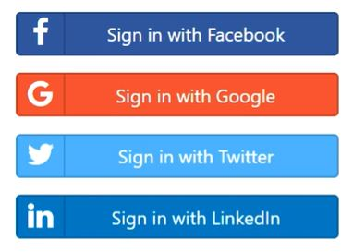
01
Introduction
Fig 1. social logins
Fig 2. OAuth Logo

Slide 5
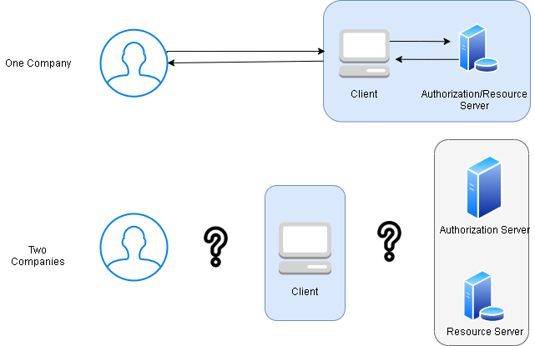
01
Introduction
Fig 3. OAuth Intuition

Slide 6
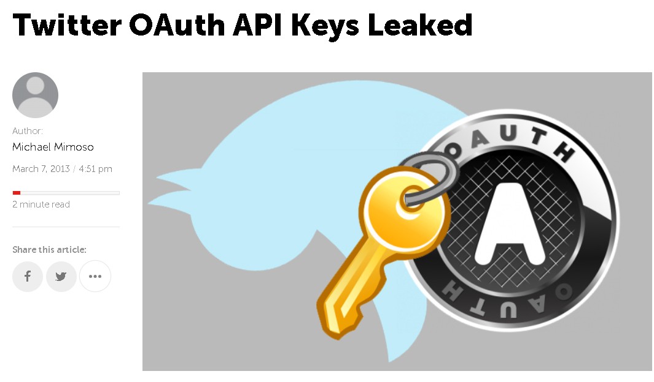



01
Introduction
Many companies suffer from the OAuth Security

Slide 7
01
Introduction
Clickjacking
Covert Redirection

Slide 8

01
Introduction
Fig 4. Spring Security Logo

Slide 9
02
Related work
Phishing Attack
Impersonation Attack
Applying Spring Security Framework and OAuth2
To Protect Microservice Architecture API
CVE-2008-2951

Slide 10
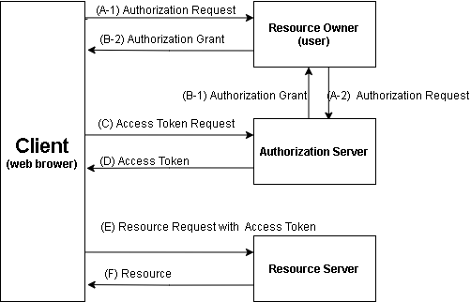
03
OAuth 2.0 Authorization Flow
Fig 5. OAuth2.0
Authorization Flow

Slide 11
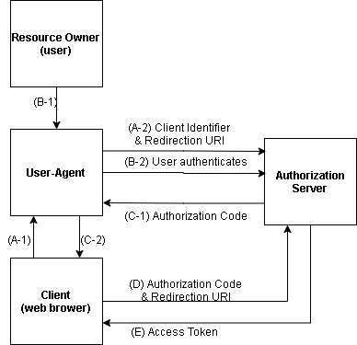
03
OAuth 2.0 Authorization Flow
Fig 6. OAuth2.0
Code grant type

Slide 12
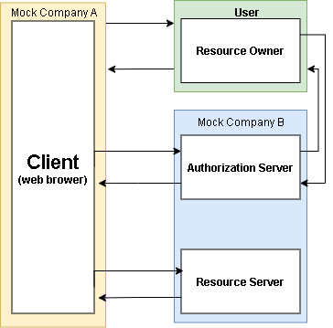
04
Project Formulations with Scenario
Fig 7. OAuth 2.0
Between Two companies

Slide 13
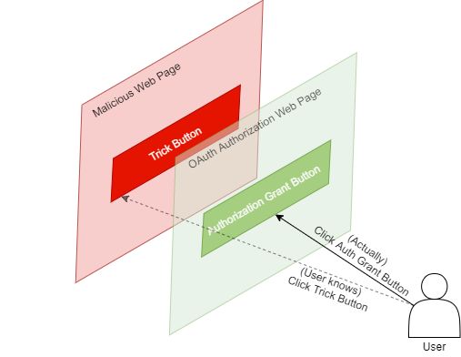
04
Project Formulations with Scenario
Clickjacking attack in OAuth 2.0

Slide 14
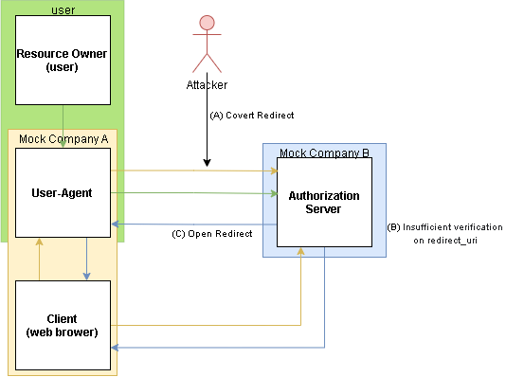
04
Project Formulations with Scenario
Covert Redirect in OAuth 2.0

Slide 15
05
Project Plan
Proposal
Midterm
Report
Final
Report
 | Week5 | Week6 | Week7 | Week8 | Week9 | Week10 | Week11 | Week12 | Week13 | Week14 | Week15
 | 9/27-10/2 | 10/4-10/9 | 10/11-10/16 | 10/18-10/23 | 10/25-10/30 | 11/1-11/6 | 11/8-11/13 | 11/15-11/20 | 11/22-11/27 | 11/29-12/4 | 12/5-12/10
Implement WebServers
Client
Authorization/Resource
Integrate and upgrade Servers
Integrate and upgrade Servers
Attack Simulation
Clickjacking
Covert Redirect
Deukyun
Youngjin
Taeui
Youngjin
Deukyun
Taeui

