Slide 1
LabFiz
ZAM
Zain Abedin . Alwin Baby . Muhammad Ahmed
April 10, 2020

Slide 2

Introduction
Safety is paramount in any workplace
Legal requirement to maintain record of safety inspection

Slide 3
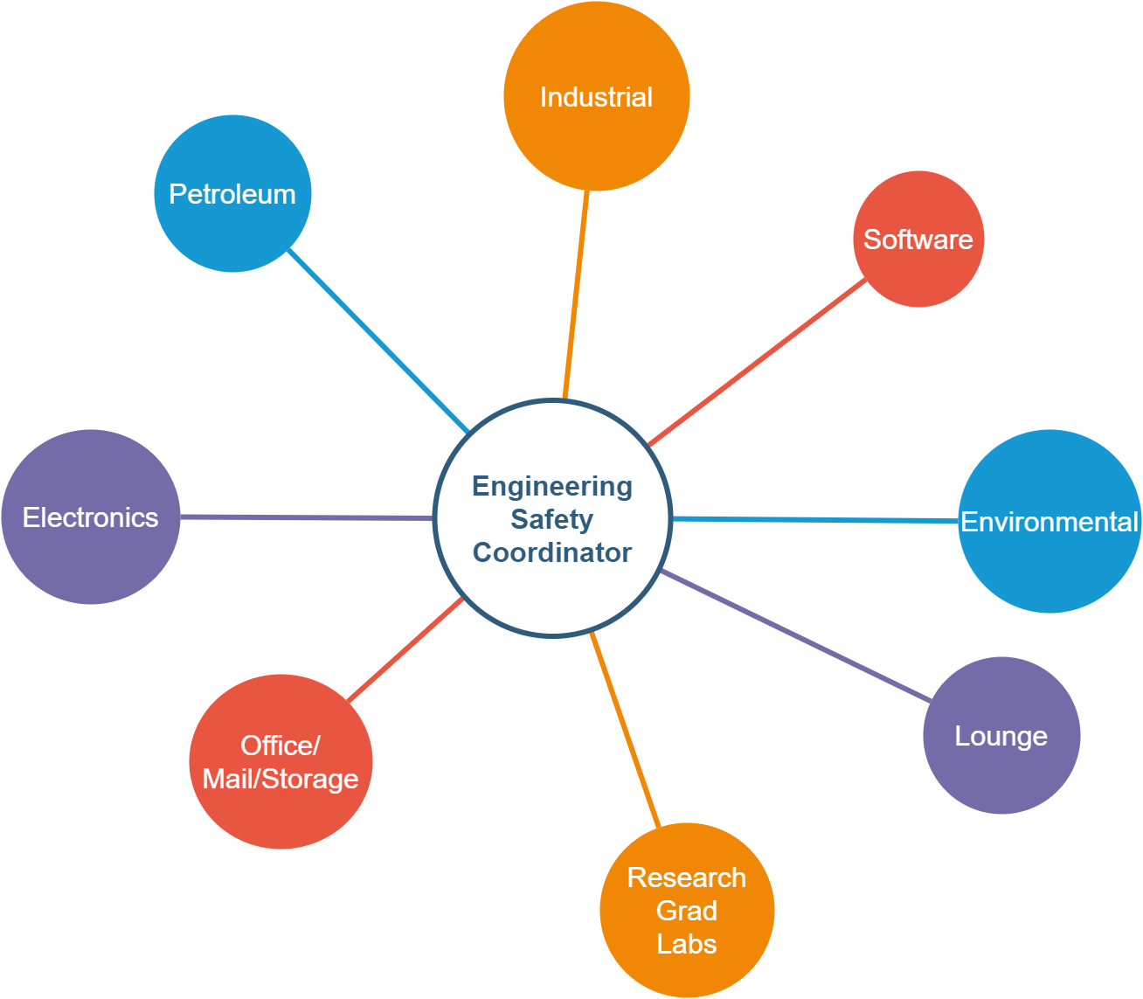
Introduction
Multiple labs with different characteristics
Over 200 Lab Inspections in Engineering
Hard to track and keep record of each inspection
No metrics available via paper processing

Slide 4
Our Solution: LabFiz
Web App for Lab Safety & Inspection
Create, assign and track inspections
Create and track Issue logs
Inspectors and Coordinators collaborate efficiently

Slide 5
Existing Solutions
Extremely pricey
Geared towards specific industry application
Offer boat load of features
Outdated UI and cumbersome UX

Slide 6
LabFiz Build
Front End
Vue.js
Component Based Design
UI inspired from Material Design
Responsive
Back End
Laravel PHP & mysql
MVC Architecture
RESTful API w/ expirable access/refresh tokens
Repository and Service Layer Pattern
Dependency Inversion
Interface Segregation
Security :
SQL Injection, CSRF , Direct Access Protection

Slide 7
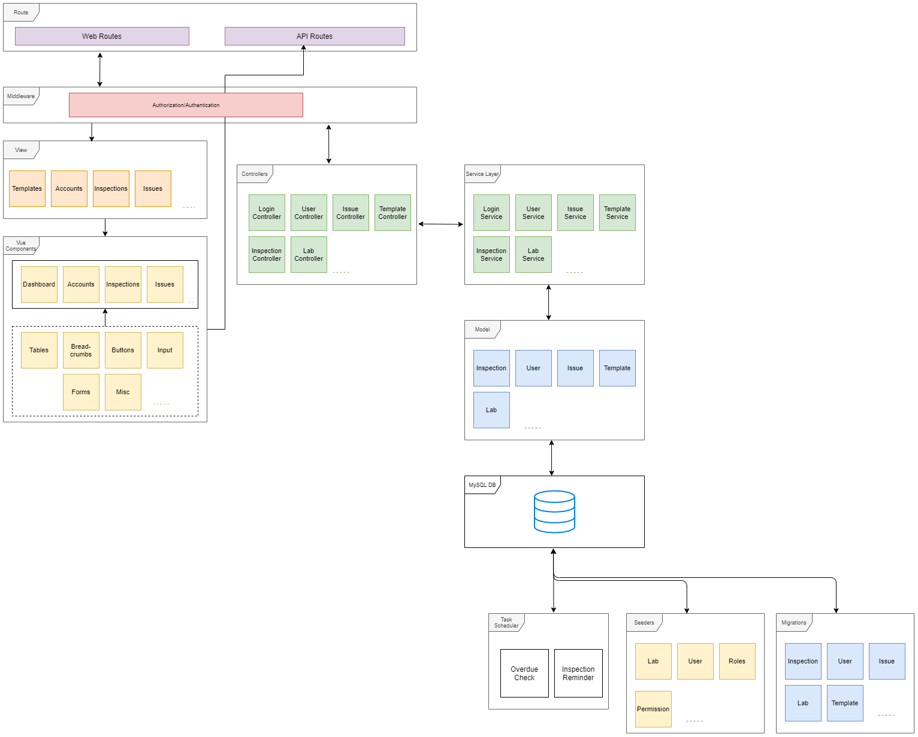
Architecture Overview

Slide 8
DEMO @ LABFIZ.COM
Notes:
Assigned to : Muhammad

Slide 9
Documentation & Process
Project Management
Asana / Kanban
Development Methodology
Hybrid Waterfall/Agile
Code Base
Github

Slide 10
Group Reflection
Barriers Faced ?
New technologies to learn
Time conflict with classes
What we learned?
Real customer interaction
Change/Process Management
New technology; Laravel , Vue.js , AWS Hosting

Slide 11
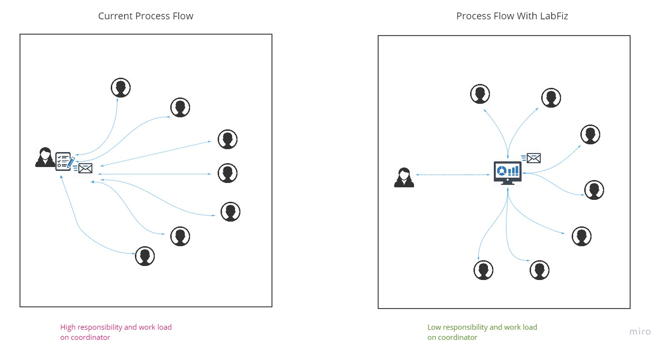

Slide 12
Mentor Q/A

