Slide 1
Buildmart
CAPSTONE B · SPRINT 4 · FINAL SHOWCASE
Secure Retail System
A full-stack e-commerce platform for hardware and home improvement — HTML/CSS/JS front end, Node.js + Express API, SQLite database.
Group 2 · Ranjan, Kalyan, Shailendra, Diya, Dipesh, Sujan, Anjan
8
19
100
86
entities
API endpoints
automated tests
commits
Notes:
12-15 minutes total. Keep this slide to 20 seconds. Ranjan: welcome, name the project and the team, then hand to the agenda. The four numbers are proof points we return to later - mention them only briefly here.

Slide 2
What we will cover
1
Problem & Overview
2
Design & Planning
3
Database
Why Buildmart exists, who it serves
Requirements, business rules, sprint journey
8 entities, ERD, data dictionary
4
Development
5
Integration
6
CRUD & Testing
Front end, back end, 19 API endpoints
How a click reaches the database and back
Full CRUD, checkout, and 100 tests
7
Evidence
8
Live Demonstration
9
Reflection
GitHub, CI, team contributions
The working system, end to end
Challenges, lessons, what comes next
Notes:
Ranjan: 20 seconds. Point out that sections 5, 6 and 8 - integration, CRUD and the live demo - carry the most weight, and that every claim in this deck is backed by evidence in the repository.

Slide 3
The problem we set out to solve
The situation
What we built
Buildmart is a hardware and home improvement retailer. Its customers need to browse stock, build a basket across a visit, and trust that what they see is what is actually available.
A three-tier system where the database is the single source of truth. Every product, price, stock level and cart line is read from and written to SQLite through a REST API.
What was wrong
Products load from the database, never the page
Product data lived in the page, so prices and stock could drift from reality
The cart existed only in browser memory - a refresh lost everything
Nothing stopped a customer ordering more than existed in stock
No accounts, so no way to recognise a returning customer
The cart survives a refresh - it lives in SQLite
Stock and quantity limits enforced server-side
Secure accounts with bcrypt-hashed passwords
The front end never decides what is true. It asks the API, and the API asks the database.
Notes:
Ranjan: 60 seconds. Lead with the business problem, not the technology. The line at the bottom is the thesis of the whole project - say it out loud. Anticipates Q1 (what problem does your project solve).

Slide 4
Target users and project objectives
WHO USES THE SYSTEM
PROJECT OBJECTIVES
Retail customers
Move every piece of product and cart data into a real database
Expose it through a documented REST API with full CRUD
Validate every input server-side - never trust the browser
Protect accounts with industry-standard password hashing
Prove it works with automated tests and continuous integration
Deliver it through a genuine Git workflow: issues, branches, pull requests, review
Browse the 8-product catalogue, build a cart, see GST-inclusive totals, create an account and log in
Returning customers
Log in and find the cart exactly as they left it, because it is stored server-side
Store staff (future)
MAIN FEATURES
The schema and API already separate stock from display, ready for an admin view
Product catalogue
Shopping cart
Quantity controls
GST totals
Registration
Login / logout
Notes:
Ranjan: 45 seconds. Answers Q2 (who are the users) and Q3 (major features). Do not read all six features aloud - say 'catalogue, cart and accounts' and let the slide carry the rest.

Slide 5
Requirements analysis
FUNCTIONAL REQUIREMENTS
BUSINESS RULES ENFORCED BY THE SYSTEM
View all products with price, unit and stock from the database
Add a product to the cart with a chosen quantity
Change the quantity of a cart line
Remove a line, or the whole item, from the cart
See a GST-inclusive subtotal, GST component and total
Register an account and log in and out securely
# | Rule | Enforced by
1 | A cart line must point to a real cart and real product | Foreign keys + 404
2 | Quantity must be a whole number above zero | CHECK + 400
3 | At most 20 of any one product per cart | API returns 400
4 | Cannot exceed available stock | API returns 409
5 | A product appears only once per cart | UNIQUE(cart_id, product_id)
6 | Prices include GST; GST = total - total / 1.1 | getCart() in server.js
7 | Usernames and emails unique in any letter case | UNIQUE COLLATE NOCASE
8 | Passwords stored only as bcrypt hashes | auth/passwords.js
NON-FUNCTIONAL REQUIREMENTS
Validation enforced on the server, not only in the browser
Passwords never stored in recoverable form
Responsive down to 375px with no sideways scrolling
Graceful failure when the API cannot be reached
Notes:
Sujan or Ranjan: 60 seconds. The business rules table is the strongest part of this slide - every rule names where it is enforced, which shows the rules live in the system, not in a document. Rule 6 pre-empts a question about GST.

Slide 6
The sprint journey
1
2
3
4
Capstone A
Sprint 2
Sprint 3
Sprint 4
Foundation
Cart in the browser
Database and API
Integration and accounts
Static site: home, about, shop, contact. Shared stylesheet, responsive layout.
Shopping cart module - drawer, add to cart, quantity controls, GST totals. All client-side.
Node.js + Express + SQLite. Products and cart tables, REST endpoints, automated tests.
Front end rewired to the API. Accounts with bcrypt and JWT. CI, full test suite, documentation.
The turning point
Sprint 3 built a working API and Sprint 2 built a working cart - but they were not connected. Sprint 4 was mostly integration work: making the page we already had speak to the database we already had.
Notes:
Sujan: 60 seconds. Be honest that Sprint 4 was integration rather than new features - markers reward an accurate account of the journey. This sets up the CORS story in the reflection.

Slide 7
Database design decisions
SQLite
8
6
9
Chosen over MySQL
Entities
Relationships
Business rules
WHY SQL, NOT NoSQL
WHY SQLite SPECIFICALLY
Our data is strongly relational - a cart line is meaningless without its cart and its product
Foreign keys let the database itself refuse an orphaned cart line
A UNIQUE constraint on (cart_id, product_id) enforces 'one line per product' without any application code
CHECK constraints keep quantity above zero and price at or above zero at the storage layer
Totals and GST are a natural SQL JOIN and aggregation
Zero configuration - the database is a single file, so every team member runs the same thing after one npm command
Fully relational: foreign keys, CHECK and UNIQUE constraints all supported
better-sqlite3 is synchronous, which kept our route handlers simple and readable
Each test file creates its own temporary database, so tests never touch buildmart.db
Trade-off we accepted: SQLite handles one writer at a time. For a single-store prototype that is fine; a multi-store deployment would move to MySQL or PostgreSQL, and the schema would port directly.
Notes:
Kalyan: 60 seconds. Answers Q12 (why this technology stack). Naming the trade-off unprompted is what separates a Distinction from a High Distinction - say the limitation before a marker asks.

Slide 8
Entity relationship diagram
PRODUCTS
CART_ITEMS
CARTS
USERS
1 : N
N : 1
N : 1
PK product_id
PK cart_item_id
PK cart_id
PK user_id
name
FK cart_id
customer_name
username (UK)
description
FK product_id
FK user_id
email (UK)
category
quantity
created_at
password_hash
price
created_at
unit
password_changed_at
stock
1 : N
ORDER_ITEMS
ORDERS
PASSWORD_RESETS
REVOKED_TOKENS
N : 1
PK order_item_id
PK order_id
PK reset_id
PK jti
FK order_id
FK user_id
FK user_id
expires_at
FK product_id
status
token_hash (UK)
product_name
total
expires_at
unit_price
gst_included
used_at
quantity
created_at
Two further relationships are not drawn, to keep the diagram readable: USERS 1 : N ORDERS · USERS 1 : N PASSWORD_RESETS. REVOKED_TOKENS stands alone — it stores a logged-out token id, not a link to a user.
Notes:
Kalyan: 90 seconds - this is worth 5 marks, the joint highest. Q4: EIGHT entities. Q5: a primary key uniquely identifies each row, e.g. product_id. Q6: a foreign key points at another table's primary key, e.g. cart_items.cart_id. Q7: walk the carts to cart_items one-to-many, or users to orders. Note that order_items copies product_name and unit_price, so an order keeps the price actually paid even if the product price changes later.

Slide 9
Data dictionary and constraints
Table | Column | Type | Constraint | Purpose
products | product_id | INTEGER | PRIMARY KEY | Unique product number
 | category | TEXT | NOT NULL, DEFAULT General | Drives the shop category filter
 | price / stock | REAL / INTEGER | NOT NULL, CHECK >= 0 | GST-inclusive price, units held
carts | cart_id | INTEGER | PRIMARY KEY | Unique cart number
 | user_id | INTEGER | FK -> users | The account the cart belongs to
cart_items | cart_id / product_id | INTEGER | NOT NULL, FK | Which cart, which product
 | quantity | INTEGER | NOT NULL, CHECK > 0 | Units in the cart
 | (cart_id, product_id) | - | UNIQUE | One line per product per cart
orders | order_id | INTEGER | PRIMARY KEY | Unique order number
 | user_id | INTEGER | NOT NULL, FK -> users | Who placed the order
 | status | TEXT | NOT NULL, CHECK in list | Placed, Shipped, Delivered, Cancelled
 | total / gst_included | REAL | NOT NULL, CHECK >= 0 | Amount charged and its GST part
order_items | product_name / unit_price | TEXT / REAL | NOT NULL | Copied at checkout - the price actually paid
users | username / email | TEXT | UNIQUE COLLATE NOCASE | Case-insensitive identity
 | password_hash | TEXT | NOT NULL | bcrypt hash, cost 12
order_items copies product_name and unit_price at checkout. If a product’s price changes later, the order still shows what the customer actually paid — the historical record stays correct.
Notes:
Kalyan: 45 seconds. Do not read the table. Point to the constraint types - PRIMARY KEY, FOREIGN KEY, CHECK, UNIQUE - and say the database refuses bad data even if the API has a bug. Then make the order_items point at the bottom: copying the price at checkout is a deliberate design decision, not duplication.

Slide 10
Front-end development
BUILT WITH
WHAT THE FRONT END DOES - AND DOES NOT DO
Plain HTML5, CSS3 and vanilla JavaScript - no framework. Six pages sharing one stylesheet.
Does
Does not
Render what the API returns
Validate early for fast feedback
Show loading and error states
Keep the token in sessionStorage
Re-draw the cart from each response
Hold the cart in memory
Calculate the total itself
Decide what is in stock
Hard-code any product or price
Trust its own validation alone
shop.html
Catalogue + cart drawer
register.html
Validation + strength meter
login.html
Login / logout session
REGISTRATION FORM - REAL-TIME VALIDATION
index.html
Home and hero
Username
3-30 characters, letters, numbers and underscore
about.html
Project and team
Email
Format checked as you type, uniqueness checked by the API
Password
Live checklist: length, uppercase, lowercase, number, symbol
contact.html
Enquiry form
Confirm
Must match, checked on every keystroke
Strength meter
Updates live as the rules are satisfied
Client-side validation is a courtesy to the user. The server re-checks everything, because a browser can be bypassed.
Notes:
Diya: 60 seconds. The 'does / does not' pair is the key idea - the front end is a renderer, not a decision maker. The closing line answers 'how does your system handle invalid input' from the front-end side.

Slide 11
Back-end development
THE STACK
WHAT THE BACK END IS RESPONSIBLE FOR
Node.js 20
JavaScript runtime
1
Validate
Every id, every quantity, every field - before touching the database
Express 4.21
HTTP routing and middleware
2
Authorise
better-sqlite3 12
Synchronous SQLite driver
Check the bearer token and that it has not been revoked
bcryptjs 3
Password hashing, cost factor 12
3
Enforce rules
Stock levels, the 20-item cap, one line per product
jsonwebtoken 9
HS256 tokens, 1-hour expiry
Query
4
node:test
Built-in test runner, no extra dependency
Prepared SQL statements - never string concatenation
5
Calculate
Security measures in the code
Line subtotals, cart total and the GST component
JWT secret read from the environment, never committed
Server refuses to start in production without JWT_SECRET
Login returns one message for a wrong password and an unknown email - no user enumeration
Static file allow-list: only root .html plus /css and /js are served
6
Respond
Correct HTTP status and a consistent JSON shape
Notes:
Shailendra: 75 seconds. Answers Q9 (role of the backend) and Q10 (how it connects to the database - better-sqlite3 opens buildmart.db and we use prepared statements). The six numbered duties are the answer to 'what does your backend actually do'.

Slide 12
API endpoints
GET
/api/products
List products, filtered by category and search
Read
GET
/api/products/:id
Single product detail
Read
GET
/api/categories
Category list with a product count for each
Read
GET
/api/my-cart
The logged-in user's own cart
Read
GET
/api/carts/:id/items
Cart contents with subtotals, GST and total
Read
POST
/api/carts/:id/items
Add a product, or raise its quantity
Create
PATCH
/api/carts/:id/items/:productId
Set the quantity of a cart line
Update
DELETE
/api/carts/:id/items/:productId
Remove a line from the cart
Delete
POST
/api/orders
Checkout: turn the cart into an order, take stock
Create
GET
/api/users/:id/orders
A user's order history, paginated
Read
GET
/api/orders/:orderId
One order with its lines, totals and status
Read
PATCH
/api/orders/:orderId
Change order status, for example Cancelled
Update
POST
/auth/register
Create an account; stores a bcrypt hash
Create
POST
/auth/login
Verify credentials and issue a JWT
Read
GET
/auth/verify
Validate the bearer token, return the user
Read
POST
/auth/logout
Revoke the token by its jti
Update
19 application endpoints plus a health check at GET / · Also POST /auth/forgot-password and /auth/reset-password · Every one returns JSON and is covered by tests
Notes:
Shailendra: 45 seconds. Answers Q11. Do not read them out. Say: product and category endpoints, four cart endpoints covering full CRUD, four order endpoints, six auth endpoints - 19 in total, all JSON, all tested. Point at POST /api/orders: that is checkout, and it is the one that takes stock inside a transaction.

Slide 13
How information flows through the system
USER
Clicks + on the Claw Hammer line in the cart drawer
shop.html
FRONTEND
shop.html sends PATCH /api/carts/1/items/2 with {"quantity": 5}
HTML / CSS / JavaScript
BACKEND API
Express validates the id and quantity, checks the 20-item cap and the stock level
Node.js + Express
DATABASE
UPDATE cart_items SET quantity = 5 WHERE cart_id = 1 AND product_id = 2
SQLite
RESPONSE
JOIN recalculates the line subtotal, cart total and GST, returned as JSON
200 OK
USER SEES
The drawer re-draws: quantity 5, line total $124.75, GST included $11.34
Updated cart
One click. Six stages. The browser never calculates the total and never decides what is in stock - it asks, and it renders the answer.
Notes:
Kalyan: 90 seconds - the brief calls this the single most important section. Trace the arrow top to bottom with your finger on the screen. Answers Q13, Q14, Q15 and Q16 in one slide. The values 124.75 and 11.34 are real - we verified them, and the live demo will reproduce them exactly.

Slide 14
CRUD functionality — Create and Read
POST
Create
GET
Read
POST /api/carts/1/items
GET /api/products · GET /api/carts/1/items
Adds a product to the cart. If the product is already in the cart, the quantity is raised instead of creating a duplicate row.
Lists the catalogue, and returns the cart with a SQL JOIN that attaches each product's name and price to its cart line.
VALIDATION PERFORMED
VALIDATION PERFORMED
product_id must be a positive integer
quantity must be a positive integer
The product must exist, or 404
Combined quantity must stay at or under 20, or 400
Combined quantity must not exceed stock, or 409
Cart id must be a positive integer, or 400
The cart must exist, or 404
Subtotals computed in SQL, not in the browser
GST derived as total - total / 1.1
Rows ordered by cart_item_id for a stable display
VERIFIED RESULT
VERIFIED RESULT
201 Created
{"cart_id":1,"items":[{"product_id":2,
"name":"Claw Hammer 450g","quantity":2,
"subtotal":49.9}],"gst_included":4.54,"total":49.9}
200 OK
[{"product_id":1,"name":"Bolt",
"description":"Zinc plated, M10","price":12,
"unit":"each","stock":50}, ... 8 products]
Notes:
Dipesh: 60 seconds. Worth 5 marks with the next slide. The green blocks are real responses captured from the running server - say so. Note the Create behaviour: adding the same product twice raises the quantity rather than duplicating the row, enforced by UNIQUE(cart_id, product_id).

Slide 15
CRUD functionality — Update and Delete
PATCH
Update
DELETE
Delete
PATCH /api/carts/1/items/2
DELETE /api/carts/1/items/2
Sets the quantity of an existing cart line to an exact value, then recalculates the line subtotal, cart total and GST.
Removes a line from the cart entirely, whatever its quantity, and returns the recalculated cart so the page can re-draw.
VALIDATION PERFORMED
VALIDATION PERFORMED
product_id must be a positive integer
quantity must be a positive integer
The cart line must already exist, or 404
Quantity must stay at or under 20, or 400
Quantity must not exceed stock, or 409
Cart id and product_id must be valid integers
The cart must exist, or 404
The cart line must exist, or 404
Deletion is confirmed by result.changes
The updated cart is returned, so totals stay in step
VERIFIED RESULT
VERIFIED RESULT
200 OK
{"items":[{"product_id":2,"quantity":5,
"subtotal":124.75}],
"gst_included":11.34,"total":124.75}
200 OK
{"cart_id":1,"items":[],
"gst_included":0,"total":0}
Notes:
Dipesh: 60 seconds. Answers Q17 (how did you test CRUD). Make the distinction clear: the minus button lowers the quantity by one via PATCH, and only reaching zero triggers DELETE; the Remove button deletes the whole line regardless of quantity. We corrected a test case during Sprint 4 that had this backwards.

Slide 16
Testing evidence
100
100
0
25
automated tests
passing
failing
manual integration tests
AUTOMATED SUITE — npm test
MANUAL INTEGRATION TESTS — TESTING.md
Test file | Tests | Covers
auth.test.js | 45 | Hashing, register, login, verify, logout, reset
orders.test.js | 23 | Checkout, stock, order history, cancel, access
cart.test.js | 20 | Full CRUD, stock, 20-item cap, totals, GST
static.test.js | 7 | Page serving and path-traversal defence
seed.test.js | 5 | The 8 seeded products and cart 1
Total | 100 | All passing
ID | Category | Test | Result
T01 | Read | Products load from the database | Pass
T02 | Read | Cart survives a page refresh | Pass
T03-04 | Create | Add item; add the same item again | Pass
T05-06 | Update | Increase and decrease quantity | Pass
T07-08 | Delete | Remove item; decrease to zero | Pass
T09 | Calculation | Totals and GST: $128.00 / $11.64 | Pass
T10-11 | Validation | Stock limit; 20-item cap | Pass
T30 | Create | Cart linked to the logged-in account | Pass
T33 | Create | Checkout writes an order, stock drops | Pass
T36 | Read | Order history reads the order back | Pass
Every test was run against the real system on 2 November 2026, after the final merge. Screenshots are committed in docs/screenshots/, named by test ID.
Notes:
Anjan: 75 seconds. Lead with 100 of 100 passing. Mention that each test file builds its own temporary database so the tests never touch buildmart.db - that is why we can run them repeatedly. Have the terminal ready to run npm test live if asked.

Slide 17
Validation and error handling
Scenario | What we sent | Status | Message returned | Database
Blank field, missing field, or wrong data type | quantity omitted, {} sent, or quantity: "abc" / -2 | 400 | product_id must be a positive integer and quantity must be a positive integer | Unchanged
Incorrect product id | product_id: 999 | 404 | Product not found | Unchanged
Incorrect cart id | cart 999 | 404 | Cart not found | Unchanged
Incorrect cart item | PATCH a product not in the cart | 404 | Cart item not found | Unchanged
Duplicate record | same product added twice | 201 | No duplicate row - quantity raised | 1 row, qty 2
Over stock limit | 4 x Safety Glasses (stock 3) | 409 | Requested quantity exceeds available stock | Stays at 3
Over the 20 cap | 21 x Bolt (stock 50) | 400 | Maximum quantity per item is 20 | Stays at 20
Wrong password | valid email, bad password | 401 | Invalid email or password | No session
Unknown email | email not registered | 401 | Invalid email or password | No session
Server unreachable | API stopped mid-session | - | Could not reach the server | Unchanged
Two deliberate choices. Row 1: blank, missing and wrong-type inputs share one message because the handler validates both fields in a single condition. Rows 7 and 8: a wrong password and an unknown email answer identically, so an attacker cannot discover which emails have accounts.
Notes:
Anjan: 60 seconds. Answers Q20 (how does your system handle invalid input) completely. The no-user-enumeration point in the box is a genuine security decision - make it, because it demonstrates thinking beyond the brief. Answers Q27 partly too.

Slide 18
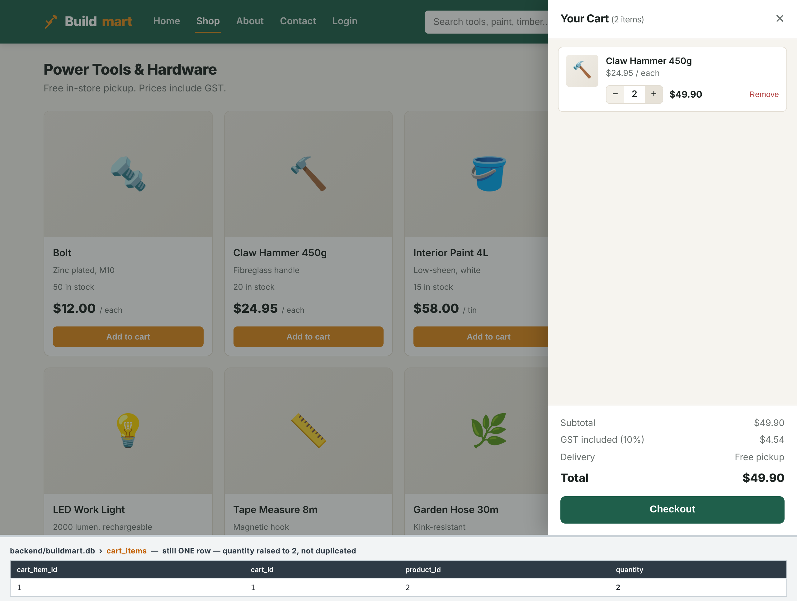

CRUD evidence — Create and Update
CREATE — the same product added twice
UPDATE — quantity set to 5
One row, quantity raised to 2 — UNIQUE(cart_id, product_id) prevents a duplicate
Line total $124.75, GST included $11.34, and quantity 5 in the table
Captured from the running system: the page on top, the cart_items table underneath. The numbers on the page and in the database match.
Notes:
Dipesh: 45 seconds. This is the proof behind the previous two slides. Point at the left image first - one row, quantity 2, not two rows - that is the UNIQUE constraint doing its job. Then the right: the page says $124.75 and the table says quantity 5. Same data, two layers.

Slide 19
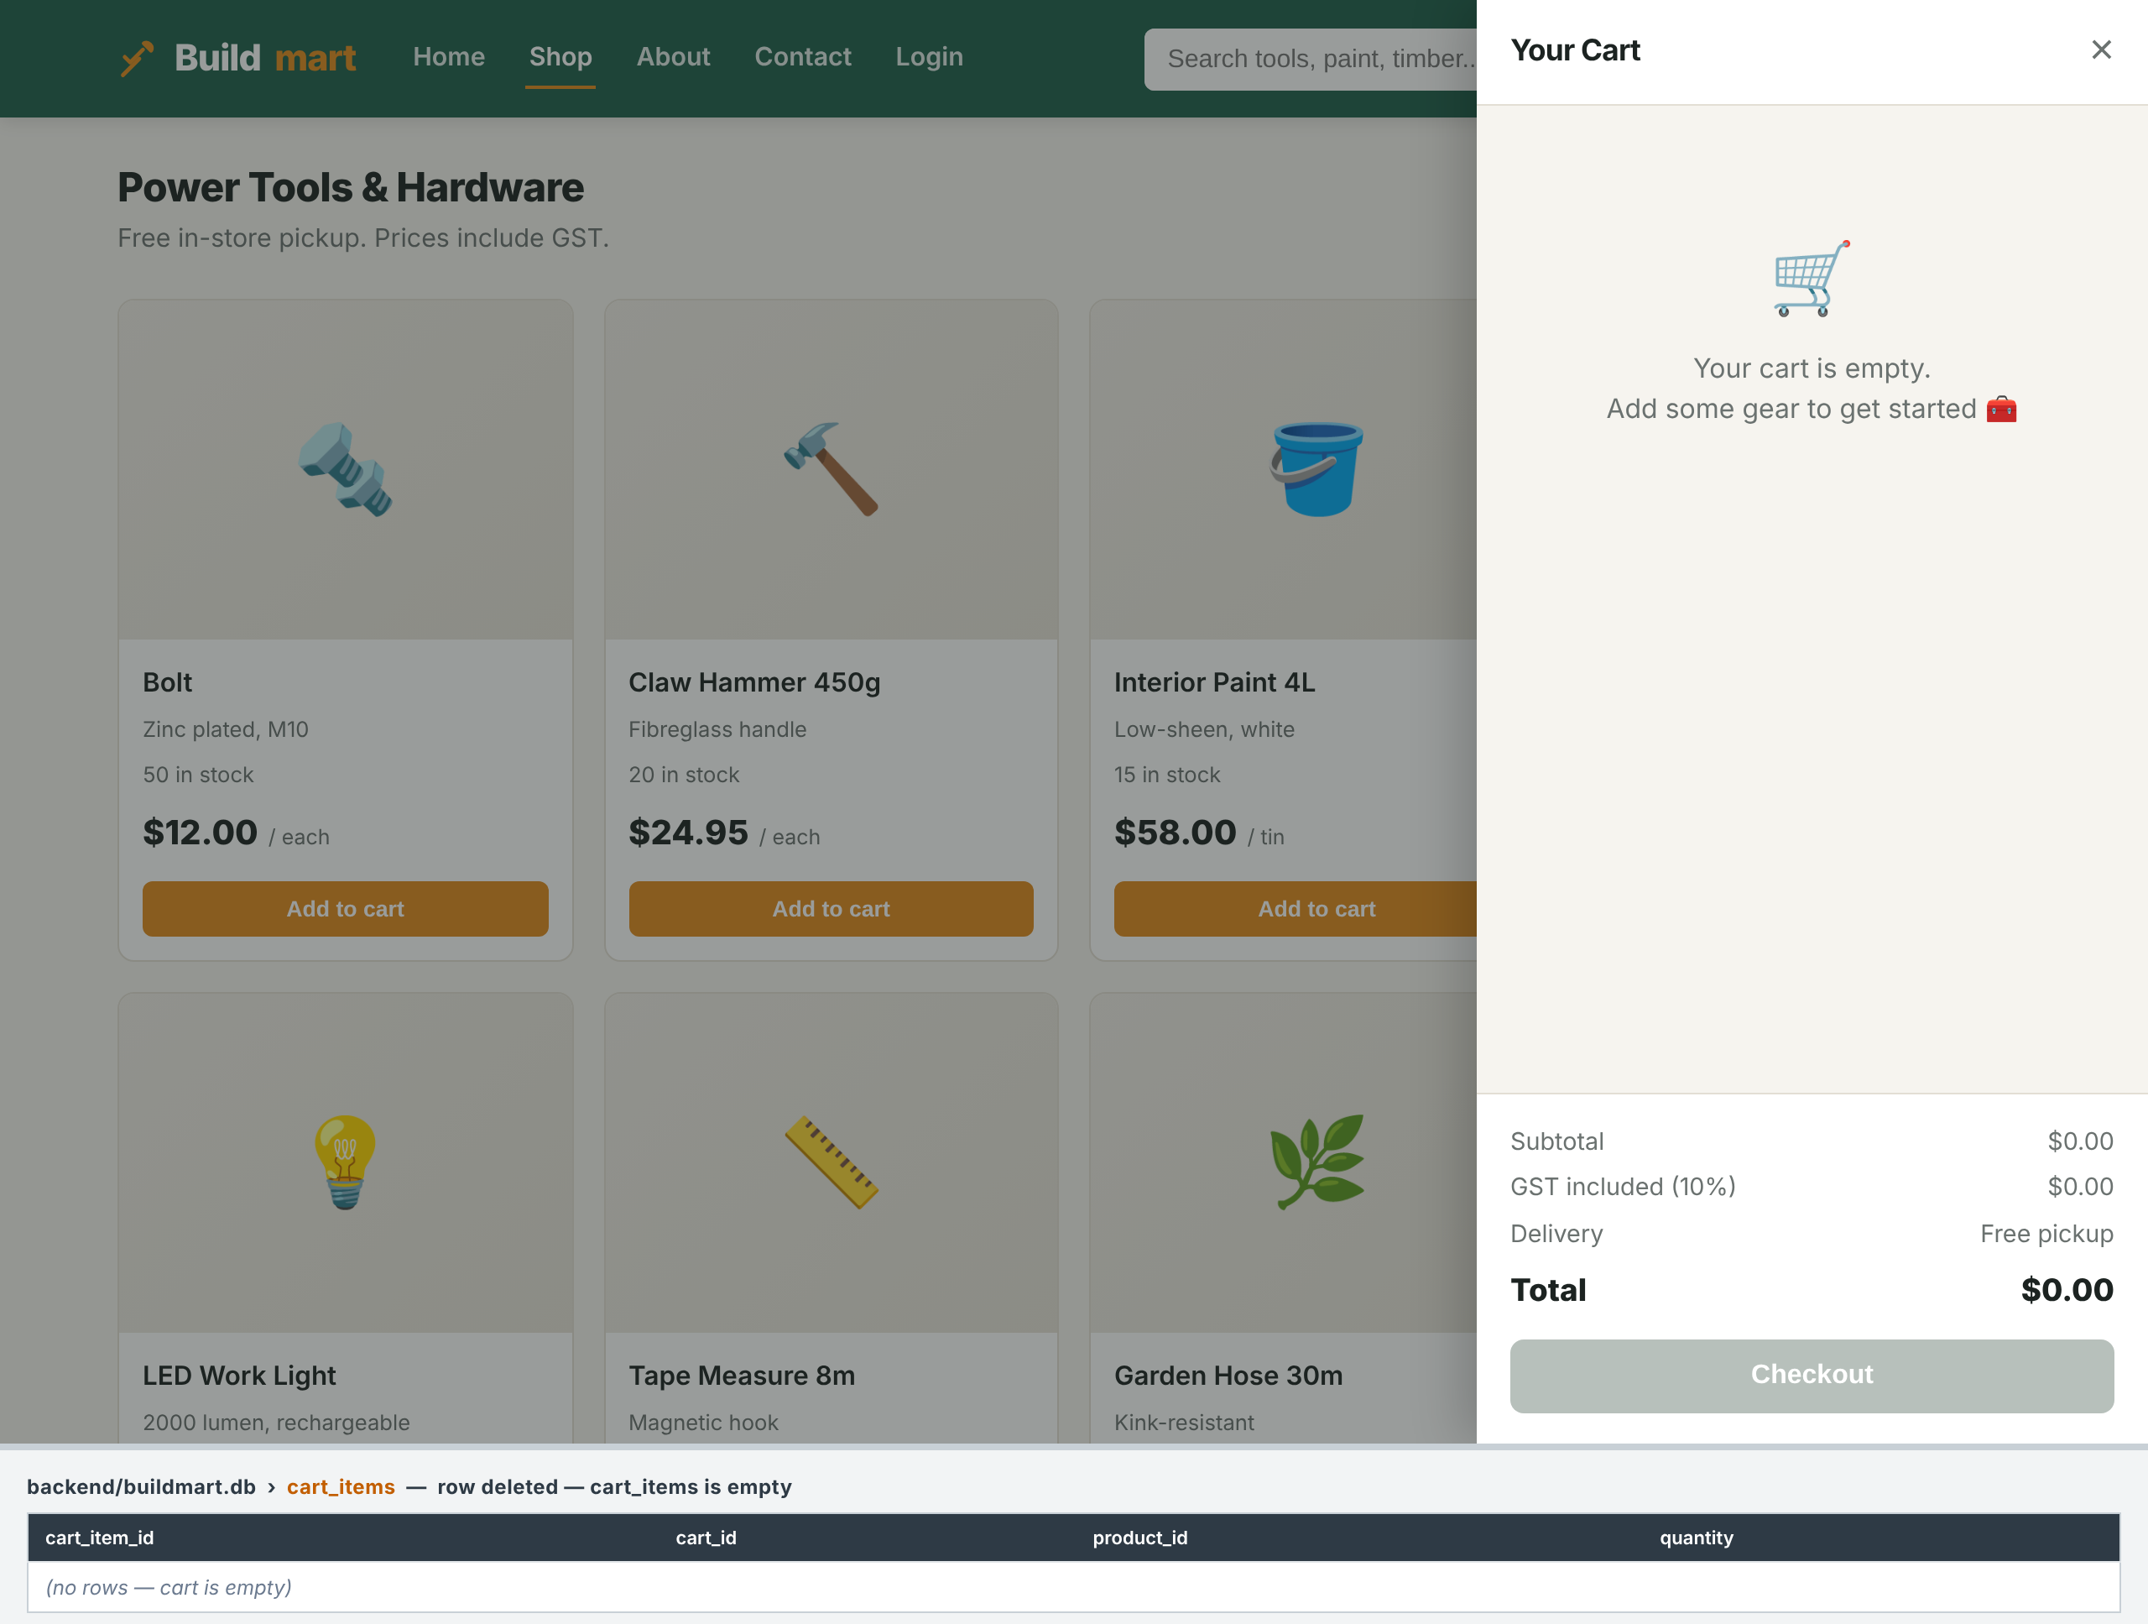
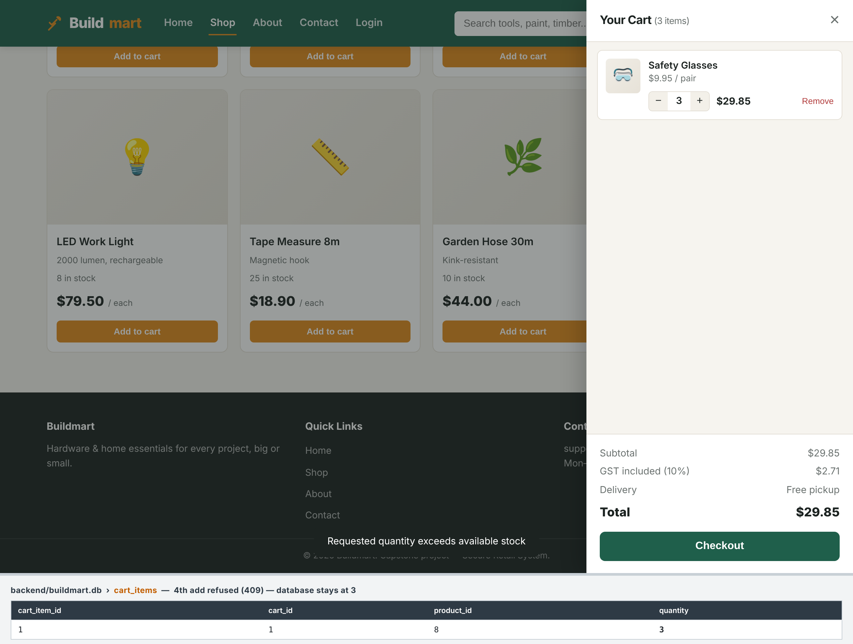
CRUD evidence — Delete and stock validation
DELETE — the line removed
VALIDATION — stock limit enforced
Drawer empty and cart_items has no rows — the row is gone from the database
Safety Glasses stock is 3; the 4th add is refused with 409 and the table stays at 3
The stock check happens on the server. The browser cannot talk its way past it, because the browser is not the thing deciding.
Notes:
Dipesh: 45 seconds. Left: deletion really removes the row, it is not just hidden in the page. Right: this is the single best evidence of server-side validation - the page asked for a 4th item and the server said no, so the database still reads 3.

Slide 20
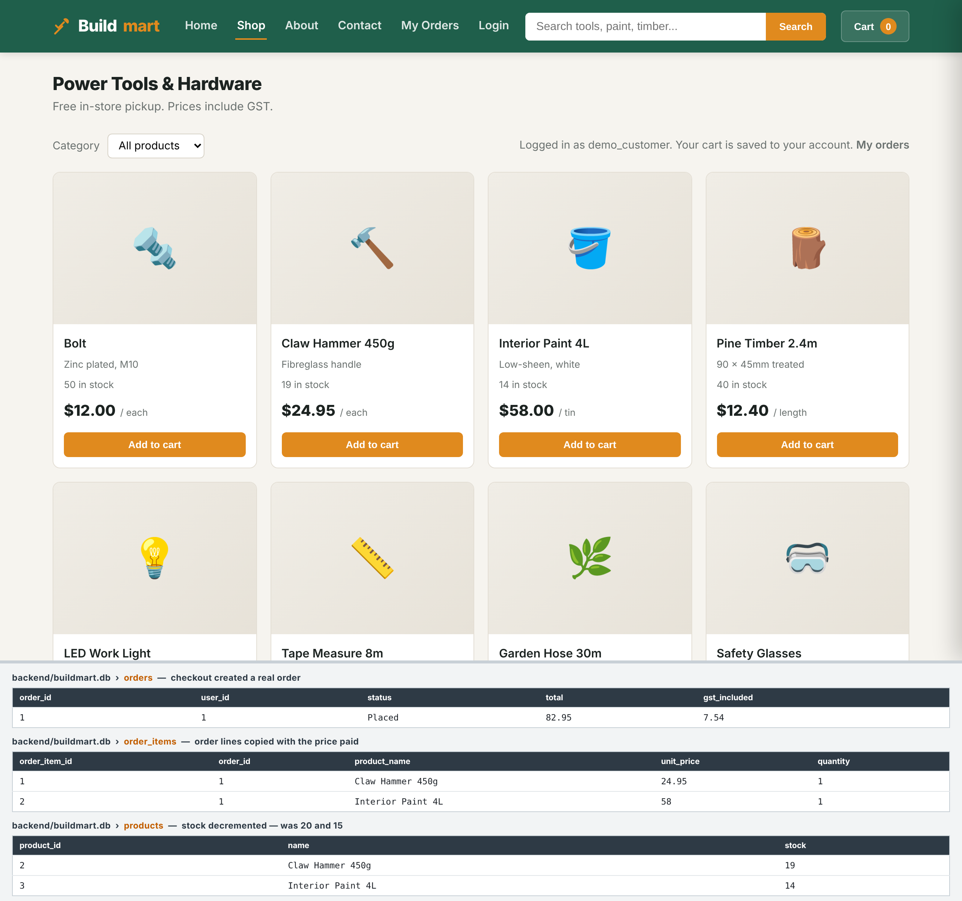
Checkout — cart becomes a real order
One click on Checkout writes three changes inside a single database transaction. If any part fails, none of it is saved.
orders
A row with the user, status Placed, total $82.95 and GST $7.54
order_items
One line per product, copying product_name and unit_price — the order keeps the price actually paid
products
Stock decremented: Claw Hammer 20 → 19, Interior Paint 15 → 14
All three in one transaction — all or nothing
Captured from the running system. The cart is emptied by the same transaction, which is why the Cart badge reads 0.
Notes:
Kalyan: 60 seconds. This is the slide that answers 'what happens when a user submits new information' end to end. Make the transaction point explicitly: if the stock check fails on the second product, the first product's stock is not taken and no order row survives. That is what ACID buys you, and it is why checkout is a POST to one endpoint rather than several calls from the browser.

Slide 21
GitHub evidence
86
21
7
2
commits on main
merged pull requests
contributing members
CI workflows
THE WORKFLOW WE FOLLOWED
CONTINUOUS INTEGRATION
1
Issue
Every feature begins as a GitHub issue, labelled and assigned to its owner
backend-tests.yml
Runs all 100 tests on Node 20 for every push and pull request to main
2
Branch
The owner works on a feature branch cut from main
frontend-check.yml
3
Pull request
Work is opened as a PR, never pushed straight to main
Validates every HTML page against .htmlvalidate.json
4
Review
Another member reviews before the merge
The repository also contains
CI
Tests and HTML validation must pass before merging
Source code (front end + back end) · Schema scripts · TESTING.md · Database design and ERD · Data dictionary · Team contribution record · Test screenshots
5
github.com/CapstoneAB/capstone_A_B
Notes:
Sujan: 60 seconds. Answers Q23 and Q24. The honest line here: work went through 21 reviewed pull requests. Have the Actions tab open in a browser tab ready to show green ticks.

Slide 22
Team contributions
Member | Responsibility | Work delivered | Evidence | Presents
Ranjan | Project coordination | Project coordination and site integration | 3 commits | Introduction, requirements, conclusion
Kalyan | Data and integration | Week 2 data analysis, GST in the cart API, Sprint 4 integration | PR #46, #49, #53 | Database, ERD, integration, demo
Shailendra | Add to cart and backend | Contact form, add-to-cart, cart backend and REST API | PR #2, #14, #47, #48 | Backend
Diya | Cart interface and login | Cart drawer, login form, HTML checks in CI | PR #15, #51 | Front end
Dipesh | Quantity update | Quantity update feature, the 20-item cap | PR #4, #21 | CRUD, future improvements
Sujan | Pricing and CI | GST-inclusive totals, backend test suite, GitHub Actions | PR #18, #50 | Sprint journey, GitHub, team
Anjan | Testing and accounts | Edge-case tests, registration page, auth API, password hashing | PR #19, #52 | Testing, reflection
Commits on main before the Sprint 4 pull request: Kalyan 24 · Sujan 11 · Anjan 11 · Diya 7 · Shailendra 5 · Ranjan 3 · Dipesh 3 · Total 64
Counts combine the different names each member has committed under. They record participation, not the size or value of the work — a single integration commit can represent a week of effort.
Notes:
Sujan: 45 seconds. Each member should be ready to answer Q21 and Q22 about their own row in their own words. The caveat under the commit counts matters - do not let a marker read raw commit counts as a measure of contribution.

Slide 23
Live demonstration
Everything shown is a test that has already passed. Nothing untested is demonstrated.
1
READ
8 products load from SQLite, with a working category filter
Open the shop
2
ACCOUNTS
The header shows the account and the cart is now saved to it
Log in
3
CREATE
New rows in cart_items, linked to this user's cart
Add two products
4
UPDATE
Line total and GST recalculate; quantity changes in the table
Change a quantity
5
DELETE
The row disappears from cart_items
Remove a line
6
VALIDATE
Stock is 3 - the 4th is refused with 409 and the table stays at 3
Add 4 Safety Glasses
7
CHECKOUT
An orders row is written, order_items copies the prices, and stock drops
Place the order
8
READ
The order reads back with its status, total and lines
Open My Orders
Notes:
Kalyan drives, Dipesh narrates: 3 minutes maximum. BEFORE YOU START: cd backend, npm run reset-db, npm start, open http://localhost:3000/shop.html - NOT the file directly - and register a demo account first so step 2 is a login, not a signup. Have DB Browser open on buildmart.db beside the browser; press F5 after each step. Step 7 is the strongest moment: show orders, order_items AND the products stock dropping, all from one click. Do not click Forgot password - it is a Version 2 placeholder.

Slide 24
Reflection and future improvements
THE HARDEST TECHNICAL PROBLEM
KNOWN LIMITATIONS WE ARE OWNING
Connecting the front end to the back end. Our fetch requests were blocked by CORS errors, and the cart total did not refresh after an update or a delete.
No payment or email
Checkout records a real order and takes stock, but there is no Stripe or PayPal step, no confirmation email and no invoice download
How we solved it
Guest cart is not merged
Express now serves the website pages itself, so the page and the API share one origin and CORS never applies
Every cart change re-draws the drawer from the JSON the API returns, instead of from local state
Cart changes are sent one at a time, so rapid clicks cannot arrive out of order
A guest builds a cart, logs in, and the guest items are not moved into the account's cart
Customers only, no staff role
Order status changes only by the customer cancelling; there is no staff page to mark an order Shipped or Delivered
WITH MORE TIME — IN PRIORITY ORDER
LESSONS LEARNED
1
Add payment through Stripe, then a confirmation email
Build the integration early - two working halves are not a working system
Validate on the server; the browser can always be bypassed
Automated tests caught regressions a manual pass would have missed
Small pull requests reviewed by a teammate were faster than large ones
2
Merge a guest cart into the account's cart on login
3
Add a staff role and an order management page
4
Build the forgot-password page - the API already exists
5
Host the backend, so the site works beyond localhost
Notes:
Anjan: 90 seconds. Answers Q18, Q19, Q25, Q26, Q27 and Q28. Name the three limitations before a marker finds them. These are current as of the final merge: carts ARE linked to users, orders ARE stored, and stock DOES decrement - do not describe those as missing, they are delivered features and we demo them.

Slide 25
Conclusion
Buildmart began Capstone B as four static pages. It ends as a working three-tier system where the database is the single source of truth.
Database
Back end
8 entities, 6 relationships, constraints enforced in SQL
Express API, 19 endpoints, prepared statements throughout
Front end
Integration
7 pages that render what the API returns and nothing more
Every product, price, cart line and total flows end to end
CRUD
Security
Full CRUD on the cart, plus real checkout into orders
bcrypt cost 12, JWT with revocation, no user enumeration
Testing
Collaboration
100 automated tests and 25 manual integration tests, all passing
86 commits, 21 reviewed pull requests, CI on every one
Thank you — we are ready for your questions
Group 2 · Ranjan · Kalyan · Shailendra · Diya · Dipesh · Sujan · Anjan · github.com/CapstoneAB/capstone_A_B
Notes:
Ranjan: 30 seconds. Do not read the eight boxes - let them sit on screen while you say one closing sentence about the journey from static pages to a working system. Then invite questions and hand to whoever owns the topic asked about.

Slide 26
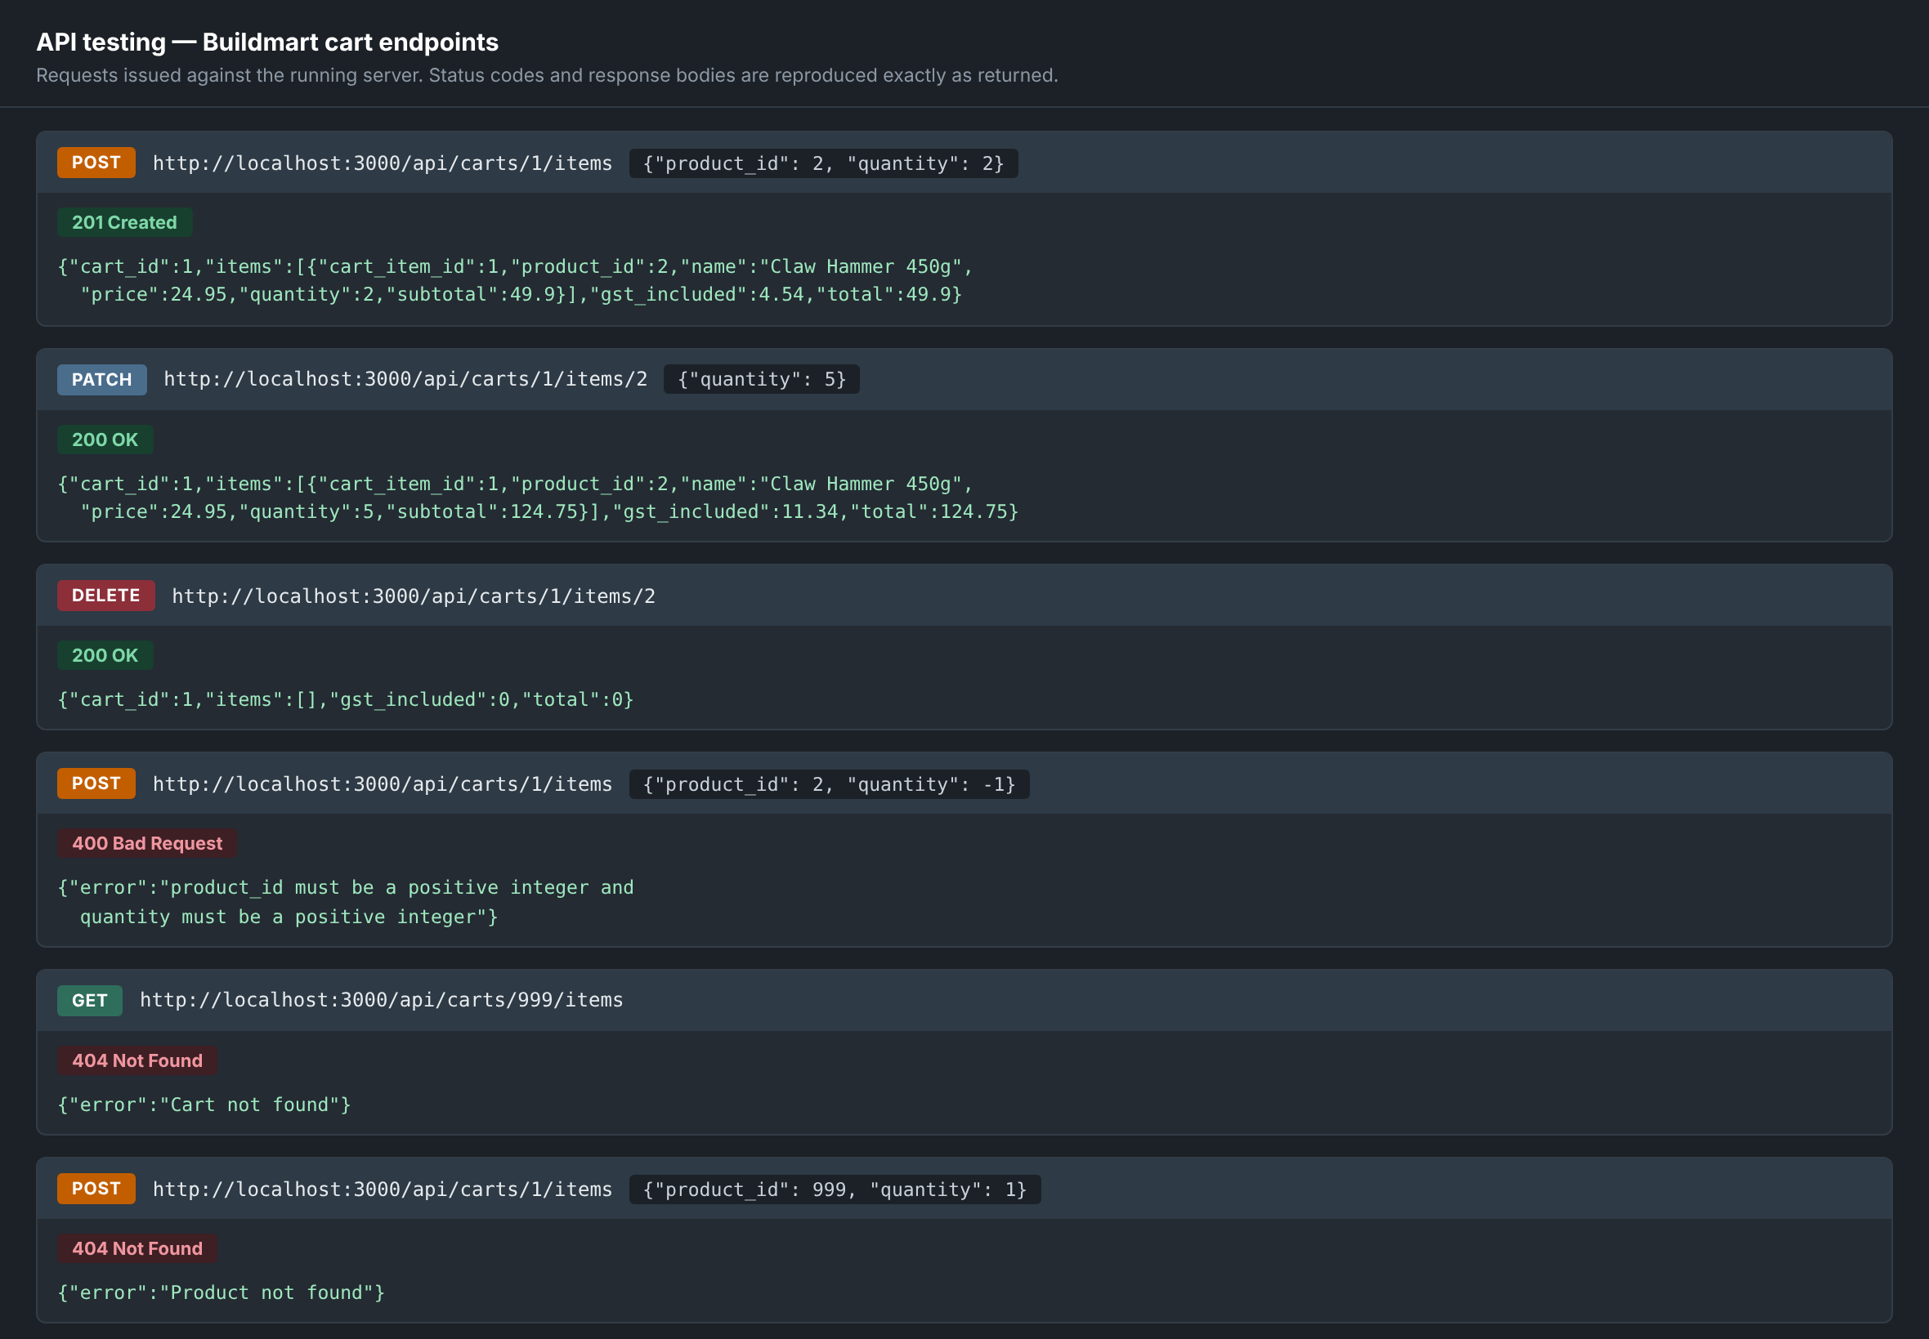
Backup — API testing evidence
Hold this slide for Q&A
Not part of the 15 minutes. Use it if a marker asks to see the API tested directly rather than through the page.
WHAT IT SHOWS
Create returns 201 with the new cart line
Update returns 200 with quantity 5 and total $124.75
Delete returns 200 with an empty cart
A negative quantity is refused with 400
An unknown cart and an unknown product both return 404
Why it matters
The page and the API were tested separately. A fault in either one shows up on its own rather than hiding behind the other.
Notes:
BACKUP SLIDE - do not present. Skip straight from Conclusion to questions. Bring this up only if asked how the API itself was tested, or for Q17. Every status code and body shown was returned by the running server.

