Slide 1
PSCS_647_District Integrated Dashboard
CSE7101- Capstone Project
Review-3
Batch Number : CSE_137
Under the Supervision of,
Dr. Saurabh Sarkar(ECE)
School of Computer Science and Engineering
Presidency University
Roll Number | Student Name
20221CSE0454 | Yanamala Jaswanth Reddy
20221CSE0506 | Amaregouda
20221CSE0451 | Purohith Satyanarayana
Name of the Program : CSE
Name of the HoD: Dr. Asif Mohammed
Name of the Program Project Coordinator: Dr. Jayavadivel Ravi
Name of the School Project Coordinators: Dr. Sampath A K , Dr. Geetha A

Slide 2
Problem Statement Number: PSCS_647
Organization: Presidency University
Category (Hardware / Software / Both) : Software(since web based Solution)
Problem Description:
“This project involves building an interactive and user-friendly dashboard that visualizes key performance indicators (KPIs) and real-time data to assist government or public sector officials in policy evaluation and management”.

Slide 3
Content
Abstract
Literature Survey
Objectives
Existing Methods and Drawbacks
Proposed Method & Feasibility Study
Modules
Hardware and Software Details
Timeline (Gantt Chart)
References

Slide 4
Abstract :
District-level data is often scattered across multiple government departments with little integration.
Our objective is to build a unified dashboard that integrates 10+ KPIs across health, education, agriculture, and infrastructure.
The dashboard supports real-time data updates, comparative analytics, and automatic reporting for decision support.
We use open-source technologies (React.js, Flask/Django, PostgreSQL, Pandas, Plotly) to ensure scalability and cost-efficiency.
The solution addresses the gap between city-level smart dashboards and fragmented district-level systems.

Slide 5
Literature Survey (Overview) :
Databases searched: IEEE Xplore, Scopus, Web of Science.
Keywords: government dashboard, e-governance analytics, real-time visualization, district data.
Reviewed 30+ papers, shortlisted 10 highly relevant works from 2011–2022.
Key themes:
Smart city dashboards for monitoring KPIs.
Visualization frameworks for decision support.
Real-time ETL pipelines and data integration.
Public portals and e-governance dashboards.
Observation: Most works are urban or sector-specific, rarely multi-sector at district level.
Gap Identified: Lack of comprehensive, integrated, scalable solutions for district-level governance.

Slide 6
Sl. No. | Paper (Year) | Problem Studied | Approach | Findings | Gap
1 | SoSE 2020 | Governance dashboards for smart cities | System-of-systems, Singapore | Multi-sector feasibility | City-scale only, no district KPIs
2 | IoT Journal 2020 | Automated smart city dashboards | Modular framework | Simplifies creation | Urban focus only
3 | IEEE TVCG 2019 | Dashboard definitions & design | Theoretical survey | Clear design guidelines | Conceptual only
4 | IEEE/Elsevier 2022 | Real-time visualization | Kafka + Grafana | Sub-second updates | IoT only
5 | IEEE Smart Cities 2021 | Indian smart cities open data | Case studies | Transparency improved | No district integration
6 | ICCIC 2017 | University KPI dashboard | Data unification | Better education tracking | Education only
7 | WICT 2013 | E-Gov portal architecture | Hybrid distributed | Interoperable services | No dashboards
8 | IJCSS 2011 | Smart city evaluations | Governance evaluation | Service metrics | Old, sector-specific
9 | MDPI/IEEE 2019 | Geospatial dashboards | Semantic + spatial | Improved KPI mapping | City-only
10 | ArXiv/IEEE 2021 | COVID-19 India dashboard | Real-time health KPIs | District feasibility | Health-only

Slide 7
Objectives :
Data Integration
Collect and unify data from 3+ official sources (APIs, CSVs, government databases).
Multi-Sector Coverage
Track 10+ Key Performance Indicators (KPIs) across health, education, agriculture, and infrastructure.
Automation
Enable automated data refresh every 24 hours to minimize manual intervention.
Visualization & Analytics
Provide interactive dashboards with filters, trends, and cross-sector comparative analysis.
Reporting
Auto-generate PDF/Excel reports in < 1 minute for district officers and stakeholders.
Accessibility & Usability
Role-based access (administrators, officers, public users) with responsive web UI for desktops and mobiles.
Scalability
Design a modular system that can be extended to multiple districts or scaled to state-level aggregation in the future.

Slide 8
Existing Methods & Drawbacks (Elaborated) :
UP CM DARPAN Dashboard (State-level)
Description: A centralized platform by the Government of Uttar Pradesh for state-level performance monitoring across departments (health, education, agriculture, infrastructure).
Strengths:
Wide coverage of departments.
Ranking-based evaluation of districts.
Provides historical comparisons and trend analysis.
Drawbacks:
Macro-level only – does not provide granular district KPIs.
Focused on rankings rather than actionable insights.
No sector-to-sector correlation (e.g., how education outcomes influence health).

Slide 9
2. Kalaburagi COVID Dashboard (District-level) :
Description: Developed during the pandemic to monitor real-time COVID-19 statistics in Kalaburagi district (Karnataka).
Strengths:
District-focused.
Real-time case counts, recoveries, vaccination tracking.
Public-friendly with open access.
Drawbacks:
Single-sector only (Health) – no integration with other district functions.
Static design, built only for pandemic monitoring.
No comparative analytics (time trends beyond health, or multi-sector view).

Slide 10
Proposed Method :
Data Integration (ETL): APIs, CSVs, DBs consolidated in ETL pipelines.
Data Storage: PostgreSQL schema optimized for time-series KPIs.
Processing: Python (Pandas/NumPy) for aggregations, anomaly detection, trend analysis.
Visualization: React.js + Plotly for dynamic charts, filters, geospatial mapping.
Reporting: PDF/Excel export with charts in under 1 minute.
Security: Role-based access (public vs. admin).
Scalability: Modular → add more KPIs, sectors, or expand to state-level.

Slide 11
Feasibility Study :
Technical Feasibility:
Stack: React.js, Flask/Django, PostgreSQL, Pandas.
Proven frameworks for real-time dashboards.
Operational Feasibility:
Automated refresh ensures no dependency on manual updates.
Easy adoption by district officers (export-ready).
Economic Feasibility:
Open-source, zero licensing costs.
Low deployment cost (cloud or local servers).
Resource Feasibility:
4-member team split into data, backend, frontend, visualization.
Clear division of tasks → predictable delivery.
Scalability Feasibility:
Future-ready for GIS mapping, real-time IoT integration (Kafka).

Slide 12
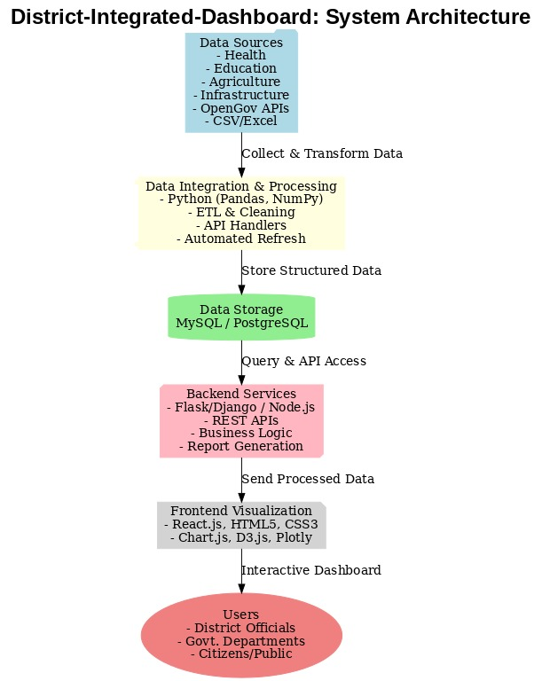
Architecture Diagram & Explanation :
Flow: Data → ETL → Database → Analytics → Backend → Frontend → End Users.
(ASCII diagram as earlier, but for PPT we’ll use the colored PNG version).
ETL Layer: Cleans, validates, and merges diverse inputs.
Database: Stores KPIs with metadata for fast retrieval.
Analytics: Trends, anomalies, sector comparisons.
Backend API: Provides secure endpoints + generates reports.
Frontend: Interactive charts, filters, exports.
End Users: Officers, Dept Heads, Citizens – role-based.

Slide 13
Modules :
Data Collection & Gathering – APIs, CSV, DB feeds.
Data Cleaning & Validation – Missing data, duplicates, errors handled.
Data Processing & Transformation – Aggregations, anomalies, correlation analysis.
Data Storage – Structured schema in PostgreSQL/MySQL.
Visualization Module – React.js interface, charts, filters, comparisons.
Reporting Module – Generate PDF/Excel dashboards on-demand.
Monitoring & Security – Backups, access control, HTTPS, JWT, CI/CD.

Slide 14
Technology Stack(Hardware and Software Details) :
Layer | Technology | Purpose | Why Chosen | Role in Project
Frontend | React.js | Interactive UI | Fast, modular | User dashboards
Charts | Chart.js / Plotly | KPI visualization | Real-time updates | Time-series & geospatial
Backend | Flask/Django / Node.js | APIs & business logic | Lightweight & flexible | API endpoints, reporting
Database | PostgreSQL / MySQL | Structured KPI storage | Reliable & scalable | Central data repository
Analytics | Pandas / NumPy | Data processing | Handles large datasets | Trend & anomaly detection
Scheduler | Cron / Celery | Auto-refresh every 24h | Simple & reliable | Automated ETL pipelines

Slide 15
Timeline of the Project (Gantt Chart)
August 2025: Requirement gathering and design.
September 2025: Literature Survey, Methods & Proposed Architecture
October 2025: Frontend development and visualization.
November 2025: Testing and deployment.
December 2025: Final documentation and review.

Slide 16
Academic References (IEEE/Scopus/Web of Science) :
[1] A. P. Dameri, “Towards a Governance Dashboard for Smart Cities Initiatives: A System of Systems Approach,” IEEE Systems of Systems Engineering (SoSE), 2020.
[2] J. D. Velázquez et al., “Cities-board: A Framework to Automate the Development of Smart Cities Dashboards,” IEEE Internet of Things Journal, vol. 7, no. 9, pp. 8793–8805, 2020.
[3] C. Few and S. Edge, “What Do We Talk About When We Talk About Dashboards?,” IEEE Transactions on Visualization and Computer Graphics, vol. 25, no. 1, pp. 479–489, Jan. 2019.
[4] H. L. Truong et al., “Real-Time Data Visualization Frameworks for Smart City Applications,” Elsevier Future Generation Computer Systems, vol. 125, pp. 432–446, 2022.
[5] P. K. Paul et al., “Exploring Open Data Journey of Indian Smart Cities,” IEEE Smart Cities Newsletter, 2021.
[6] A. R. Pradana et al., “Design of KPI Dashboard for Indonesian Higher Education,” in Proc. IEEE Int. Conf. on Computing, Communication and Informatics (ICCIC), 2017, pp. 1–6.
[7] D. Misra and S. Sarkar, “A Hybrid and Distributed Architecture for an Interoperable E-Government Portal,” in Proc. IEEE WICT, 2013, pp. 58–63.

Slide 17
[8] C. K. Hsu, “Governance to Service—Smart City Evaluations in Taiwan,” Int. J. of Computer Science Studies (IJCSS), vol. 3, no. 4, pp. 56–64, 2011.
[9] R. Mora et al., “Geospatial Dashboards for Monitoring Smart City Performance,” IEEE/MDPI Sensors, vol. 19, no. 23, p. 5185, Dec. 2019.
[10] S. Ray et al., “Interactive Dashboard for COVID-19 Monitoring in India,” IEEE Access, vol. 9, pp. 125478–125490, 2021.
[11] National Health Mission (NHM) – HMIS Portal, Govt. of India. [Online]. Available: https://hmis.nhp.gov.in
[12] Unified District Information System for Education (UDISE+) – Govt. of India. [Online]. Available: https://udiseplus.gov.in
[13] Open Government Data (OGD) Platform India – Govt. of India. [Online]. Available: https://data.gov.in
[14] National Crime Records Bureau (NCRB) – Govt. of India. [Online]. Available: https://ncrb.gov.in
[15] Census of India – Office of the Registrar General & Census Commissioner. [Online]. Available: https://censusindia.gov.in
[16] The World Bank – World Development Indicators. [Online]. Available: https://data.worldbank.org
[17] NITI Aayog – Aspirational Districts Dashboard. [Online]. Available: https://dashboard.niti.gov.in
[18] S. Kumar et al., “Smart City Performance Indicators,” in Proc. IEEE Int. Smart Cities Conf. (ISC2), 2019, pp. 293–298.

Slide 18
Github Link
The Github link provided should have public access permission.
Github Link
https://github.com/CapstoneCSE137/District-Integrated-Dashboard.git

Slide 19


