Slide 1
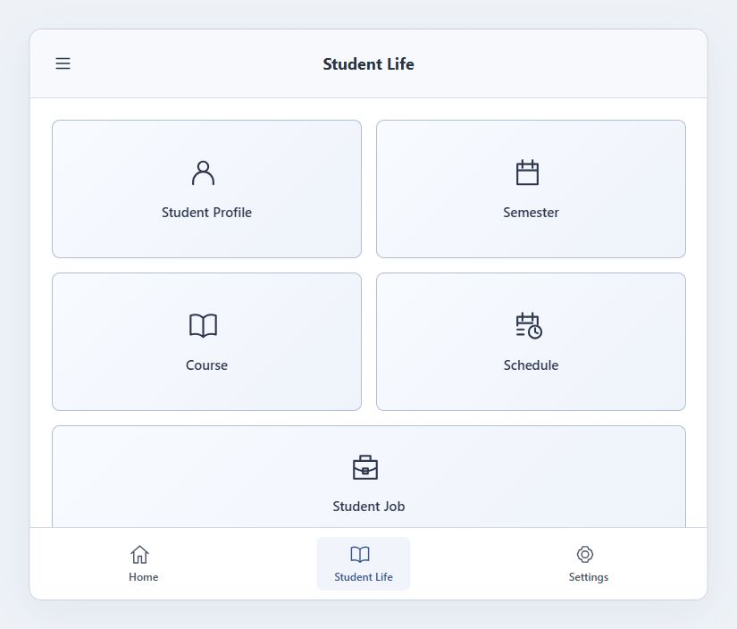
TEAM 1 · ULSAN COLLEGE · MIDTERM
StudentHub
Academic information
and job opportunities
in one place
For students who plan their week
and administrators who organise it.
Open StudentHub
Member 1 · 0:30
01
Notes:
Good morning. We are Team 1, and our project is StudentHub, a student-life platform for Ulsan College. Students need an easy way to check courses and weekly schedules while finding job opportunities that fit their study time. Administrators need connected tools to organise academic information. StudentHub brings these needs together on laptops and phones.
Evidence / sources:
https://github.com/CapstoneDesign-Fall2026-UlsanCollege/Team1/blob/main/classroom/week7/design-doc-v1.md
https://github.com/CapstoneDesign-Fall2026-UlsanCollege/Team1/blob/main/classroom/student_ss/01-student-life.jpg

Slide 2
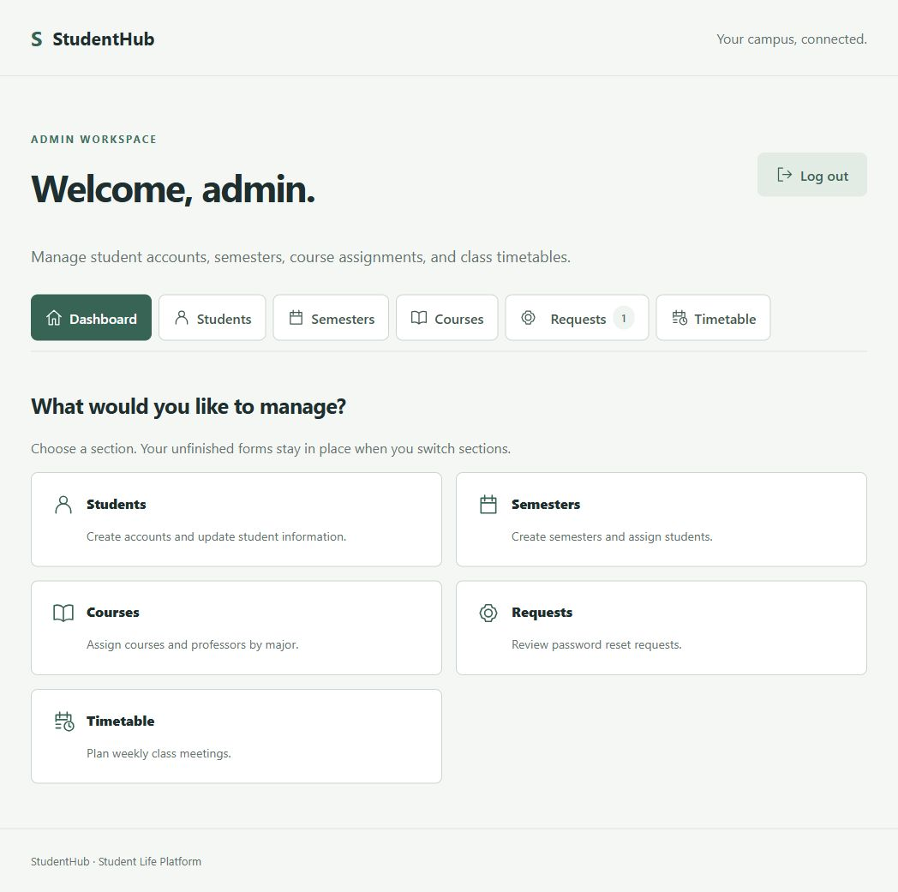
SCOPE
The current application
Students
Profiles, courses and timetable
Job search and favourites
Administrators
Accounts and semester assignments
Courses, professors and class meetings
View project scope
Member 1 · 0:20
02
Notes:
Our current version connects student accounts, semesters, courses, timetables and job search. Administrators manage the underlying information. Today we will demonstrate one student journey: checking the timetable, finding a job and saving it for later.
Evidence / sources:
https://github.com/CapstoneDesign-Fall2026-UlsanCollege/Team1/blob/main/classroom/week7/design-doc-v1.md
https://github.com/CapstoneDesign-Fall2026-UlsanCollege/Team1/blob/main/classroom/admin_ss/01-dashboard.jpg

Slide 3
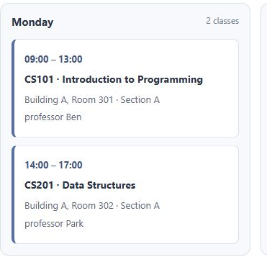
ONE STUDENT PATH
1. Check the weekly timetable
The student’s assigned
classes for the week
Course, day and time
Room and professor
Monday timetable excerpt
Live demo: Student Life → Schedule
View full timetable
Member 2 · 0:25
03
Notes:
[Open the prepared student account and select Schedule.] First, the student checks their weekly timetable. It shows course names, class days, times and locations together. The classes match the student’s assigned semester and major. This provides the study schedule before the student looks for work.
Evidence / sources:
https://github.com/CapstoneDesign-Fall2026-UlsanCollege/Team1/blob/main/classroom/student_ss/05-timetable.jpg
https://github.com/CapstoneDesign-Fall2026-UlsanCollege/Team1/issues/40

Slide 4
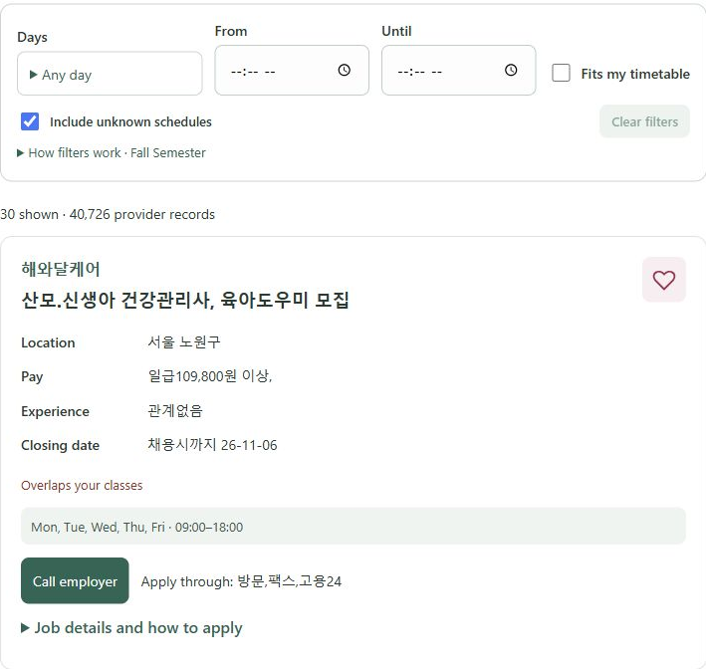
ONE STUDENT PATH
2. Find work around classes
Seoul Open Data
recruitment listings
Search title, company or location
Choose available days and hours
Compare known shifts with classes
View job-search screen
Member 2 · 0:35
04
Notes:
[Open Student Job. Use a prepared keyword if it has already been checked before the presentation.] Our listings come from Seoul Open Data. Students search by company, job title or location, then narrow results using available days and hours. Fits my timetable compares known working schedules with saved classes. The controls are compact so they take less space on phones. [Point to the filters and a result; avoid spending the demo waiting for a fresh catalogue download.]
Evidence / sources:
https://github.com/CapstoneDesign-Fall2026-UlsanCollege/Team1/issues/47
https://github.com/CapstoneDesign-Fall2026-UlsanCollege/Team1/blob/main/classroom/student_ss/06-job-search.jpg
https://github.com/CapstoneDesign-Fall2026-UlsanCollege/Team1/blob/main/docs/job-finder.md

Slide 5
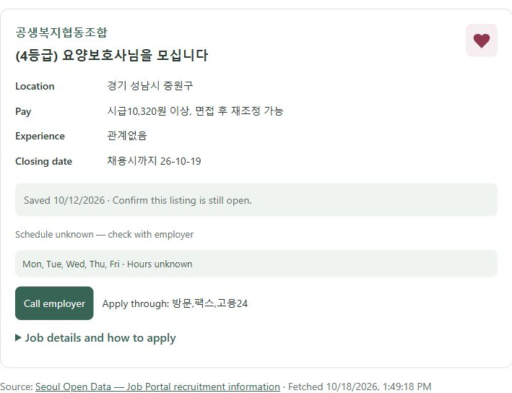
ONE STUDENT PATH
3. Save a job for later
Heart → Favourites
Keep the listing’s details
and return to them later
Employer contact and
application instructions
View saved jobs
Member 2 · 0:30
05
Notes:
[Use a prepared listing. Select the heart if needed, then open Favourites.] The saved job is available here for the student to revisit. The listing shows employer contact information and application instructions when supplied. StudentHub supports the search and saving workflow; it does not submit applications. [For a screenshot-only presentation, describe the existing saved listing without claiming that the screenshot itself proves a new save.]
Evidence / sources:
https://github.com/CapstoneDesign-Fall2026-UlsanCollege/Team1/issues/48
https://github.com/CapstoneDesign-Fall2026-UlsanCollege/Team1/blob/main/classroom/student_ss/07-favourites.jpg

Slide 6
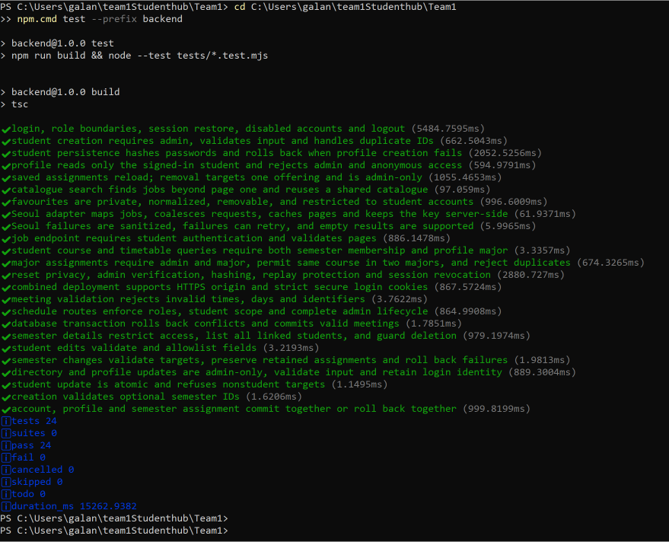
VERIFICATION
Evidence and one limitation
24 passed
0 failed
Backend test result
Screenshot linked in the test report
Limit: unclear employer hours need
confirmation; travel time is excluded.
Open test report
Member 3 · 0:30
06
Notes:
Our evidence is in GitHub through implementation commits, test files and screenshots. With coding assistance, the recorded backend run passed all 24 tests, and the frontend build passed. Galan also reported the live semester-deletion and cross-device favourites checks passed, recorded in issues 52 and 53. One limitation is employer information: unclear working hours cannot establish a confirmed timetable fit, and travel time is not included.
Evidence / sources:
https://github.com/CapstoneDesign-Fall2026-UlsanCollege/Team1/blob/main/classroom/testing/test-report.md
https://github.com/CapstoneDesign-Fall2026-UlsanCollege/Team1/blob/main/classroom/testing/test_result.png
https://github.com/CapstoneDesign-Fall2026-UlsanCollege/Team1/issues/52
https://github.com/CapstoneDesign-Fall2026-UlsanCollege/Team1/issues/53

Slide 7
TEAM EVIDENCE
Every member’s contribution
Galan Bishal
Implementation and integration; job-search usability; semester details
Bal Raju
Ansh Sharma
Buddha Raj Giri
View contribution evidence
All four members · 1:15
07
Notes:
Each member speaks for about 18 seconds.
Galan: My name is Galan Bishal. I improved the job-search interface and added semester details connecting students, courses and timetables, with coding assistance. My evidence is our implementation commits. These changes reduce searching and unnecessary steps.
Bal Raju:
Ansh Sharma:
Buddha Raj Giri:
Evidence / sources:
https://github.com/CapstoneDesign-Fall2026-UlsanCollege/Team1/blob/main/classroom/week7/individual-evidence-receipt.md

Slide 8
PLANNED AFTER MIDTERM
Campus Eat: the campus canteen
Today’s menu and prices
Opening hours and canteen location
Available and sold-out items
First action: confirm who updates the canteen menu.
Member 4 · 0:20
08
Notes:
Campus Eat will focus on our campus canteen. Students will see the menu, prices, opening hours and item availability. Our first step is to agree with the canteen on who supplies and updates this information. This phase covers canteen information. Ordering and payment are outside the first version.
Evidence / sources:

Slide 9
PLANNED AFTER MIDTERM
Room Finder: available classrooms
For administrators planning classes
Choose a day and time range
Check recorded class conflicts across majors
First action: confirm the classroom inventory and room IDs.
Member 4 · 0:20
09
Notes:
Room Finder will help administrators find classrooms available at a selected time by checking recorded classes across majors. We will first confirm the room inventory and consistent room identifiers. This planned version will show availability from schedules. It will not detect live occupancy or book rooms. Thank you.
Evidence / sources:

Slide 10
REFERENCE LINKS
Live demo and evidence links
Open StudentHub
Repository
Test report
Weekly report
Implementation commits
Design document
Optional during questions · Outside the timed talk
10
Notes:
Use this reference slide when the audience asks to see the application or evidence. Open StudentHub uses the currently signed-in account. Keep a prepared demo account ready. Blue underlined labels are clickable external links. In PowerPoint editing view, use Ctrl+click. In slideshow view, click normally.
Evidence / sources:
https://team1-production.up.railway.app/
https://github.com/CapstoneDesign-Fall2026-UlsanCollege/Team1
https://github.com/CapstoneDesign-Fall2026-UlsanCollege/Team1/blob/main/classroom/testing/test-report.md
https://github.com/CapstoneDesign-Fall2026-UlsanCollege/Team1/blob/main/classroom/week7/weekly-report.md
https://github.com/CapstoneDesign-Fall2026-UlsanCollege/Team1/commits/main/
https://github.com/CapstoneDesign-Fall2026-UlsanCollege/Team1/blob/main/classroom/week7/design-doc-v1.md

Slide 11
SUPPORTING EVIDENCE
Administrator workflow
Accounts and semester assignments
Courses and class meetings
Password reset requests
View administrator screenshots
Optional during questions · Outside the timed talk
11
Notes:
This supporting slide covers the administrator side if asked. Use the screenshot folder to show the relevant saved screen. Password delivery remains a private manual step after identity verification.
Evidence / sources:
https://github.com/CapstoneDesign-Fall2026-UlsanCollege/Team1/tree/main/classroom/admin_ss

