Slide 1
SMARTSERVE
SMART-SERVE
POS SYSTEM
SMARTSERVE
Team 3
Lama Muskan(2412063)
Hyolmo sherap choephel (2412050)
Majhi sujita(2412054)
Ualson tamang
Shreya rai
LIVE SITE
Github link
Notes:
Source: user-supplied project description in this chat, October 21, 2026. Visual reference: D:/Downloads/Presentation 5.pdf. Adapted terracotta, sage, cream, serif headings, and repeated background typography.

Slide 2
SMART-SERVE BACKGROUND
Manual order and billing errors
Difficulty tracking ingredient stock
Recording orders and calculating bills manually can lead to mistakes.
Café staff may not know how much stock remains after each sale.
Unclear daily sales records
Disconnected café operations
Café owners struggle to track completed orders and daily revenue.
Managing orders, payments, and inventory separately creates extra work and inconsistent records.
SmartServe POS
02
Notes:
Source: user-supplied project description in this chat, October 21, 2026. The final item combines duplicate inventory deductions, inconsistent records, and difficulty monitoring menu and ingredient availability.

Slide 3
INTENDED USERS
01
02
03
CAFÉ OWNERS
CASHIERS
CAFÉ STAFF
Monitor sales
Manage menu Items
Check ingredient stock.
Take customer orders
Calculate totals price
Process payments.
Track ingredient usage
Check available stock during service.
SmartServe POS
03
Notes:
Source: user-supplied project description in this chat, October 21, 2026.

Slide 4
SMART-SERVE GOAL
One connected café workflow
Simplify café operations with one system for orders, payments, and inventory.
Reduce billing errors through automatic order calculations.
Track every ingredient by updating stock after each successful sale.
Give owners a clear daily overview of sales, orders, and available stock.
Our goal is to help small business owners to complete each sales with accurate billing, automatic ingredient tracking, and clear daily sales records in one simple POS system.
SmartServe POS
04
Notes:
Source: user-supplied project description in this chat, October 21, 2026.

Slide 5
CURRENT BEHAVIOUR
Ordering and checkout
Inventory and owner tools
Create and manage customer orders
Add menu items and quantities
Calculate order totals
Simulate cash, card, and QR payments
Generate and display receipts
Deduct recipe ingredients after payment
Manage ingredients and stock quantities
Manage menu items
Show daily sales and order information
on the owner dashboard
SmartServe POS
05
Notes:
Source: user-supplied project description in this chat, October 21, 2026. This slide defines MVP scope. All listed payment methods are simulated, including QR. It does not claim that every scoped capability has completed verification.

Slide 6
SMART-SERVE WORKFLOW
01
02
03
Configure
Create order
Review total
Set menu items, recipes,
and ingredient stock.
Select menu items
and quantities.
Calculate the total
and check available stock.
04
05
06
Simulate payment
Complete sale
Review records
Confirm cash, card,
or QR payment.
Display a receipt and deduct
recipe ingredients once.
Check order information,
stock, and daily sales.
SmartServe POS
06
Notes:
Source: user-supplied project description in this chat, October 21, 2026. Additional workflow source: docs/week-02/design-doc-v1.md. Failed payment or insufficient stock must not trigger inventory deduction.

Slide 7
SYSTEM TECHNOLOGY
FRONTEND
BACKEND
DATABASE
React
TypeScript
Python + FastAPI
PostgreSQL
SmartServe POS
07
Notes:
Sources: docs/week-05/Project-architecture.md and docs/week-02/design-doc-v1.md. Stack and architecture from project documentation. Current isolated automated tests use SQLite and do not establish PostgreSQL verification.

Slide 8
Lama Muskan (@Sammygit15)
Researched accurate order-total calculations.
Recommended preserving original prices in orders.
Prepared project reports, checklists, and the demo script.
Research proof
Evidence
Contribution
SmartServe POS
08
Notes:
Source: user-supplied project description in this chat, October 21, 2026.

Slide 9
Ualson Tamang (@ualsom)
Compared ways to display unavailable menu items.
Created sketches and recommended an “Out of Stock” label.
Reported ingredient-unit editing problems with screenshots.
Contribution
ISSUE CREATED
SmartServe POS
09
Notes:
Source: user-supplied project description in this chat, October 21, 2026. This slide defines MVP scope. All listed payment methods are simulated, including QR. It does not claim that every scoped capability has completed verification.

Slide 10
SHREYA RAI (@shrey776)
Investigated when ingredient stock should be checked.
Reviewed a two-order scenario with insufficient stock.
Compared cashier prototypes and supported the product grid.
PROTOTYPE REVIEW
ISSUE
SmartServe POS
10
Notes:
Source: user-supplied project description in this chat, October 21, 2026. This slide defines MVP scope. All listed payment methods are simulated, including QR. It does not claim that every scoped capability has completed verification.

Slide 11
Shuzita Majhi (@Shuzita)
Created two cashier-screen prototypes.
Compared product-grid and searchable-list layouts.
Recommended the product grid for the café menu.
ISSUE
CONTRIBUTION
SmartServe POS
11
Notes:
Source: user-supplied project description in this chat, October 21, 2026. This slide defines MVP scope. All listed payment methods are simulated, including QR. It does not claim that every scoped capability has completed verification.

Slide 12
Sherap Hyolmo (@daydevil80)
Added menu and ingredient editing.
Fixed stock calculation and receipt errors.
Tested the fixes and recorded the results.
ISSUE
CONTRIBUTION
SmartServe POS
12
Notes:
Source: user-supplied project description in this chat, October 21, 2026.

Slide 13
FUTURE OF SMART-SERVE
Real payment gateways
Supplier and purchase orders
Payments remain simulated.
Procurement workflows are excluded.
Production deployment and hosting
Multiple café branches
The MVP focuses on the project demo.
The scope covers a single café.
Enforced login and role access
Advanced accounting
Full authentication and permissions are excluded.
Detailed financial reporting is excluded.
SmartServe POS
13
Notes:
Source: user-supplied project description in this chat, October 21, 2026.

Slide 14
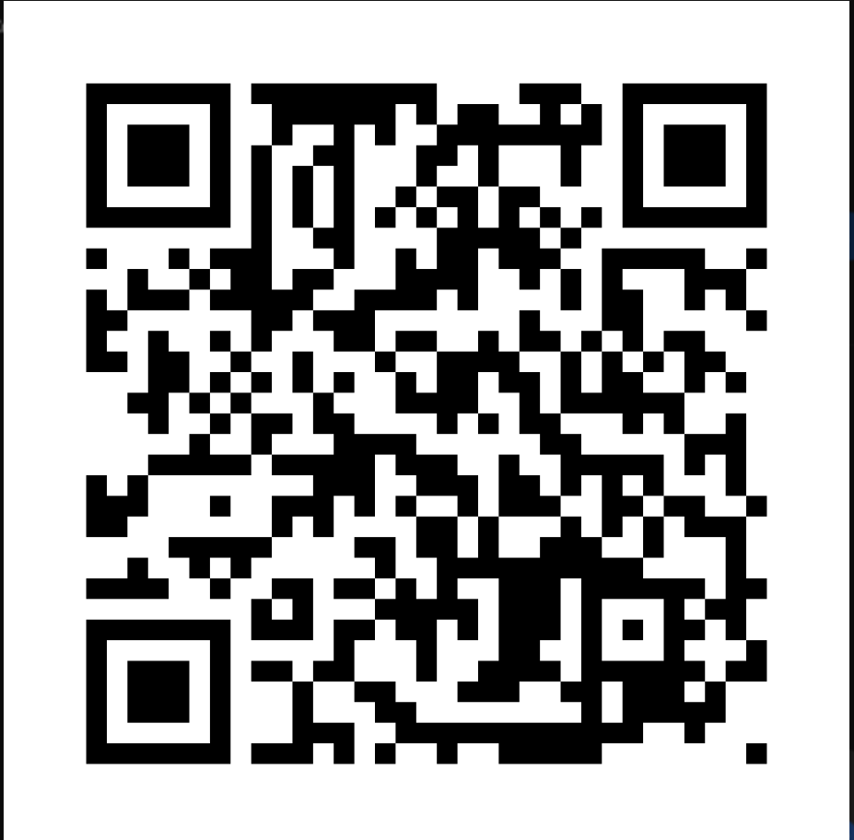
USERNAME:-
Admin
PASSWORD:-
1234$

Slide 15

THANK YOU
THANK YOU
THANK YOU
Notes:
Source: user-supplied project description in this chat, October 21, 2026. Visual reference: D:/Downloads/Presentation 5.pdf. Adapted terracotta, sage, cream, serif headings, and repeated background typography.

