Slide 1
BrewMellow.
CAPSTONE DESIGN MIDTERM · TEAM -2
Nepali specialty coffee, roasted to order and delivered fresh
github Link : https://github.com/CapstoneDesign-Fall2026-UlsanCollege/team_2_capstone_design
Live Demo : https://team-2-capstone-design-one.vercel.app
Aanchal Chand Thakuri
Aditya Kumar Gupta
Kushan Sunuwar
Rohit Chhantyal
@jaasly07
@notyouradhee
@Kushan2191
@Rohit-coder201

Slide 2
The User & The Specialty Coffee Problem
THE TARGET USER
THE REAL PROBLEM
Specialty coffee enthusiasts and home-brewers
Zero transparency in retail
Kathmandu supermarket coffee is stale, dark-roasted commercial blend with no harvest altitude, processing method or roast date.
In Nepal and the diaspora.
They seek single-origin Himalayan beans with distinct elevations and processing methods (Washed, Natural, Honey) for manual brewing: V60, Aeropress, French Press.
Inaccessible micro-lots
Premium beans from Gulmi, Ilam and Nuwakot are mostly exported. Locals have no direct platform for fresh roast-to-order subscriptions.
Aanchal Chand Thakuri · @jaasly07
1/8

Slide 3
Scope of this Demo & Full-Stack Architecture
TECHNICAL ARCHITECTURE
TRANSPARENT SCOPE BOUNDARY
Frontend
What is verified
Next.js 16 (React 19) + Tailwind CSS, live on Vercel over HTTPS.
End-to-end flow from browsing origins to checkout state sync, database records, customer dashboard and roastery backoffice.
Backend API
Django 5.1 REST Framework for orders and data models.
What is simulated
Database
Payment is flagged is_fake_payment=True. No real cards or Khalti balances are charged; real orders are still saved and tracked.
Serverless PostgreSQL cluster on Neon.
Aditya Kumar Gupta · @notyouradhee
2/8

Slide 4
Live Walkthrough: The Verified Vertical Slice
Live: team-2-capstone-design-one.vercel.app/origins
1 · /ORIGINS
2 · /CHECKOUT
3 · POST /API/ORDERS/
4 · /DASHBOARD · /ADMIN
Regional origins
State synchronization
Payment & order record
Post-purchase hubs
3 micro-lots: Gulmi Reserve (1,600m), Ilam Gold (1,800m), Nuwakot Heritage (1,400m).
Gulmi Reserve passes parameters in the URL query string; total Rs. 1,200 recalculates with no state loss.
Writes an order row to PostgreSQL and opens the 2.0s simulated confirmation modal.
4-stage tracking (Confirmed → Roasting → Dispatched → Delivered); admin shows Rs. 22,150 revenue and roasting queues.
Aditya Kumar Gupta · @notyouradhee
3/8

Slide 5
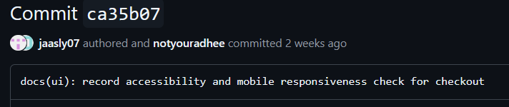
Individual Contribution: Aanchal Chand Thakuri (@jaasly07)
CONCRETE CONTRIBUTIONS
GITHUB EVIDENCE & PROOF
Formulated the target user persona and the specialty coffee retail transparency problem.
Commit ca35b07:docs(ui): record accessibility and mobile responsiveness check for checkout”
Test record: docs/week-06/accessibility-and-mobile-check.md
Audited the vertical slice at a 390px mobile viewport against WCAG 2.1 AA.
Receipt: docs/week-07/receipts/receipt-aanchal.md
Verified all CTA buttons give a 52px thumb target (py-3 px-6).
Aanchal Chand Thakuri · Frontend & Accessibility Auditor
Individual Contribution ·4 /8

Slide 6

Individual Contribution: Aditya Kumar Gupta (@notyouradhee)
CONCRETE CONTRIBUTIONS
GITHUB EVIDENCE & PROOF
Architected the full-stack vertical slice: Next.js 16, Django REST Framework, Neon PostgreSQL.
Issue: #43 “Feature: Coffee Origin Selection Page”
Pull request: #44 “feat: origin selection flow with query-param checkout integration”
Built /origins to /checkout state sync via URL parameters, preventing loss on reload.
Commit: 30081cc “connect origin selection to checkout state”
Receipt: docs/week-07/receipts/receipt-aditya.md
Deployed the production app on Vercel over HTTPS.
Built the customer dashboard, admin console and the simulated payment boundary (is_fake_payment=True).
Aditya Kumar Gupta · Project Lead & Full-Stack
Individual Contribution · 5/8

Slide 7
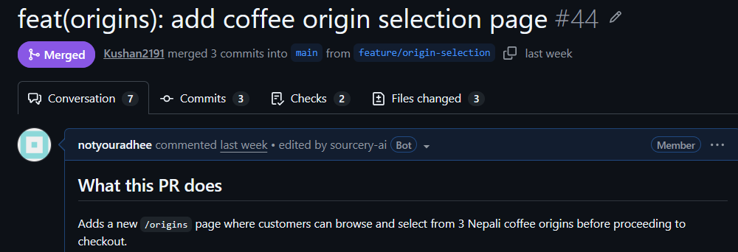
Individual Contribution: Kushan Sunuwar (@Kushan2191)
CONCRETE CONTRIBUTIONS
GITHUB EVIDENCE & PROOF
Merge commit: 9d45f95 “Merge pull request #44 from CapstoneDesign-Fall2026-UlsanCollege/feature/origin-selection”
Ran an independent clean-clone test on separate hardware, with no author coaching.
Test note: docs/week-06/tested-by-note.md
Reviewed PR #44, verified parameter behavior and merged it (merge commit 9d45f95).
Edge case commit: f69700e “add defensive empty cart fallback”
Receipt: docs/week-07/receipts/receipt-kushan.md
Tested the empty-cart edge case: opening /checkout with no parameters shows a “Your Cart is Empty” card with a “Build Your Plan” button instead of crashing.
Kushan Sunuwar · QA Lead & Code Reviewer
Individual Contribution · 6/8

Slide 8
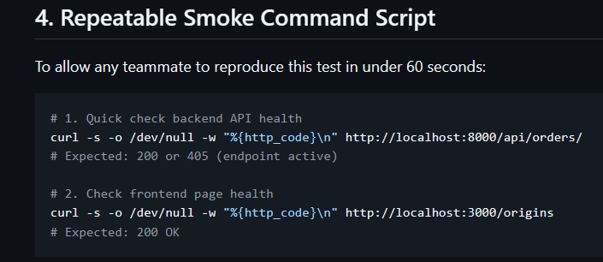
Individual Contribution: Rohit Chhantyal (@Rohit-coder201)
CONCRETE CONTRIBUTIONS
GITHUB EVIDENCE & PROOF
Outage test record: docs/week-06/api-smoke-test-record.md
Ran backend outage testing: stopped the Django server and verified the frontend handles the dropped connection with an explicit alert.
README section: README.md#smoke-testing
Quality checks: docs/week-07/sprint-1-quality-quick-checks.md
Receipt: docs/week-07/receipts/receipt-rohit.md
Wrote repeatable curl smoke-test commands in the README for continuous health checks.
Completed Sprint 1 Quality Quick Checks confirming zero secrets and safe demo data.
Rohit Chhantyal · DevOps & Resilience Lead
Individual Contribution 7/8

Slide 9
Next Steps & Sprint 2 Post-Midterm Roadmap
WHAT REMAINS INCOMPLETE TODAY
SPRINT 2 ACTION PLAN
Simulated payment gateway
1. Khalti Sandbox SDK: replace the simulated modal with real test wallet credentials (NPR).
Checkout uses the mock flag is_fake_payment=True; real Khalti wallet sandbox deduction is pending.
2. Transactional email: automate confirmation and courier tracking emails on order placement.
Automated transactional emails
3. Roastery operations portal: expand backoffice fulfillment status workflows.
Orders are saved to PostgreSQL; automated dispatch emails via SMTP are in progress.
Thank you, Professor and classmates. We welcome any questions!
Aditya Kumar Gupta · @notyouradhee
8/8

