Slide 1
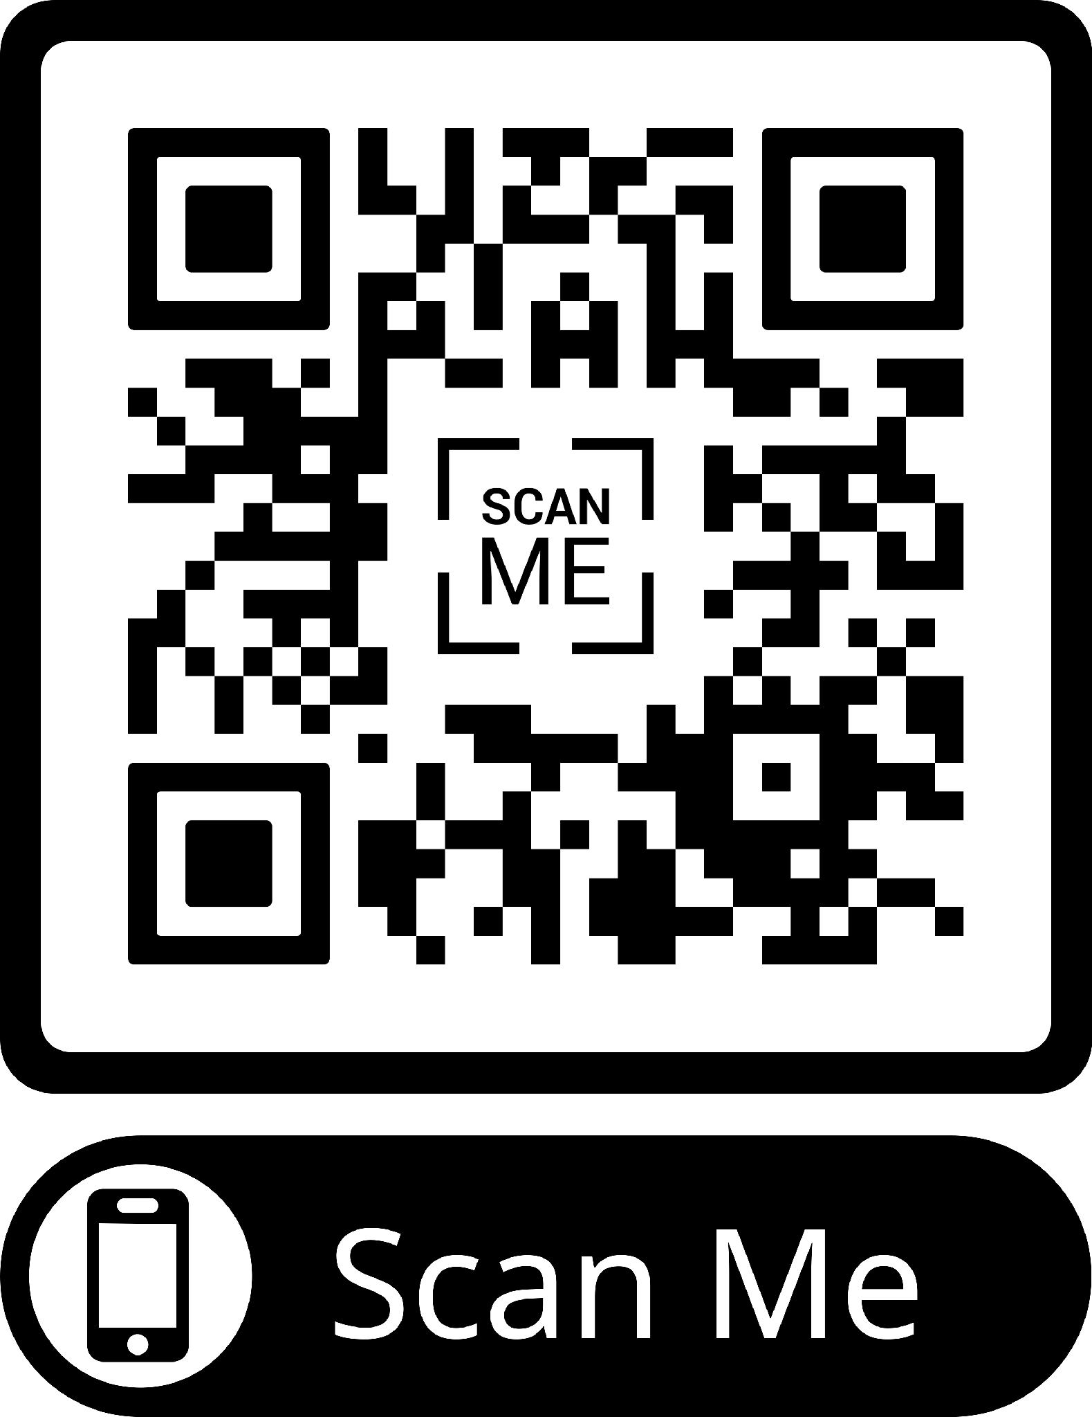
FINAL PORTFOLIO PRESENTATION
CampusMarketplace
MVP
Signup, login, browse, create, manage
Evidence
Portfolio + sprint packets + repo history
A campus-only marketplace for verified Ulsan College students to buy, sell, and manage second-hand items.
Defense
Architecture, QA, AI ownership, limits
React + Vite
Flask API
MongoDB
GitHub Pages + Render-ready
Team: Gayatri K. Bhandari, Aayuska Rai, Sudarshan Rai, Sagar Sob, Ananda Tamang
Scan to open the live demo
CampusMarketplace final portfolio | Spring 2026
01

Slide 2
PROBLEM
Campus trading is local, but the tools are not.
Students need affordable books, electronics, furniture, and dorm supplies. Public marketplaces are too broad; group chats are hard to search and trust.
Trust gap
Discovery gap
Campus fit gap
Generic marketplaces expose students to strangers, scams, and irrelevant sellers.
Listings disappear inside chats and scattered posts instead of one searchable place.
Students need pickup, seller context, and categories that match semester life.
CampusMarketplace final portfolio | Spring 2026
02

Slide 3
FINAL MVP FLOW
The core loop: verify, browse, list, manage.
1
2
3
4
5
Campus signup
JWT login
Browse/search
Create listing
Manage trust
@office.uc.ac.kr email + password validation
Authenticated access to protected flows
Active listings, categories, item detail
Title, price, category, status, images
Profile, favorites, reviews, messages
The final MVP intentionally avoids payment, shipping, native mobile apps, and admin moderation so the campus marketplace loop stays explainable and demoable.
CampusMarketplace final portfolio | Spring 2026
03

Slide 4
PRODUCT SURFACE
What the final product can show.
Identity
Marketplace
Trust layer
Campus email signup
Browse listings
Favorites
OTP endpoints
Search/category
Public profiles
Login + JWT
Item detail
Seller reviews
Profile/avatar
Create/update item
Messaging endpoints
Evidence: frontend routes, Flask endpoints, README setup notes, Week 11 verification, and Week 13 feature-completion packet.
CampusMarketplace final portfolio | Spring 2026
04

Slide 5
ARCHITECTURE
A small full-stack system with clear service boundaries.
MongoDB
users/items/messages/reviews
React + Vite Frontend
GitHub Pages
Flask API
app.py
Student Browser
SendGrid / SMTP
OTP email
Cloudinary / local
image storage
Auth: JWT + password hashing + OTP verification flow. Data model: users, email verification records, items, images, favorites, threads, messages, seller reviews.
CampusMarketplace final portfolio | Spring 2026
05

Slide 6
SEMESTER JOURNEY
The project narrowed from idea to verified MVP.
Weeks 1-3
Weeks 6-8
Weeks 9-11
Weeks 12-13
Weeks 14-16
Pitch, agreement, stories, wireframes, architecture
Vite frontend, backend setup, GitHub Pages, midterm story
MVP verification: auth, verification gate, item APIs
Listings UI, search, dashboard, images, profiles, reviews
Final polish: messages, dark mode, readability, portfolio
Historical integrity: missing or template-only weekly evidence is called out directly in the portfolio instead of being invented after the fact.
CampusMarketplace final portfolio | Spring 2026
06

Slide 7
QA + STABILIZATION
The demo is defensible because limitations are visible.
Area
Status
Evidence / note
Frontend build
Verified
Vite production build passes
Core API routes
Implemented
Auth, profile, items, messages, reviews
Manual QA
Documented
Profile notes + sprint verification packets
Automated tests
Limited
Test draft needs Flask client fixture
External services
Risk
OTP, Cloudinary, MongoDB, hosting config
CampusMarketplace final portfolio | Spring 2026
07

Slide 8
AI + CODE OWNERSHIP
AI assisted the work; humans own the defense.
AI helped with
Ownership risks to explain
Validation patterns, responsive UI guidance, Vite/build setup, Flask route/schema boilerplate, debugging ideas, sprint/PR wording.
OTP email delivery needs provider setup
Cloudinary requires credentials
Tests need fixture setup
Humans changed
Messaging is beyond the minimum demo path
Campus email rule, password requirements, real Flask/MongoDB integration, API connections, environment docs, limitation notes.
Deployment depends on external services
Rule used in the portfolio: AI-assisted work only counts where the team can run it, explain it, test it, debug it, and link evidence.
CampusMarketplace final portfolio | Spring 2026
08

Slide 9
FINAL PRESENTATION PLAN
15 minutes: story, demo, evidence, defense.
2 min
Project story
Backup demo rule
5 min
Live MVP demo
If external services fail, switch to local run, pre-verified account, existing demo listings, image URL fallback, and GitHub code evidence.
2 min
Semester journey
2 min
QA evidence
Do not submit mystery code
1 min
AI ownership
3 min
Technical defense
CampusMarketplace final portfolio | Spring 2026
09
Notes:
https://capstonedesign-spring2026-ulsancollege.github.io/campusMarketPlace/

Slide 10
CLOSING CLAIM
Working, understandable, evidence-linked.
CampusMarketplace is ready to present because the portfolio links the real semester work, the final MVP scope, setup instructions, QA evidence, AI ownership, and backup plan.
Repo: campusMarketPlace
Portfolio: /portfolio/README.md
Demo: GitHub Pages + local fallback
Next improvements: real CI fixtures, seed demo data, stronger screenshots, and each teammate's individual page.
CampusMarketplace final portfolio | Spring 2026
10

Slide 11
CLOSING CLAIM
OUR SITE ITSELF IS PERFECT BUT STILL IF YOU WANNA BE COOL IN FRONT OF MR.BEN THEN…..
ANY QUESTIONS?
10

