Slide 1
WIPRO CAPSTONE PROJECT SHOP FOR HOME GROUP G11
Presented By:
Sowmiya A.
Manohar Lakhineni
Nagalakshmi Ravipati
Manmitha Guthireddy
Som Mahanti Sailleja

Slide 2
Contents
OBJECTIVES
SOFTWARE USED
DATABASE SCHEMA
API CONTROLLERS
SPRING BOOT FLOW ARCHITECTURE
FRONTEND

Slide 3
Objectives
Create git repository
Create database schema (all tables along with their relationships)
Create entities in Spring
Create Microservice based structure.
CRUD on User and Products
Create an eCommerce Template in Angular (Static only) to hold images and products lists.
Develop Search Functionality in Angular
Bulk upload implementation.

Slide 4
Software Used
Sprint Boot - Backend (Spring Tool Suite)
Front End - Angular JS (Visual Studio Code Editor)
Database - MySQL

Slide 5
Database Schema
Use the MySQL as database.
Create Entities for : users, cart, product category, product in order, wish-list, product info, discount.
Entity classes are mapped to relational database.
Define Repositories

Slide 6
API Controllers & Microservices
Rest API Controllers are used to handle all the client request mappings.
Microservices acts like a server for rest of the API controllers.
Define and implement the services that are used to handle the business logic to provide services.

Slide 7
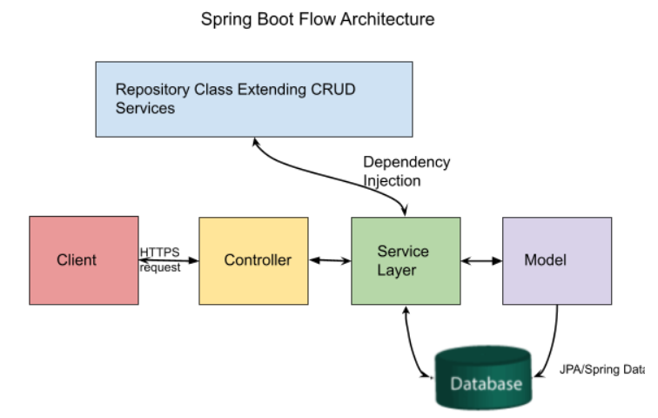
Fig. 1: Spring Boot Flow Architecture

Slide 8
Frontend
AngularJS is a structural framework for dynamic web applications, it uses html as template language and extend the syntax to define components clearly.
Define the components for admin, user, cart, card, login, signup, product-detail, user-edit, order.
Define the services that usually make REST Client calls towards the server.
The command “npm start” will build and serve the application and rebuild if any changes occur and runs on localhost:4200.

Slide 9
Any Queries

Slide 10
Thank You

