Slide 1
Create a Visually programmable PLC controller using WIFI Automation I/O Profile
PIP2001 Capstone Project
Final Review
Batch Number:
STUDENT NAME | ROLL NUMBER
SANJAY S | 20211CIT0161
NALLABHUTHALA RAKSHITHA | 20211CIT0162
G VINAY | 20211CIT0107
GOUTHAM | 20211CIT0160
MOHANA KRISHNA RAJU B D | 20211CIT0102
Under the Supervision of,
Dr./Mr./Ms./Prof. Ms Raesa Raseen
Professor / Associate Professor / Assistant Professor
School of Computer Science and Engineering
Presidency University
Name of the Program: Bachelor Of Technology(CSE-IOT)
Name of the HoD: Dr.AnandRaj S P
Name of the Program Project Coordinator: Dr. Sharmasth Vali
Name of the School Project Coordinators:Dr. Sampath A K / Dr. Abdul Khadar A / Mr. Md Ziaur Rahman

Slide 2
Introduction
A PLC (Programmable Logic Controller) is a digital computer used to automate industrial processes.
By combining Bluetooth communication and automation I/O profiles, the system can control various inputs and outputs wirelessly.
This project involves creating a visually programmable interface for PLC controllers using a Bluetooth Automation I/O profile, allowing users to interact with devices efficiently and flexibly.
With Bluetooth and visual programming, the system provides flexible, wireless control of devices, allowing users to adjust and monitor processes in real-time from a smartphone or tablet.

Slide 3
Literature Review
Traditionally, PLC systems rely on wired communication protocols like Modbus or Profibus, limiting flexibility in industrial automation.
Recently, wireless technologies such as Bluetooth have emerged, enhancing portability and reducing installation complexity.
The Bluetooth Automation I/O profile enables the use of wireless communication for industrial automation, allowing real-time control and monitoring of devices such as sensors and actuators over a Bluetooth link.

Slide 4
Existing method Drawback
Conventional PLC systems have some limitations:
Wired Connections: Complex and expensive to install and maintain.
Limited Flexibility: Lack of mobility and adaptability in changing environments.
High Cost: The need for dedicated hardware and cabling increases installation costs.
Low Customization: Predefined logic and functions, making it difficult for dynamic modifications.

Slide 5
Proposed Method
The project proposes a Bluetooth-based PLC Controller:
Uses the Bluetooth Automation I/O profile to communicate with connected devices.
Provides a visually programmable interface, enabling easier system setup and changes.
Enhances flexibility by allowing wireless communication between PLCs and remote devices.
Enables real-time control and monitoring of industrial processes with minimal infrastructure.

Slide 6
Objectives
Develop a Bluetooth-based wireless PLC controller: Create a PLC system that communicates wirelessly with devices using Bluetooth technology, removing the need for wired connections.
Implement a visual programming interface for user-friendly control: Design a graphical interface that allows users to easily program the PLC by dragging and dropping blocks without needing to write code.
Integrate the Automation I/O profile for Bluetooth communication: Use the Bluetooth Automation I/O profile to send and receive input and output signals between the PLC and connected devices like sensors and actuators.
Provide real-time device monitoring and control over a Bluetooth connection: Enable users to monitor and control devices instantly and wirelessly from a smartphone or computer via Bluetooth.

Slide 7
Methodology/Modules
Bluetooth Communication Modul: Utilizes Bluetooth for wireless data transfer between PLC and external devices.
Visual Programming Module: Provides a drag-and-drop interface for programming logic without writing code.
PLC Control Module: Executes the logic and sends/receives commands from sensors and actuators.
Monitoring and Feedback Module: Allows real-time monitoring of inputs and outputs through the user interface.

Slide 8
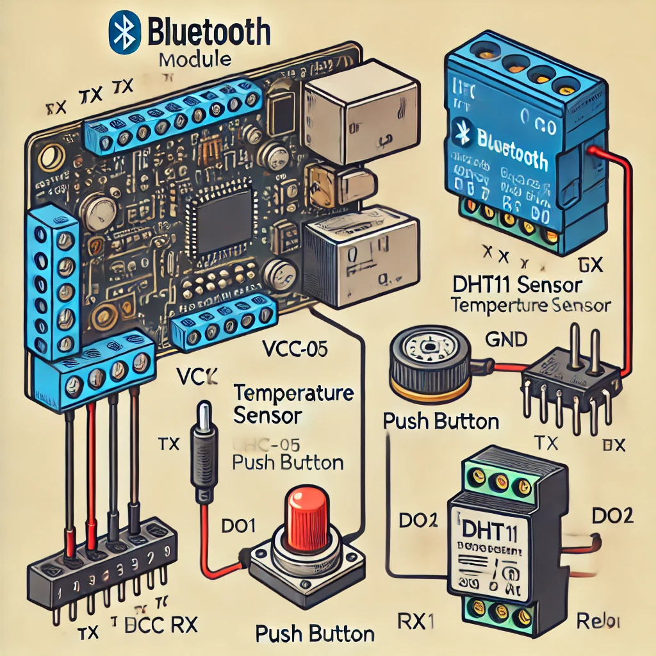
Architecture

Slide 9
Hardware/software components
Bluetooth Module: HC-05 or BLE for wireless communication.
Microcontroller: PLA.
Sensors/Actuators: Input and output devices like temperature sensors, motors, etc.
Software: Visual programming platform (LabVIEW, Node-RED) for PLC logic creation.
IDE: microcontroller programming.

Slide 10
Timeline of Project
Week 1-2: Research and planning.
Week 3-4: Hardware setup (Bluetooth module, sensors).
Week 5-6: Developing the visual programming interface.
Week 7-8: Integrating Bluetooth communication with PLC logic.
Week 9-10: Testing and debugging.
Week 11-12: Final implementation and documentation.

Slide 11
Expected Outcomes
A working Bluetooth-enabled PLC controller: This project will develop a PLC that can communicate wirelessly via Bluetooth, allowing it to send and receive signals from devices like sensors or actuators without physical connections.
A user-friendly visual programming interface for wireless control of inputs/outputs: The system will include an easy-to-use visual programming tool that enables users to set up and modify control logic for the PLC using a drag-and-drop interface, making it accessible for non-experts.
Enhanced flexibility in industrial automation by reducing wiring complexity: By eliminating the need for extensive wiring, the wireless Bluetooth PLC controller increases flexibility in how and where devices can be installed and controlled, simplifying the overall automation setup.
Real-time monitoring and control over a Bluetooth connection, improving the user experience: The system will allow users to monitor and control devices in real-time via Bluetooth, providing a faster, more efficient, and responsive way to manage industrial processes from a smartphone or tablet

Slide 12
Conclusion
This project aims to show how Bluetooth technology can be successfully combined with PLCs (Programmable Logic Controllers) to create an efficient automation system.
By using a visually programmable interface, users can easily set up and modify the control logic without needing to write code.
The wireless Bluetooth communication simplifies the process of installing and operating industrial control systems by eliminating the need for complex wiring.
This makes the system more cost-effective, flexible, and easier to maintain, which is highly beneficial for modern industries that need quick adjustments and real-time control.

Slide 13
References
Siemens. (2021). LOGO! Manual - Siemens Automation Technology. Retrieved from Siemens LOGO! Documentation.
Mitsubishi Electric. (2020). Alpha 2 Series Programmable Controller User’s Manual. Retrieved from Mitsubishi Alpha 2 Documentation.
Bluetooth Special Interest Group (SIG). (2016). Bluetooth Generic Attribute Profile (GATT) – Automation I/O Profile. Retrieved from Bluetooth.com.
Bolton, W. (2015). Programmable Logic Controllers (6th ed.). Newnes.
Kurniawan, A. (2019). Arduino Programming with MATLAB for Controllers and Automation Systems. Packt Publishing.
Yury, A., & Gupta, S. (2018). Bluetooth-Based Wireless Communication in Industrial Automation. International Journal of Electronics and Communication Engineering.
Siemens. (2021). LOGO! Soft Comfort V8.3: Software for Programming Siemens LOGO! PLCs. Retrieved from Siemens Automation Software.
MIT. (2022). MIT App Inventor: Design and Develop Apps for Android. Retrieved from MIT App Inventor Website.
Hughey, J. (2016). Introduction to Ladder Logic and PLC Programming. The Automation Learning Series.
Wago. (2020). Wago PFC100 Controller Manual. Retrieved from Wago PFC100 Documentation.

Slide 14

Project work mapping with SDG

Slide 15
Thank You

