Slide 1
RECOMMENDATION OF WEBSITES BASED ON REVIEWS
Group- 14
ABHILASH RAO PALLINENI
KETANA PEREDDIGARI
AMANDEEP KAUR

Slide 2
Table of content
Description
Dataset
Scrapy
Challenges
Ethical principles
Outcome assessed
references

Slide 3
Description
Most of the customer rely on reviews to make any decision related to purchases or any service utilization provided.
We would like to address the project by classifying the reviews into most preferable and least preferable based on purchased and non-purchased respectively.
Our focus is to concentrate mainly on purchased user reviews for this project.

Slide 4
Dataset
Overview: Till now we have collected 28887 rows with 16 attributes from online sources and using scrapy tool.
Product name
Categories
Primary Categories
Image URLs
Manufacturer
Reviews Source URLs
Review text
Attributes

Slide 5

Scrapy
Scrapy provides a powerful framework for extracting the data, processing it and then save it.
It is based on SPIDERS to extract the information from any websites.

Slide 6
Crawling through websites
Collect metadata
Collect in text
Data itself in a html
Long process to select particular data regarding any product

Slide 7
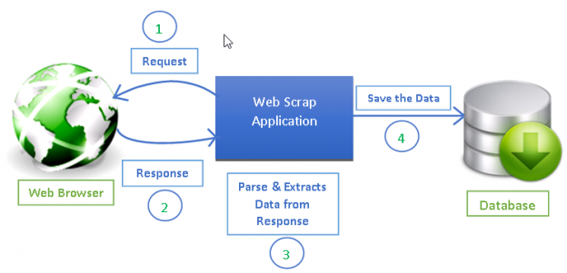

Slide 8
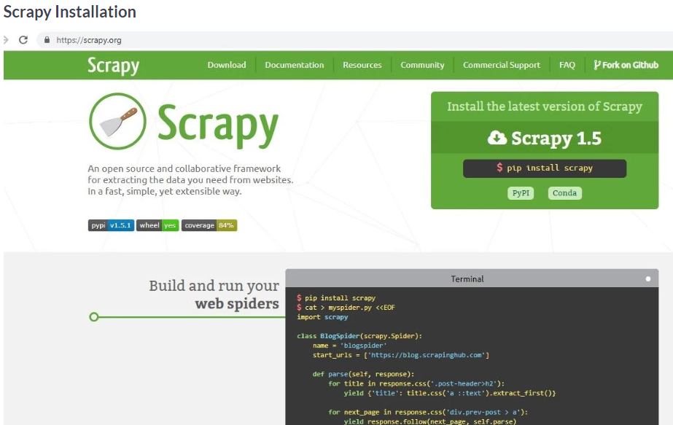

Slide 9
Challenges
Collecting data itself a challenge
Scrapy is a project itself
Merging of different datasets

Slide 10
Ethical principles
Consent:
This project, Recommendation of Websites based on review is chosen to give the genuine information to the customers. To implement this project, data is collected from e-commerce websites were the user’s opinions are given for the products/services with consent. Here we are using the data which is openly available for the better product and website recommendation.
Clarity:
This dataset provides information regarding product details, reviews, rating, purchase date, product URL. Review URL etc. with which we can analyze the data and build appropriate models for efficient recommendation engine.

Slide 11
Ethical principles
Consequences:
In our dataset we are not retrieving any personal information of customers so there are no consequences to be deal with.
Control and Transparency:
We have merged the data collected from various ecommerce site and formed a dataset. Here the information is analyzed using sentimental analysis to filter out the classification and perform further process we assure that the data will not be manipulated or mis-used.
Consistency:
Our data is consistent as we are interpreting the intentions of customers through the reviews and analyzing their views on the product to build better recommendation model for search engine. As our dataset does not contain any personal information about the users so, we are consistent with the information taken from online sites to work on our project.

Slide 12
Outcomes Assessed
Sentimental analysis will be done to get the categories of reviews.
In the analysis we will filter out the reviews of non-buyers of any product to give genuine information written by customers as a result of search engine.
The categorization of the reviews by using any classifier we can get most preferable and least preferable.

Slide 13
Reference DataCamp Community. (2020). Making Web Crawlers Using Scrapy for Python. [online] Available at: https://www.datacamp.com/community/tutorials/making-web-crawlers-scrapy-python#overview. Tableau + ParseHub Integration: Use Tableau to Visualize Data Scraped by ParseHub. (2020). From https://www.parsehub.com/blog/use-tableau-to-visualize-data-scraped-by-parsehub/ Ganesan, K. (2020). User Review Datasets | Kavita Ganesan. From https://kavita-ganesan.com/user-review-datasets/#.Xkv3sChKhPY

Slide 14

Thank you

