Slide 1

RECOMMENDATION OF WEBSITES BASED ON REVIEWS
Group- 14
ABHILASH RAO PALLINENI
KETANA PEREDDIGARI
AMANDEEP KAUR

Slide 2
Dataset -
We have contacted julian.mcauley@gmail.com for user reviews data.
Merged dataset
Web Scrapy
Parsehub
-

Slide 3

Scrapy
Scrapy provides a powerful framework for extracting the data, processing it and then save it.
It is based on SPIDERS to extract the information from any websites.

Slide 4
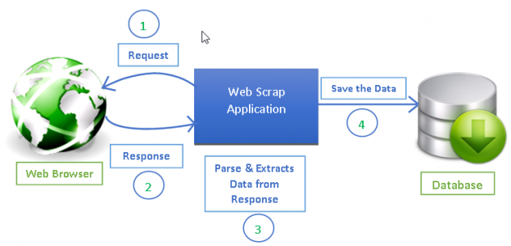

Slide 5
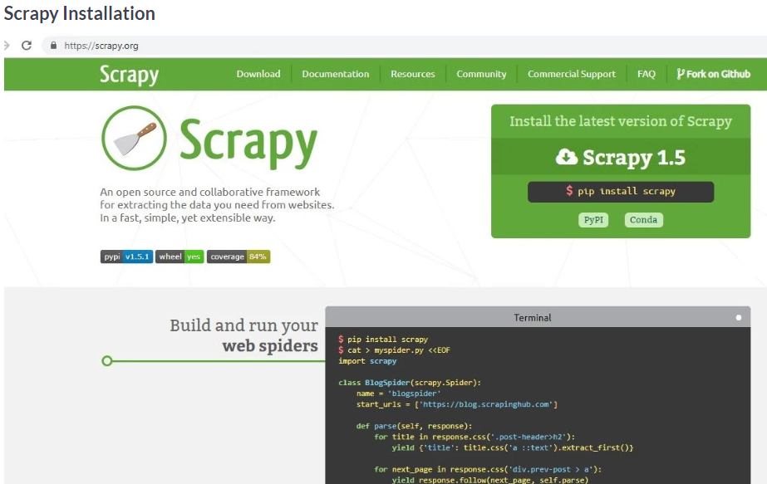

Slide 6
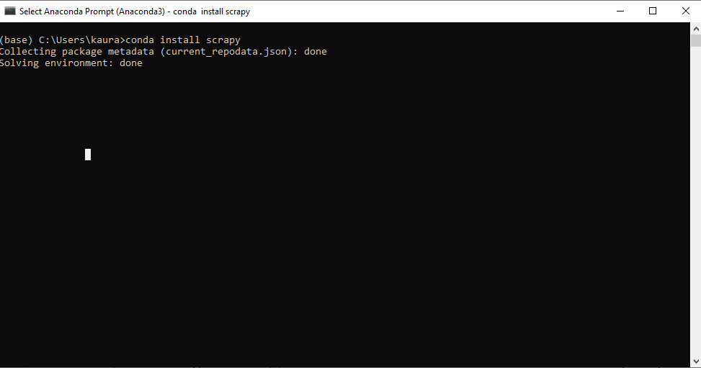
Scrapy installation

Slide 7
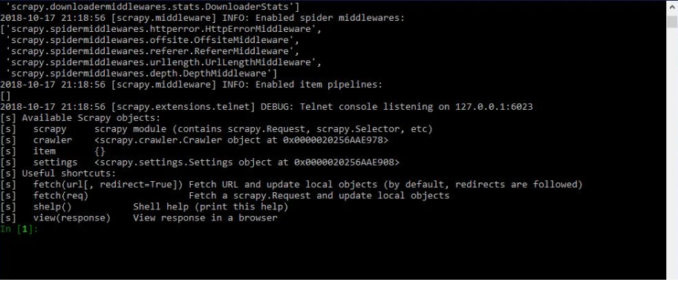
fetch(http://www.amazon.com/category/20006007/tablets.html

Slide 8
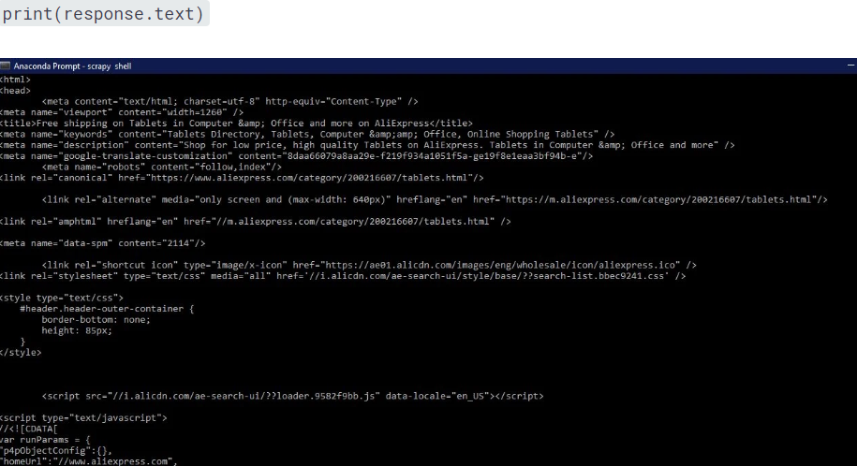

Slide 9
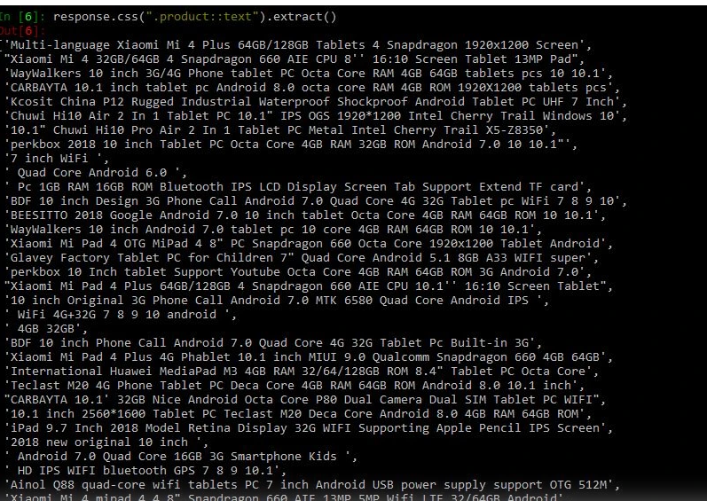
Response.css(“.product::text”).extract()

Slide 10
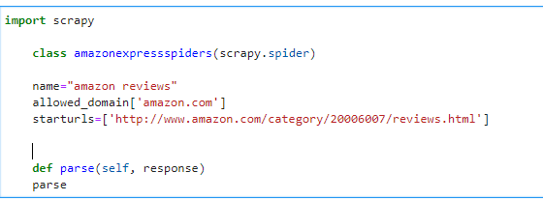

Slide 11

Exporting data

Slide 12
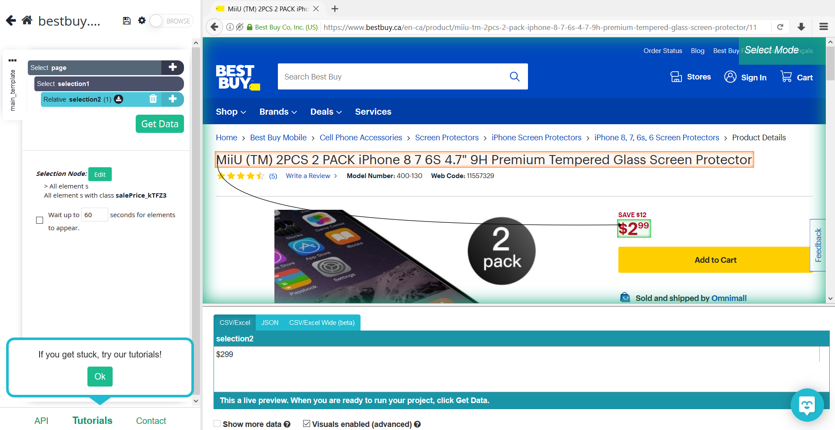
ParseHub

Slide 13
Reference https://www.datacamp.com/community/tutorials/making-web-crawlers-scrapy-python#overview https://www.parsehub.com/blog/use-tableau-to-visualize-data-scraped-by-parsehub/

